Slide 1


SYRIATEL CUSTOMER CHURN ANALYSIS
PRESENTATION BY:
VIVIAN MOSOMI
Notes:
After you’ve done your research, it’s time to put your presentation together. The first step in the process is to introduce the topic. This is a great time to connect your topic to something that your audience can relate. In other words, why should they listen to all the information you will be sharing in your research presentation? What is in it for them? You may also want to include a graphic or image to grab their attention.
Feel free to duplicate this slide by right-clicking on this slide in the slides pane to the left and select Duplicate Slide.
The next step in your presentation is to state your claim or topic clearly. Your teacher may even call this your thesis. As you state your thesis, you may find that this layout is not the best layout for your claim or topic. You can change the layout by clicking the drop-down menu next to the Layout in the Slides menu section. You can choose Two Content, Comparison, or Picture with Caption. Note: A different layout might change the look of the icons on this page.
You will also want to state your facts. You have done the research now share some of the interesting facts with your audience. Facts do not have to be boring; you can communicate facts in a variety of ways by going to the Insert Tab. In the Insert tab you can:
Insert pictures from your computer or online.
Add a chart
Create some SmartArt
Insert a variety of icons to help your facts come to life. Note: You can change the color of the icons by selecting the icon and then click on the Format tab and then Graphics Fill. From there, you will choose a color from the list or choose More Fill Colors to give you more options.
Since this research presentation is a result of your hard work and searching, you want to make sure you support the claims or points in your presentation with facts from your research findings. Make sure you give the author proper credit for helping you share your ideas. If one of your sources has a video that is relevant to your topic, you can add the video as added support. Keep in mind the length of the video and the amount of time you have for your presentation. For a 5 minute speech, the video should be no longer than 30 seconds.
Questions to consider:
How will you state the author of the source?
Will you need to cite the source on the slide?
What are some ways you can engage your audience so they feel like they are a part of the presentation? Some ideas to consider is by taking a quick poll like: by a show of hands, how many of you think school uniforms are a way to cut down on bullying? Another suggestion is to have them hold up a certain number of fingers to see if they agree or disagree. Finally, you can share a story that the audience can relate to that makes them laugh.
After all the applause, your audience may have some questions. Be prepared to answer some of their questions by making a list of questions you think they might ask. You may also want to share the presentation with them by providing the link to your presentation, if they want more information.

Slide 2



OBJECTIVE
INTRODUCTION
SyriaTel - A Telecommunication Company, is facing customer attrition.
Understanding and predicting customer churn is crucial for the company's sustainability and growth in the telecommunications industry. The company is interested in reducing how much money is lost because of customers who don't stick around very long by being able to use a predictive model that can identify customers who are likely to churn based on various factors.
BUSINESS
PROBLEM
To be able to predict and identify factors causing customer churn, this will help the company can take measures to retain customers and prevent financial loss
Notes:
When conducting research, it is easy to go to one source: Wikipedia. However, you need to include a variety of sources in your research. Consider the following sources:
Who can I interview to get more information on the topic?
Is the topic current and will it be relevant to my audience?
What articles, blogs, and magazines may have something related to my topic?
Is there a YouTube video on the topic? If so, what is it about?
What images can I find related to the topic?

Slide 3




FEATURE COLUMNS
DATA UNDERSTANDING
The dataset consists of 3333 rows, 21 columns
state, account length, area code, phone number, international plan,
voice mail plan, number vmail messages, total day minutes,
total day calls, total day charge, total eve minutes, total eve calls,
total eve charge, total night minutes, total night calls, total night charge,
total intl minutes, total intl calls, total intl charge, customer service calls,
churn
Notes:
Once you find your sources, you will want to evaluate your sources using the following questions:
Author:
Who is the author?
Why should I believe what he or she has to say on the topic?
Is the author seen as an expert on the topic? How do you know?
Current:
How current is the information in the source?
When was the source published?
Is the information out-of-date?
Accuracy:
Is the content accurate?
Is the information presented objectively? Do they share the pros and cons?

Slide 4
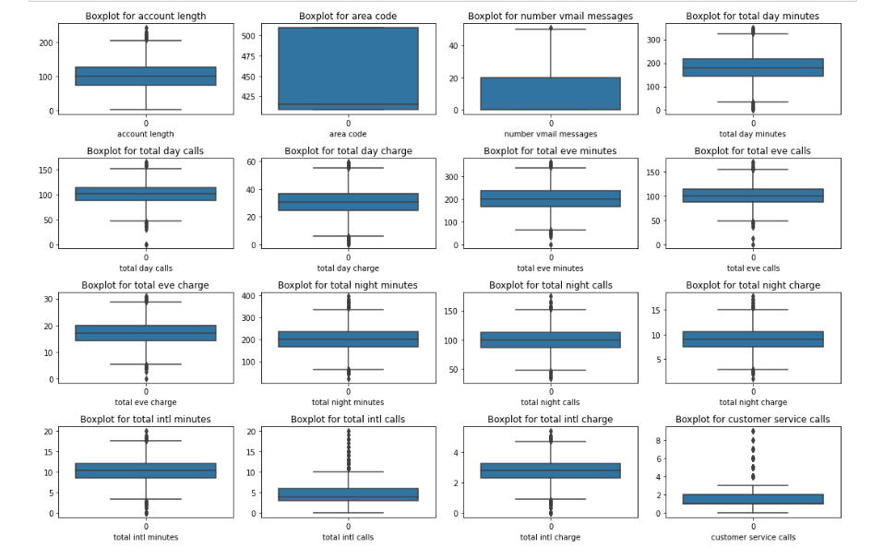
VISUALIZATION
analyzing the outliers in every numeric column
Notes:
When conducting research, it is easy to go to one source: Wikipedia. However, you need to include a variety of sources in your research. Consider the following sources:
Who can I interview to get more information on the topic?
Is the topic current and will it be relevant to my audience?
What articles, blogs, and magazines may have something related to my topic?
Is there a YouTube video on the topic? If so, what is it about?
What images can I find related to the topic?

Slide 5
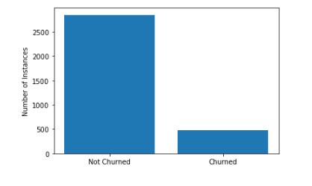
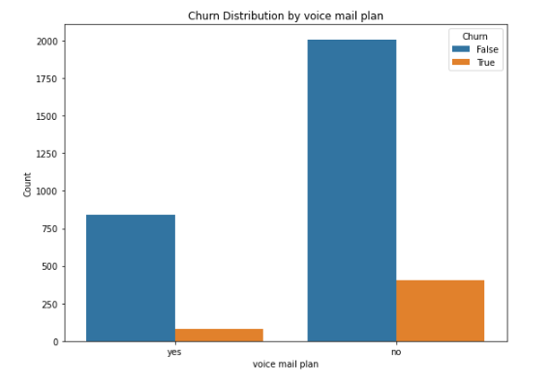
Visualizing the relationship between number of churn and not churned instances
Visualizing the churn distribution by voice mail plan
Notes:
When conducting research, it is easy to go to one source: Wikipedia. However, you need to include a variety of sources in your research. Consider the following sources:
Who can I interview to get more information on the topic?
Is the topic current and will it be relevant to my audience?
What articles, blogs, and magazines may have something related to my topic?
Is there a YouTube video on the topic? If so, what is it about?
What images can I find related to the topic?

Slide 6
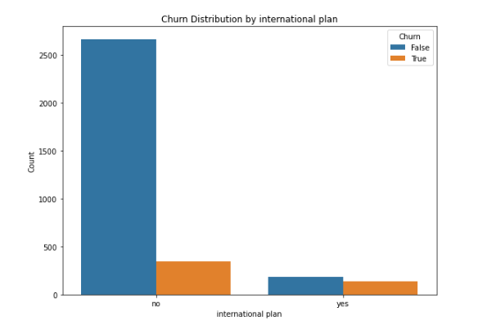
Visualizing the churn distribution by international plan
From the above plots of voice mail plan and international plan, we can see that the count of customers with no voice mail and international plan have a high churn count.
Notes:
When conducting research, it is easy to go to one source: Wikipedia. However, you need to include a variety of sources in your research. Consider the following sources:
Who can I interview to get more information on the topic?
Is the topic current and will it be relevant to my audience?
What articles, blogs, and magazines may have something related to my topic?
Is there a YouTube video on the topic? If so, what is it about?
What images can I find related to the topic?

Slide 7
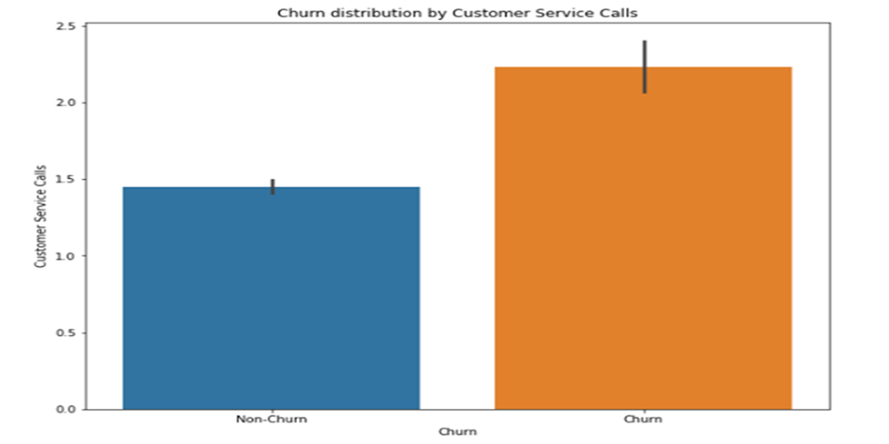
Visualizing the relationship between
customer service with churn and non-churner
From the above plot for customer service calls with churn rate, we can see that there's high rate of customer service calls
for churn customers.
Notes:
When conducting research, it is easy to go to one source: Wikipedia. However, you need to include a variety of sources in your research. Consider the following sources:
Who can I interview to get more information on the topic?
Is the topic current and will it be relevant to my audience?
What articles, blogs, and magazines may have something related to my topic?
Is there a YouTube video on the topic? If so, what is it about?
What images can I find related to the topic?

Slide 8
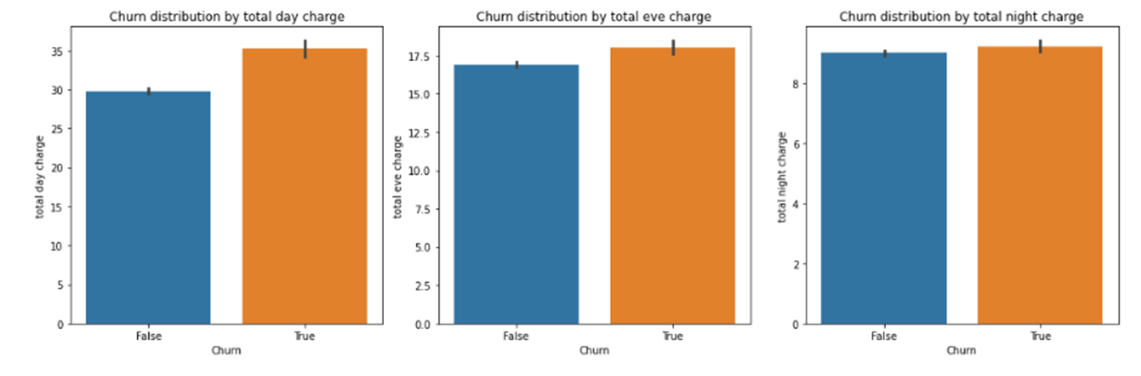
Distribution of churn and charges(day, evening and night charges)
From the charges plot above, we can see that the higher the charges the higher the churn rate.
For total evening charge and night charge, the churn rate is slightly higher than those who do not churn
Notes:
When conducting research, it is easy to go to one source: Wikipedia. However, you need to include a variety of sources in your research. Consider the following sources:
Who can I interview to get more information on the topic?
Is the topic current and will it be relevant to my audience?
What articles, blogs, and magazines may have something related to my topic?
Is there a YouTube video on the topic? If so, what is it about?
What images can I find related to the topic?

Slide 9
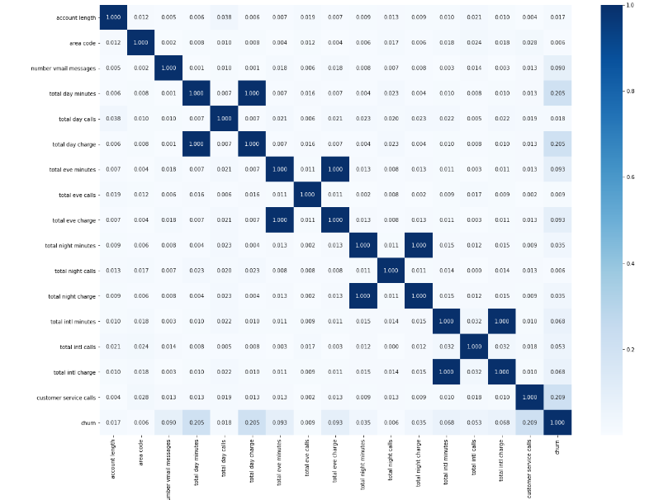
From the correlation matrix, most of the features do not appear to be perfectly correlated but features like:-
total day charge and total day minutes,
-total evening charge and total evening minutes,
-total night charge and total night minutes,
-total intl charge and total intl minutes
Notes:
When conducting research, it is easy to go to one source: Wikipedia. However, you need to include a variety of sources in your research. Consider the following sources:
Who can I interview to get more information on the topic?
Is the topic current and will it be relevant to my audience?
What articles, blogs, and magazines may have something related to my topic?
Is there a YouTube video on the topic? If so, what is it about?
What images can I find related to the topic?

Slide 10
MODELLING AND EVALUATION
 | Logistic Regression | Random Forest Classifier | Decision Tree classifier | XGBoost
precision | 0.38 | 0.80 | 0.67 | 0.92
Recall | 0.78 | 0.75 | 0.71 | 0.78
F1-score | 0.52 | 0.78 | 0.69 | 0.84
Accuracy | 0.78 | 0.94 | 0.91 | 0.96

Slide 11

AFTER MODEL TUNING
 | Baseline Logistic Regression | Random Forest Classifier | Decision Tree classifier | XGBoost
precision | 0.38 | 0.84 | 0.68 | 0.94
Recall | 0.78 | 0.77 | 0.73 | 0.78
F1-score | 0.52 | 0.80 | 0.70 | 0.85
Accuracy | 0.78 | 0.94 | 0.91 | 0.96
Notes:
Now, that you have narrowed your topic, you will want to organize your research in a structure that works. There are some common organizational patterns based on the kind of research you are doing.
Organizational Structures:
Cause and Effect- this kind of structure is great for explaining the causes and effects of a topic
Compare and Contrast- in this pattern you highlight the similarities and differences of the topic
Explain process- this structure is great for outlining a series of steps to follow;
Definition- if you want to make sure your audience understands what something is using illustrations, meanings, clarifying misconceptions, you may want to use this structure
Classification- a common organizational structure is grouping like topics or facts from the research together. For instance, in the internet safety about social media apps, you may organize the research where you look at each social media app one at a time

Slide 12
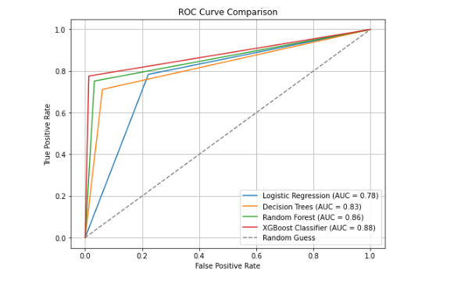
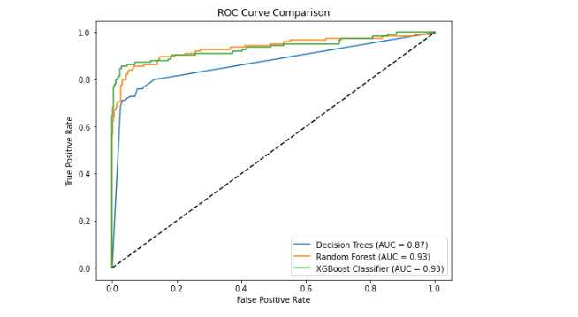
AFTER TUNING
ROC CURVE ANALYSIS
BEFORE TUNING
Notes:
When conducting research, it is easy to go to one source: Wikipedia. However, you need to include a variety of sources in your research. Consider the following sources:
Who can I interview to get more information on the topic?
Is the topic current and will it be relevant to my audience?
What articles, blogs, and magazines may have something related to my topic?
Is there a YouTube video on the topic? If so, what is it about?
What images can I find related to the topic?

Slide 13

SELECTING OUR MODEL
The XGBoost and Random Forest models were the most suitable due to its strong performance in terms of recall and F1 score
Notes:
Now, that you have narrowed your topic, you will want to organize your research in a structure that works. There are some common organizational patterns based on the kind of research you are doing.
Organizational Structures:
Cause and Effect- this kind of structure is great for explaining the causes and effects of a topic
Compare and Contrast- in this pattern you highlight the similarities and differences of the topic
Explain process- this structure is great for outlining a series of steps to follow;
Definition- if you want to make sure your audience understands what something is using illustrations, meanings, clarifying misconceptions, you may want to use this structure
Classification- a common organizational structure is grouping like topics or facts from the research together. For instance, in the internet safety about social media apps, you may organize the research where you look at each social media app one at a time

Slide 14
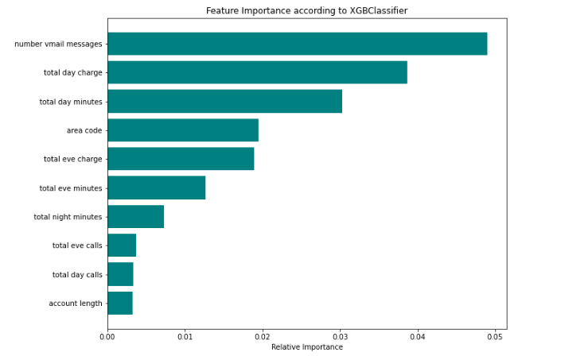
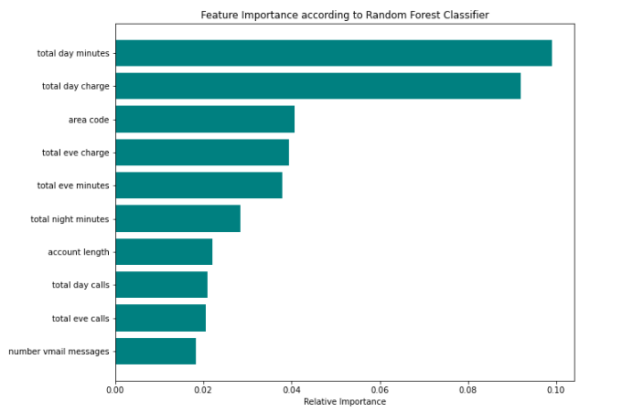
3 top most important features for this model are: number of voicemail messages, total day charge and total day minutes
3 top most important features from this model are: total day minutes, total day charge and area code

Slide 15


CONCLUSION
Using the important features from our top tuned classifiers, that is Random Forest and XGBoost:
-Random Forest has the following important features: - Total day charge - Total day minutes - Area code
- XGBoost Classifier has the following important features: - Number of Voice Mail Messages - Total day charge - Total day minutes
From the above we can tell that the high total day charge and number of voice mail messages influence churn rate as they are deemed as the important features in the two models.
From Exploratory Data Analysis, we saw that total evening charge, total night charge and customer service calls also have an influence on the churn rate of customers.
The states New Jersey, California and Texas have higher churn rates.
This suggests that addressing service-related issues might mitigate high churn rates. These findings can help direct efforts to retain customers and improve service quality
Notes:
After consulting a variety of sources, you will need to narrow your topic. For example, the topic of internet safety is huge, but you could narrow that topic to include internet safety in regards to social media apps that teenagers are using heavily. A topic like that is more specific and will be relevant to your peers. Some questions to think about to help you narrow your topic:
What topics of the research interest me the most?
What topics of the research will interest my audience the most?
What topics will the audience find more engaging? Shocking? Inspiring?

Slide 16
RECOMMENDATIONS
Based on the insights gained, it is recommended to focus on enhancing the following:
- Improve customer service quality so as to reduce the high customer service calls that increase the churn rate. That can be done by first understanding the individual customer needs and trying to maintain high standard of service.
-Syria Tel Company can take measures to revise pricing strategies for day, evening and night call charges. The company can negotiate for different plans that offer reduced call charges hence preventing customer attrition.
-Looking into the cause of high churn rate in New Jersey, California and Texas. It may be that these states experience poor network coverage or service disruptions hence leading to high churn rate. The Company can also consider marketing the company in those specific states.
-Area Code is also highlighted as one of the important features and hence, the company can look into area codes that have high churn rates and introduce acitivites that will reduce churn rate such as marketing and offering promotions to customers.
Notes:
After consulting a variety of sources, you will need to narrow your topic. For example, the topic of internet safety is huge, but you could narrow that topic to include internet safety in regards to social media apps that teenagers are using heavily. A topic like that is more specific and will be relevant to your peers. Some questions to think about to help you narrow your topic:
What topics of the research interest me the most?
What topics of the research will interest my audience the most?
What topics will the audience find more engaging? Shocking? Inspiring?

Slide 17
Limitation: Syria Tel can consider using the above predictive models to predict customer churn and take measures to enable proactive retention strategies,but should be aware of computational ability limitations, especially with models such as random forest and xgboost when using a high number of trees when tuning.
Notes:
After consulting a variety of sources, you will need to narrow your topic. For example, the topic of internet safety is huge, but you could narrow that topic to include internet safety in regards to social media apps that teenagers are using heavily. A topic like that is more specific and will be relevant to your peers. Some questions to think about to help you narrow your topic:
What topics of the research interest me the most?
What topics of the research will interest my audience the most?
What topics will the audience find more engaging? Shocking? Inspiring?

Slide 18
Project Presentation End
THANK YOU!!
Notes:
You can use this slide as your opening or closing slide. Should you choose to use it as a closing, make sure you review the main points of your presentation. One creative way to do that is by adding animations to the various graphics on a slide. This slide has 4 different graphics, and, when you view the slideshow, you will see that you can click to reveal the next graphic. Similarly, as you review the main topics in your presentation, you may want each point to show up when you are addressing that topic.
Add animation to images and graphics:
Select your image or graphic.
Click on the Animations tab.
Choose from the options. The animation for this slide is “Split”. The drop-down menu in the Animation section gives even more animations you can use.
If you have multiple graphics or images, you will see a number appear next to it that notes the order of the animations.
Note: You will want to choose the animations carefully. You do not want to make your audience dizzy from your presentation.

