Slide 1
University of Salzburg · Bachelor Thesis Defense
Benchmarking Large Language Models on Algorithmic Programming Tasks
A case study using Advent of Code with Python and Rust
Vanessa Kobler
Supervisor: Univ.-Prof. Dr. Wolfgang Pree
Degree Program: Computer Science
Bachelor Thesis Defense · Benchmarking LLMs on Algorithmic Programming Tasks
1

Slide 2
Agenda
1
Motivation & research question
2
Benchmark design
3
Implementation & evaluation metrics
4
Results: correctness, runtime, memory
5
Discussion, limitations & conclusion
Bachelor Thesis Defense · Benchmarking LLMs on Algorithmic Programming Tasks
2

Slide 3
Motivation
Why benchmark LLM-generated code on full programming tasks?
LLMs are widely used for code
Algorithmic tasks are demanding
Language matters
Large language models are increasingly more to generate, explain, refactor, and debug code, which makes them important tools in software development.
The model must parse a natural-language problem, infer the algorithm, implement it, and handle the full input correctly.
Python and Rust differ strongly in typing, compilation, runtime behavior and memory profile, so generated solutions may differ.
Bachelor Thesis Defense · Benchmarking LLMs on Algorithmic Programming Tasks
3

Slide 4
Research question
Research question
Main research question:
How effectively can large language models solve algorithmic programming tasks from Advent of Code and how do their generated solutions differ between Python and Rust?
Sub-questions compare:
Correctness
Runtime
Memory
Algorithms
Code Quality
Bachelor Thesis Defense · Benchmarking LLMs on Algorithmic Programming Tasks
Bachelor Thesis Defense · Benchmarking LLMs on Algorithmic Programming Tasks
4
4

Slide 5
Advent of Code as benchmark
Why these tasks are useful for evaluating algorithmic code generation
Full-program tasks
Two-part structure
Algorithmic variety
Understanding a natural language problem
Reading Input
producing a complete solution
The selected tasks cover:
parsing
simulation
graph/search logic
state tracking
Arithmetic and optimization-style reasoning
Part B usually extends Part A with harder constraints or a changed solution strategy
Bachelor Thesis Defense · Benchmarking LLMs on Algorithmic Programming Tasks

Slide 6
Large language models used
Two CLI-based code-generation systems are compared under the same prompt conditions
OpenAI Codex
Anthropic Claude Code
Used through the Codex CLI version recorded in the thesis. It generated complete Python and Rust programs from the standardized prompt without additional model-specific hints.
Used through the Claude Code CLI version recorded in the thesis. It was evaluated with the same tasks, inputs, repair rule and measurement pipeline.
Important for fairness: the prompt template stayed fixed; only the problem statement, input path, output file and target language changed.
same tasks
same prompt
same pipeline
same metrics
Bachelor Thesis Defense · Benchmarking LLMs on Algorithmic Programming Tasks

Slide 7
Programming languages used
Python and Rust expose different strengths and constraints for generated code
Python
Rust
High-level and dynamically typed. It is usually concise and easier to generate, but interpreted execution leads to higher runtime and memory usage in this benchmark.
Compiled and statically typed. It requires ownership, borrowing, mutability and type correctness, but usually produces much lower runtime and memory measurements.
Flexible built-in data structures
No compile step for syntax/type checking
Useful for rapid algorithm expression
Stronger compiler constraints
Lower memory footprint in the results
More sensitive to language-specific idioms
Bachelor Thesis Defense · Benchmarking LLMs on Algorithmic Programming Tasks

Slide 8
Benchmark design
Same tasks, same prompt structure, two models, two languages
2
2
12
88
1
models
languages
AoC problems
final results
repair attempt allowed
Independent variables
Dependent variables
Model: OpenAI Codex vs. Claude Code
Language: Python vs. Rust
Problem year and part: 2024/2025, A/B
Correctness and compilation
Runtime and memory usage
Lines of code and algorithmic/code-quality evaluation
Bachelor Thesis Defense · Benchmarking LLMs on Algorithmic Programming Tasks
8

Slide 9
Execution pipeline
How each generated solution was evaluated
1. Submit standardized prompt
2. Save raw generated code
3. Compile when required
4. Run on fixed input
5. Measure runtime and memory
6. Compare exact output
Failure rules: compile fail, runtime error, timeout, wrong output, or incorrect output format are treated as failures.
Bachelor Thesis Defense · Benchmarking LLMs on Algorithmic Programming Tasks
9

Slide 10
Results
Correctness, runtime and memory usage
Bachelor Thesis Defense · Benchmarking LLMs on Algorithmic Programming Tasks
11

Slide 11
Correctness result
All generated solutions were correct on the first attempt in the tested set
100%
0
0
first-attempt correctness
repair prompts used
compile/runtime failures in final set
The central difference between models and languages therefore appears mainly in efficiency and code characteristics, not in functional correctness for the selected tasks.
Bachelor Thesis Defense · Benchmarking LLMs on Algorithmic Programming Tasks
12

Slide 12
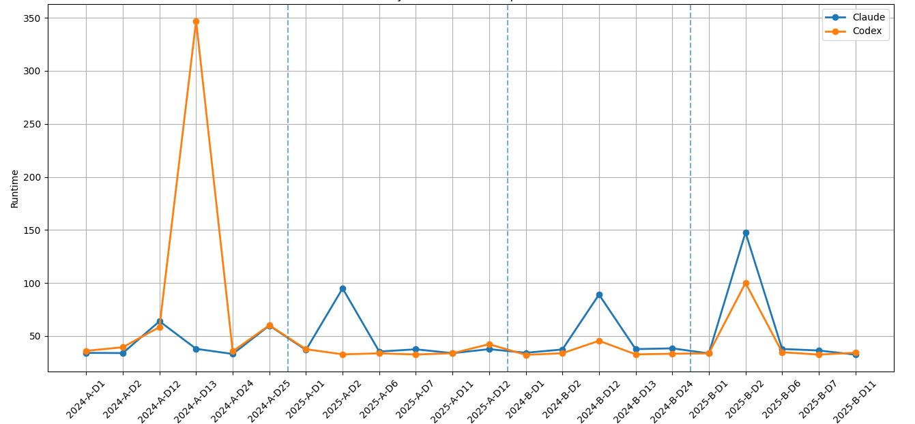
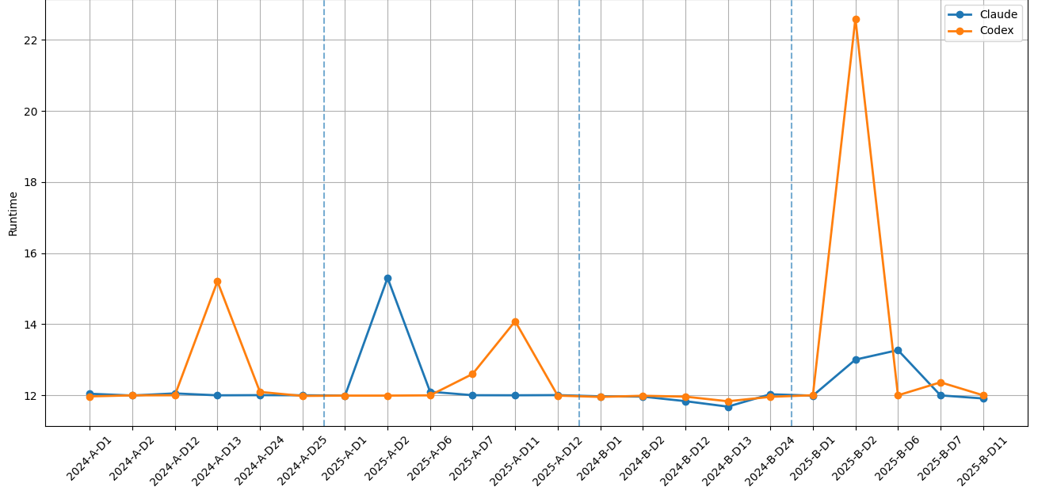
Runtime comparison across all problems
Python shows stronger variation; Rust is generally tightly clustered around the baseline runtime
2025 Part B Day 2
2024 Part A Day 13
Python (app. 40 – 330 ms)
Rust (app. 12 – 22 ms)
2025 Part B Day 2
2025 Part A Day 2
2024 Part B Day 12
2024 Part A Day 13
2025 Part A Day 2
2025 Part A Day 11
2024 Part A
2025 Part A
2024 Part B
2025 Part B
2024 Part A
2025 Part A
2024 Part B
2025 Part B
Bachelor Thesis Defense · Benchmarking LLMs on Algorithmic Programming Tasks
13

Slide 13
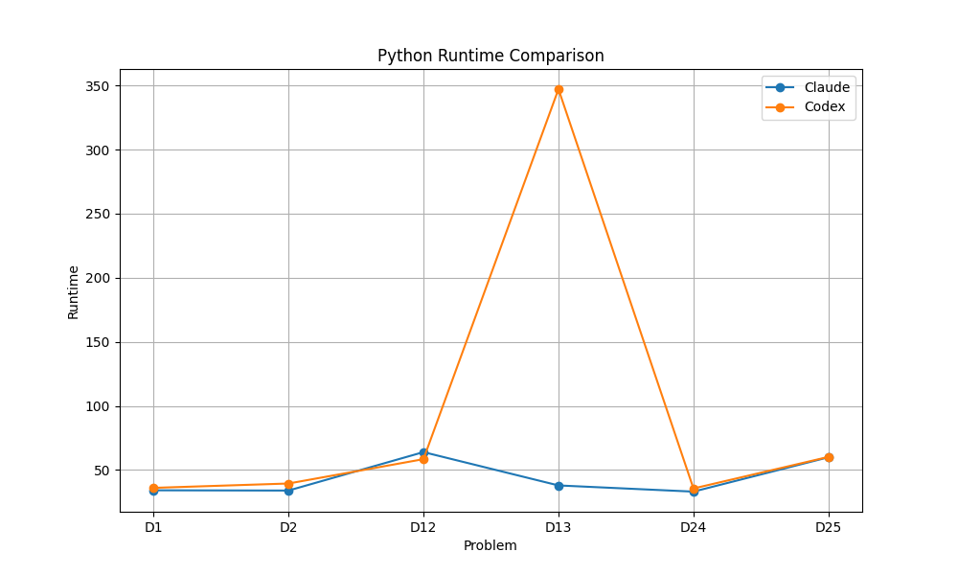
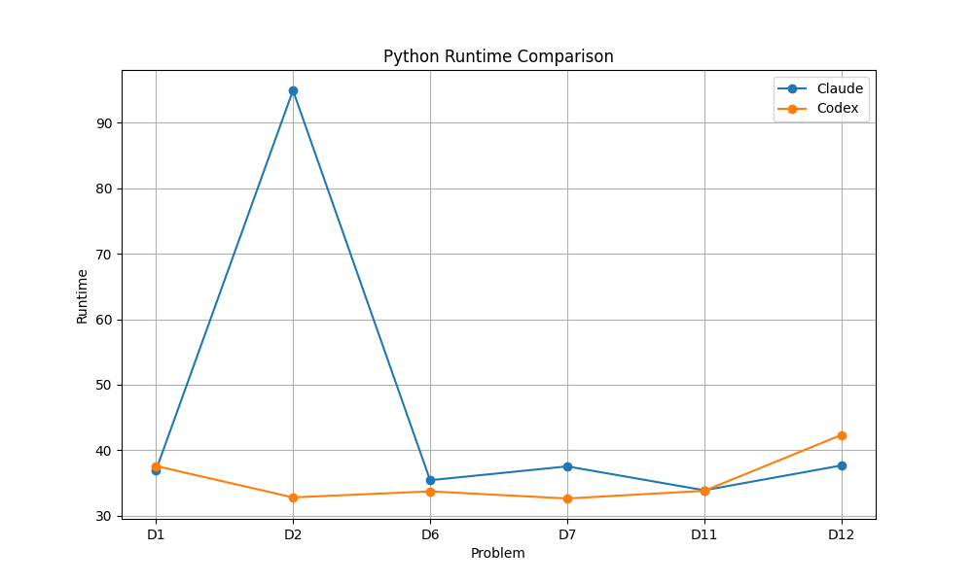
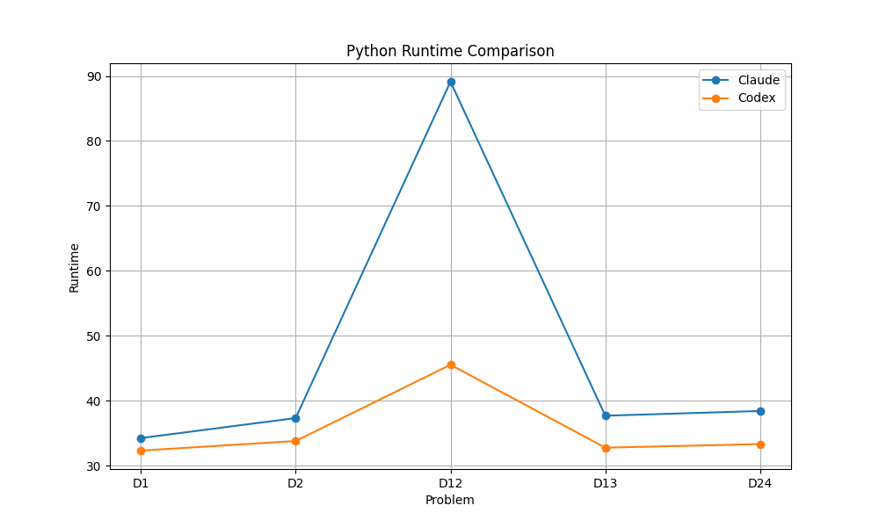
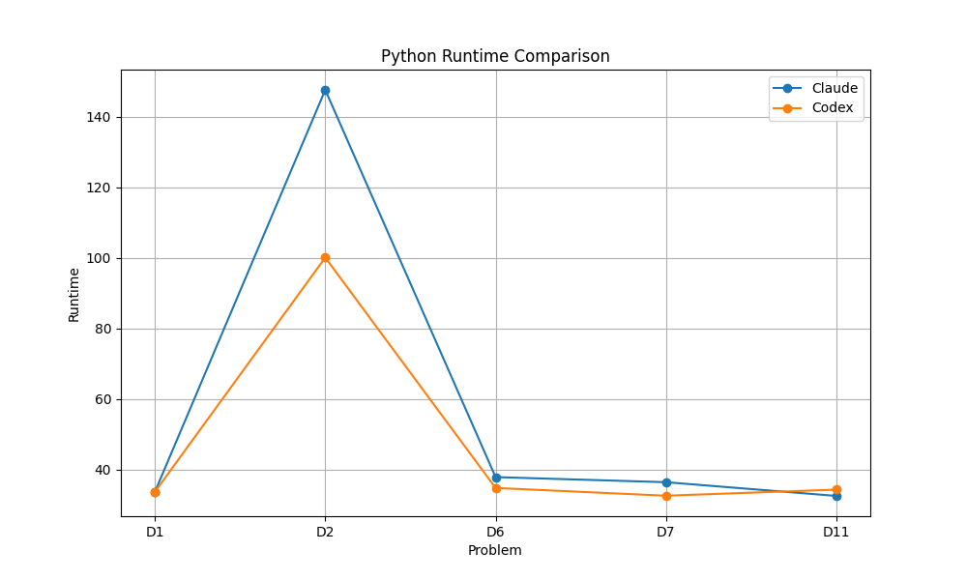
Python runtime by year and part
Part A 2024
Part A 2025
Part B 2024
Part B 2025
Bachelor Thesis Defense · Benchmarking LLMs on Algorithmic Programming Tasks
14

Slide 14
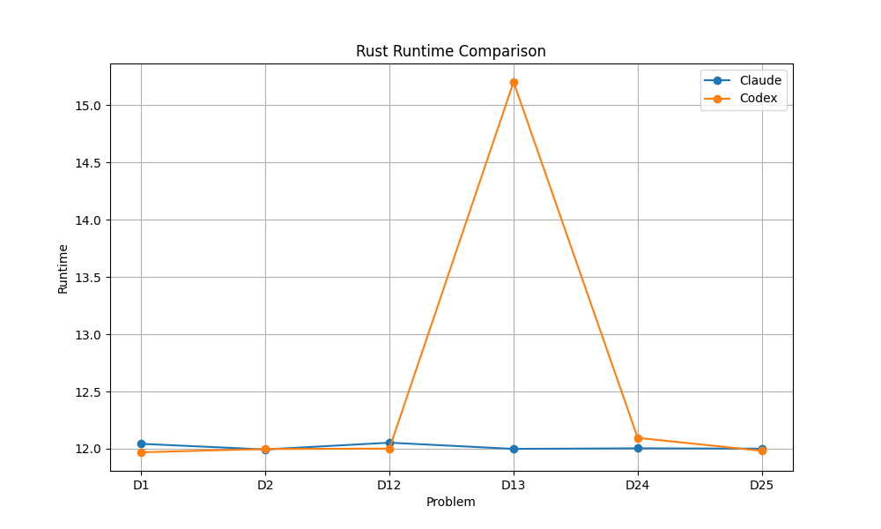
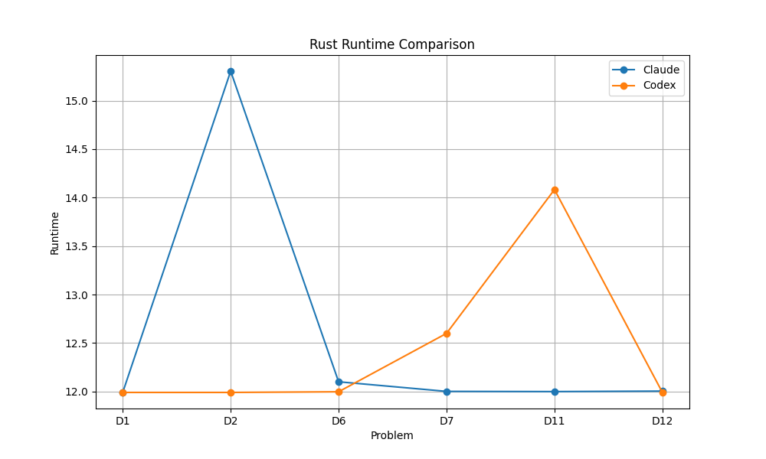
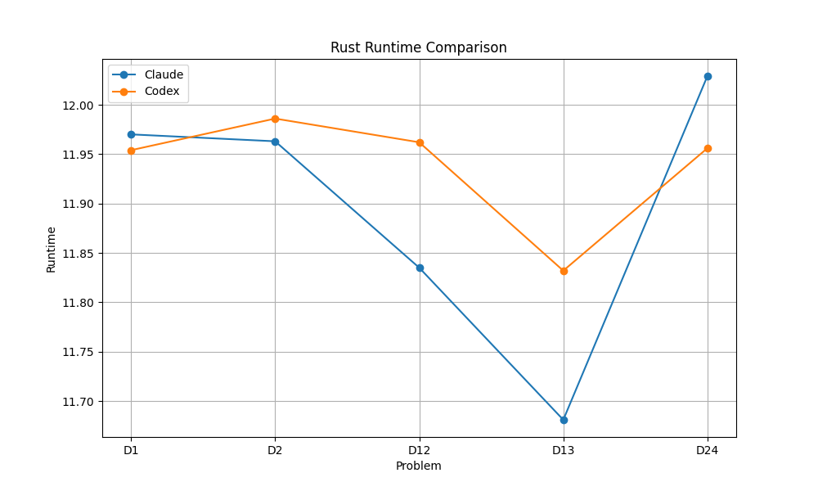
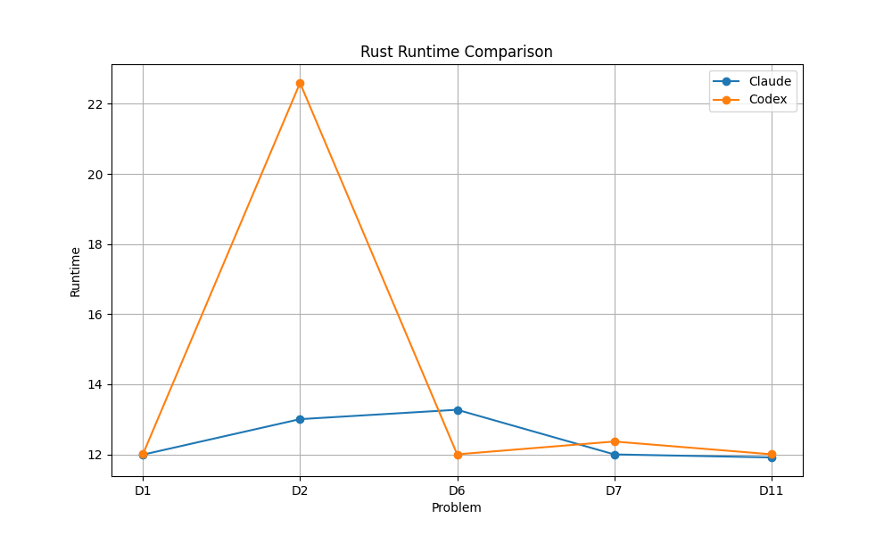
Rust runtime by year and part
Part A 2024
Part A 2025
Part B 2024
Part B 2025
Bachelor Thesis Defense · Benchmarking LLMs on Algorithmic Programming Tasks
14

Slide 15
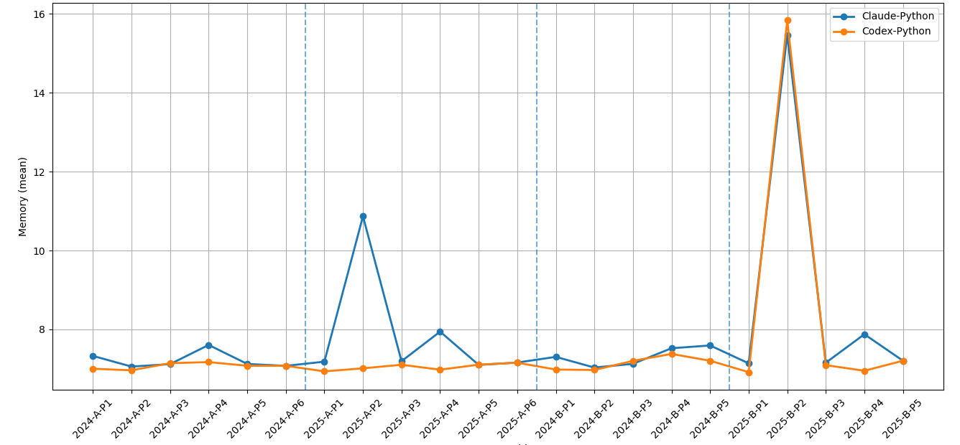
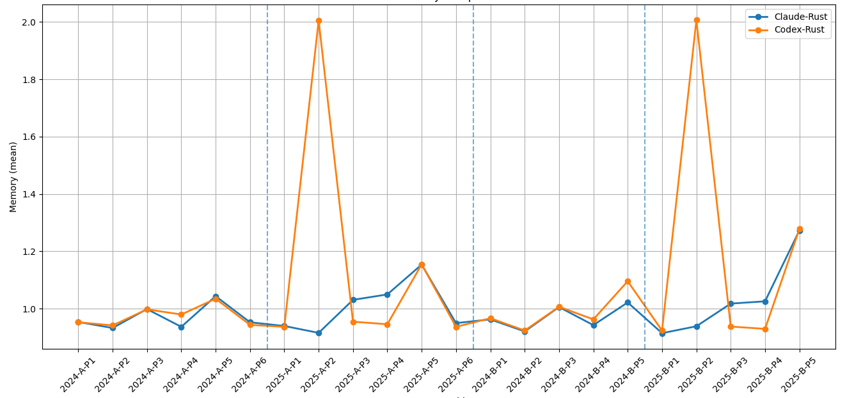
Memory usage overview
Rust uses substantially less memory, while Python has a higher and more variable footprint
2025 Part B Day 2
Python (app. 7 – 16 MIB)
Rust (app. 1 – 2 MIB)
2025 Part B Day 2
2025 Part A Day 2
2025 Part A Day 2
2025 Part B Day 11
2024 Part A
2025 Part A
2024 Part B
2025 Part B
2024 Part A
2025 Part A
2024 Part B
2025 Part B
Bachelor Thesis Defense · Benchmarking LLMs on Algorithmic Programming Tasks
16

Slide 16
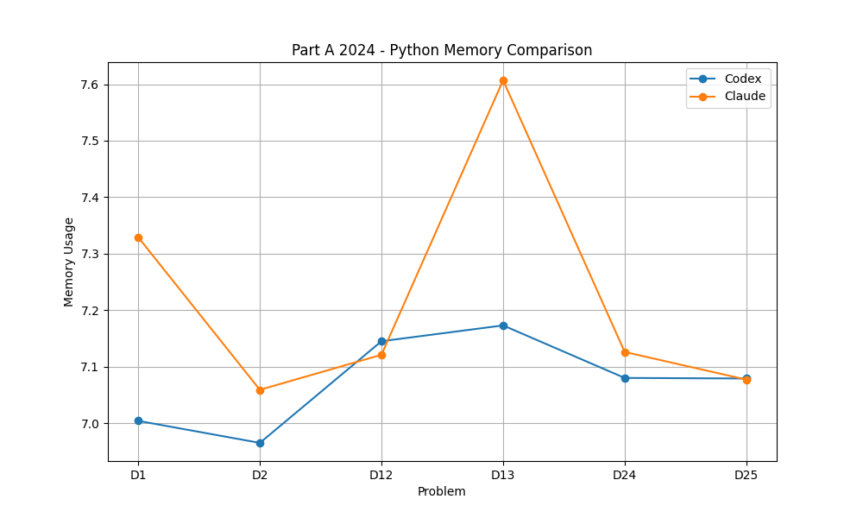
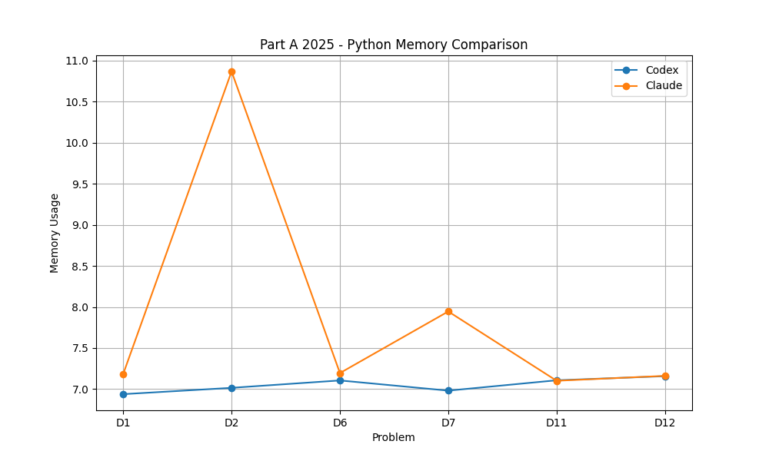
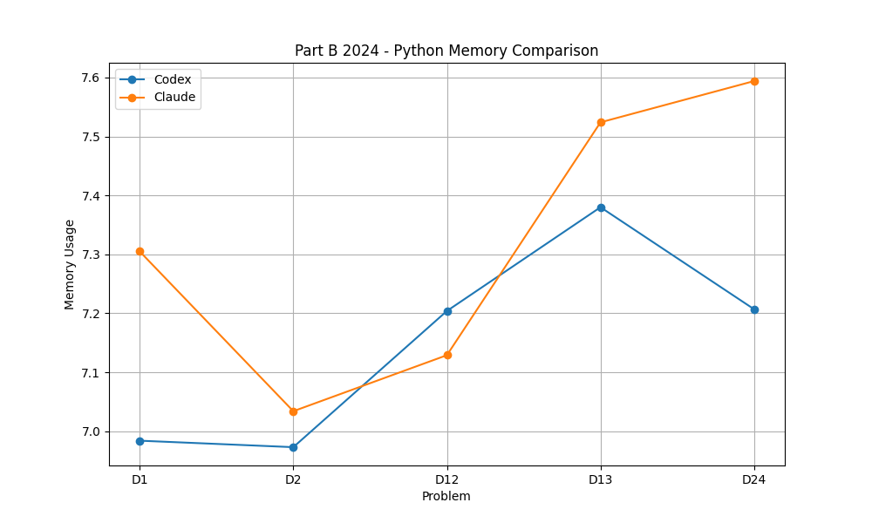
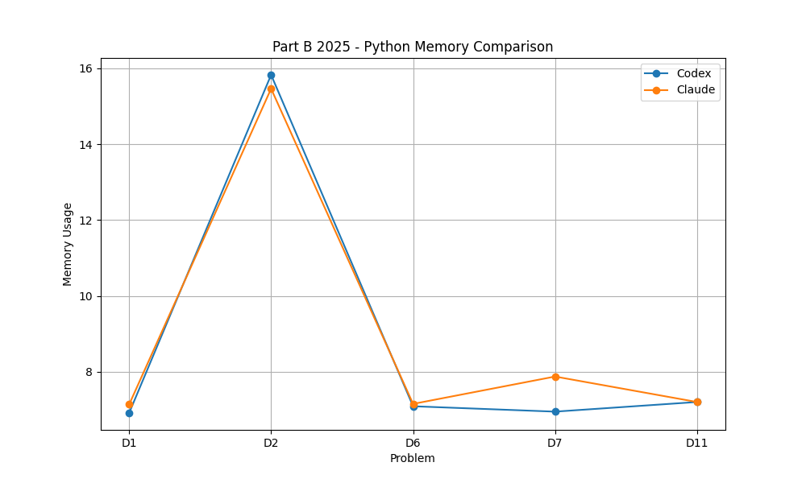
Python memory usage details
Part A 2024
Part A 2025
Part B 2024
Part B 2025
Bachelor Thesis Defense · Benchmarking LLMs on Algorithmic Programming Tasks
17

Slide 17
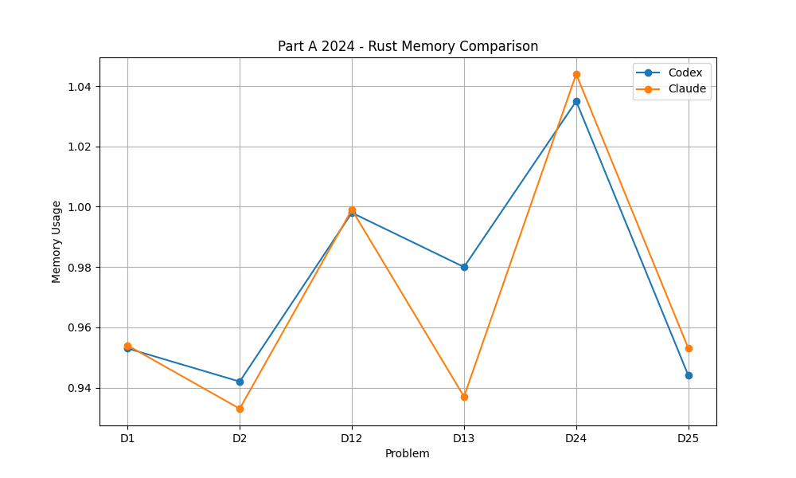
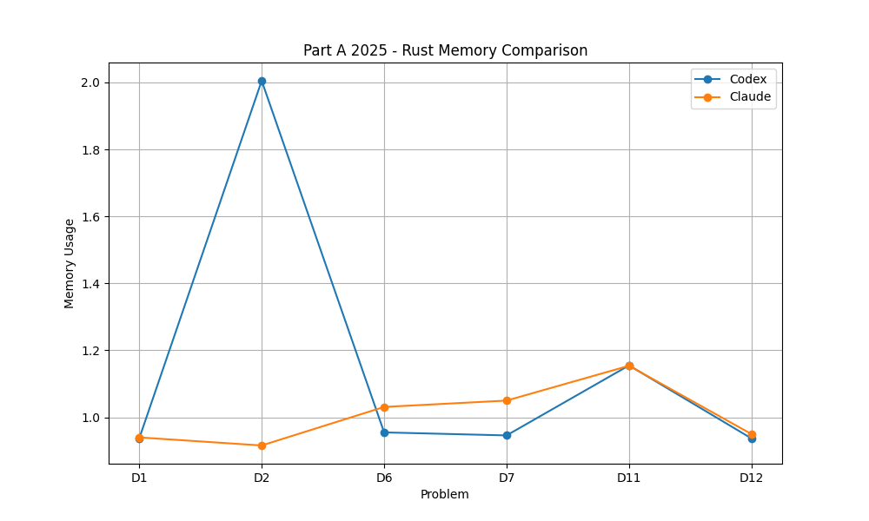
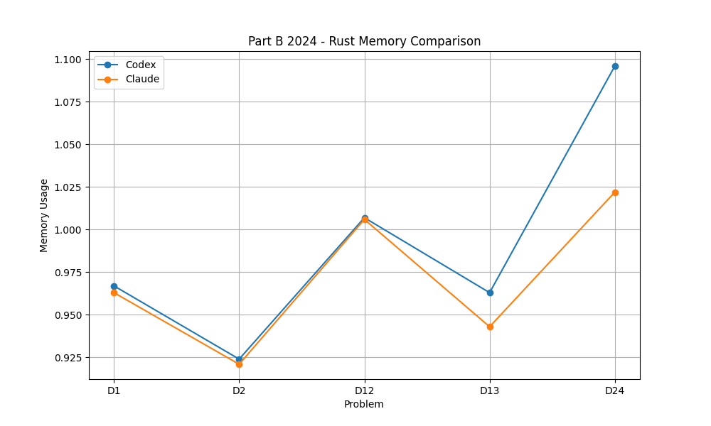
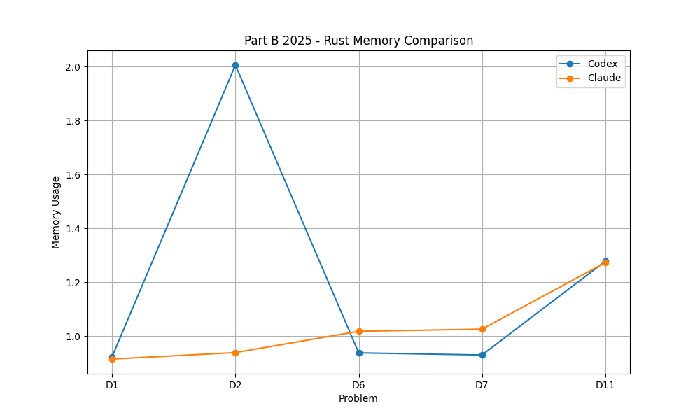
Rust memory usage details
Part A 2024
Part A 2025
Part B 2024
Part B 2025
Bachelor Thesis Defense · Benchmarking LLMs on Algorithmic Programming Tasks
18

Slide 18
Code-quality review results
Average scores across the uploaded review files
Model
Language
Readability
Structure
Idiomatic
Low complexity
Overall
Codex
Python
4.27
3.68
4.14
4.32
4.10
Codex
Rust
4.23
3.45
4.09
3.91
3.92
Claude
Rust
3.77
3.09
3.77
3.91
3.64
Claude
Python
3.64
2.82
4.09
3.95
3.62
Highest average
Main weakness
Interpretation
Codex/Python receives the highest overall code-quality score in the review files.
Structure is the lowest-scoring dimension overall, especially when solutions are kept as one top-level script.
Correctness was perfect in this dataset, so quality scores help distinguish maintainability.
Bachelor Thesis Defense · Benchmarking LLMs on Algorithmic Programming Tasks

Slide 19
Stronger interpretation: runtime spikes reveal algorithmic fragility
The outliers are more important than the average trend
Python behavior
Rust behavior
Interpretive conclusion
Python shows the clearest runtime instability. Several tasks are close together, but individual cases create strong peaks. This suggests that small algorithmic differences are amplified by interpreter overhead.
Rust runtime is usually tightly clustered around a low baseline. When spikes occur, they stand out clearly and likely point to problem-specific implementation or algorithmic choices rather than general language overhead.
The models are capable of finding working algorithms, but not always equally robust efficient ones. Runtime outliers are evidence of unstable optimization quality.
Bachelor Thesis Defense · Benchmarking LLMs on Algorithmic Programming Tasks

Slide 20
Outlier analysis method
Outliers are interpreted statistically first, then explained by reading the generated code
Detection rule
Tukey 1.5×IQR rule applied separately to Python and Rust.
Metrics checked: mean runtime, mean memory usage, and lines of code.
Separate language baselines avoid comparing interpreted Python directly against compiled Rust.
Interpretation rule
Each flagged row was mapped back to its solution file.
The final interpretation is code-based, not only spreadsheet-based.
Rust timings cluster very tightly around ~12 ms, so several Rust outliers are statistical rather than practically large.
Bachelor Thesis Defense · Benchmarking LLMs on Algorithmic Programming Tasks

Slide 21
Runtime outlier analysis: 2025 Day 2 Part B
Claude · Python
Most extreme runtime outlier in the dataset.
Generates invalid IDs globally, then scans the sorted list for every query range.
String construction and Python container overhead also increase memory.
Codex · Python
Still a runtime and memory outlier, but faster than Claude.
Uses sorted invalid IDs plus prefix sums and binary search for ranges.
Trading additional memory for better query behavior reduces—but does not remove—the spike.
Codex · Rust
Meaningful Rust outlier, not just statistical.
Globally materializes the repeated-ID universe up to max_end.
String-based block repetition keeps the code correct but heavier than necessary.
Bachelor Thesis Defense · Benchmarking LLMs on Algorithmic Programming Tasks

Slide 22
Runtime outlier analysis: 2024 Day 13 Part A
NOT DONE!
Claude · Python: per-cell corner counting
Flood-fills each region and calls corner logic for every visited cell.
Each corner check performs multiple neighbor and diagonal membership tests.
This is conceptually clean, but it creates a high Python-level constant factor.
Codex · Python: exposed-edge postprocessing
Records exposed boundary positions during flood fill.
Counts contiguous edge runs afterwards using grouped lists.
Still expensive, but it avoids repeated local corner tests at every cell.
Bachelor Thesis Defense · Benchmarking LLMs on Algorithmic Programming Tasks

Slide 23
Runtime outlier analysis: 2024 Day 2 Part A
NOT DONE!
Bachelor Thesis Defense · Benchmarking LLMs on Algorithmic Programming Tasks

Slide 24
Rust outliers
Several Rust points cross the threshold because the distribution is extremely narrow
Meaningful Rust outliers
2025 D2 Codex Rust: global precomputation and string-based reconstruction.
2025 D6 Claude Rust: char grid, column scans, and temporary number strings.
Weak statistical outliers
2025 D7 Codex Rust: clean DP with small extra vector allocation overhead.
2024 D12 and D13 Rust low outliers: slightly cheaper runs inside a tight band.
Not every Tukey outlier is a practical anomaly.
Bachelor Thesis Defense · Benchmarking LLMs on Algorithmic Programming Tasks

Slide 25
Summarized interpretation on outliers
Python outliers
Mainly caused by repeated scanning, global candidate generation, and geometry-heavy local checks.
Interpreter overhead and Python object storage magnify inefficient strategies.
The model may be correct but still operationally fragile.
Rust outliers
Usually much smaller in absolute terms.
Only strongly meaningful when tied to heavier data representation or unnecessary global precomputation.
Compiled performance compresses most normal variation.
Model behavior
Codex often uses more defensive or generalized structures.
Claude sometimes chooses simpler direct strategies with lower LOC.
Neither pattern is universally better; task structure determines the tradeoff.
Bachelor Thesis Defense · Benchmarking LLMs on Algorithmic Programming Tasks

Slide 26
Memory Spikes: Interpretation
2025 D2: candidate universe • Largest spike: Python reaches ~15.5–15.8k; Codex Rust reaches ~2.0k. • Both models precompute repeated-pattern invalid IDs up to the global maximum. • Python is much higher because sets, lists and integers have large object overhead. • Codex stores prefix sums too: more memory, but faster range queries.
2025 D11: memoized graph DP • Rust peak around ~1.27k for both models. • Extra memory comes from cached path-counting states, not from the graph alone. • Claude is slightly lighter: numeric node IDs and compact (usize, u8) memo keys. • Codex is heavier because String-based maps and memo keys keep more structure.
2024 D24: circuit structures • Elevated memory is caused by wire names, gate maps and reverse lookups. • Rust Codex duplicates structural data: HashMap<String, Gate> plus lookup maps. • Python versions also keep several maps over wires and consumer relationships. • This is structural overhead from circuit reasoning, not a failure signal.
2025 D7: cached recursion bump • Claude Python has a smaller spike around ~7.9k. • Reason: padded grid plus recursive @lru_cache over row/column states. • Codex Python stays lower with iterative DP and width-sized arrays. • This is a deliberate memory-for-simplicity tradeoff.
NOT DONE!

Slide 27
Model and language comparison
The benchmark varies two factors: which LLM generates the code, and which programming language the solution must use.
Generation systems
Target languages
Codex
Claude Code
Python
Rust
gpt-5.4 · Codex CLI v0.117.0
Sonnet 4.6 · Claude Code CLI v2.1.91
v3.14.2 · interpreted · dynamic
v1.94.1 · compiled · static
Generated complete source files.
Used with the same task files and prompt template.
Tended to produce direct solutions, but sometimes broader than necessary.
Generated complete programs under identical constraints.
Often concise and readable.
Some outliers came from higher constant-factor strategies.
Readable baseline with fast generation.
Good for parsing-heavy tasks and compact logic.
Runtime and memory rise when solutions allocate many objects.
Stricter type and ownership constraints.
Usually lower runtime and memory usage.
Reveals whether the model can satisfy compiler rules.
Bachelor Thesis Defense · Benchmarking LLMs on Algorithmic Programming Tasks
6–7

Slide 28
Limitations and threats to validity
The benchmark contains a limited selection of Advent of Code tasks rather than all possible programming tasks.
Prompt wording can influence LLM outputs, even when standardized templates are used.
Models can change over time, so exact results may not be stable across future versions.
Runtime and memory measurements are environment-dependent and can be affected by system noise.
The benchmark focuses on algorithmic problem solving for shorter codes, not broader software engineering tasks such as large systems, APIs or UI work.
Bachelor Thesis Defense · Benchmarking LLMs on Algorithmic Programming Tasks
28

Slide 29
Conclusion
LLMs can solve the selected AoC algorithmic tasks correctly in both Python and Rust.
Correctness alone is not enough: runtime, memory and code quality reveal important differences.
Rust generally provides a lower memory footprint and more stable runtime profile.
Python shows larger runtime and memory variability, especially on selected harder cases.
The language choice has a strong effect on measured efficiency; model choice affects outliers more than the overall pattern.
Bachelor Thesis Defense · Benchmarking LLMs on Algorithmic Programming Tasks
29

Slide 30
Answer to the research question
Effectiveness and differences between Python and Rust
In this benchmark, both evaluated LLMs were effective at producing functionally correct solutions for the selected Advent of Code tasks.
The main differences appeared after correctness: Rust solutions used less memory and showed a more compact runtime profile, while Python solutions had higher memory usage and more pronounced runtime spikes.
Therefore, LLM-generated code should be evaluated not only by whether it works, but also by how efficiently and idiomatically it solves the problem.
Bachelor Thesis Defense · Benchmarking LLMs on Algorithmic Programming Tasks
30

Slide 31
Thank you
Questions?
Bachelor Thesis Defense · Benchmarking LLMs on Algorithmic Programming Tasks
31

