Slide 1
FORECASTING UNEMPLOYMENT IN THE US
Linh Nguyen, Silvia Chalkou, Taiwo Bada, Veena Iyer
MSBA, MSMA, MSDI, MSBA
Bentley University, Massachusetts
MA 611 - Spring 2021 - Dr. Moinak Bhaduri
ltnguyen@falcon.bentley.edu, schalkou@falcon.bentley.edu, bada_taiw@bentley.edu, iyer_veen@bentley.edu
Nguyen, L.; Chalkou, S.; Bada, T.; Iyer, V. (Bentley Math. Sci.)
MA 611 Presentation
Spring 2021

Slide 2
Agenda
Introduction
The Dataset
Exploratory Data Analysis
Modelling
Conclusion and Future Work
Nguyen, L.; Chalkou, S.; Bada, T.; Iyer, V. (Bentley Math. Sci.)
MA 611 Presentation
Spring 2021

Slide 3


Introduction
Unemployment: key data to determine a nation’s economic health
Unemployment peaked to record high since Covid-19 pandemic
Project focus:
Forecast unemployment in the US
Unemployment trend across states and gender
Source: Financial Times
Nguyen, L.; Chalkou, S.; Bada, T.; Iyer, V. (Bentley Math. Sci.)
MA 611 Presentation
Spring 2021

Slide 4
The Dataset
Data Source: Federal Reserve Bank of St. Louis (FRED) Economic Data
Name | Size | Duration | Frequency
Total unemployment rate in the US | 244 | 1960 - 2020 | 4
Total unemployment rate in the US by state | 69 | 2003 - 2020 | 4
Entropy = 1.02
Nguyen, L.; Chalkou, S.; Bada, T.; Iyer, V. (Bentley Math. Sci.)
MA 611 Presentation
Spring 2021

Slide 5
Exploratory Data Analysis
Trend Analysis
Seasonality Check
Data Clustering
Similarity Check
Nguyen, L.; Chalkou, S.; Bada, T.; Iyer, V. (Bentley Math. Sci.)
MA 611 Presentation
Spring 2021

Slide 6
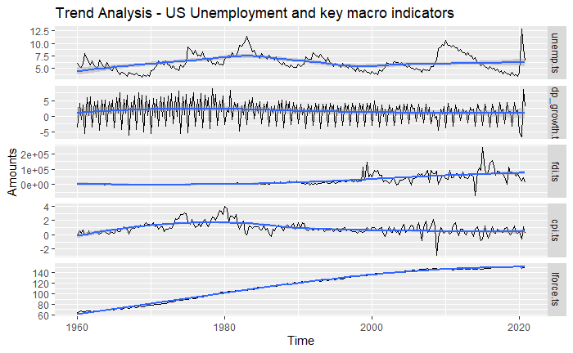
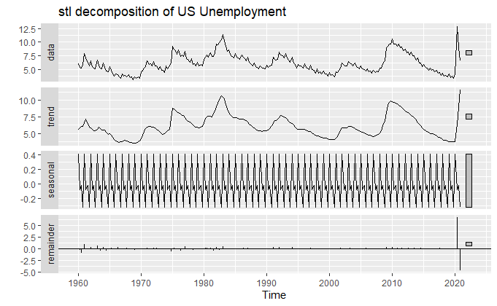
Trend Analysis & Stl decomposition
F_{t} = 0.94 ; F_{s} = 0.31
Nguyen, L.; Chalkou, S.; Bada, T.; Iyer, V. (Bentley Math. Sci.)
MA 611 Presentation
Spring 2021
Notes:
- unemployment in the US has experienced a slight upward trend, likely attributed to the change in political party governance and the economic recession and circle in each decade.
- trend of other key macro indicators including GDP growth, FDI, CPI, and labor force can partly explain the trend of unemployment but not significantly

Slide 7
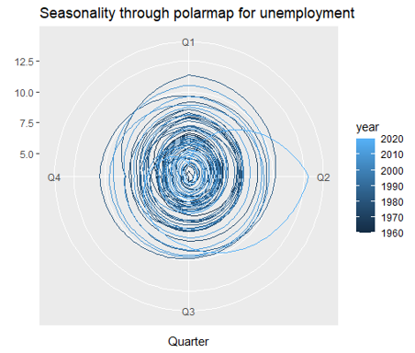
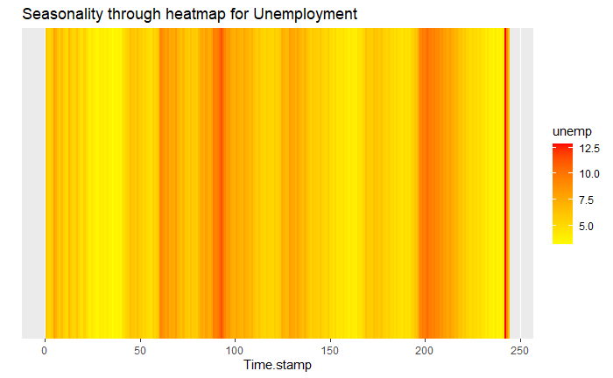
Seasonality Check
Nguyen, L.; Chalkou, S.; Bada, T.; Iyer, V. (Bentley Math. Sci.)
MA 611 Presentation
Spring 2021
Notes:
Polar map: There are clear signs of a mild seasonality (confirmed by the seasonal strength of 0.3); dark and light color gradients to overlap, this is because of the high volatility of the trend. An abnormal behavior for 2020 with a strong skew toward Q2 in 2020 that is due to the outlier registered for this quarter.
Heat map. The darkest lines are with the same timestamps of recessions as discussed in the trend analysis above and peak in the latest time stamps for 2020 in the heat map.

Slide 8
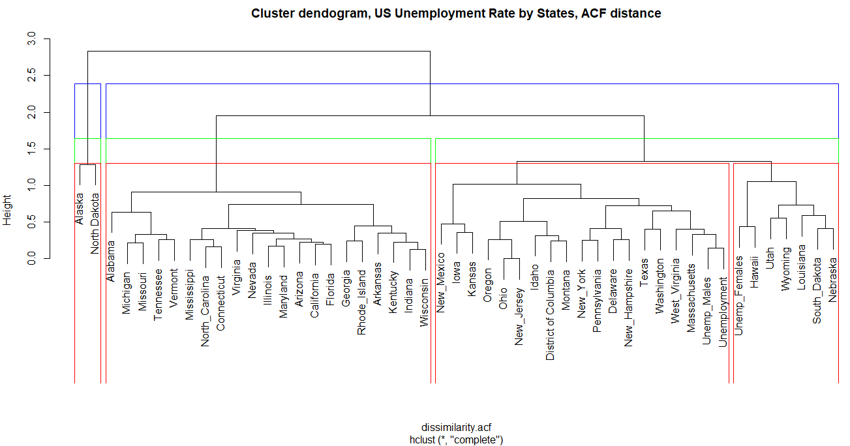
Similarity Check
Nguyen, L.; Chalkou, S.; Bada, T.; Iyer, V. (Bentley Math. Sci.)
MA 611 Presentation
Spring 2021
Notes:
Data clustering methods including Elbow, Silhouette and Gap methods on the whole data set, -> optimal number of clusters can be 4 as the curve is flattened after the 4th cluster, meaning no more significant variance captured after that point.
The ACF distance appears to be a better choice to evidence for the dissimilarity between a pair of numeric time series based on their estimated autocorrelation coefficients and reasonable as one of these data items can have impacts on the other with some lags in time.
Clustered based on the industry strength or focus.
Cluster 1 includes Alaska and North Dakota, both being offshore and known to be strong in oil and gas;
Cluster 2 are groups of states with industry focus in manufacturing, IT, health care services, and insurance;
Cluster 3 are mostly big economic hubs and strong in financial services,
Cluster 4 are states with lots of companies in oil & gas but onshore and in remote areas.

Slide 9
Modeling
Data Cleaning
Data Partitioning
Non-linearity Test
Models
Rolling Window Cross Validation
Retrospective Analysis
Diebold-Mariano Test
Model Evaluation
Nguyen, L.; Chalkou, S.; Bada, T.; Iyer, V. (Bentley Math. Sci.)
MA 611 Presentation
Spring 2021

Slide 10
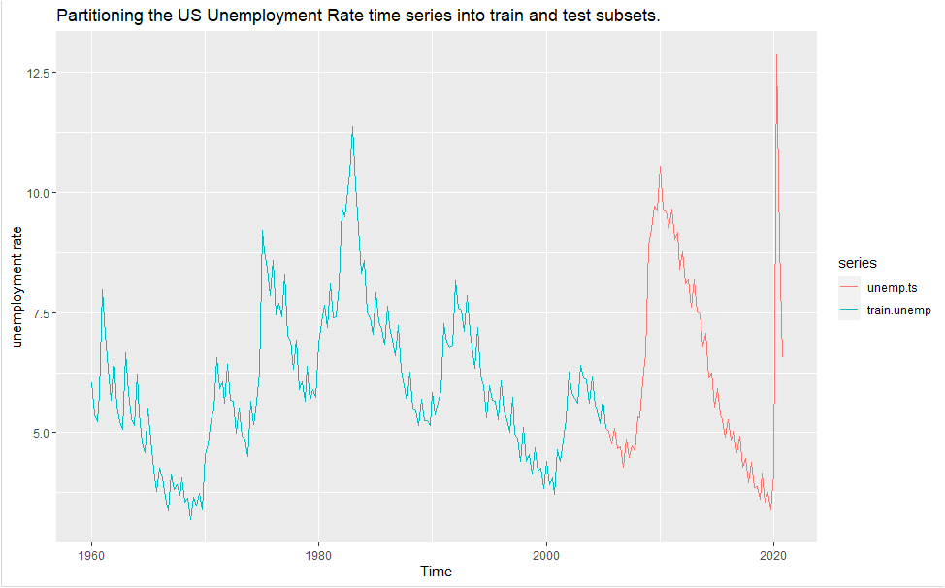
Data Partitioning & Non-linearity Tests
Non-linearity tests:
p-values – mostly more than 0.05 at 5% significance level
Fail to reject the null hypotheses
To stationarize the data we have to go through:
Ordinary difference = 1
Seasonal difference = 1
75:25 Data Partition – Train data (183) & Test data (61 points)
Nguyen, L.; Chalkou, S.; Bada, T.; Iyer, V. (Bentley Math. Sci.)
MA 611 Presentation
Spring 2021
Notes:
We have opted for seasonal ARIMA because ndiffs() and nsdiffs() are both equal to one, meaning we need both ordinary and seasonal differences to transform the time series into stationary.

Slide 11
Models, Accuracy Metrics & Residual Check
Fitted Model | Subset | AIC | RMSE | MAE | MAPE | MASE | Residual check
Naive | Training Testing |  | 0.6694 0.4326 | 0.5399 0.3690 | 8.9968 8.0665 | 0.7187 0.4912 | 2.2 e-16
Seasonal Naive | Training Testing |  | 1.0039 0.6513 | 0.7512 0.6262 | 11.9427 13.3562 | 1.0000 0.8337 | 2.2 e-16
STL Random Walk | Training Testing |  | 0.3008 0.2454 | 0.2112 0.2145 | 3.4563 4.5867 | 0.2812 0.2856 | 0.0007153
Best ETS (A,Ad,A) | Training Testing | -352.33 | 0.3957 0.3082 | 0.2745 0.2627 | 4.4321 5.6238 | 0.3655 0.3497 | 7.183 e-11
ARIMA Brute Force ARIMA(2,0,1)(1,1,1)[4] | Training Testing | -801.78 | 0.3322 0.3509 | 0.2289 0.2942 | 3.7798 6.3380 | 0.3047 0.3916 | 0.09763
ARIMA Stepwise ARIMA(3,0,2)(1,1,1)[4] | Training Testing | -800.05 | 0.3228 0.3339 | 0.2269 0.2741 | 3.7541 5.9170 | 0.3022 0.3649 | 0.1894
Nguyen, L.; Chalkou, S.; Bada, T.; Iyer, V. (Bentley Math. Sci.)
MA 611 Presentation
Spring 2021

Slide 12
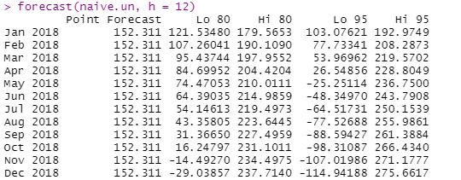
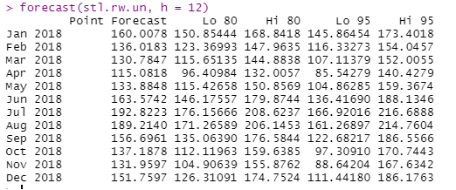
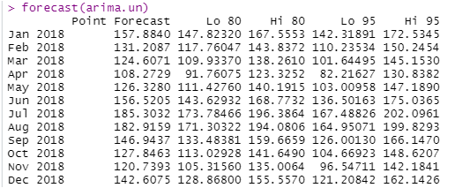
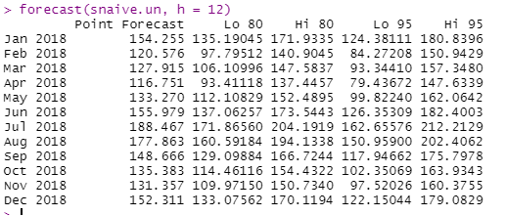
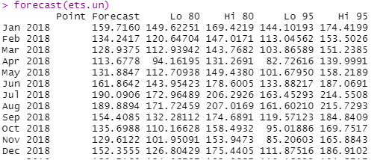
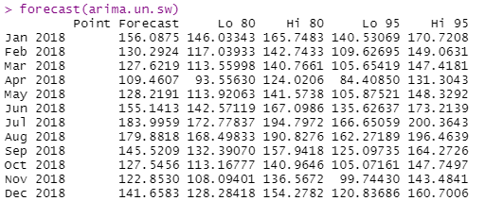
Forecast Intervals
89.898
27.537
30.215
56.458
30.317
30.190
Nguyen, L.; Chalkou, S.; Bada, T.; Iyer, V. (Bentley Math. Sci.)
MA 611 Presentation
Spring 2021

Slide 13
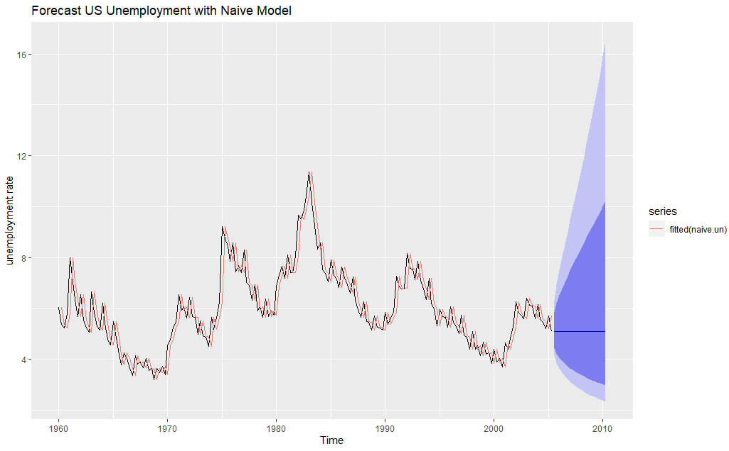
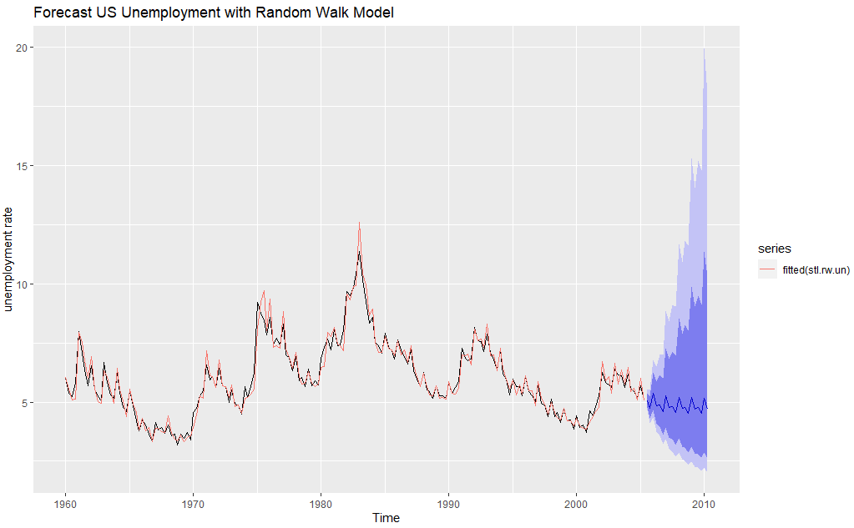
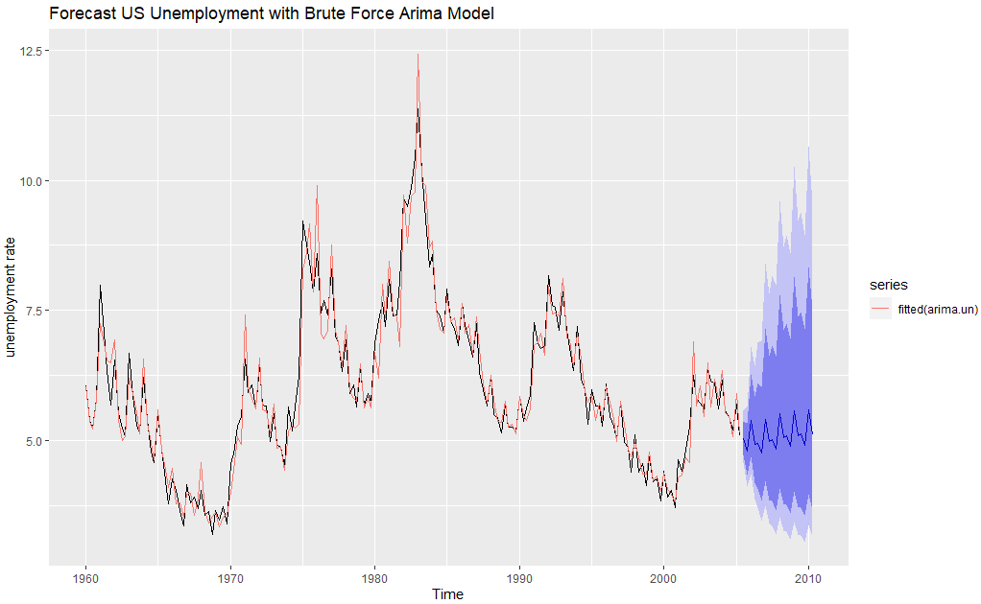
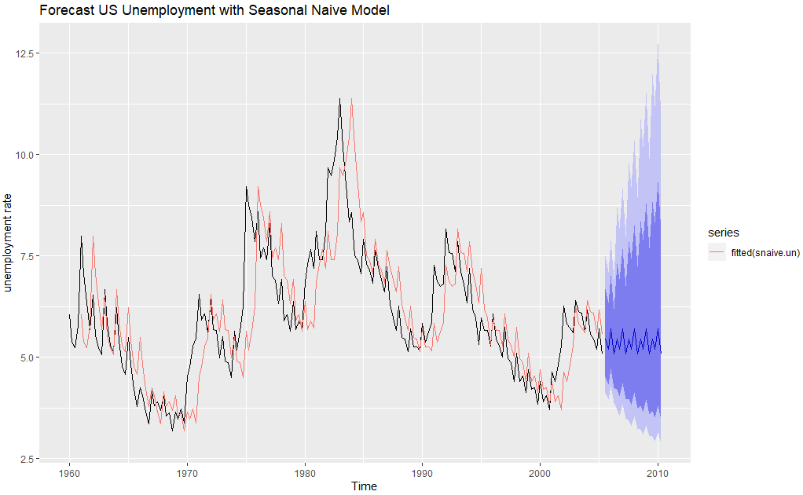
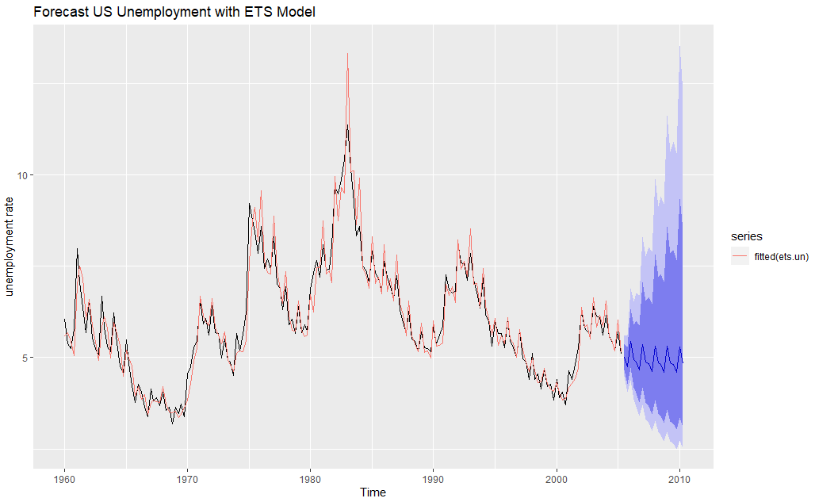
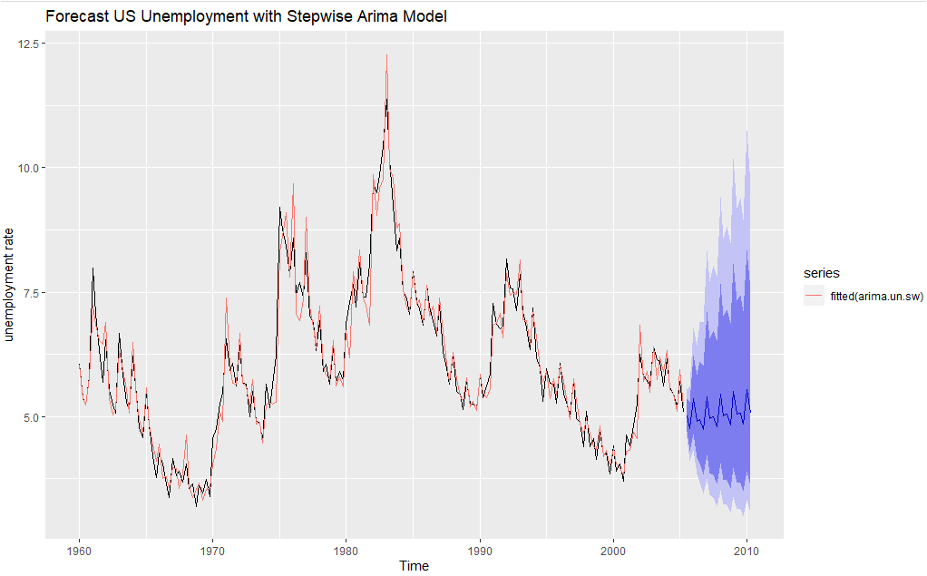
Graphical representation of fitted models
Nguyen, L.; Chalkou, S.; Bada, T.; Iyer, V. (Bentley Math. Sci.)
MA 611 Presentation
Spring 2021

Slide 14
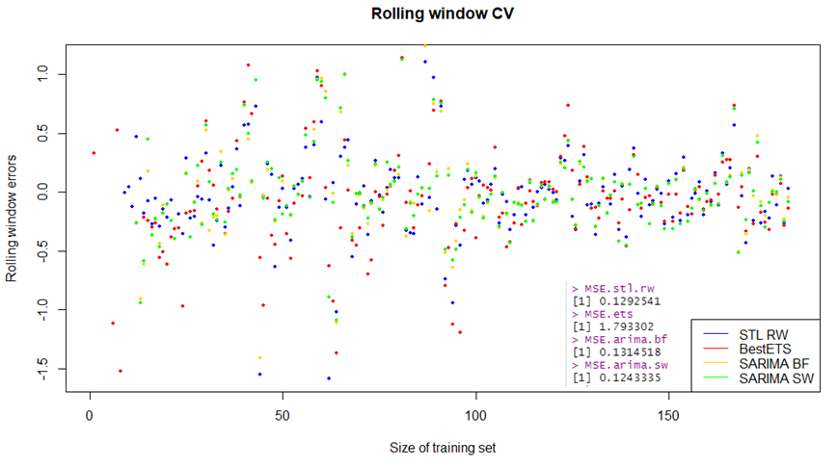
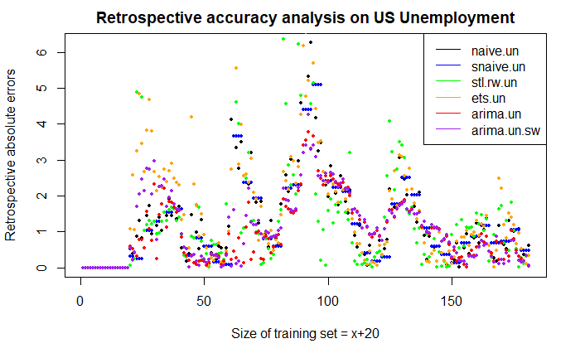
Rolling Window CV & Retrospective Analysis
Winner: ARIMA Stepwise
ARIMA(3,0,2)(1,1,1)[4])
Winner: ARIMA Stepwise
ARIMA(3,0,2)(1,1,1)[4])
Nguyen, L.; Chalkou, S.; Bada, T.; Iyer, V. (Bentley Math. Sci.)
MA 611 Presentation
Spring 2021

Slide 15
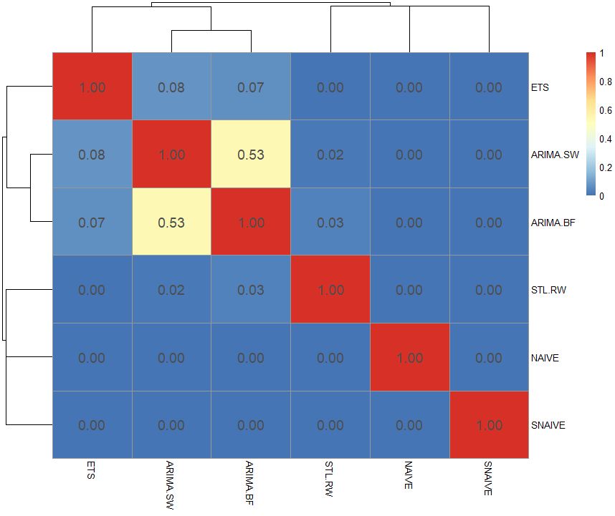
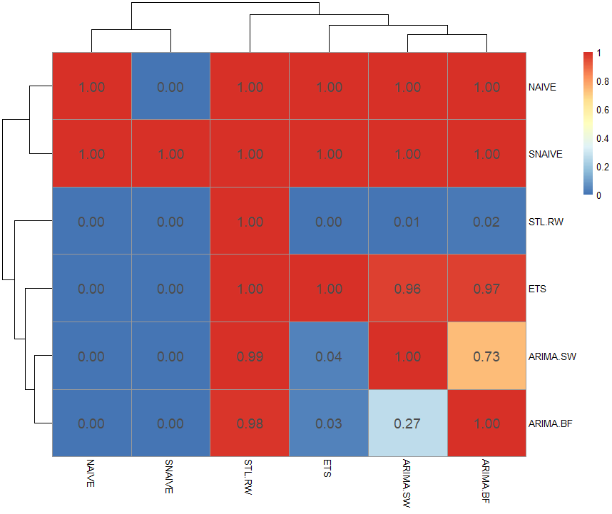
Diebold-Mariano (DM) test for in-sample accuracies
P-values from two tailed type test
P-values from less-than type test
Nguyen, L.; Chalkou, S.; Bada, T.; Iyer, V. (Bentley Math. Sci.)
MA 611 Presentation
Spring 2021

Slide 16
Model Comparison
 | Properties of Good Models | ARIMA Brute Force ARIMA(2,0,1)(1,1,1)[4] | ARIMA Stepwise ARIMA(3,0,2)(1,1,1)[4] | ETS A A_{d} A | STL RW
1 | Small MAPE / MASE | * (as per DM test) | * | ** | ***
2 | Compact Forecast Interval | * | ** |  | ***
3 | Small AIC | * |  | - | -
4 | Significant Parameters | *** | ***
5 | Good Residual Properties | *** | ***
6 | Good Retro Analysis | ** | *** | *
7 | Rolling Window Analysis | * | *** |  | **
8 | No Model Violation | *** | *** | *** | ***
9 | Logical | *** | *** | *** | ***
10 | Parsimonious | * |  | ** | ***
Nguyen, L.; Chalkou, S.; Bada, T.; Iyer, V. (Bentley Math. Sci.)
MA 611 Presentation
Spring 2021

Slide 17
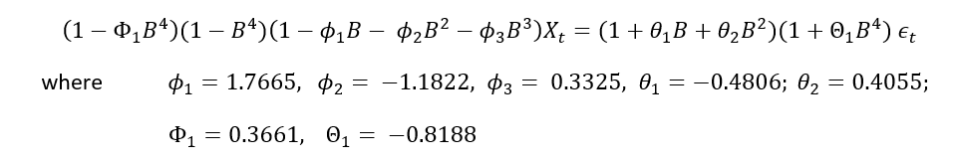
Selected model
ARIMA(3,0,2)(1,1,1)[4] with no drift
p = 3, d = 0, q = 2 for the ordinary part
P = 1, D = 1, Q = 1 for the seasonal part
with seasonal period 4
Additional Option: Ensemble Model with Weighted Average:
40% ARIMA.SW + 40% ARIMA.BF + 10% STL.RW + 10% ETS
MA 611 Presentation
Spring 2021
Nguyen, L.; Chalkou, S.; Bada, T.; Iyer, V. (Bentley Math. Sci.)
MA 611 Presentation
Nguyen, L.; Chalkou, S.; Bada, T.; Iyer, V. (Bentley Math. Sci.)

Slide 18
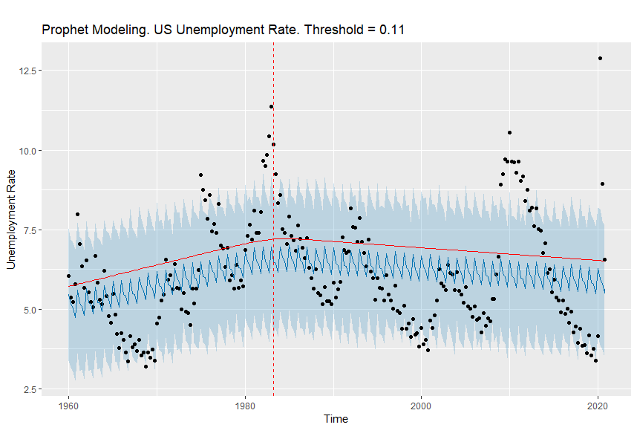
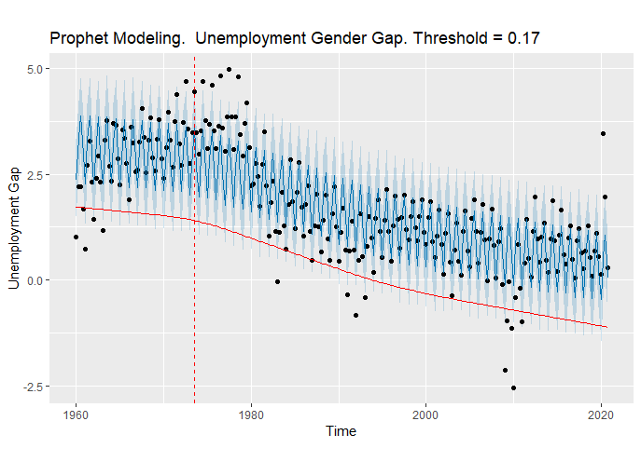
Detecting Change Points
Unemployment Gap = Female Unempl Rate – Male Unempl Rate
Nguyen, L.; Chalkou, S.; Bada, T.; Iyer, V. (Bentley Math. Sci.)
MA 611 Presentation
Spring 2021

Slide 19
Conclusion
Linear models proved to be the best for forecasting unemployment rate in the US.
Best linear model: ARIMA(3,0,2)(1,1,1)[4] - Stepwise
Clustering for state unemployment into 4 large clusters which can be used to transfer features between states within the same cluster
Prophet model showed that the change point in gender unemployment gap was in year 1975
Nguyen, L.; Chalkou, S.; Bada, T.; Iyer, V. (Bentley Math. Sci.)
MA 611 Presentation
Spring 2021

Slide 20
Future Work
Unemployment rate peak in 2020 Q2: the next change point in the future, relevant for further studies upon similar events in the future
Study for better forecast accuracy: ensemble weighted averaging the four best linear models (Arima BF – 40%, Arima SW – 40%, ETS – 10%, STL – 10%).
Nguyen, L.; Chalkou, S.; Bada, T.; Iyer, V. (Bentley Math. Sci.)
MA 611 Presentation
Spring 2021

Slide 21
Q&A
Nguyen, L.; Chalkou, S.; Bada, T.; Iyer, V. (Bentley Math. Sci.)
MA 611 Presentation
Spring 2021

Slide 22
References
Albanesi, S., & Sahin, A. (2017). The Gender Unemployment Gap .
Amadeo, K. (2020, September 27). The Balance. Retrieved from www.thebalance.com: https://www.thebalance.com/labor-force-definition-how-it-affects-the-economy-4045035
Fred Economic Data. (2021, April 2). Fred Economic Data. Retrieved from www.fred.stlouisfed.org: https://fred.stlouisfed.org/series/UNRATE
Simpson, S. (2020, September 24). Investopedia. Retrieved from investopedia.com: https://www.investopedia.com/financial-edge/0811/the-cost-of-unemployment-to-the-economy.aspx
U.S. Bureau of Labour Statistics . (2020, May 13). U.S. Bureau of Labour Statistics. Retrieved from www.bls.gov: https://www.bls.gov/opub/ted/2020/unemployment-rate-rises-to-record-high-14-point-7-percent-in-april-2020.htm?view_full
https://www.ft.com/content/bc513b58-8ef2-11ea-af59-5283fc4c0cb0
Nguyen, L.; Chalkou, S.; Bada, T.; Iyer, V. (Bentley Math. Sci.)
MA 611 Presentation
Spring 2021

