Slide 1


CMR TECHNiCAL CAMPUS UGC AUTONOMOUS Accredited by NBA & NAAC with A Grade Approved by AICTE, New Delhi and Affiliated to JNTU, Hyderabad
DEPARTMENT OF COMPUTER SCIENCE AND ENGINEERING
MAJOR PROJECT
ON
Enhancement of e-government services using Machine Learning and AI
GUIDED BY
B P DEEPAK KUMAR(Asst. Prof)
Presented by
Yogitha Sree Annangi (197R1A0559)
Chandana Yarlagadda (197R1A0557)
Deverakonda Veena Laxmi Gayatri (197R1A0511)

Slide 2
OverView
Abstract
Introduction
Existing System
Disadvantages
Proposed System
Advantages
Architecture
Hardware and Software Requirements
Modularity
UML Diagrams
Sample Code
Results
Conclusion

Slide 3
ABSTRACT
Artificial Intelligence (AI) has recently advanced the state-of-art results in an ever-growing number of domains. However, it still faces several challenges that hinder its deployment in the e-government applications both for improving the e-government systems and the e-government citizens interactions.
Our overarching goal is to utilize trustworthy AI techniques in advancing the current state of e-government services in order to minimize processing times, reduce costs, and improve citizen’s satisfaction.

Slide 4
INTRODUCTION
ARTIFICIAL INTELLIGENCE (AI) has been around for some decades in several theoretical forms and complicated systems; however, only recent advances in computational powers and big data have enabled AI to achieve outstanding results in an ever growing number of domains.
E-government is the application of employing advanced electronic techniques and web services to present, exchange and advance the government’s services for citizens and businesses with a goal of improving the productivity while reducing the cost.

Slide 5
EXISTING SYSTEM:
The existing system just takes the feedback from the customer/user but they do not analyze the information obtained efficiently and that also requires a lot of human labor or man power.

Slide 6
DISADVANTAGES
Time consuming
High Maintenance cost
Inaccessibility
Lack of productivity

Slide 7
PROPOSED SYSTEM
In this project, we propose a novel framework that utilizes recent advances in AI to improve the e-government systems and their interactions with the citizens.
And framework to automate and facilitate the management of e-government systems using AI techniques.
Second, we develop and present several deep learning models that aim at automating e-government feedback services.

Slide 8
ADVANTAGES
Interactive with citizens or clients
Automatic feed back(So that improvements are made)
More efficient
Less cost and maintenance

Slide 9
HARDWARE REQUIREMENTS
Processor : i3
Hard Disk : 40 GB
Ram : 4 GB
GPU : 2 GB(optional)

Slide 10
SOFTWARE REQUIREMENTS
Operating system : Windows 7 or 10 or 11
Coding Language : Python
Platforms : Jupyter Note book or colab(google)
Date sets : Data sets from Online Resources

Slide 11
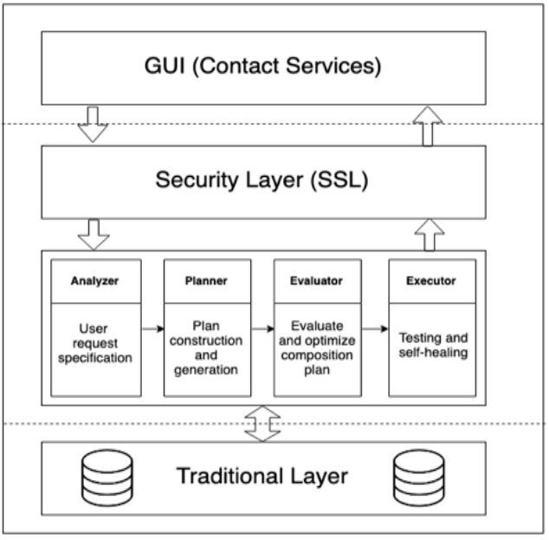
Architecture

Slide 12
Modules
1 . Data preprocessing
2 . Data set Preparation
3 . Training and Model Building
4 . Evaluation
5 . Results

Slide 13
Data preprocessing and Date sets
The data sets are collected from the two online resources “Kaggle” and “IAM”.
In data preprocessing the inconsistence and redundant data is removed using data preprocessing techniques (data cleaning, data transformation, dimension reduction etc.)
Processed data is divided in to train(80%) and test (20%)for model building and evaluation.

Slide 14
Model and Evaluation
The train (80%) data is given to CNN(Convolutional Neural Networks) classifier which is multi layer artificial neural network.
The whole network will work as three parts as input layer ,hidden layer and out put layer.
Required and trainable features are extracted from the input layer and weights are added to hidden layer.
To extract the final classifier features the network uses max pooling and normalization techniques which results the flattened single dimensional features matrix.
Trained model is evaluated against the test data .

Slide 15
UML DIAGRAMS

Slide 16
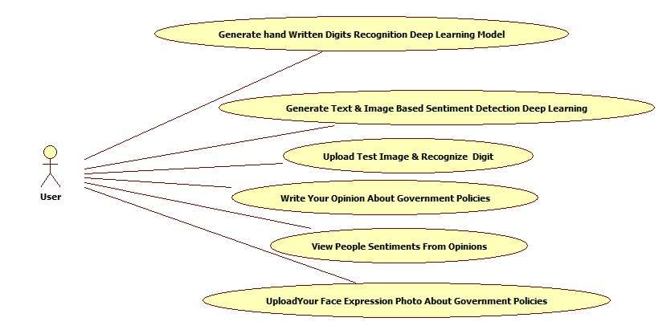
USE CASE DIAGRAM

Slide 17
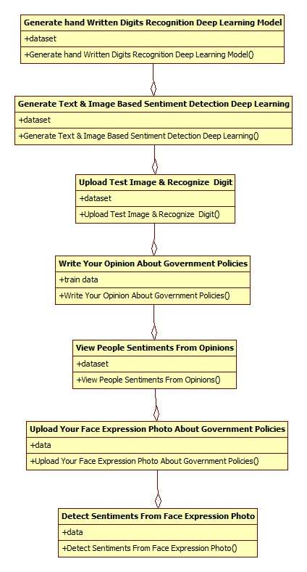
CLASS DIAGRAM

Slide 18
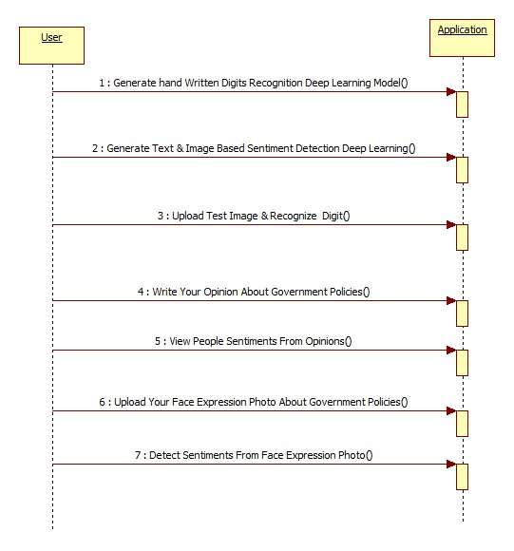
SEQUENCE DIAGRAM:

Slide 19
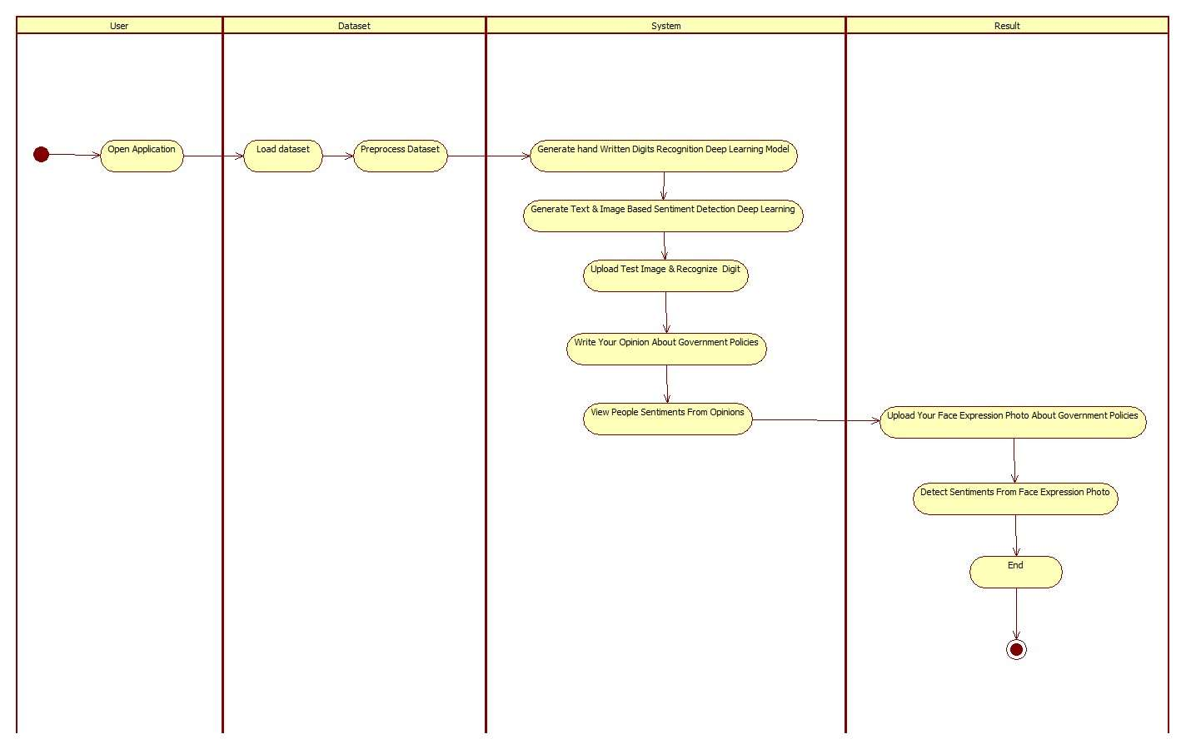
ACTIVITY DIAGRAM

Slide 20
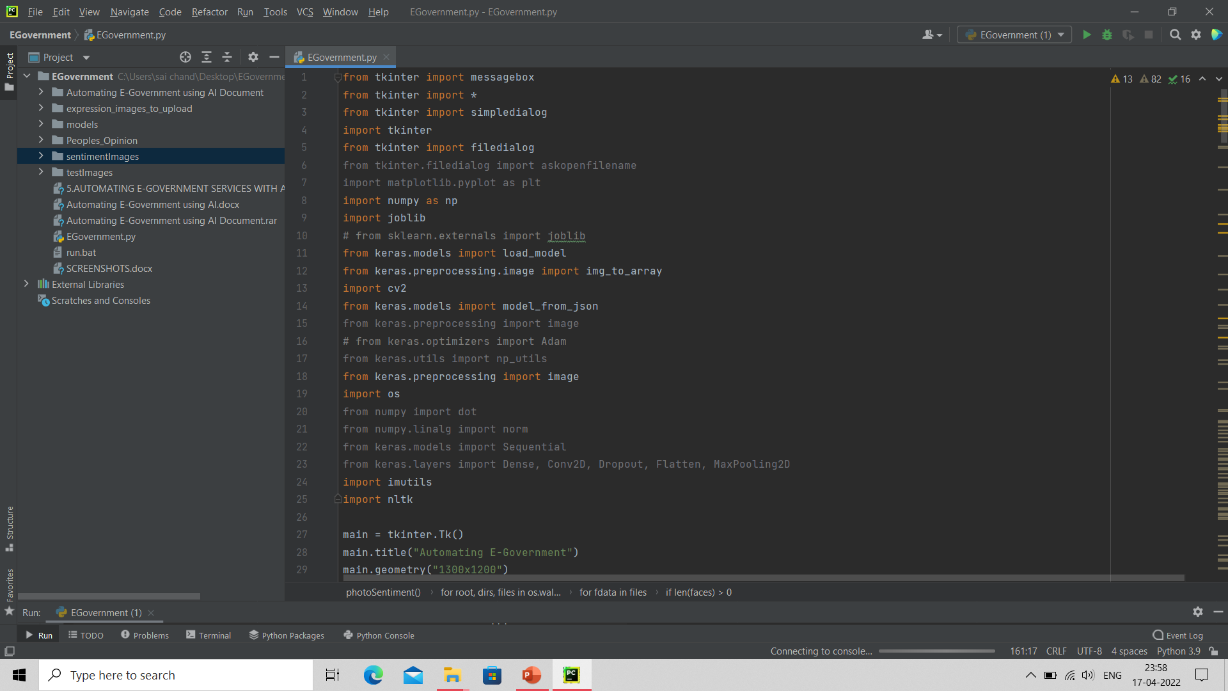
SAMPLE CODE

Slide 21
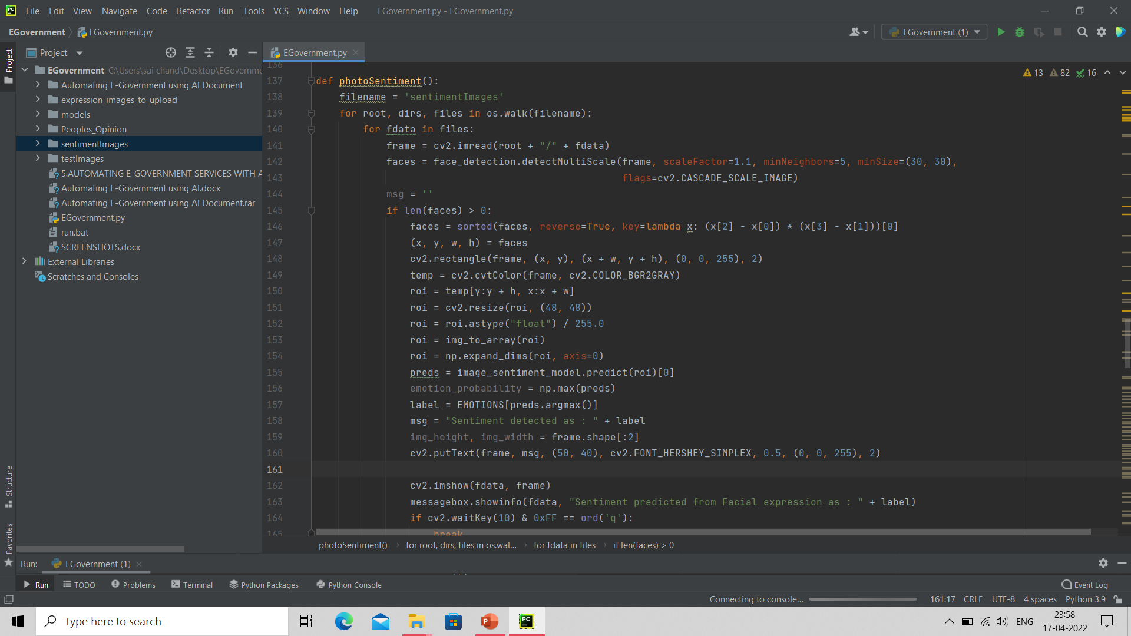

Slide 22
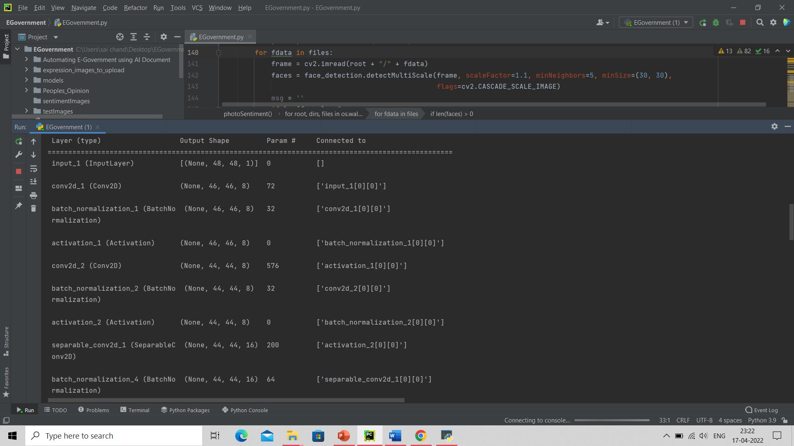
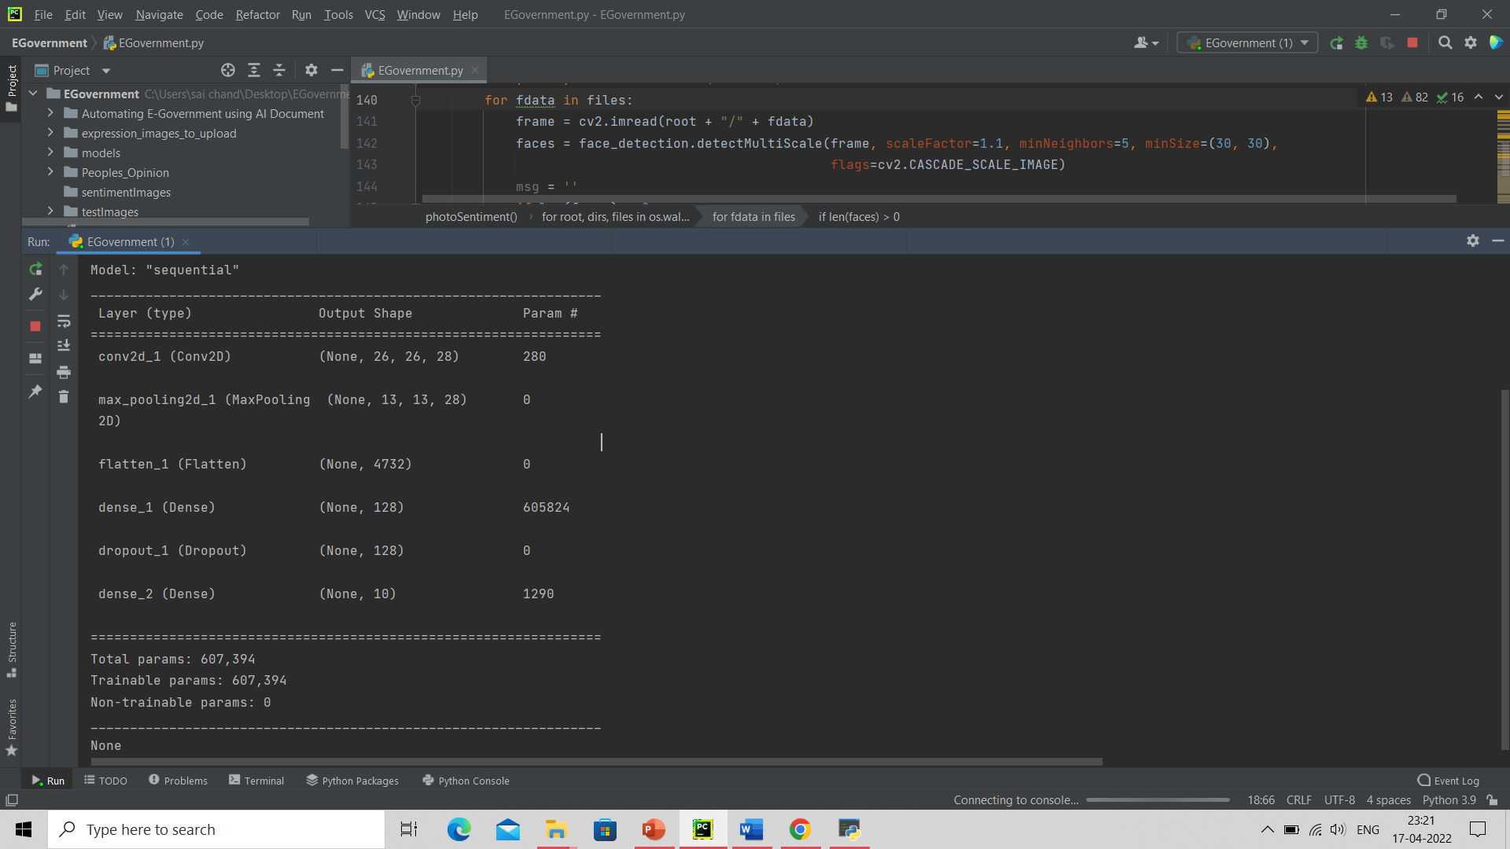
RESULTS

Slide 23
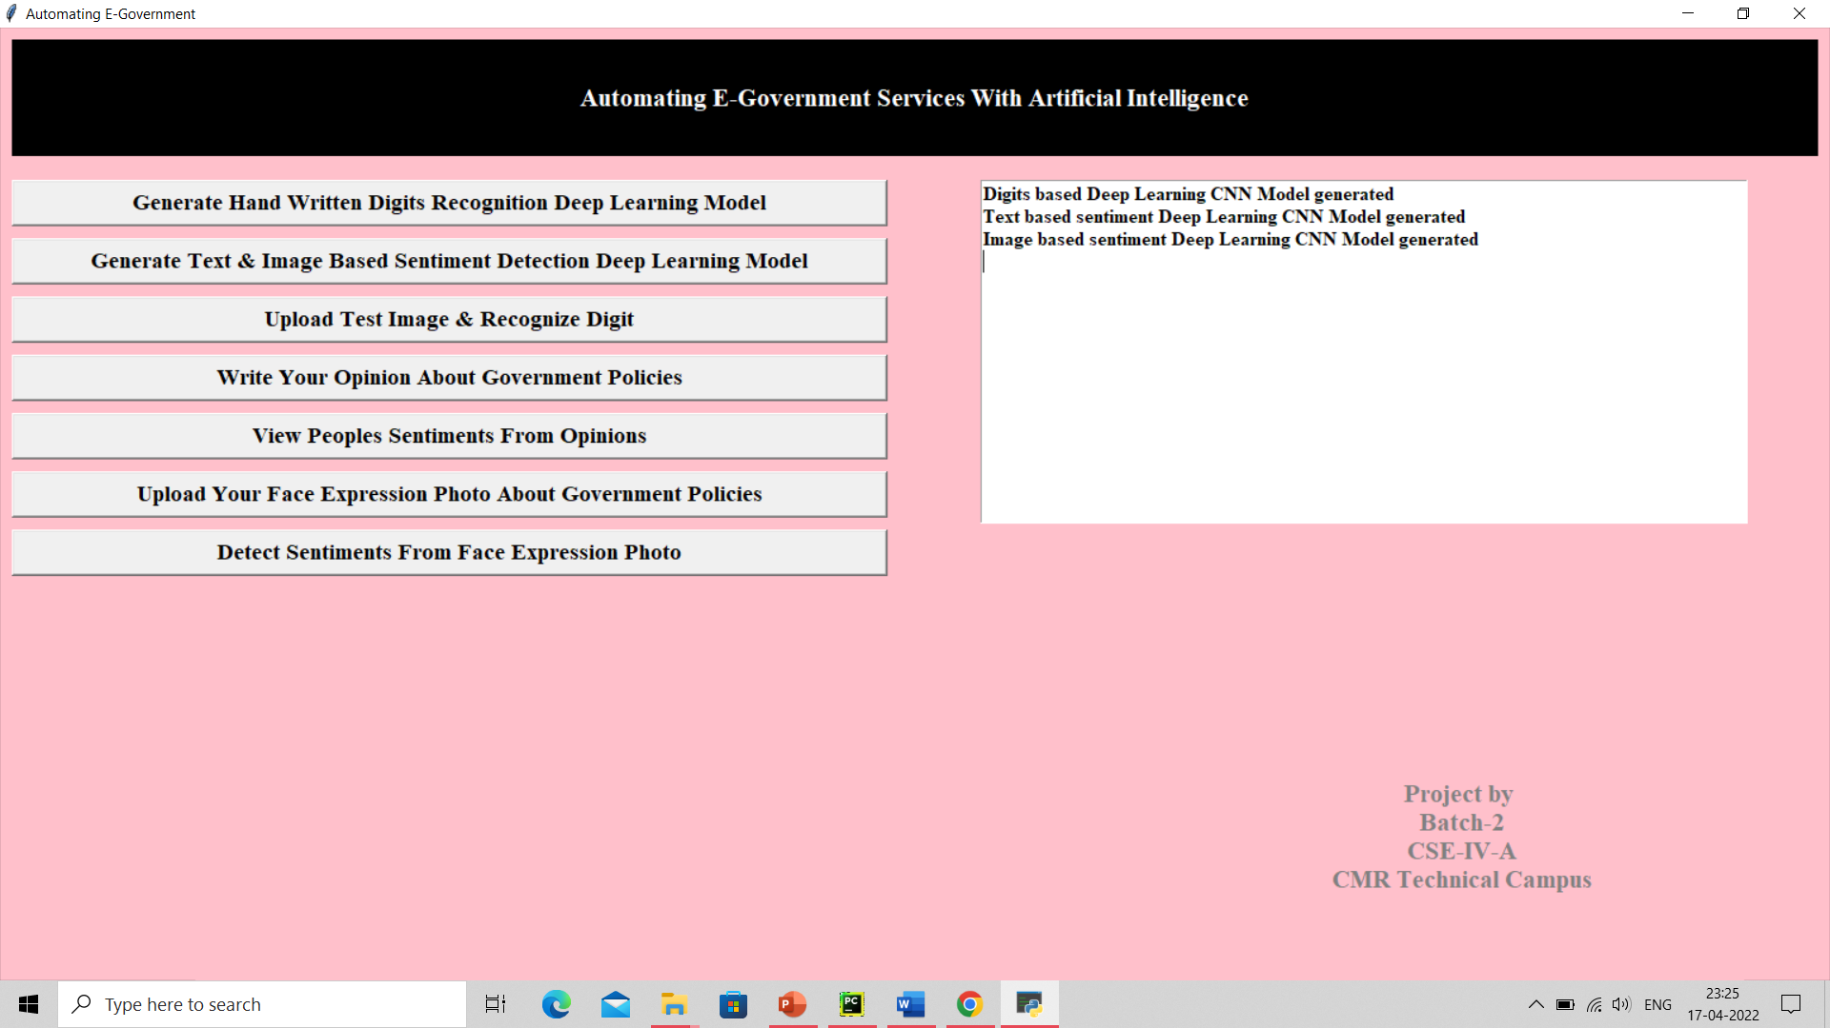
Output

Slide 24
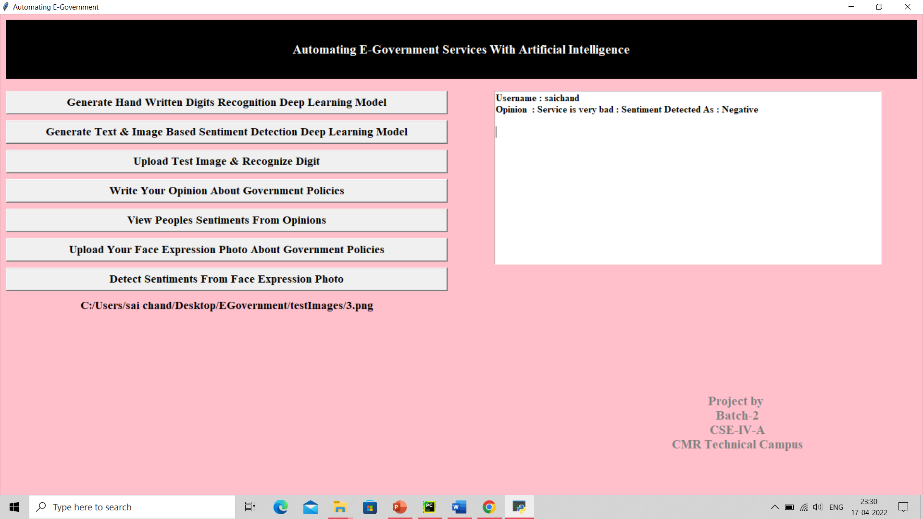
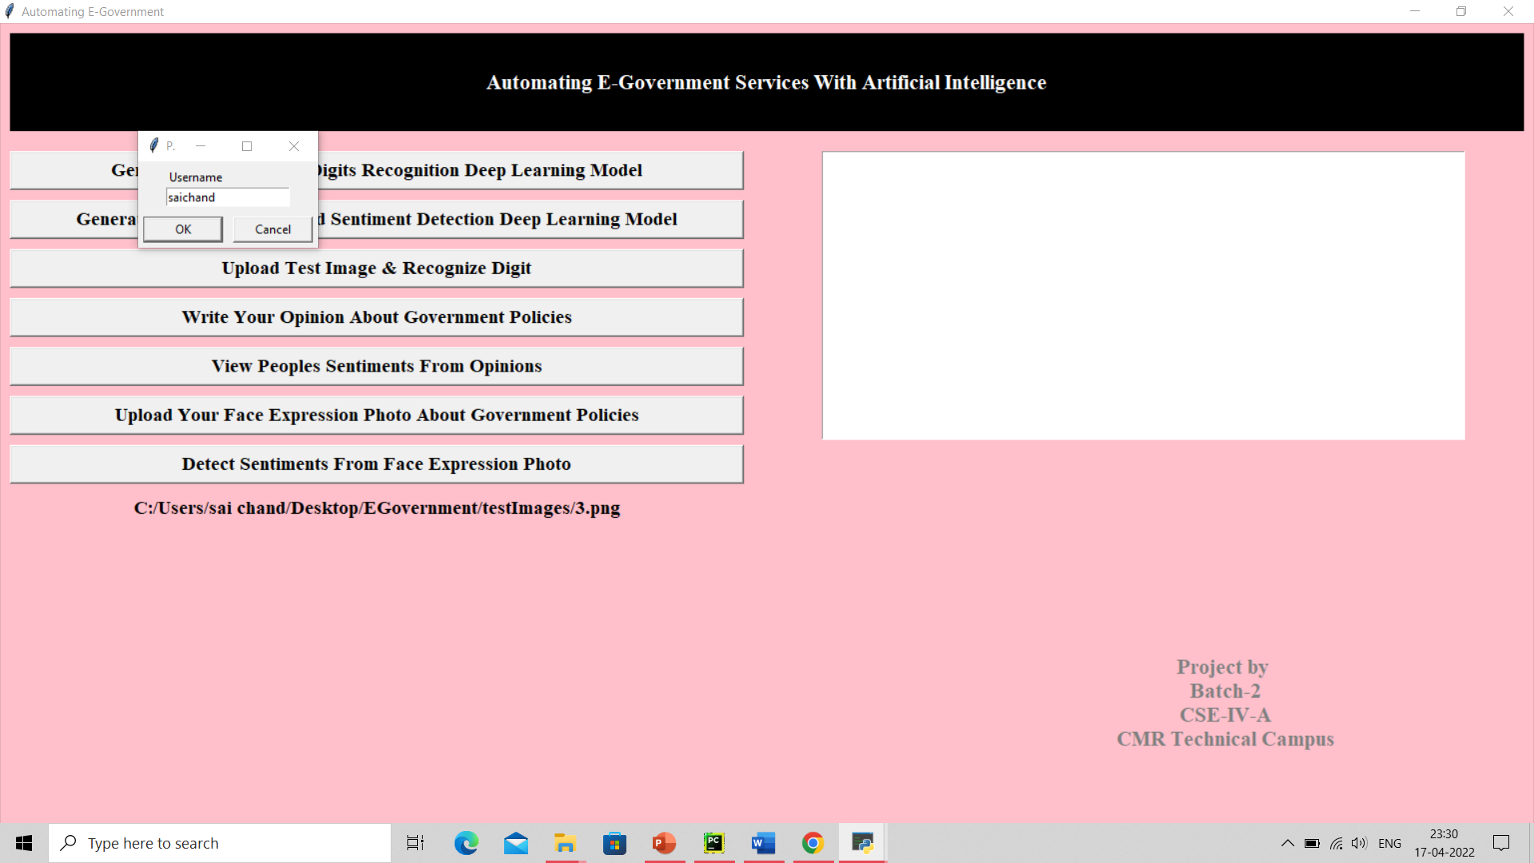
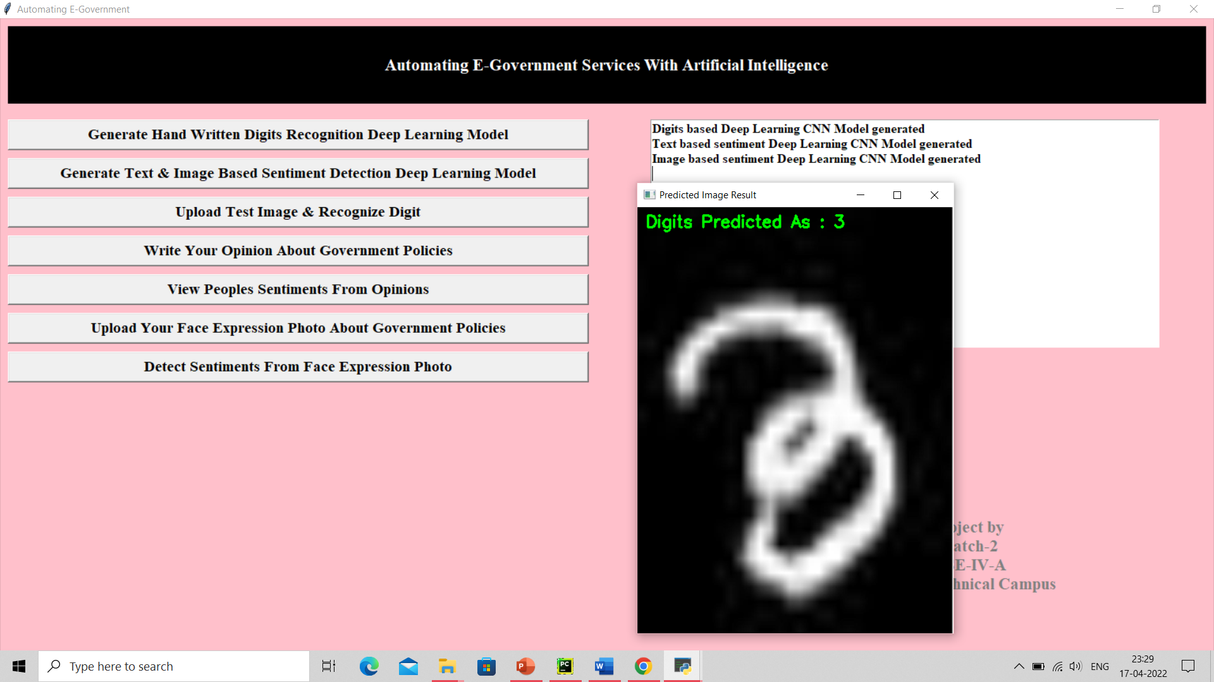
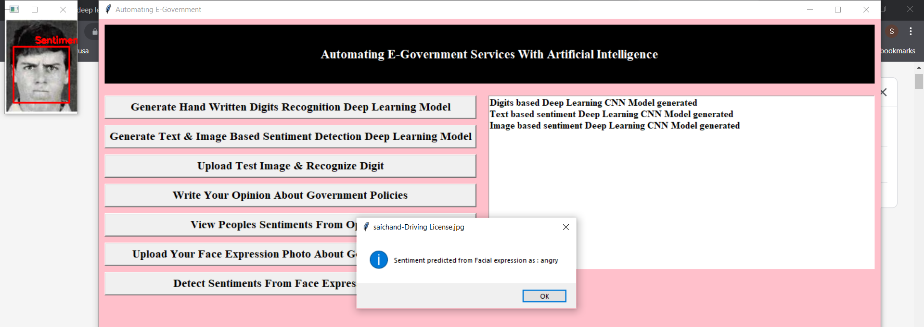

Slide 25
Conclusion
The overall goal of this project is to introduce new frameworks and platform to integrate recent advances in AI techniques in the e-government systems and services to improve the overall trust, transparency, and efficiency of e-government.

Slide 26
FUTURE ENHANCEMENT
1. No man power is required.
2. Feedbacks improve the performance of policies.

Slide 27
REFERENCES
[1] K. He, X. Zhang, S. Ren, and J. Sun, ‘‘Deep residual learning for image recognition,’’ in
Proc. IEEE Conf. Comput. Vis. Pattern Recognit., Jun. 2016, pp. 770–778.
[2] Y.-D. Zhang, Y. Zhang, X.-X. Hou, H. Chen, and S.-H. Wang, ‘‘Sevenlayer deep neural
network based on sparse autoencoder for voxelwise detection of cerebral microbleed,’’
Multimedia Tools Appl., vol. 77, no. 9, pp. 10521–10538, May 2018.
[3] S. Venugopalan, H. Xu, J. Donahue, M. Rohrbach, R. Mooney, and K. Saenko,
‘‘Translating videos to natural language using deep recurrent neural networks,’’ 2014,
arXiv:1412.4729. [Online]. Available: https://arxiv.org/abs/1412.4729

Slide 28
THANK YOU

