Slide 1
Amazon Data Rating Review Analysis and Predicting

Slide 2
Abstract
Sentiment analysis is one of the fastest spreading research areas in computer science, making it challenging to keep track of all the activities in the area.
. We present a customer feedback reviews on product, where we utilize opinion mining, text mining and sentiments, which has affected the surrounded world by changing their opinion on a specific product.
Data used in this study are online product reviews collected from http://Amazon.com. We performed a comparative sentiment analysis of retrieved reviews.
Amazon data with collection of review text, product details, rating and review are taken as input. In the first step data analysis is performed from data based and graphical representation of each product, category, count, comparison is shown (rating, label vs rating, label vs product category, rating vs product category, verified purchases after analysis part is done.
Testing training and prediction of rating from given review is performed in this process text processing, feature vectorization, feature extraction from text, cross validation, splitting data and training classifier steps are performed using machine learning and then algorithm (linear SVC algorithm) is applied to the review text and classifier is generated.

Slide 3
Problem statement
Sentiment analysis is one of the fastest spreading research areas in computer science, making it challenging to keep track of all the activities in the area. For effective analysis of online product purchase fast way of data analysis is required.

Slide 4
Existing System
Conventionally, sentiment analysis has been about opinion contradiction, i.e., whether someone has positive, neutral, or negative opinion towards something.
Auto detection of text and giving rating for given product was not performed in existing system

Slide 5
Disadvantages
Opinion mining and positive and negative analysis was only done
Automatic prediction of rating from review with various analysis reports was not performed in existing system

Slide 6
Proposed system
Machine learning techniques are used for preprocessing, vectorizing, classifier and features are extracted from dataset and prediction is performed for given review and accuracy of model is calculated.

Slide 7
Advantages
Various data analysis factors are covered for product analysis.
Automatic rating calculation is done using machine learning classifier.

Slide 8
Modules
Dataset Collection:
In this module amazon dataset is collected from Kaggle website and features and labels are extracted from the dataset.
Preprocessing:
In this module data is divided to features and labels and converted to required format using vectorizer.
Data Analysis:
Data analysis is performed to show graphs on various factors of data.

Slide 9
Testing Training:
Data is divided in to testing and training with 80 -20 percent ratio and divided as train data and test data. Train data is used for model training test for accuracy calculation.
Algorithm Model training:
Initialize algorithm fit train features and labels to algortim and create model.
Prediction:
Prediction is performed based on reviews and rating is predicted.

Slide 10
S/W & H/W requirements
System : intel core i3.
Hard Disk : 500 GB.
Monitor : 15 VGA Color.
Mouse : Logitech.
RAM : 2 GB.

Slide 11
Operating system : Windows XP/7/10
Coding Language : python
Development environment : anaconda , Jupiter
Dataset : Amazon review rating dataset
IDE : Jupiter notebook

Slide 13
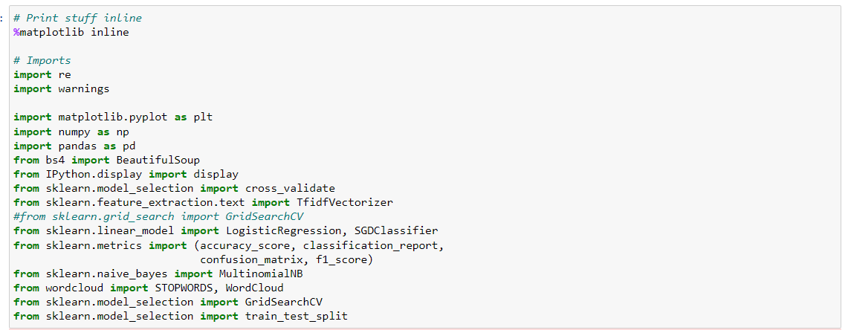
Import Libraries

Slide 14
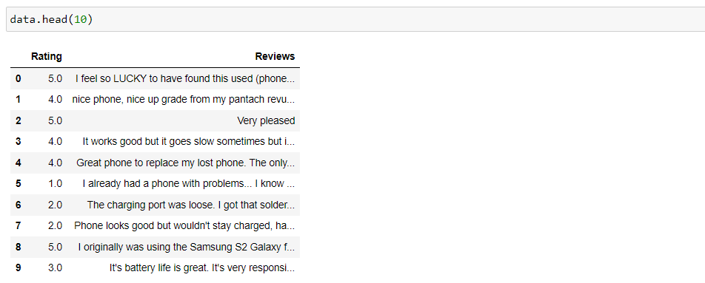
View Features and Labels

Slide 15
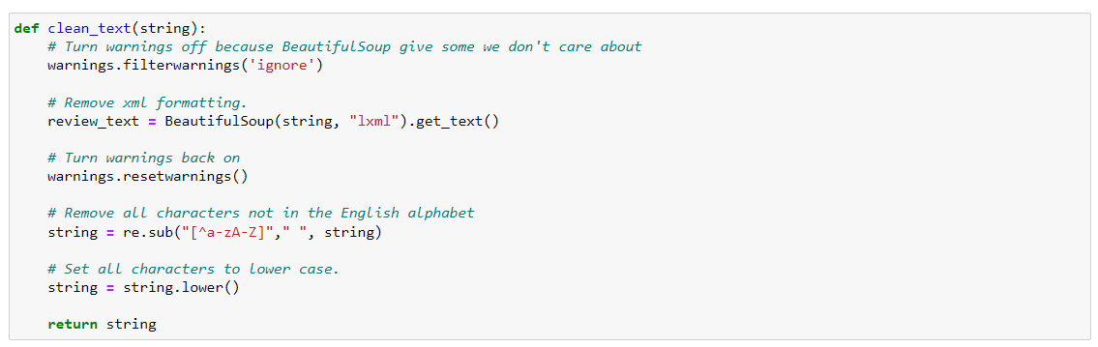
Implementation/ preprocessing

Slide 16
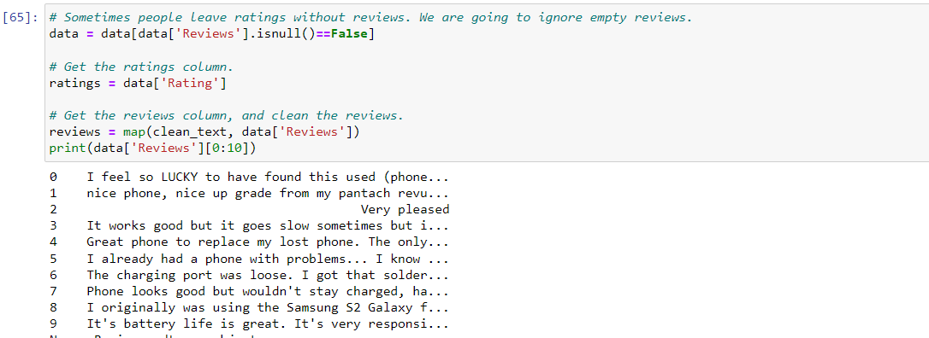
Preprocessed Data

Slide 17
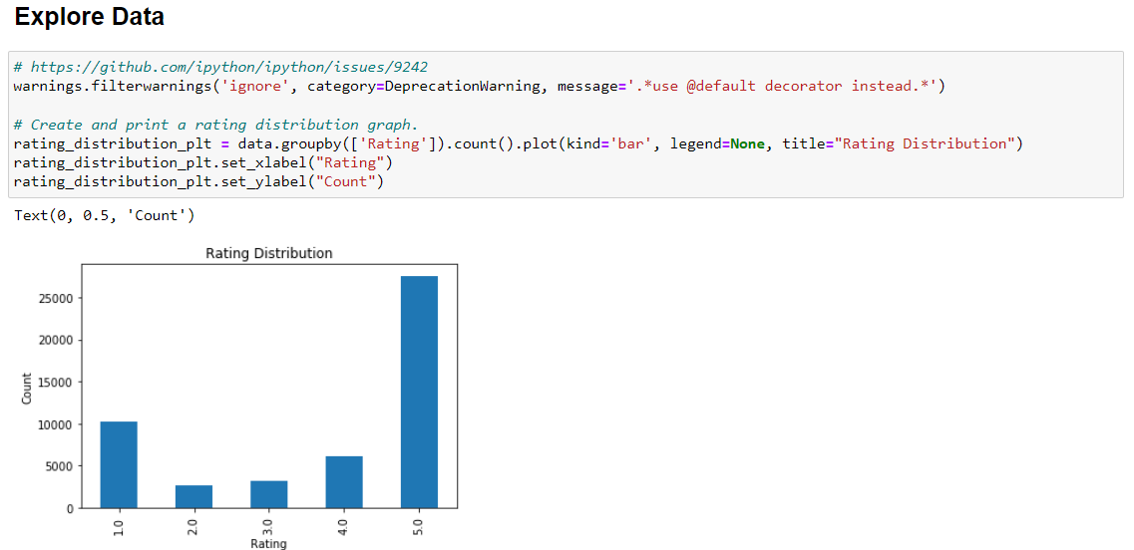
Explore Data

Slide 18
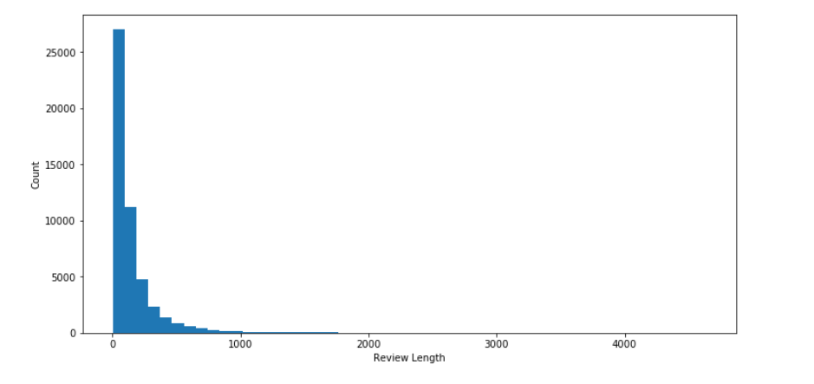
Distribution Graph

Slide 19
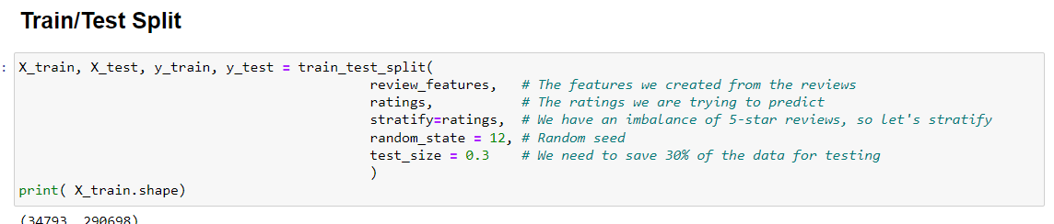
Train/Test Split

Slide 20
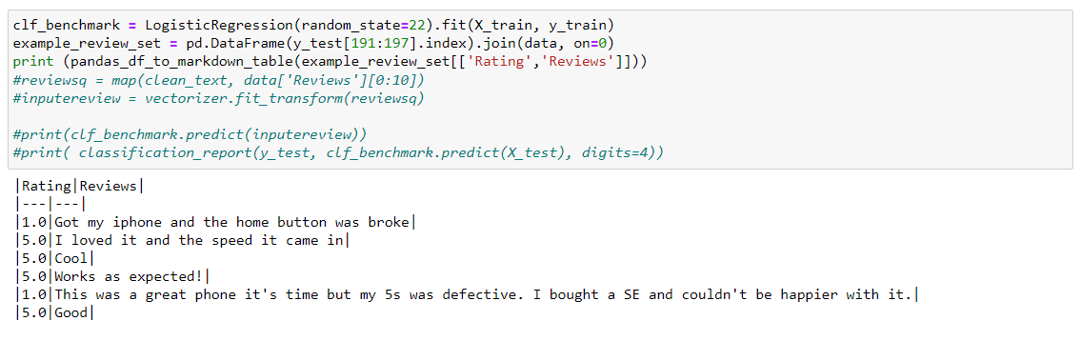
Model Training

