Slide 1

Capstone Project (Facial Emotion Recognition)
Project done by
Veena Gindo

Slide 2
Contents
Introduction
Problem Statement
Dataset Used
Data Preprocessing
Model Building and Evaluation
Hyper Parameter Tuning
Metrics Used
Inference
Future Improvements
Conclusion

Slide 3
Introduction
Facial Emotion Recognition (FER) is an emerging technology at the forefront of artificial intelligence and computer vision, designed to interpret human emotions through facial expressions. In the context of customer service, FER can play a transformative role by enabling systems to recognize and respond to customers' emotional states in real time.
The primary goal of this project is to develop a system that can accurately identify and classify facial expressions into predefined emotional categories such as happiness, sadness, anger, surprise, fear, neutral and disgust. Leveraging deep learning models and powerful image processing tools, this project aims to enhance the understanding of non-verbal communication by interpreting subtle facial cues.

Slide 4
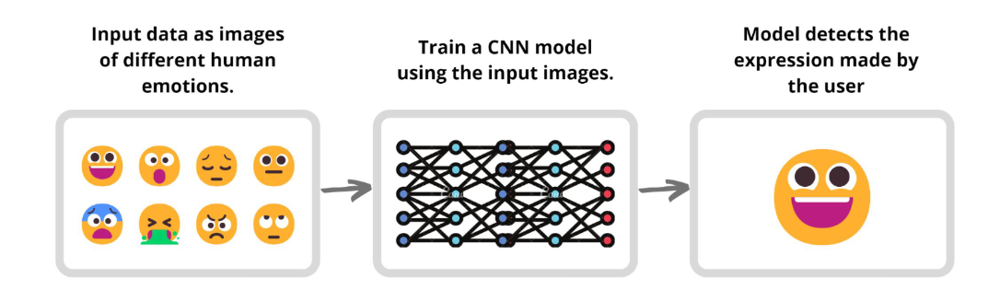
Problem Statement
A challenging problem in retail industry is understanding customer emotions for enhancing service quality and customer satisfaction.
Traditional systems lack the ability to interpret emotional cues, limiting their ability to respond effectively to customer needs.
This project aims to develop a Facial Emotion Recognition system that identifies customer emotions in real time to enable more personalized and empathetic retail interactions. Thus bridging the emotional gap between businesses and customers.

Slide 5
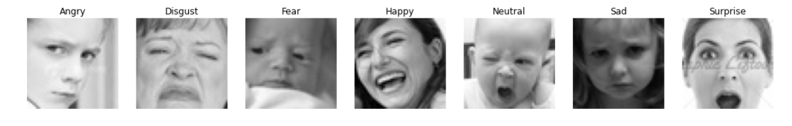
Dataset Used
I have utilized the FER 2013 dataset provided in Kaggle.
The data consists of 48x48 pixel grayscale images of faces. The faces have been automatically registered so that the face is more or less centred and occupies about the same amount of space in each image.
The training set consists of 28,709 examples and the validation set consists of 7163 examples. The test set consists of varying pixel size of 45 examples.

Slide 6
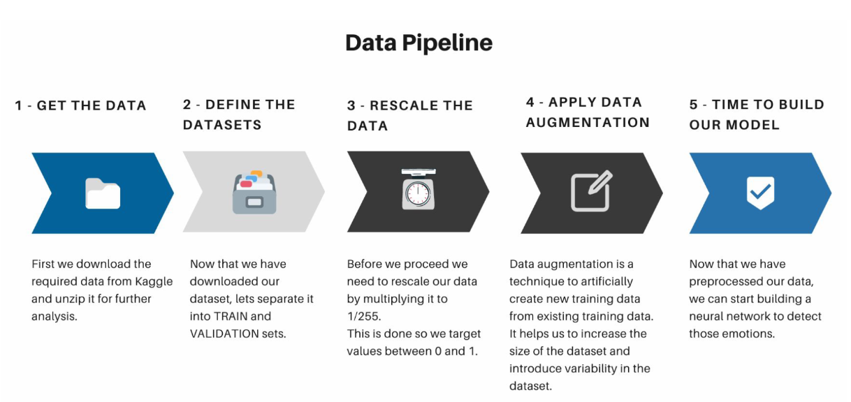
Data Preprocessing

Slide 7
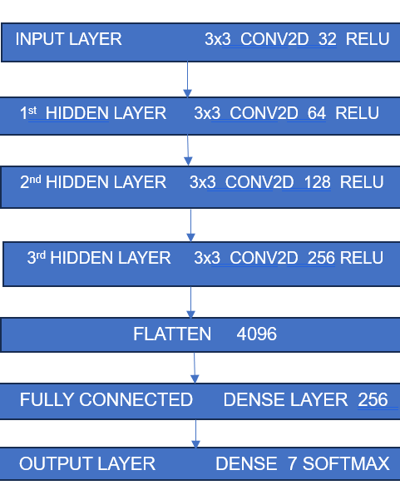
Model Building and Evaluation
Used Convolutional Neural Network (CNN) using Tensorflow libraries and Keras for building the model.
The neural network contained an input layer, three hidden layers and a fully connected layer to process the images and predict the emotions.
In between each layer a max pooling layer and dropout layer is added for downsampling the data and prevent our model from overfitting. Also used Early stopping to prevent overfitting and wasting resources during trials

Slide 8
Hyper Parameter Tuning
Hyperparameter tuning is the process of finding the best values for a learning algorithm's hyperparameters to optimize model performance.
I have used Optuna , a software framework for automating the optimization process of hyperparameter tuning
Best Hyper Parameters after 20 Optuna Study Trials
dense_units: 192
dropout_rate: 0.10504893311227131
learning_rate: 0.00044000050917227527
batch_size: 32

Slide 9
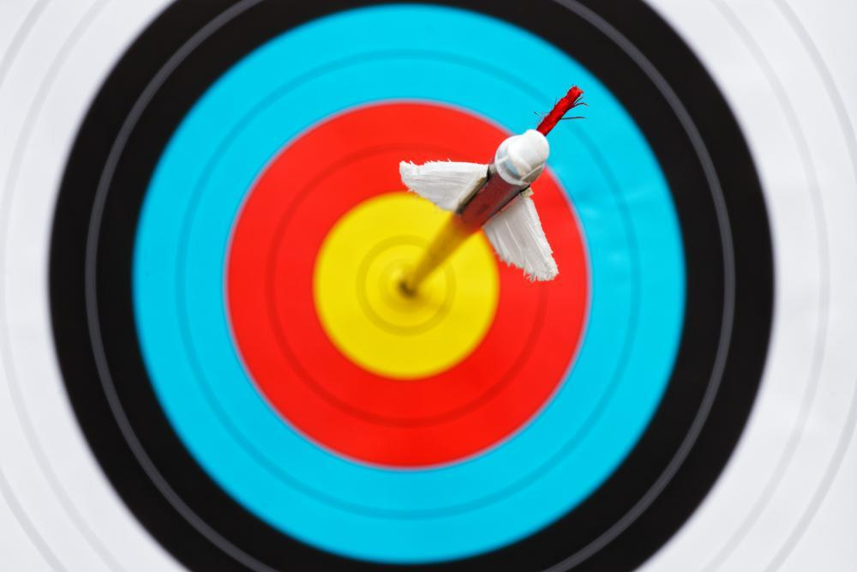
Metrics Used – Accuracy
Base Model
Training Accuracy: 63.2%
Validation Accuracy: 60.59%
Test Accuracy: 67%
Hyper Parameter Tuned Model
Training Accuracy: 62.37%
Validation Accuracy: 60.03%
Test Accuracy: 76%

Slide 10
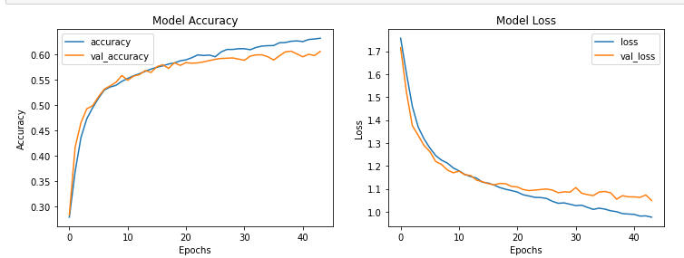
Plots of Accuracy and Loss
The model ran for almost 50 epochs, although it stopped at 44th epoch because of the early stopping callback with patience as 5.
Training accuracy : 63.2%
Validation Accuracy: 60.59%
Training Loss: 0.9766
Validation Loss: 1.0491

Slide 11
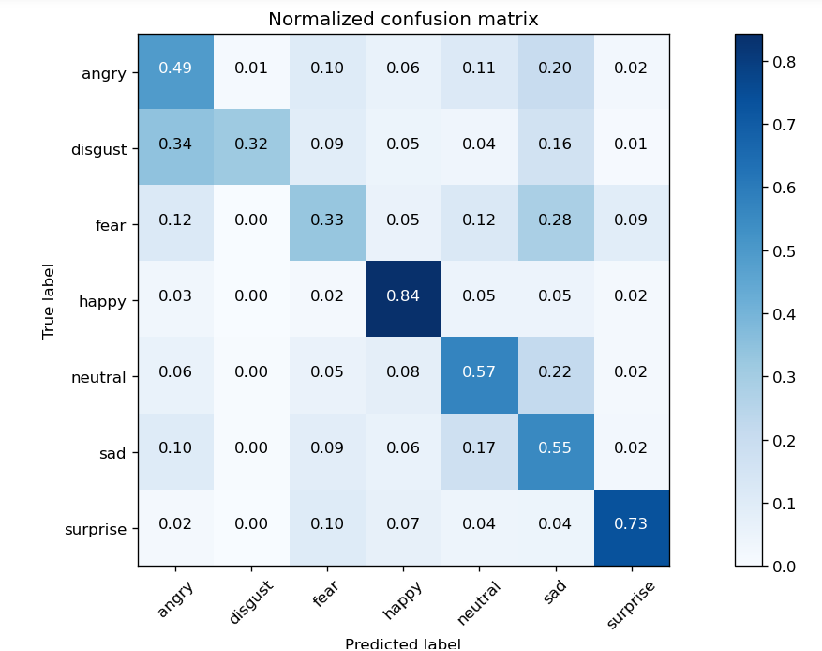
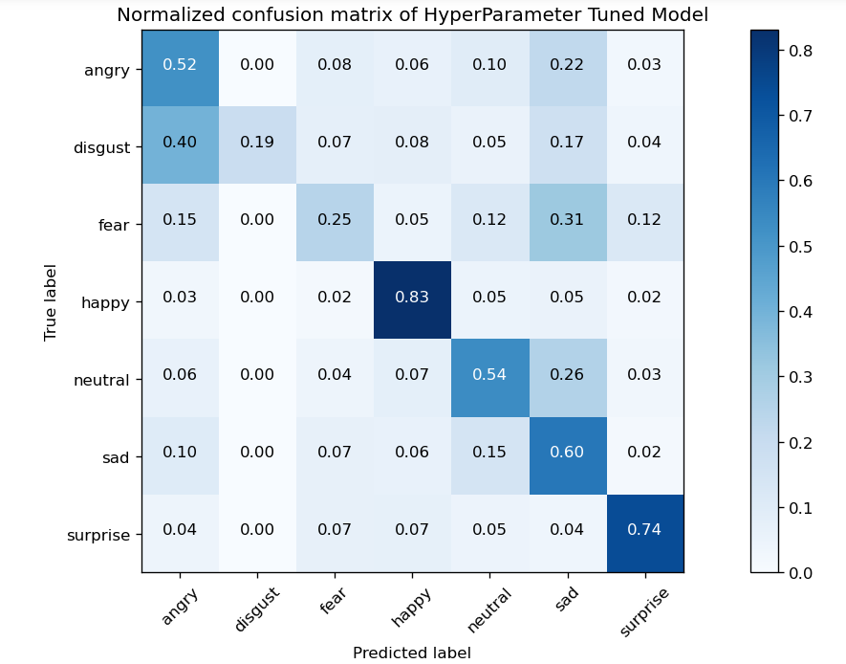
Metrics Used – Confusion Metrics
Base Model
HyperParameter Tuned Model

Slide 12
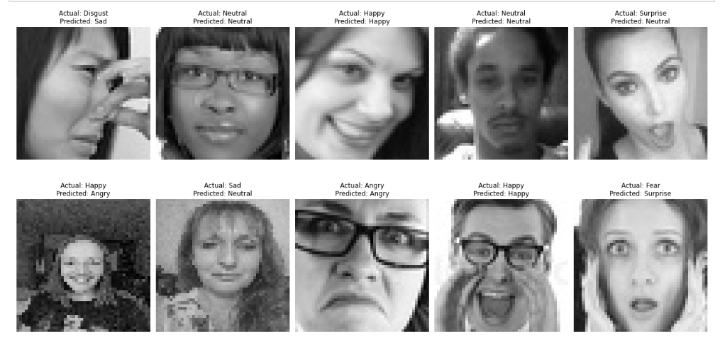
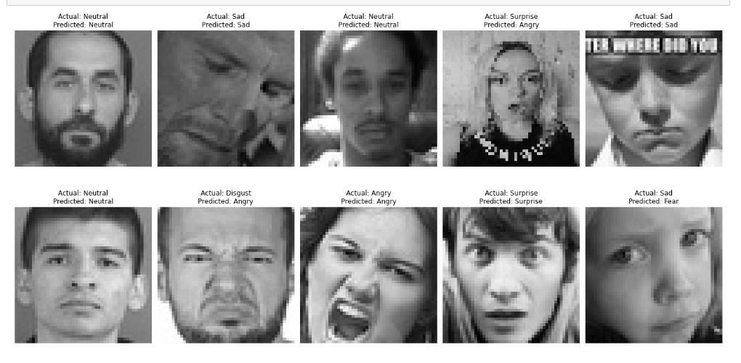
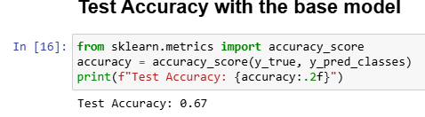
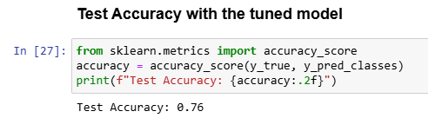
Inference
Base Model
Accuracy – 67%
Hyper Parameter tuned Model
Accuracy – 76%

Slide 13
Future Improvements
Transfer Learning: Leverage pretrained models like EfficientNet, ResNet50, or MobileNetV2 to improve feature extraction and training speed.
Attention Mechanisms Use Squeeze-and-Excitation (SE) blocks or self-attention to focus on important facial regions like eyes and mouth.
Model Ensembling Combine multiple models (e.g., CNN + Transformer or CNN + SVM) and average their predictions to improve robustness and accuracy.
Real-time Deployment Integrate with OpenCV for real-time emotion detection in live camera feeds.

Slide 14
Conclusion
This project explores the FER 2013 dataset provided by Kaggle
Successfully achieved our objective and created a model capable of recognizing seven different classes of emotions mentioned in the dataset.
The code and the model weights and the images of all the metrics are available in the below github link.
https://github.com/VeenaGindo/AI-ML/tree/main/FacialEmotionRecognition

