Slide 1

Facial Emotion Recognition Capstone Project
Presented by
Veena Gindo

Slide 2
Contents
Introduction
Problem Statement
Dataset Used
Data Preprocessing
Model Building and Evaluation
Hyper Parameter Tuning
Metrics Used
Inference
Future Improvements
Conclusion

Slide 3
Introduction
Facial Emotion Recognition (FER)
Interpret human emotions through facial expressions.
Enables system to recognize and respond to customers' emotional states in real time.
Project Goal
Develop a system to accurately classify facial expressions.
Predefined emotional categories : happiness, sadness, anger, surprise, fear, neutral and disgust.
Utilize deep learning and image processing

Slide 4
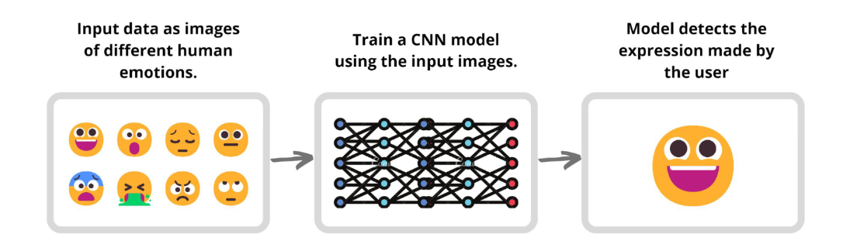
Problem Statement
Challenge in the Market Research and Advertising: Understanding customer emotions.
Analysing consumer reactions to advertisements, products, or services.
Project Aim:
Develop a real-time Facial Emotion Recognition system.
Enable personalized and empathetic retail interactions.
Understand the influence of emotions in purchasing decisions.

Slide 5
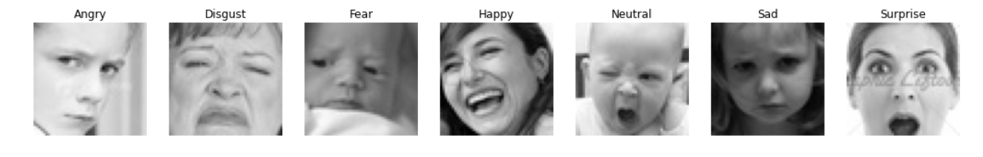
Dataset Used
FER 2013 dataset from Kaggle.
Image Characteristics:
48x48 pixel grayscale images of faces.
Faces are centered and occupy similar space in each image.
Dataset Split:
Training set: 28,709 examples.
Validation set: 7,163 examples.
Test set: 45 examples (varying pixel size).

Slide 6
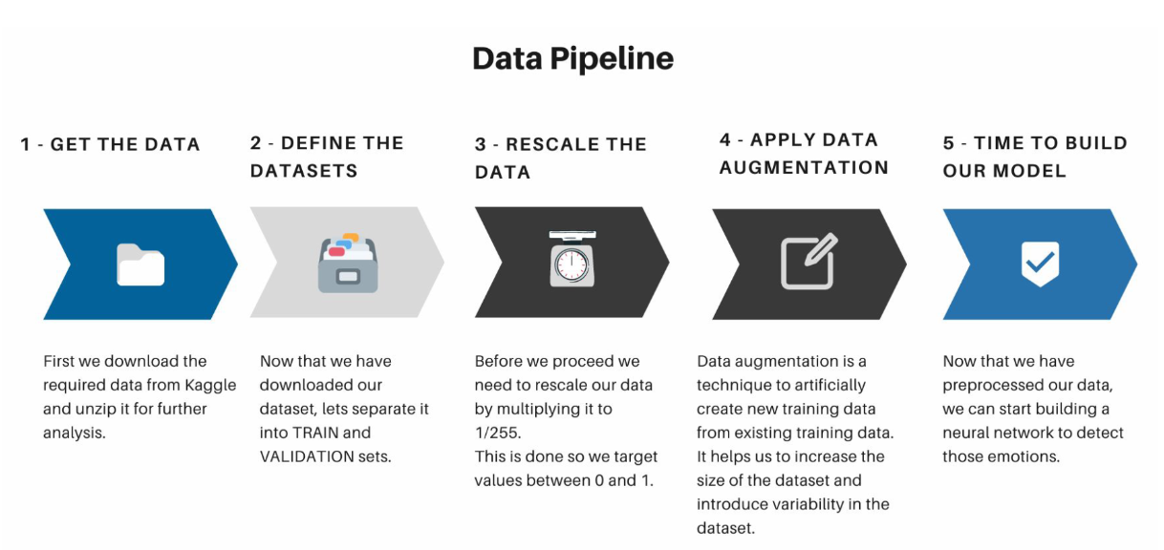
Data Preprocessing

Slide 7
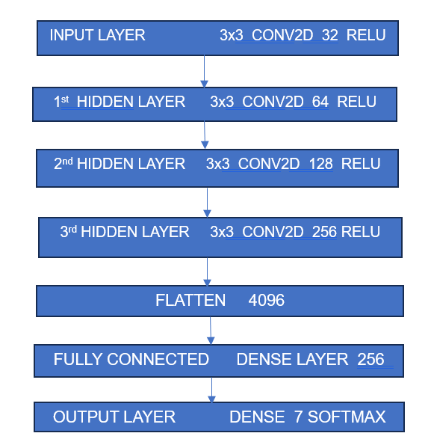
Model Building
Convolutional Neural Network (CNN)
using TensorFlow and Keras
Techniques to improve performance:
Max pooling (down sampling).
Dropout layers (prevent overfitting).
Early stopping (prevent overfitting,
conserve resources).

Slide 8
Hyper Parameter Tuning
Optimizing model performance by finding the best hyperparameter values.
Tool used : Optuna
A software framework for automating the hyperparameter optimization
Best Hyper Parameters (after 20 Optuna Study Trials):
dense_units: 192
dropout_rate: 0.10504893311227131
learning_rate: 0.00044000050917227527
batch_size: 32

Slide 9

Metrics Used – Accuracy
Base Model
Training Accuracy: 63.2%
Validation Accuracy: 60.59%
Test Accuracy: 67%
Hyperparameter Tuned Model:
Training Accuracy: 62.37%
Validation Accuracy: 60.03%
Test Accuracy: 76%

Slide 10
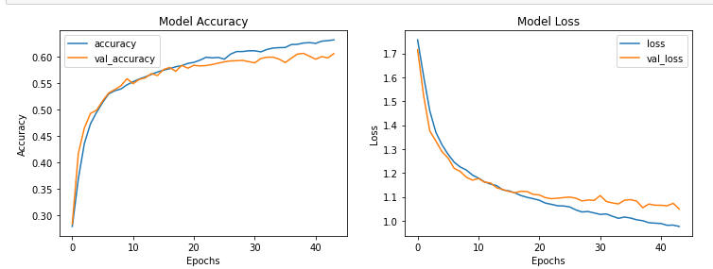
Plots of Accuracy and Loss
Model ran for approx. 50 epochs
Early Stopping at the 44th epoch (patience =5)
Training accuracy : 63.2%
Validation Accuracy: 60.59%
Training Loss: 0.9766
Validation Loss: 1.0491

Slide 11
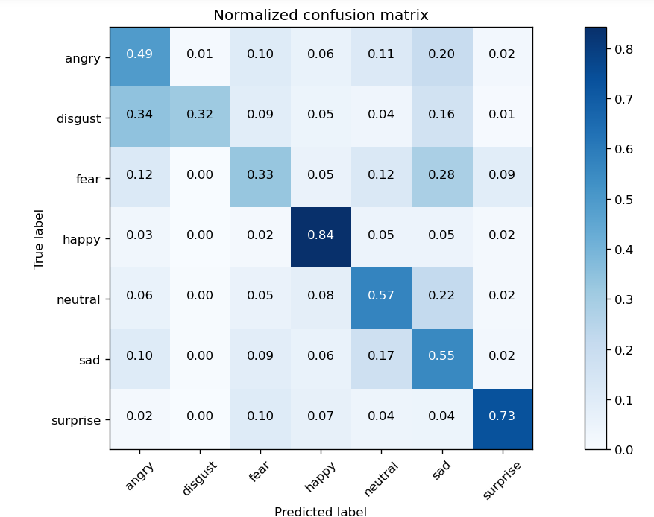
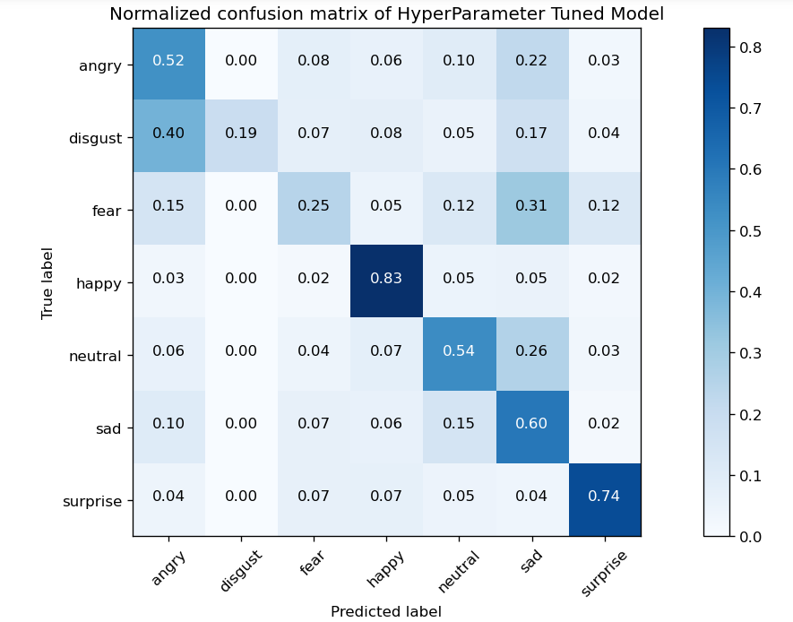
Metrics Used – Confusion Metrics
Base Model
Hyper Parameter Tuned Model

Slide 12
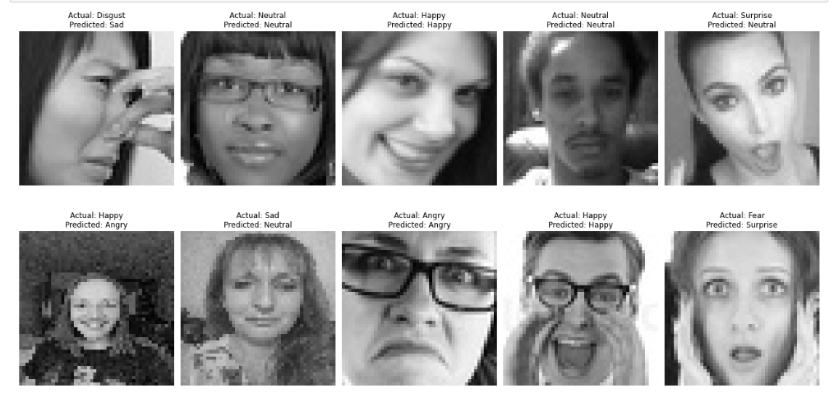
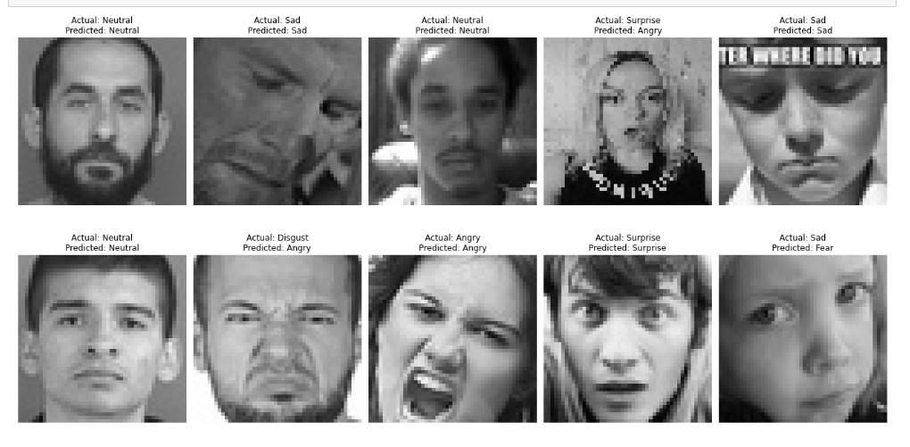
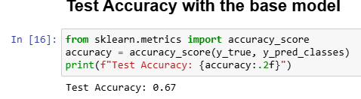
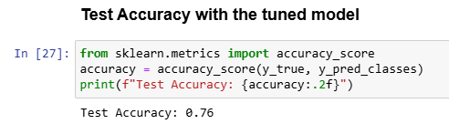
Inference
Base Model
Accuracy – 67%
Hyper Parameter tuned Model
Accuracy – 76%

Slide 13
Future Improvements
Transfer Learning:
Leverage pre-trained models (EfficientNet, ResNet50, MobileNetV2).
Attention Mechanisms:
Use Squeeze-and-Excitation (SE) blocks or self-attention.
Focus on important facial regions (eyes, mouth).
Model Ensembling:
Combine multiple models (e.g., CNN + Transformer, CNN + SVM).
Average predictions for increased robustness and accuracy.
Real-time Deployment:
Integrate with OpenCV.
Enable real-time emotion detection from live camera feeds.

Slide 14
Conclusion
Project utilized the FER 2013 dataset from Kaggle.
Successfully developed a model to recognize seven emotion classes.
Code, model weights, and metric visualizations are available on GitHub:
https://github.com/VeenaGindo/AI-ML/tree/main/FacialEmotionRecognition

Slide 15
thank YOU

