Slide 1

Presented by Team 8 Amogh Doijode Ravi Kiran Veena Iyer

Slide 2
Opening Statements

Slide 3
AWS
Launched in 2006 used by majority of companies around the world Book Title
Dominates cloud computing domain with almost 40% of market share
Provides a wide range of services covering a wide range of domains

Slide 4
Azure
Launched in 2010 used by almost 80% of Fortune 500 companies in the world
Provides services to more regions than any other cloud service in the market
More than 100 services available covering a wide variety of domains

Slide 5
Current Market Stats

Slide 6
Performance
AWS - covers 40% of market share which indicates that most organizations’ clear interest in using AWS. AWS is #1 because of years of experience & trust created among users
Azure - covers 30% of market share indicating they are not far behind & more than 80% of fortune 500 companies trust Azure

Slide 7
Pricing
Azure Pricing includes:
1. Reserved instances, which can save you money on a one to three-year contract.
2. Hybrid implementation, which can save you up to 40% if you are running software on-premise while still using cloud services.
3. Developer Pricing for testing or DevOps can bring down the Azure pricing even further, especially if you’re using Visual Studio.
4. Microsoft Enterprise Agreements are for large organizations that negotiate equally large discounts.

Slide 8
Pricing
AWS Pricing includes:
1. On-demand pricing, which is a standard cost structure with no discounts. It’s like the window sticker MSRP on a car.
2. Spot pricing can be applied if you don’t care where your processing is happening. If you have data that needs processes with no deadline, Amazon will run it wherever or whenever it fits.
3. Reserved Instances offer discounts for contracts.
4. Dedicated Hosts are applied if you’ve already paid licensing fees. You can save a little money sometimes when using something other than an on-demand server.

Slide 9
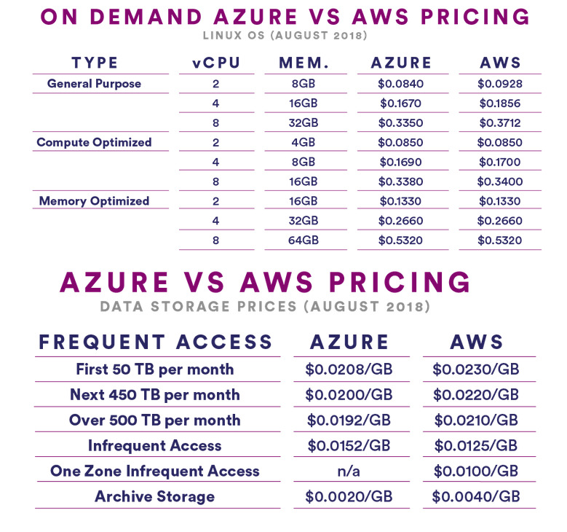
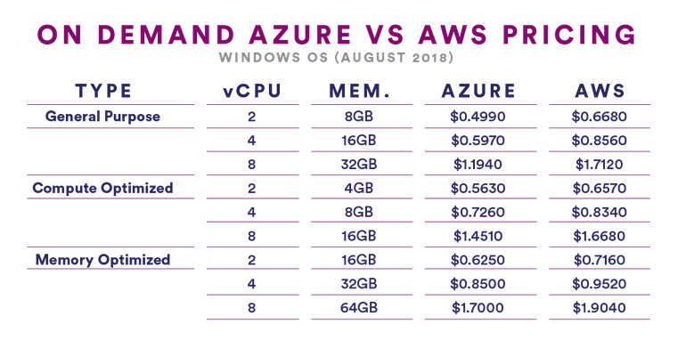

Slide 10
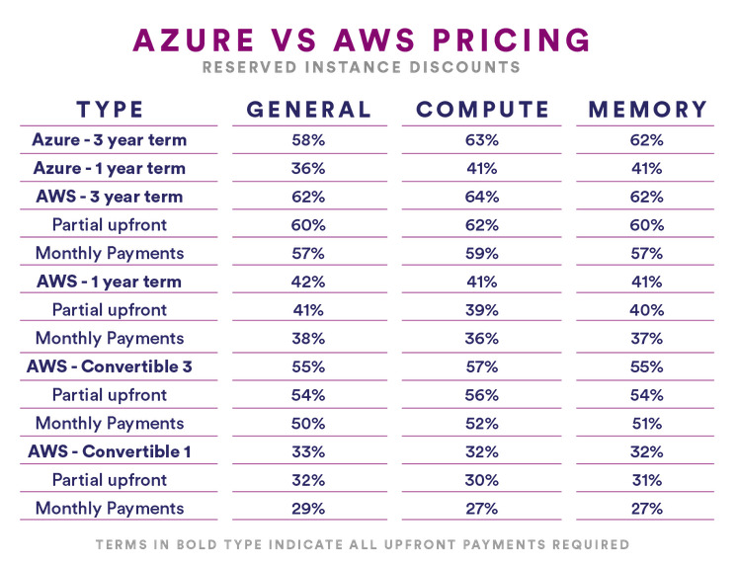

Slide 11
Free Tier
AWS - The services under Free Tier fall under 2 categories Always Free >20 services offered viz. Amazon SNS, SQS, Cloudwatch Valid for a year ~20 services offered viz. Amazon S3, EC2, ElastiCache etc
Azure- Has 2 categories as well Always Free 25+ services offered viz. App Service, Functions, Container Service, Active Directory etc Valid for a year 8 services offered viz. Linux/Windows virtual machines, Blob storage, SQL Database etc

Slide 12
Largest Instance
The largest instance offered by AWS 256 GB RAM + 16 vCPUs
The largest instance offered by Azure 224 GB RAM + 16 vCPUs

Slide 13
Feature-Feature Mapping
 | Microsoft Azure | Amazon Web Services (AWS)
Compute Services | Virtual Machines (VMs) Cloud Services Azure Websites and Apps Azure Visual Studio Online | Elastic Compute Cloud (EC2) Amazon Elastic Beanstalk None
Scaling Options | Azure Autoscale (how to) | Auto Scaling
Government Services | Azure Government | AWS GovCloud
Storage Options | Azure Storage (Blobs, Tables, Queues, Files) | Amazon Simple Storage (S3)
Block Storage | Azure Blob Storage | Amazon Elastic Block Storage (EBS)
Block Storage | Azure Blob Storage | Amazon Elastic Block Storage (EBS)
Database Options | Azure SQL Database | Amazon Relational Database Service
NoSQL Database Options | Azure DocumentDB | Amazon Dynamo DB

Slide 14
Feature-Feature Mapping
 | Microsoft Azure | Amazon Web Services (AWS)
Networking Options | Azure Virtual Network | Amazon VPC
Load Balancing | Load Balancing for Azure | Elastic Load Balancing
Administration & Security | Azure Active Directory | AWS Directory Service AWS Identity and Access Management (IAM)
Monitoring | Azure Monitor | Cloudwatch
Monitoring | Event Grid | Amazon Simple Notification Service
Other Services & Integrations | Azure Functions | AWS Lambda

Slide 15
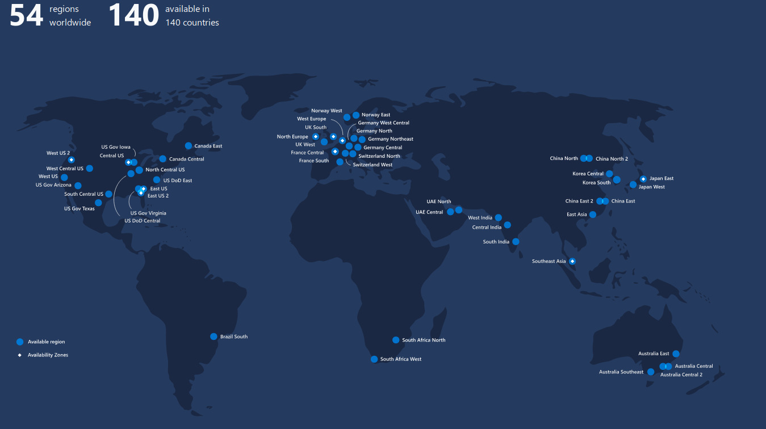
Azure Global Infrastructure

Slide 16
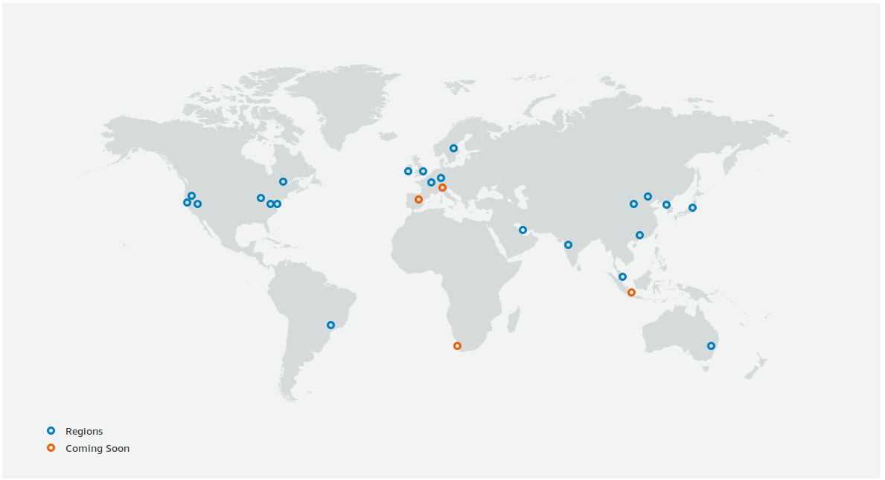
AWS Global Infrastructure

Slide 17

Summary
Vendor | Pros | Cons
AWS | • Dominant market position • Extensive, mature offerings • Support for large organizations • Extensive training • Global reach | • Difficult to use • Cost management • Overwhelming options
Microsoft Azure | •Second largest provider • Integration with Microsoft tools and software • Broad feature set • Hybrid cloud • Support for open source | •Issues with documentation • Incomplete management tooling

Slide 18
Azure Differentiators
Individual subnet name for firewall resource and Azure VPN gateway
IAM roles - To create custom roles organization needs Azure AD Premium P1 or P2
Email needs sign up to SendGrid Solutions and select a plan
The Azure VPN gateway takes 30 - 60 mins for creation via terraform

Slide 19
Thank You

