Slide 1
Donation Donate and save lives

Slide 2
Motivation:
There are many things left at our house unused. These things may not be useful for us but for others they mean a lot.
There are many people who may be deprived of many things which are useful for them
So, we decided to create a platform where we can donate things online and make use of them efficiently
Any one can donate their things by registering.
They can get the donated things through the portal.

Slide 3
Donation includes
Food
Clothes
Accessories
Furniture

Slide 4
Deliverables
We have created a web application work for donar slide where desired donated items list and quantities need to be mentioned. We also asked for the donar details
We have created a static web application for client side consisting the requested item list and quantities.

Slide 5
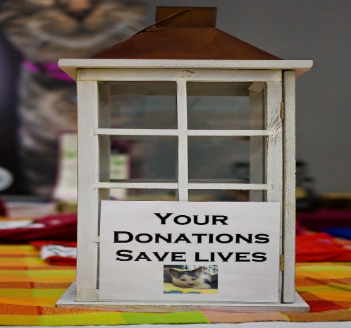
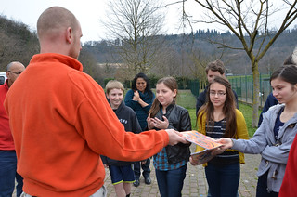

Our Model
DONAR
Website
Client/Receiver

Slide 6
Conclusion:
We have created a static websites which has donor details and the items they have decided to donate their quantity.
Later on with client site the clients are requested for the required items and their quantity is taken into considerations.

Slide 7
THANK YOU

