Slide 1
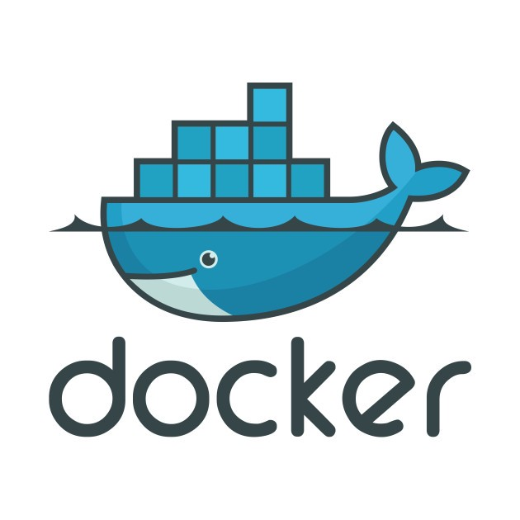
Docker Images
VEENA M

Slide 2
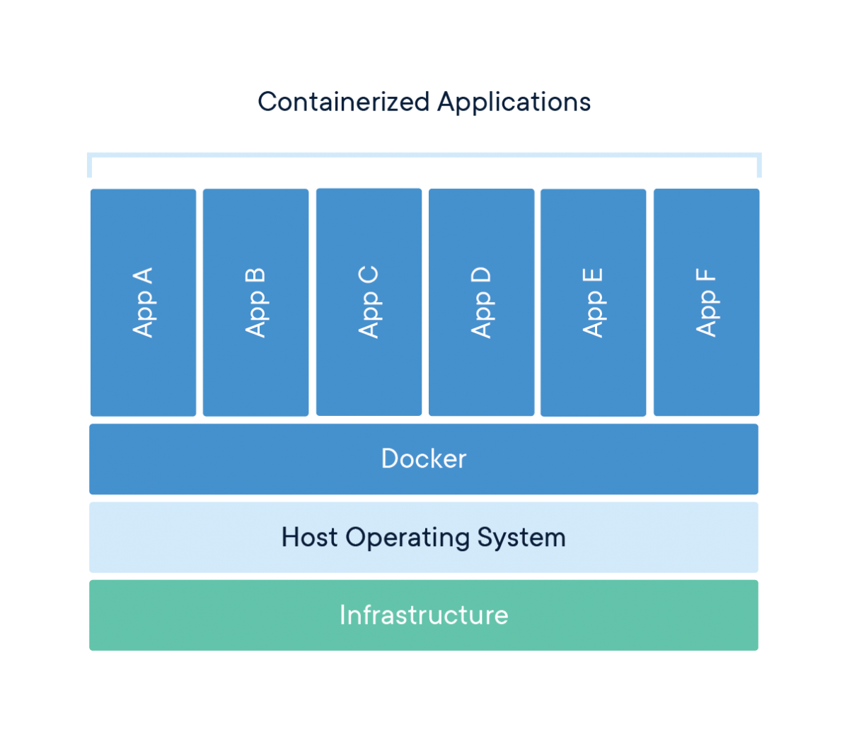

What is a Docker Images and how to use it?
Docker Image can be compared to a template which is used to create Docker Containers. They are the building blocks of a Docker Container. These Docker Images are created using the build command. These Read only templates are used for creating containers by using the run command.
Staging Server
Container
Docker File
Docker Image
Docker Hub
Project Code
Docker Container
Production Server
Virtual Machine
Container

Slide 3
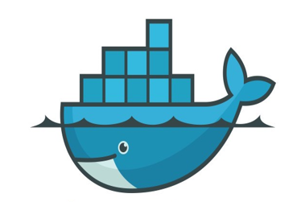
How to create Containers?
Docker files are used to build a Docker Image & that image will also contain all the project codes. The Same Docker image can be used to spin ‘n’ no of containers, each with modifications to the underlying Image. The final Image can then be uploaded to Docker Hub & shared with other collaboration for testing/deployment.
Create a Dockerfile on your Workstation
Github repo to build
Select the project from your Github repo on Docker Host to build
Git push
Push the Dockerfile to Github
Staging Server
Triggers build
Run a Container from the image on your Workstation
Pull Image
Docker Images gets ready for the pull
Image Created
Build starts in Docker Daemon

Slide 4




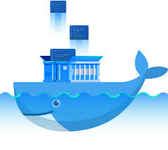
How to Build Docker Images? – Using Predefined Images
Docker images are the base of containers. Whenever you provision or launch a container, Docker will search for the image locally on your Docker host and try to use them. In case the image is not found locally then it will download images from Docker public registry.
Docker container images can be built in three ways, 1. Commit 2. Dockerfile 3. Compose
Staging Server
Build Image
Push Image
Pull Image
Docker Registry/ Hub

Slide 5
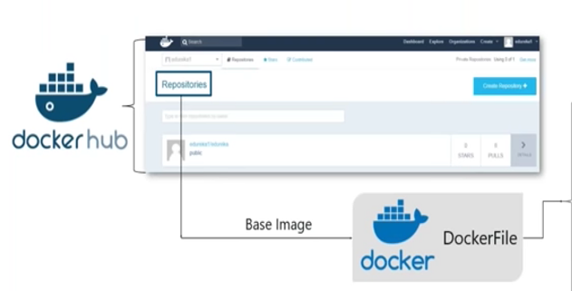
How to Build Docker Images? – Using DockerFile
Dockerfile is a script, composed of various commands (instructions) and arguments listed successively to automatically perform actions on a base image in order to create (or form) a new one.
Staging Server
RUN
ENV
FROM
EXPOSE
MAINTAINER
USER
ADD
VOLUME
CMD
WORKDIR
ENTRYPOINT

Slide 6
DockerFile Syntax
Dockerfile Syntax consists of two kind of main line blocks: comments and commands + arguments
Syntax:
Example:
# Print “Welcome to HCL!” RUN echo “Welcome to HCL!”
# Line blocks used for commenting command argument argument1 …

Slide 7
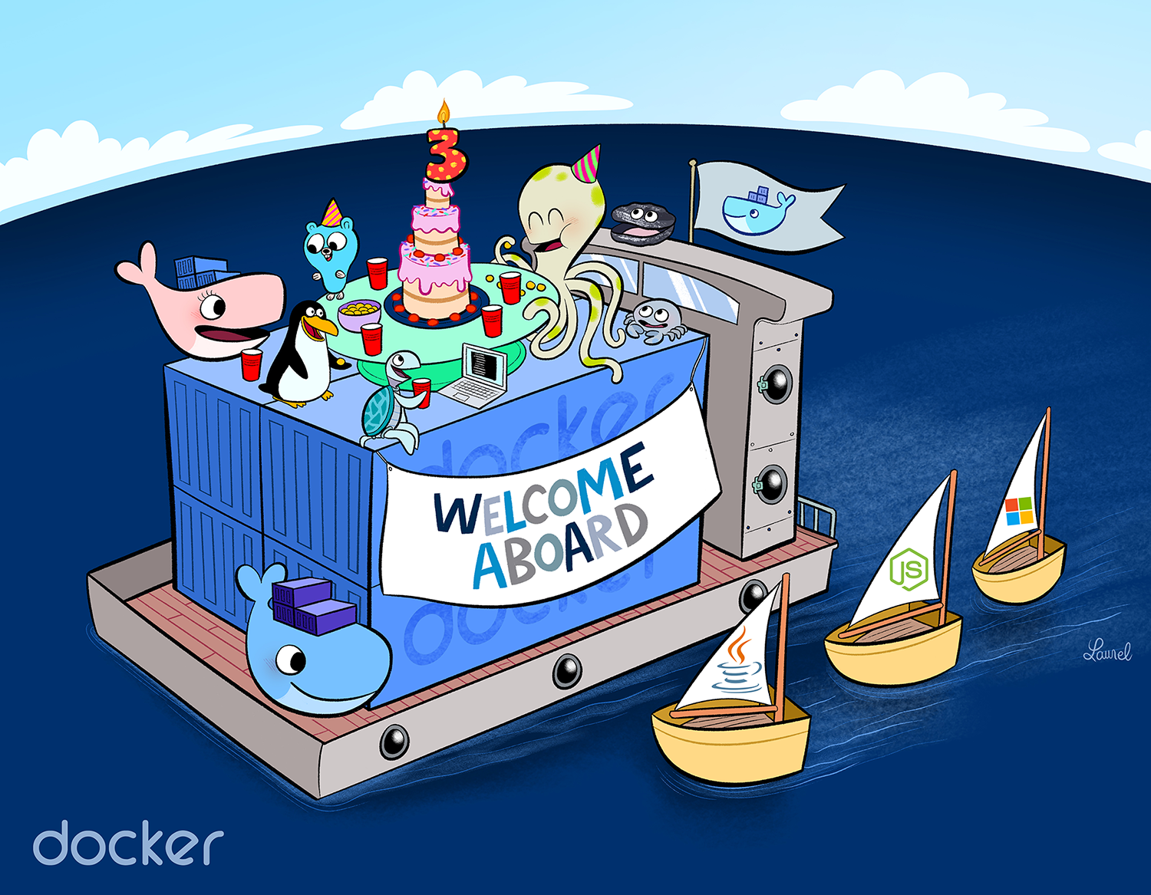
DockerFile Commands - FROM
FROM
FROM directive is probably the most crucial amongst all others for Dockerfiles, It defines the base image to use to start the build process.
Example:
# Usage: FROM [image name] FROM ubuntu

Slide 8
DockerFile COMMANDS:
The RUN commands is the central executing directive for Docketfiles. It takes a command as its arguments and runs it to form the image. Unlike CMD is actually is used to build the image.
RUN
CMD
The Command CMD similar to RUN, can be used for executing a specific system command. However, unlike RUN it is executed during build, but when a container is instantiated using the image being built.
ENTRYPOINT
ENTRYPOINT arguments sets the concrete default application that is used every time a container is created using the image.
ADD
The ADD command gets two arguments a source and a destination. It basically copies the file from the source on the host into the container’s own filesystem at the set destination.

Slide 9
DockerFile COMMANDS:
The ENV command is used to set environment variables. These variables consists of “key value” pairs which can be accessed within the container by scripts and applications alike
ENV
WORKDIR
The WORKDIR directive is used to set where the command defined with CMD is to be executed.
EXPOSE
The EXPOSE command is used to associate a specified port to enable networking between the running process inside the container and the outside world( Docker Host)
MAINTAINER
The MAINTAINER command is a not-executing command declares the author. It should come nonetheless after FROM command.
USER
The USER directive is used to set the UID (or username) which is to run the container based on the image being built.

Slide 10
Building Docker Images using Docker Commit
Image
Docker run
Running Container
New Image
Stopped Container
Docker commit

Slide 11
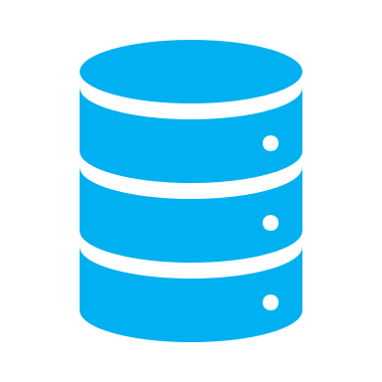
Docker – Volumes:
Volumes are the preferred mechanism for persisting data generated and used by the containers.
Volumes are used for:
Decoupling containers from storage
Sharing data/storage among other containers
Attach volume to a container
On deletion of container, volume is not deleted unless explicitly deleted.
Docker Host Server
Docker Container
Volume

Slide 12
Docker Volumes Command:
To create or list or delete volumes, use command:
$ docker volume create <volume-name> → To create a new volume.
$ docker volume is → To list all created volumes on docker host.
$ docker volume inspect <volume-name> → To get complete information about a volume.
$ docker volume rm <volume-name> → To delete a volume.
$ docker volume prune → To delete all unused volumes in a docker host.
To create or list or delete volumes, use command:
$ docker run –v <volume-name>:<container_path> <image_name>

Slide 13
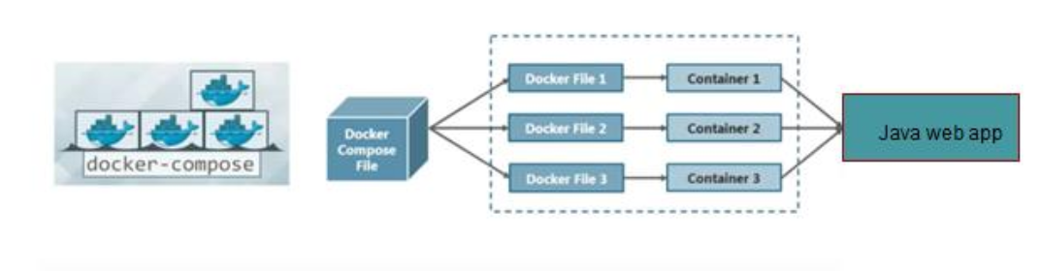
Docker – Compose:
Docker Compose is tool used to run multi-container application .
Each container will run a stand-alone application and it can communicate with other containers present in the same host.
Example- Sprint boot application – using web component and database component.

Slide 14
Docker – Compose:
Using Docker Compose is a 3-step process
Define your app’s environment with a Dockerfile, so it can reproduce anywhere.
Define the services that make up your app in a docker-compose, so they can run together in any isolated environment.
Run Docker Compose up and compose starts and run the entire application.
Features
The Features of Compose that make it effective are:
Multiple isolated environments on a single host.
Preserve volume data when container are created.
Only recreate containers that have changed.
Variables and moving a composition between environments.

Slide 15


