Slide 1
PADS Tutorial
Hands On Exercise

Slide 2
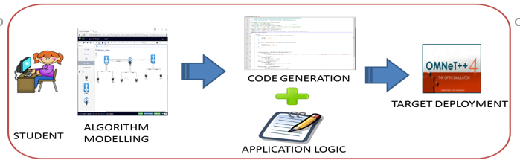
Exercise 1

Slide 3
Publish Subscribe Pattern
Broker
Publisher
Subscriber
Publisher
Subscriber
Publisher
Subscriber
Publisher
Subscriber

Slide 4
Mininet Emulator
“Mininet is a network emulator which creates a network of virtual hosts, switches, controllers, and links. Mininet hosts run standard Linux network software, and its switches support OpenFlow for highly flexible custom routing and Software-Defined Networking” Source -http://mininet.org/overview/

Slide 5
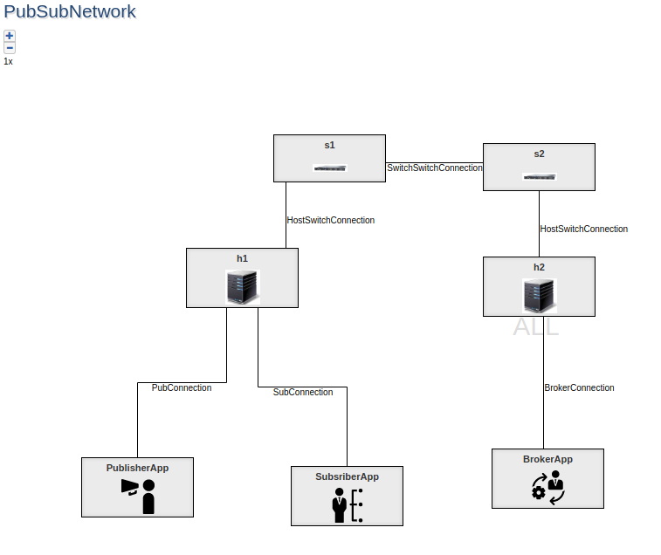
Exercise 1 - Topology

Slide 6

Exercise 2

Slide 7
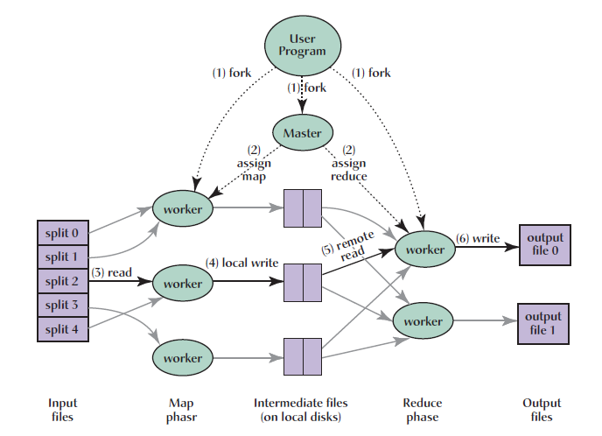
MapReduce Computing

Slide 8
Motivation
Significant computational power needed to process very large amounts of data
e.g., processing web logs, computing inverted indices, etc
Sequential processing could not scale => need for parallelization and distributed processing
However, many challenges exist
writing distributed, parallelized code is hard for developers
Handling failures in the context of parallelized computations is even harder
Load balancing, data distribution, etc are other challenges
Need for a programming model and library that will somehow magically automate all of these complex issues while allowing a developer to focus on the business logic.

Slide 9
MapReduce: Basics
A new abstraction to express the simple computations while hiding all the complex issues
Based on the functional primitives of “Map” and “Reduce” found in Lisp and other functional programming languages
Functional primitives are better suited for parallelization
User does not need to know anything about parallelizing the code
Just take the function and apply it in parallel to the data sets
In fact, a library can do this parallelizing activity; user just supplies the map and reduce functions, and the data sets

Slide 10
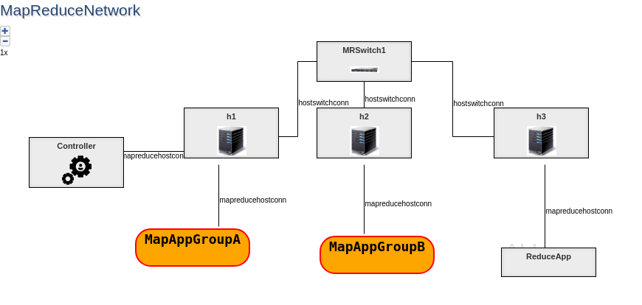

Slide 11
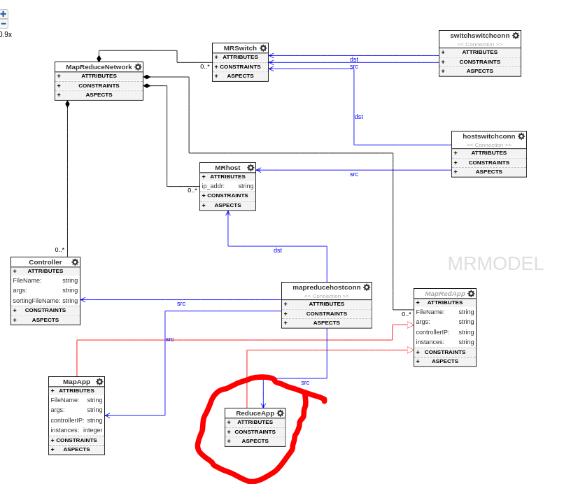

Slide 12
backup

Slide 13
Execution Overview (1/7)
User invokes MapReduce call submitting the request to the master
Master will split up the input data into M pieces
Figure is taken from the paper on MapReduce by Dean and Ghemawat

Slide 14
Execution Overview (2/7)
Master identifies idle workers and assigns the map tasks to these idle workers
There will be a total of M such tasks started
Figure is taken from the paper on MapReduce by Dean and Ghemawat

Slide 15
Execution Overview (3/7)
A worker who was assigned the map task will read the data from the partition that was sent to it
The worker extracts the input key and its value from the split and passes it to the user-supplied map function
Generated pairs of <intermediate key, value> are buffered in memory
Figure is taken from the paper on MapReduce by Dean and Ghemawat

Slide 16
Execution Overview (4/7)
Periodically the buffered memory is dumped into a local disk on the machine where the worker is executing
The location of this disk is conveyed to the master (so it can later use it for the Reduce phase)
Worker tells the master it is “done” with the map task
Figure is taken from the paper on MapReduce by Dean and Ghemawat

Slide 17
Execution Overview (5/7)
Master now identifies idle workers to whom it can assign Reduce tasks (total of R such tasks) passing it the location of local disk of the Map worker
Each Reduce worker makes a remote procedure call to pull the data from the local disk
After all the data is read, the worker will sort the intermediate keys so their values are grouped
Sorting is needed because a reduce worker may be handling multiple intermediate keys (recall R << M)
Figure is taken from the paper on MapReduce by Dean and Ghemawat

Slide 18
Execution Overview (6/7)
The worker now invokes the Reduce function for each intermediate key and the list of grouped values
Generated output of the Reduce is sent to some global storage
The Worker sends a “done” message to the Master
Figure is taken from the paper on MapReduce by Dean and Ghemawat

Slide 19
Execution Overview (7/7)
When all Map and Reduce tasks are completed, the Master unblocks the user program and passes back the desired results
Figure is taken from the paper on MapReduce by Dean and Ghemawat

