Slide 1
PADS – Applying Model Driven Engineering Techniques for Distributed Systems Algorithms Learning Toolkit
By
Yogesh D. Barve, Anirban Bhattacharjee and Aniruddha Gokhale
Dept of EECS, Vanderbilt University, Nashville, TN 37212, USA

Slide 2
Tutorial Structure
Motivation
PADS Introduction
WebGME Introduction
Hands On Activity:
Exercise 1: Student Role: Pub/Sub Model
Exercise 2: Instructor Role: MapReduce Model

Slide 3
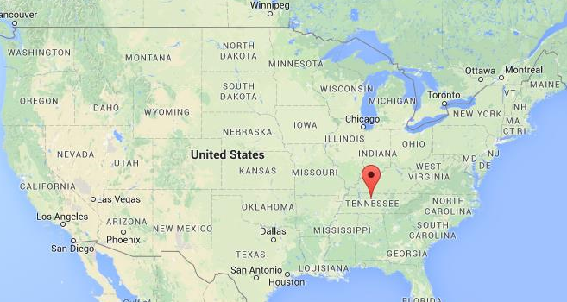
Vanderbilt Univ, Nashville, Tennessee

Slide 4


Nashville City & Vanderbilt University
Nashville facts
Capital city of TN
Music city, USA
Athens of the south
Several recording studios
Healthcare and healthcare IT
Banks of Cumberland river
City pop: 660,388; Metro area pop: 1,830,345
Vanderbilt University facts
Private university
Undergraduates: 6,871
Graduate students: 5,716
Total faculty: 4,315
Total staff: 4,195
Connected to Medical center
Ranked top 14 for undergraduate education

Slide 5
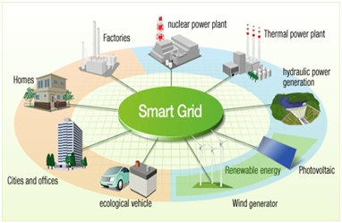
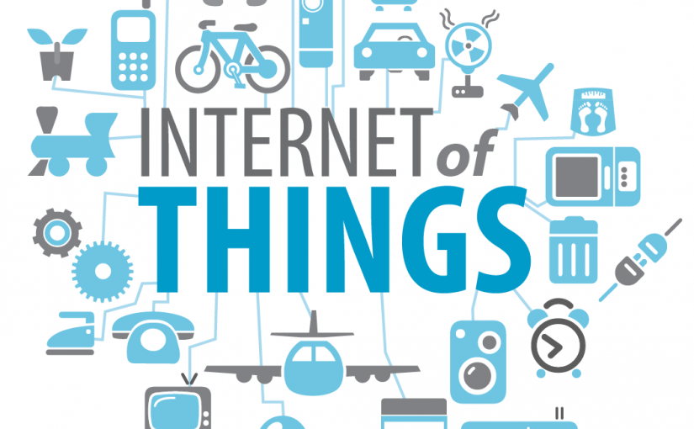
Distributed Systems
Computer systems are inherently distributed
Data centers or clusters or grid or cloud
Mobiles or ad-hoc networks
Also many of the real-world systems are distributed
Intelligent transportation systems
Industry manufacturing automation
Military systems
IoT (smartcity, smarthome etc.)
Many applications are distributed
Multiplayer games
Collaborative software
Notes:
Learning of these technologies is key to a successful operation of Distributed Systems.

Slide 6
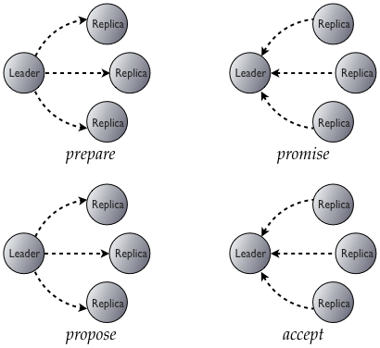
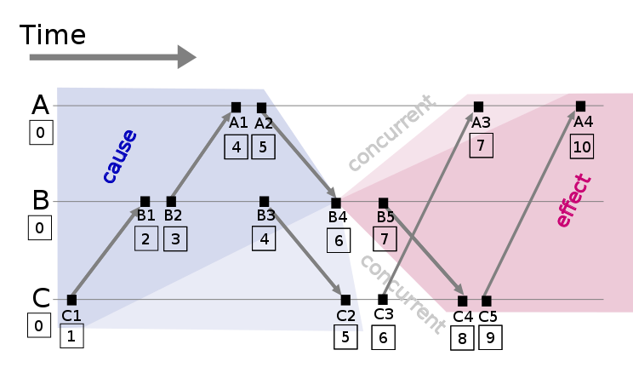
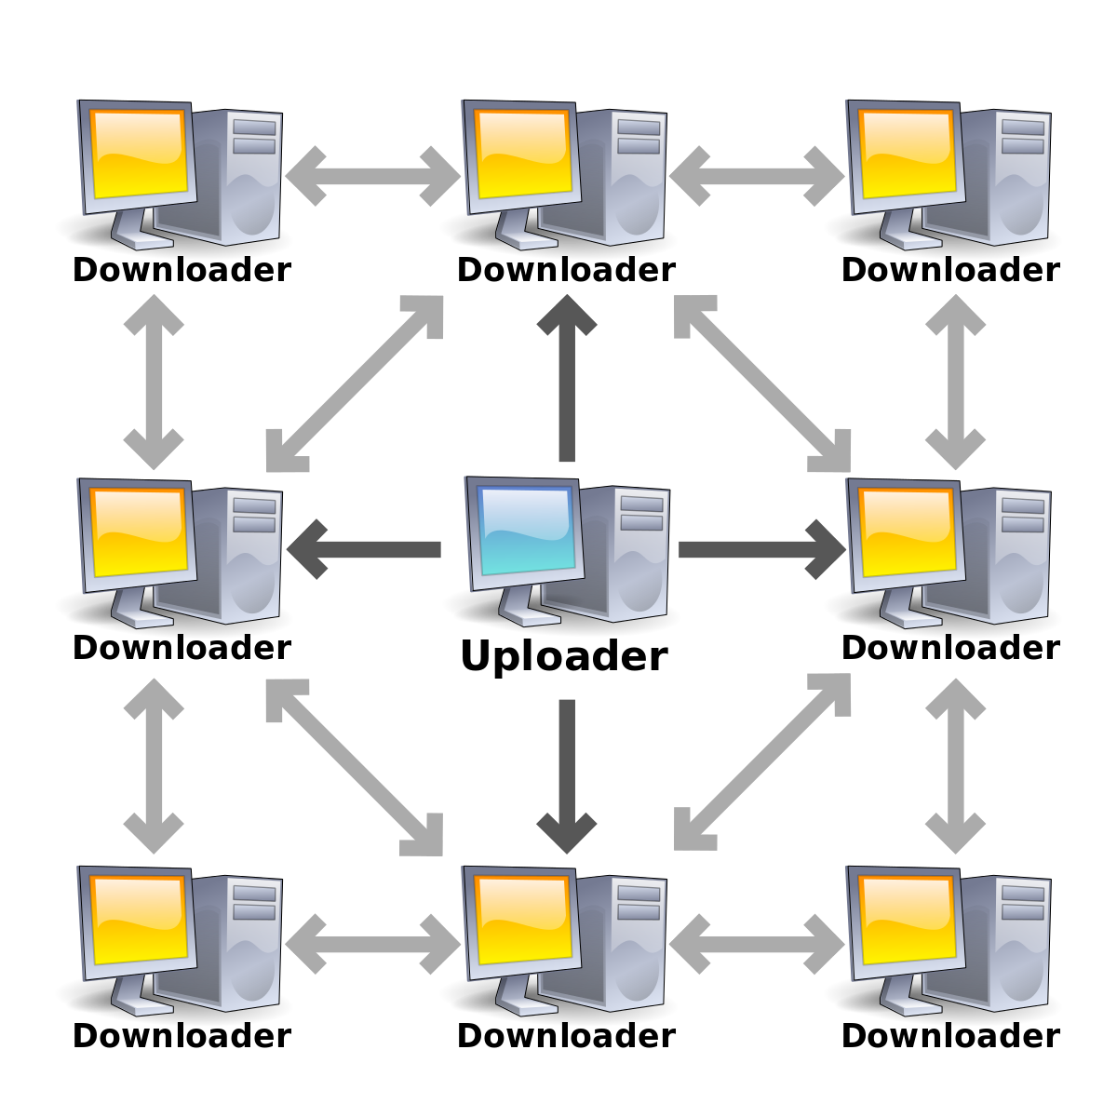
Distributed Algorithms
Distributed algorithms are very important for managing such systems especially for
Leader election
Deadlock avoidance
Fault management (replica or state synchronization)
Time Synchronization
Consensus
Distributed database management
Transactional systems(CAP, ACID)
Notes:
Learning of these technologies is key to a successful operation of Distributed Systems.

Slide 7
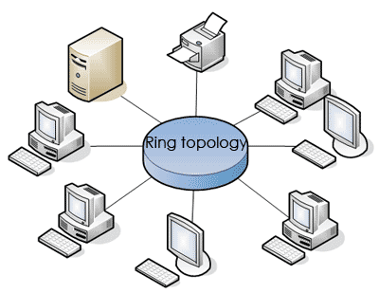
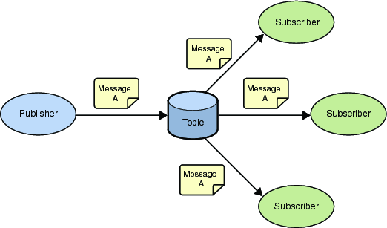
Complexities in Distributed Systems and Algorithms
There is a large degree of heterogeneity
network topology (ring, star, mesh etc.),
node types (fixed vs mobile nodes, static vs dynamic nodes, physical vs virtual nodes),
communication types (client-server, peer-to-peer, publish-subscribe etc.),
network types (Ethernet, WiFi, Satellite).
These design considerations and heterogeneity make the algorithms for distributed systems very complex

Slide 8
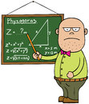
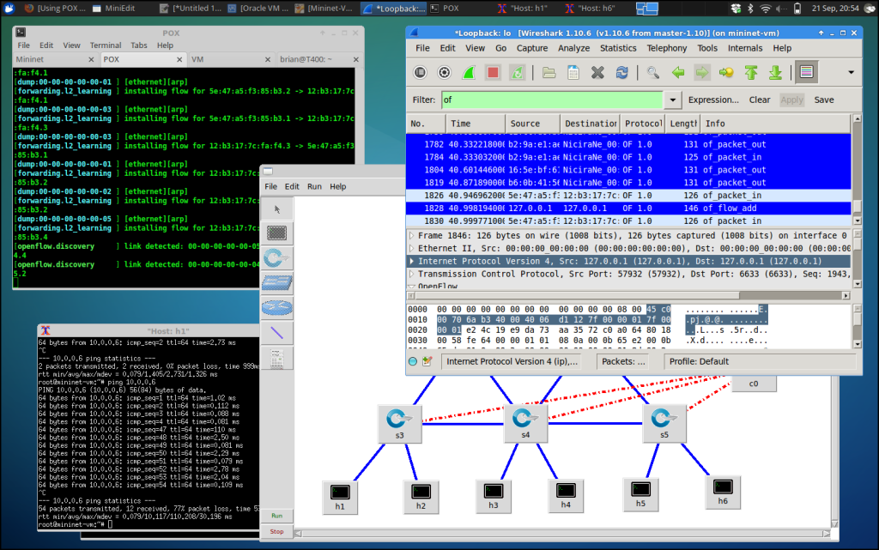
Teaching and Learning Distributed Algorithms
The general method in universities to teach distributed algorithms is
Teach it to students theoretically on paper
Ask students to implement it from scratch, run their implementation on a simulator or on an actual hardware
Ask students to optimize or modify or enhance or adapt the given algorithm for a related (or for a more complex) problem scenario.

Slide 9

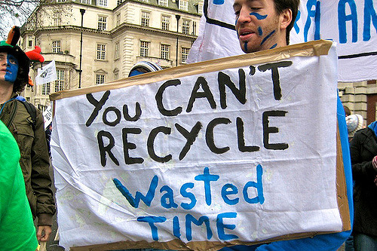
Difficulties in Teaching and Learning Distributed Algorithms
This approach incurs several difficulties. For example students
Students spend most of the time in lower level details of implementation, simulation and deployment infrastructure for the algorithm.
Hence,they miss the big picture of distributed algorithm i.e. actual workings and design of algorithm
It hinders their ability to design new algorithms or to optimize or to adapt existing algorithms in a constructive way.

Slide 10
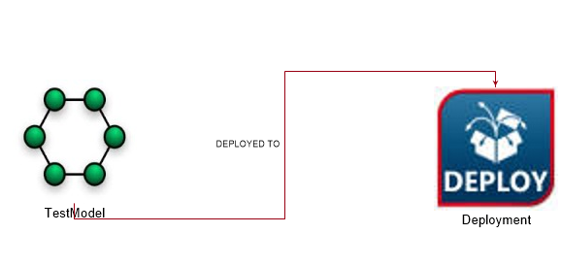
Our Solution
Playground of Algorithms for Distributed Systems (PADS)
An extensible framework that allows to design, modify, implement, prototype and deploy distributed algorithms easily. This helps students to learn these algorithms better and faster.

Slide 11
Requirements For PADS Framework
Requirement 1→ Provide higher level interface for distributed algorithm design, simulation and deployment by abstracting lower level details of programming, simulation tools, deployment platform details.
Requirement 2→ Allow heterogeneity in network topology, node types, simulation tools, test-bed types like native or virtualization infrastructure

Slide 12
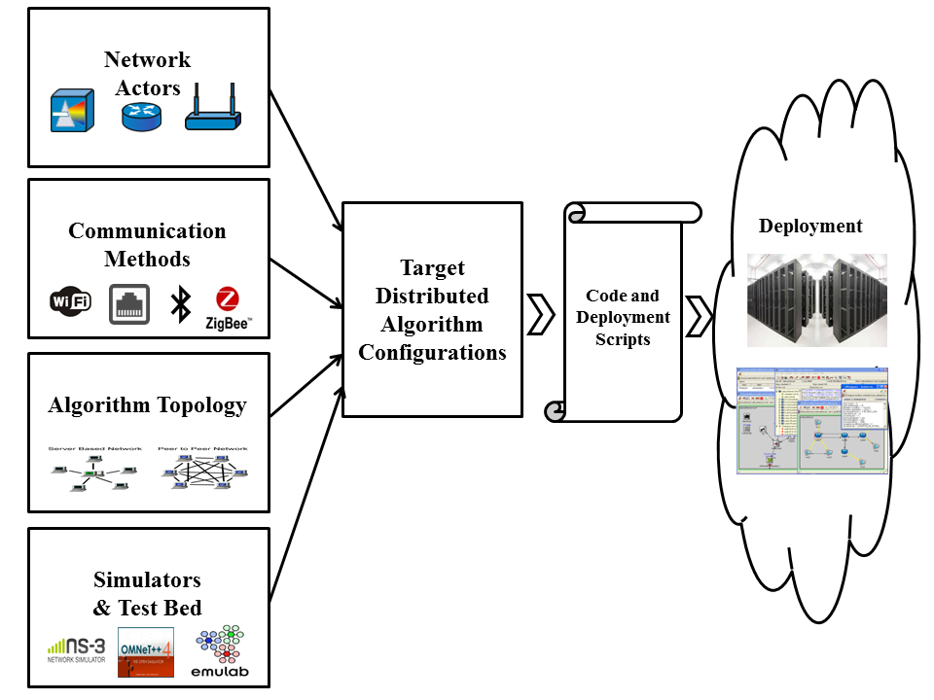
Capturing Commonality and Variability in Algorithm Learning Workflow

Slide 13
Feature Models
In PADS we need to manage the commonalities and variabilities that are exhibited for realizing the development, implementation and demonstration of distributed algorithms using Feature Models.
Feature models provide proven techniques for improving reusability by specifying the reuse rules

Slide 14
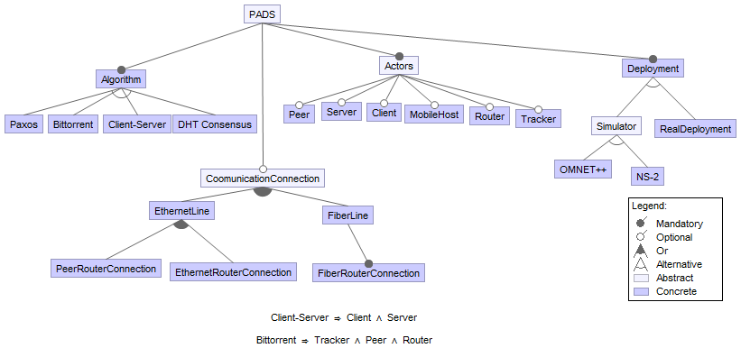
Feature Model Representation of PADS

Slide 15
Modelling PADS using model driven tools
We use model driven engineering(MDE) techniques to codify the feature model by mapping it to metamodel(s) of a domain-specific modeling language.
We use generative technologies, which are key artifacts of MDE, to automate the synthesis of product variants of our PADS product line.
Notes:
The SPLs can be built using modular software. Changes in
the feature configurations can be mapped to the changes in the
software modules [19]. Design and development of modular
software framework is a challenging task. We use modeldriven engineering(MDE) techniques to codify the feature
model by mapping it to metamodel(s) of a domain-specific
modeling language and use generative technologies, which are
key artifacts of MDE, to automate the synthesis of product
variants of our PADS product line

Slide 16

Generic Modeling Environment(WebGME)
Tool developed at Vanderbilt University.
WebGME used to develop the DSML and generative capabilities for PADS provisioning and deployment management of the experiment.
WebGME provides an environment to define the syntax and semantics of a DSML through metamodeling.
Model interpreters can be associated with the metamodels that can provide additional semantics to the language which are not captured in a visual form as well as provide the generative capabilities needed for automation.

Slide 17
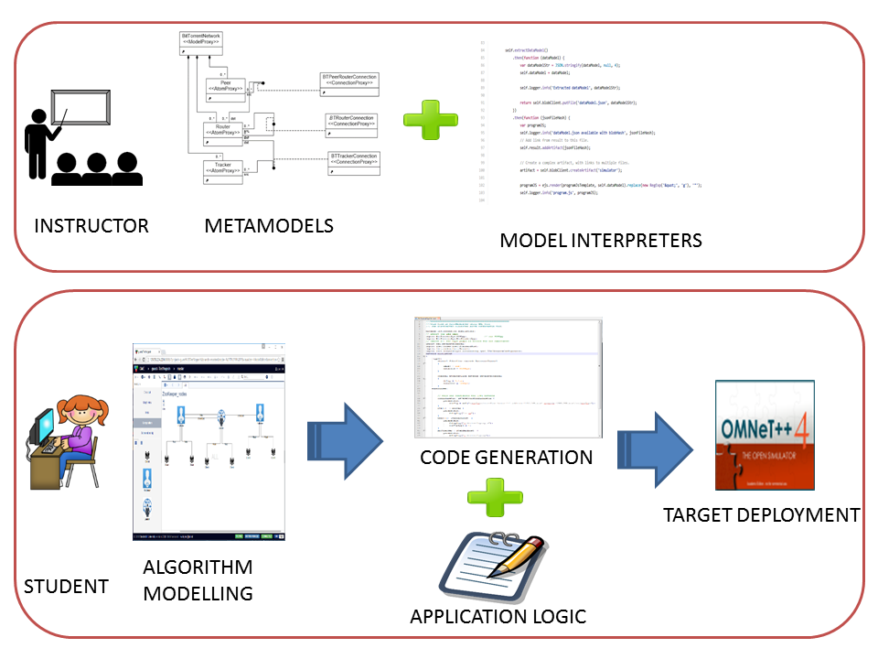
Model-based Process for Distributed Algorithm Demonstration and Deployment

Slide 18
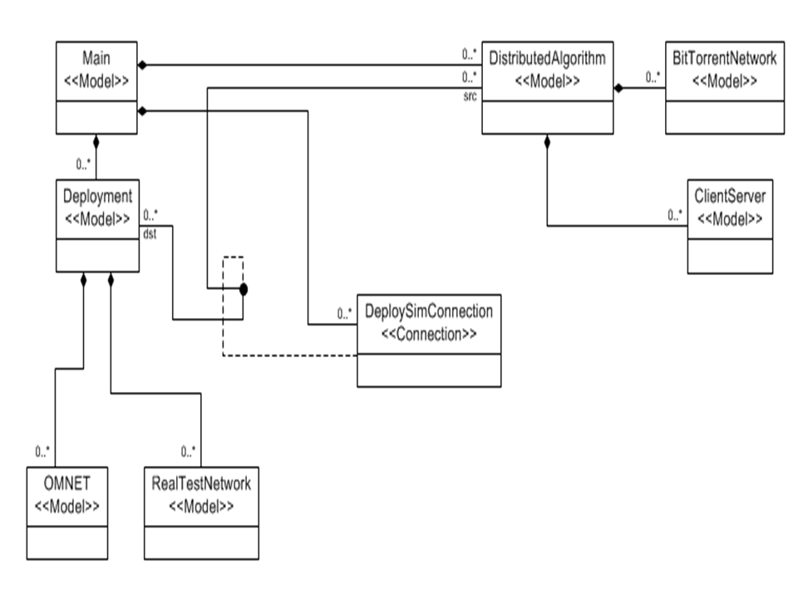
Meta-Model of Playground of Algorithms for Distributed Systems (PADS) Framework

Slide 19
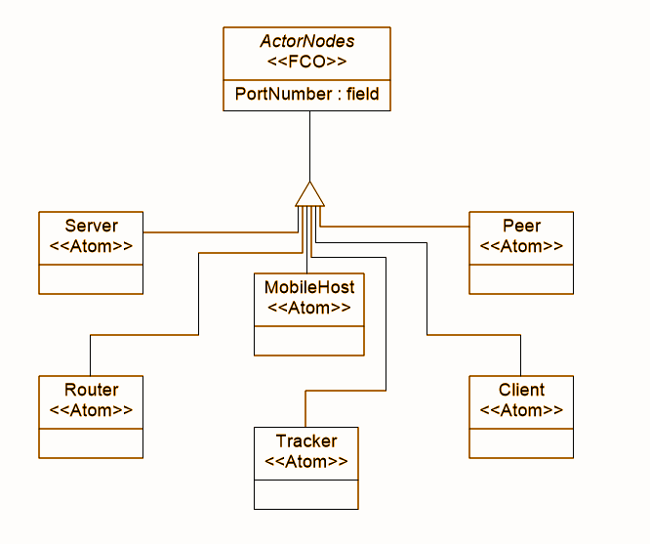
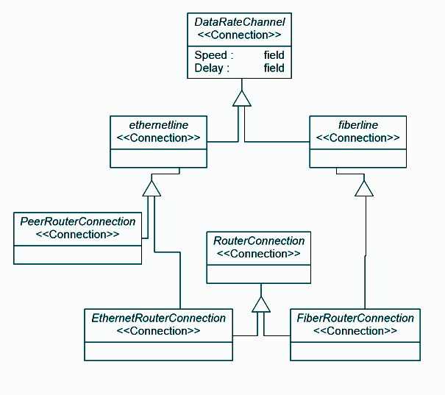
Meta-Models
Network Actors
Data Connections

Slide 20
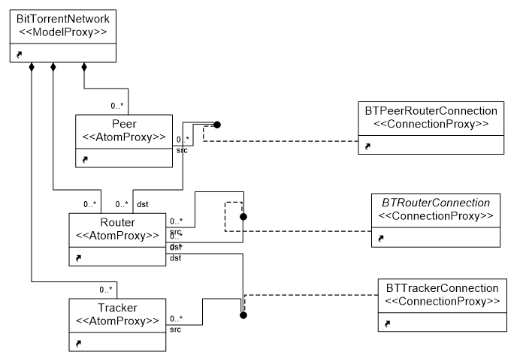
Use Case: Meta Model – Bittorrent Network

Slide 21
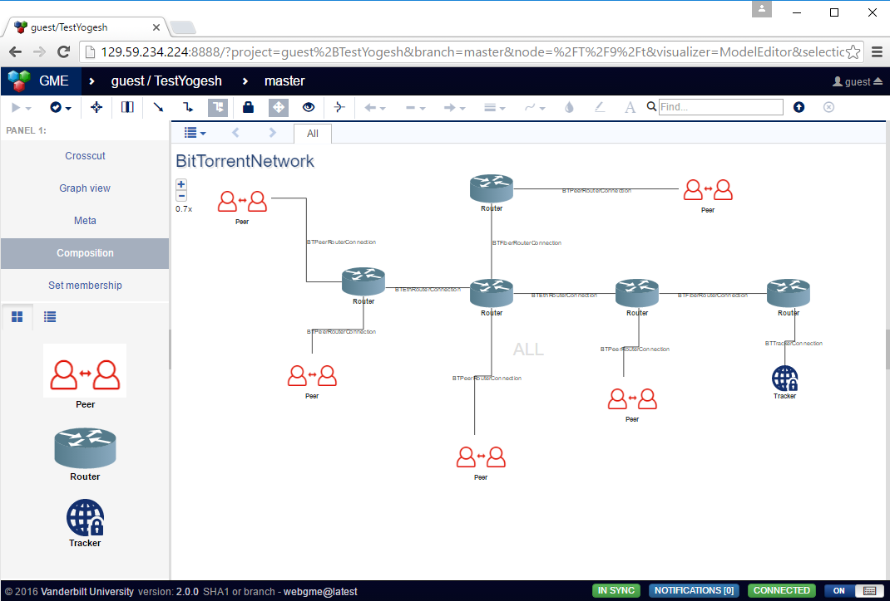
Use Case: Test Algorithm Selection – Bittorrent Network

Slide 22
Conclusion
Presented the need for an integrated teaching framework used for demonstrating distributed systems algorithms
The playground has an extensible interface and as such has lot of capabilities for adding and supporting both various distributed algorithms and deployment plans.
We evaluated the capabilities of PADS using a representative case study of BitTorrent

Slide 23
Questions?
Thank You!

