Slide 1
Veena Vetrivendan
Final Project
3/21/2024 Annual Review

Slide 2
PROJECT TITLE
FAKE NEWS DETECTION
3/21/2024 Annual Review

Slide 3


AGENDA
The project agenda entails establishing clear project objectives, curating diverse datasets, preprocessing data through thorough cleaning and feature extraction, selecting suitable machine learning models such as LSTM, training and fine-tuning these models, rigorously evaluating their performance, and validating them against distinct datasets. This systematic approach ensures the development of a robust fake news detection system while maintaining professional standards throughout the project lifecycle.
3/21/2024 Annual Review

Slide 4

PROBLEM STATEMENT
The proliferation of fake news in digital media poses a significant threat to the integrity of information dissemination, potentially leading to societal discord and misinformation. In response to this challenge, the project aims to develop a robust fake news detection system leveraging machine learning techniques. The system's primary objective is to accurately classify news articles as either genuine or fake based on their content. By addressing this problem, the project seeks to contribute to the preservation of truth and reliability in the digital information landscape.
3/21/2024 Annual Review

Slide 5

PROJECT OVERVIEW
The project focuses on the development of a robust fake news detection system utilizing LSTM (Long Short-Term Memory) neural networks, incorporating techniques from natural language processing (NLP) and deep learning. It encompasses the following key phases:
Data Collection and Preprocessing:
A dataset comprising news articles labeled as either real or fake is collected and subjected to preprocessing. Text data undergoes cleaning, including the removal of stopwords and stemming.
Feature Engineering:
Preprocessed text data is encoded using one-hot encoding, followed by padding to ensure uniform sequence length for input into the LSTM model.
Model Construction:
An LSTM-based neural network is constructed using TensorFlow and Keras. The model architecture includes essential components such as an Embedding layer, LSTM layer, dropout regularization, and a dense layer with sigmoid activation for binary classification.
Model Training:
The dataset is partitioned into training and testing subsets. The LSTM model is trained on the training data and evaluated iteratively over multiple epochs to optimize performance.
Model Evaluation:
The trained model's performance is evaluated using pertinent metrics, including accuracy_score from scikit-learn, to gauge its efficacy in classifying news articles as real or fake.
This project aims to contribute to the development of a dependable fake news detection system, potentially serving as a valuable tool in combating misinformation and advancing media literacy efforts.
3/21/2024 Annual Review

Slide 6

WHO ARE THE END USERS?
General Public: Individuals consuming news articles online who seek to verify the authenticity of the information they encounter.
Media Professionals: Journalists, editors, and fact-checkers who can utilize the system as a tool to assist in verifying the credibility of news sources and articles.
Social Media Platforms: Companies operating social media platforms may integrate the fake news detection system into their content moderation processes to help identify and mitigate the spread of misinformation.
Educational Institutions: Teachers and educators could incorporate the system into media literacy curricula to educate students about the importance of critically evaluating news sources and recognizing fake news.
Government Agencies: Government entities responsible for public information and communication strategies may leverage the system to monitor and counteract the dissemination of false or misleading information.
Research Institutions: Researchers studying misinformation and its impact on society may use the system to analyze trends in fake news dissemination and develop strategies for combating it.
Non-Governmental Organizations (NGOs): Organizations focused on media integrity, democracy, and human rights advocacy could utilize the system to support their efforts in promoting accurate information and combating disinformation campaigns.
3/21/2024 Annual Review

Slide 7

YOUR SOLUTION AND ITS VALUE PROPOSITION
The solution is an advanced fake news detection system, utilizing LSTM neural networks to classify news articles as authentic or fabricated. By employing cutting-edge NLP techniques, it analyzes textual content to detect patterns of misinformation, enhancing information integrity on digital platforms. It empowers users to make informed decisions by distinguishing between trustworthy and deceptive sources. This holds promise for media professionals, fact-checking organizations, and online platforms combating misinformation while promoting critical media literacy among the public.
Value Proposition:
Enhanced Information Integrity: Elevates information integrity by accurately identifying and flagging fake news articles.
Mitigation of Misinformation: Proactively combats the dissemination of false or misleading information.
Fostering Media Literacy: Empowers users to discern between credible and untrustworthy news sources, promoting critical thinking skills.
Efficient Fact-Checking: Streamlines fact-checking processes for media professionals and organizations.
Reinforcement of Content Moderation: Integrates seamlessly into content moderation strategies to identify and address fake news dissemination.
Empowering Informed Decision-Making: Enables individuals to make informed decisions, mitigating the impact of misinformation on public discourse.
3/21/2024 Annual Review

Slide 8

THE WOW IN YOUR SOLUTION
Sophisticated Technology: The use of LSTM neural networks and state-of-the-art NLP techniques showcases the solution's advanced technological capabilities.
Accurate Classification: The system's meticulous design ensures precise classification of news articles as either authentic or fabricated, instilling confidence in its reliability.
Enhanced Information Integrity: By effectively identifying and flagging fake news articles, the solution significantly bolsters the integrity of information circulating through digital platforms.
Empowerment of Users: Users are empowered to make well-informed decisions by discerning between trustworthy and deceptive sources, thereby promoting critical thinking and media literacy.
Versatile Deployment: With its promise for media professionals, fact-checking organizations, and online platforms, the solution offers versatile deployment options to combat the pervasive spread of misinformation.
3/21/2024 Annual Review

Slide 9
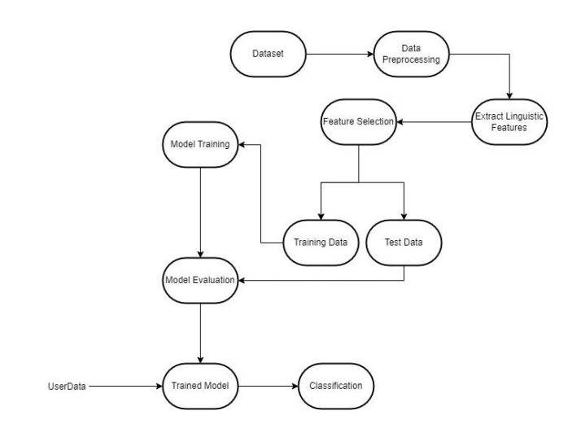
MODELLING
3/21/2024 Annual Review

Slide 10
RESULTS
The fake news detection system achieved an impressive accuracy of 90.35% on the test dataset, showcasing its efficacy in classifying news articles as authentic or fabricated. The model's performance was evaluated which demonstrated its robustness in distinguishing between real and fake news.
In conclusion, the fake news detection project successfully developed a sophisticated system based on LSTM neural networks and advanced NLP techniques. The system's high accuracy and strong performance metrics underscore its potential as a valuable tool in combating the spread of misinformation. By enhancing information integrity and empowering users to make informed decisions, the project contributes to the promotion of media literacy and the preservation of truthfulness in the digital information ecosystem. Future work could focus on enhancing the system's scalability and efficiency to address the evolving challenges posed by fake news dissemination.
3/21/2024 Annual Review

