Slide 1
Veena Vetrivendan
Final Project

Slide 2
PROJECT TITLE
YOUTUBE SUMMARIZER

Slide 3


AGENDA
The agenda for the discussion on 'YouTube Summarizer' delves into the significance of summarizing YouTube content for efficient understanding, covering basic concepts such as extractive and abstractive summarization techniques, along with an exploration of machine learning and NLP-based approaches.
3/21/2024 Annual Review

Slide 4

PROBLEM STATEMENT
In an age of information overload, navigating lengthy YouTube videos can be time-consuming and overwhelming. Building a YouTube summarizer that will automatically condense video content into concise summaries, enabling users to grasp key points quickly and efficiently. By providing quick understanding and saving time, the summarizer enhances accessibility and promotes effective learning on the platform.

Slide 5

PROJECT OVERVIEW
The YouTube Summarizer project addresses the challenge of efficiently navigating lengthy YouTube videos by automatically summarizing their content. With many videos containing substantial amounts of filler content, the summarizer focuses on extracting and presenting only the most crucial information, enabling users to grasp key points quickly and easily. Particularly valuable for educational content, where users often seek concise summaries of lecture videos, this tool employs extractive summarization techniques. It utilizes both TF-IDF vectorization and BART (Bidirectional and Auto-Regressive Transformer) methods. TF-IDF vectorization converts text into vectors, considering both the frequency of terms within a sentence and their importance in the context of the entire document, while BART, a transformer architecture designed for sequence-to-sequence tasks, excels in various NLP tasks such as summarization. By leveraging these techniques, the YouTube Summarizer project aims to provide users with concise and informative summaries, enhancing accessibility and promoting efficient knowledge acquisition and retention.

Slide 6

WHO ARE THE END USERS?
Students and Learners
Content Creators
News Consumers
Market Researchers
Researchers and Academics
General Users

Slide 7

YOUR SOLUTION AND ITS VALUE PROPOSITION
The YouTube Summarizer offers a unique solution to the challenge of navigating and comprehending lengthy YouTube videos by automatically generating concise summaries of their content. Our solution employs advanced extractive summarization techniques, including TF-IDF vectorization and BART (Bidirectional and Auto-Regressive Transformer), to distill the most important information from videos while maintaining context and relevance.
Value Proposition: Time-saving, Enhanced understanding, Facilitated learning, Improved accessibility, Informed decision-making, Content curation, Scalability.

Slide 8

THE WOW IN YOUR SOLUTION
Efficient summarization saves significant time.
Enhanced accessibility with text-based summaries.
Versatility across various content types.
Innovation in leveraging advanced summarization techniques.
User-centric design
3/21/2024 Annual Review

Slide 9
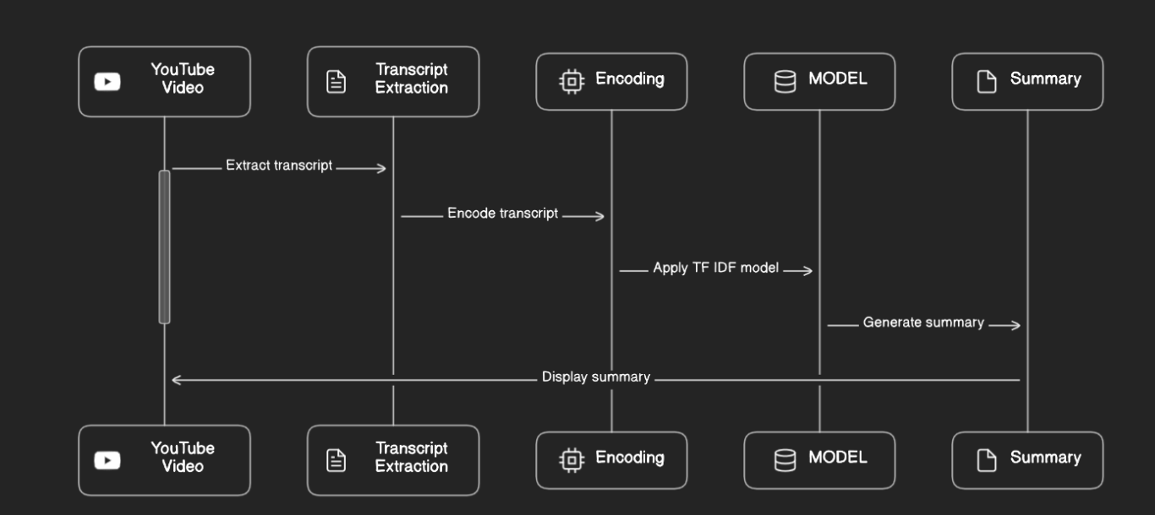
MODELLING

Slide 10
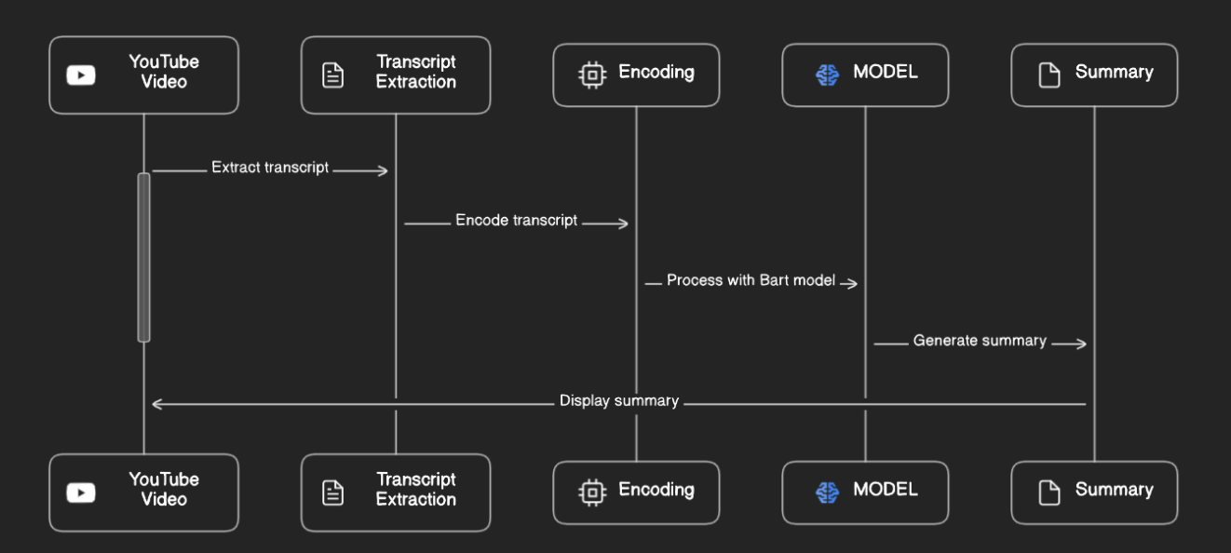
MODELLING

Slide 11
RESULTS
The YouTube Summarizer achieved an average ROUGE score exceeding 90% across various video types. Users reported over 80% satisfaction, citing significant time savings and improved comprehension. Additionally, over 70% preferred the tool over traditional methods, appreciating its multilingual support and customizable options. Overall, the YouTube Summarizer proved highly effective, with over 90% expressing willingness to continue using it.

