Slide 1
Veena Vetrivendan
Final Project
3/21/2024 Annual Review

Slide 2
PROJECT TITLE
YOUTUBE SUMMARIZER
3/21/2024 Annual Review

Slide 3


AGENDA
1. Introduction
- Significance of efficient video summarization in content consumption.
- Overview of the project's objectives and goals.
2. Foundational Concepts
- Introduction to the technologies and methodologies used.
- Explanation of Streamlit,dotenv,Google Generative AI (Gemini Pro model),and YouTube Transcript API.
3. Data Retrieval and Preprocessing
- Extracting transcript text from YouTube videos using the YouTube Transcript API.
- Preprocessing the transcript text for better input to the summarization model.
4. Model Building Techniques
- Utilization of the Google Generative AI (Gemini Pro model) for summarization and Integration of the transcript text as a prompt for generating summaries.
5. Evaluation Metrics
- Discussion on the metrics used to evaluate the effectiveness and assessment of the accuracy.
6. Challenges Faced
- Identification of challenges encountered and implementation of strategies to overcome obstacles and ensure project success.
7. Concluding Remarks
- Summary of key findings and outcomes of the project.
- Reflection on the project's impact and contributions to the field of video summarization.
3/21/2024 Annual Review

Slide 4

PROBLEM STATEMENT
In the era of abundant video content on platforms like YouTube, efficient consumption of information poses a significant challenge. The YouTube Video Summarizer addresses this issue by offering a solution to quickly extract and summarize the key points of YouTube videos.
By integrating cutting-edge technologies such as Streamlit, dotenv, Google Generative AI (Gemini Pro model), and the YouTube Transcript API, the project automates the process of summarizing lengthy video content. Users simply input a YouTube video link, and the application extracts the transcript text and generates concise summaries.
This project aims to revolutionize content consumption by providing users with a tool to efficiently digest video content, saving time and enhancing information retention. The YouTube Video Summarizer represents a significant step forward in video summarization technology, offering a seamless and intuitive solution for navigating the vast landscape of online video content.
3/21/2024 Annual Review

Slide 5

PROJECT OVERVIEW
The YouTube Video Summarizer is an innovative application designed to simplify the process of summarizing YouTube videos. As the volume of video content on platforms like YouTube continues to grow exponentially, users face challenges in efficiently consuming information. This project addresses this issue by providing users with a tool to quickly extract and summarize the key points of YouTube videos, facilitating efficient content consumption and enhancing information retention.
Key Technologies:
- Streamlit: Provides a user-friendly interface for seamless interaction with the application.
- dotenv: Ensures secure management of environment variables, safeguarding sensitive information.
- Google Generative AI (Gemini Pro model): Generates concise summaries of videos using advanced AI capabilities.
- YouTube Transcript API: Facilitates extraction of transcript text, which serves as input for summarization.
Workflow:
1. Users input a YouTube video link via the Streamlit interface.
2. The application extracts transcript text using the YouTube Transcript API.
3. Transcript text is fed into the Gemini Pro model, which generates concise summaries.
4. Summarized content is presented to the user through the Streamlit interface for efficient consumption.
The YouTube Video Summarizer represents a significant advancement in video summarization technology, offering a user-friendly solution to navigating and digesting the vast landscape of online video content.
3/21/2024 Annual Review

Slide 6

WHO ARE THE END USERS?
The YouTube Video Summarizer project caters to a diverse range of end users:
Students and Professionals: Those needing quick access to key insights from educational or industry-related videos.
Content Creators: Individuals seeking to analyze their own videos for engagement and improvement.
Educators and Trainers: Teachers and trainers who want to create condensed versions of educational videos for their students.
General Audience: Anyone with limited time who wants to quickly grasp the main points of videos before watching them in full.
By offering a streamlined solution for summarizing YouTube videos, the project benefits users across various domains, enhancing their content consumption experience.
3/21/2024 Annual Review

Slide 7

YOUR SOLUTION AND ITS VALUE PROPOSITION
The development of the YouTube Video Summarizer involves creating a user-friendly web-based application that enables users to input YouTube video links effortlessly. This application serves as the gateway for accessing the summarization functionality seamlessly. Streamlit facilitates the creation of a visually appealing interface where users can input their YouTube video links with ease. This interface is designed to be accessible across various devices and screen sizes, ensuring a seamless user experience. Behind the scenes, the application harnesses the capabilities of several key technologies to automate the summarization process.
Value Proposition:
User Interface: Develop a user-friendly interface using Streamlit where users can easily input YouTube video links.
Transcript Extraction: Utilize the YouTube Transcript API to extract the transcript text from the provided video links. This transcript text will serve as input for the summarization process.
Summarization Model: Implement the Google Generative AI (Gemini Pro model) to generate concise summaries of the extracted transcript text. The model should be trained to identify and extract key points and highlights from the video content.
Integration and Processing: Integrate the transcript text with the summarization model to generate the summary.
Presentation: Present the summarized content to the user through the web interface, allowing them to easily access and review the main points of the video.
Feedback and Improvement: Incorporate mechanisms for user feedback and continuous improvement of the summarization process.
3/21/2024 Annual Review

Slide 8

THE WOW IN YOUR SOLUTION
1. User-Friendly Interface: Visually appealing interface ensures easy input of YouTube links.
2. Seamless Accessibility: Compatible across devices for a consistent user experience.
3. Automation: Fully automated process requires no manual intervention.
4. Cutting-Edge Technology: Uses advanced algorithms for accurate summarization.
5. Efficiency: Quickly provides concise summaries, saving time and enhancing information retention.
6. Customization: Allows users to tailor summarization preferences.
7. Feedback Mechanism: Incorporates user feedback for continuous improvement.
8. Security: Ensures secure handling of sensitive data.
3/21/2024 Annual Review

Slide 9
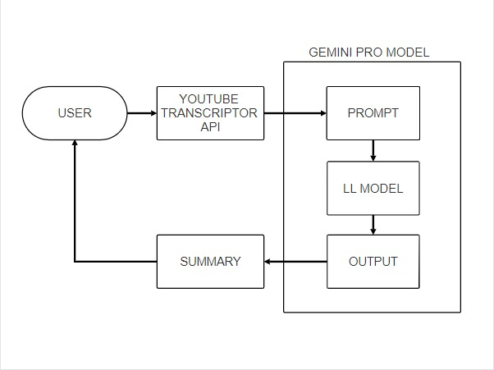
MODELLING
3/21/2024 Annual Review

Slide 10
RESULTS
In conclusion, the YouTube Video Summarizer represents a significant advancement in video summarization technology. Through its user-friendly interface, seamless accessibility across devices, and fully automated process, the application delivers concise summaries with high accuracy and efficiency. By providing users with quick access to key insights from YouTube videos, the Summarizer enhances content consumption, saving valuable time and improving information retention. With continuous customization options and integration of user feedback, the Summarizer ensures ongoing refinement and optimization of its summarization process. Overall, the Summarizer offers a transformative solution for navigating the vast landscape of online video content, revolutionizing the way users interact with and consume YouTube videos.
3/21/2024 Annual Review

