Slide 1


Hotel Booking Management System
Prepared by-
Sai Kumar- 133281_IN
Sai Vamsi -133323_IN
Tushar - 133309_IN
Pratyusha - 133322_IN
Deepthi –133282_IN

Slide 2
Contents
Introduction
Technology Used
Diagrams
Use-case diagram
Class diagram
Sequence diagram
Database
Implementation
Screenshots

Slide 3
Introduction
This project is aimed at developing an online Hotel Bookings Management System (HBMS).
This is based on J2EE.
This is providing a convenient way to search hotel rooms at different locations.
This system can be used to search for Hotel rooms and reserve them.
There are two categories of people who would access the system.
Admin
Customer

Slide 4
Admin
Login to the system using his/her credentials
Perform Hotel Management (add/delete/modify Hotel info like description, any special offers etc)
Perform Room Management (add/delete/modify Room info like revised tariff)
Generate various reports like:
View List of Hotels
View Bookings of specific hotel
View guest list of specific hotel
View bookings for specified date

Slide 5
Customer
Register into the system.
Login to the system using his/her credentials.
After login ,user can perform following-
Search for hotel rooms.
Book hotel rooms.
View Booking Status

Slide 6
Technology Used
Business Logic Components and Services :-
Java Beans
Front End & Web Components:–
HTML/JavaScript
Servlets
JSP
Application Servers :-
WildFly
Databases:-
Oracle 9i

Slide 7
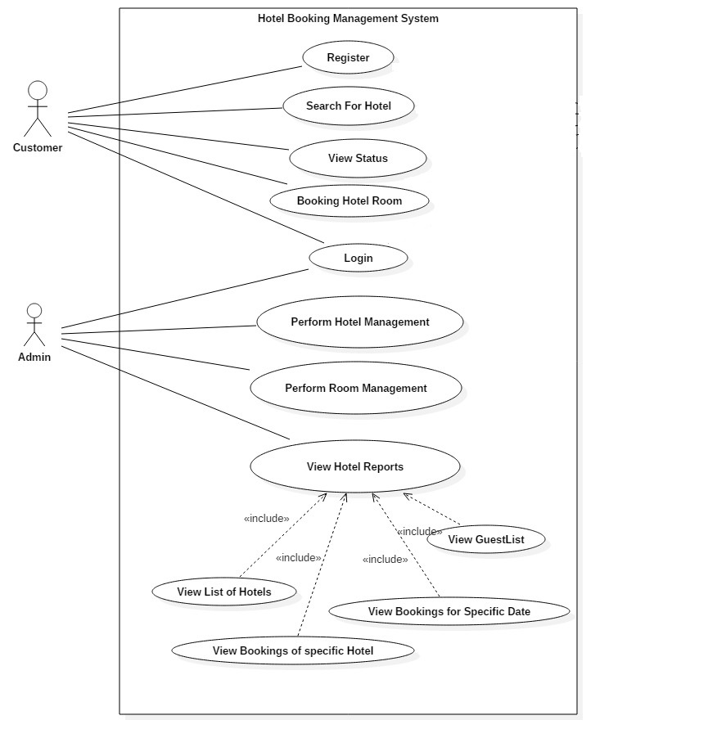
Use Case Diagram

Slide 8
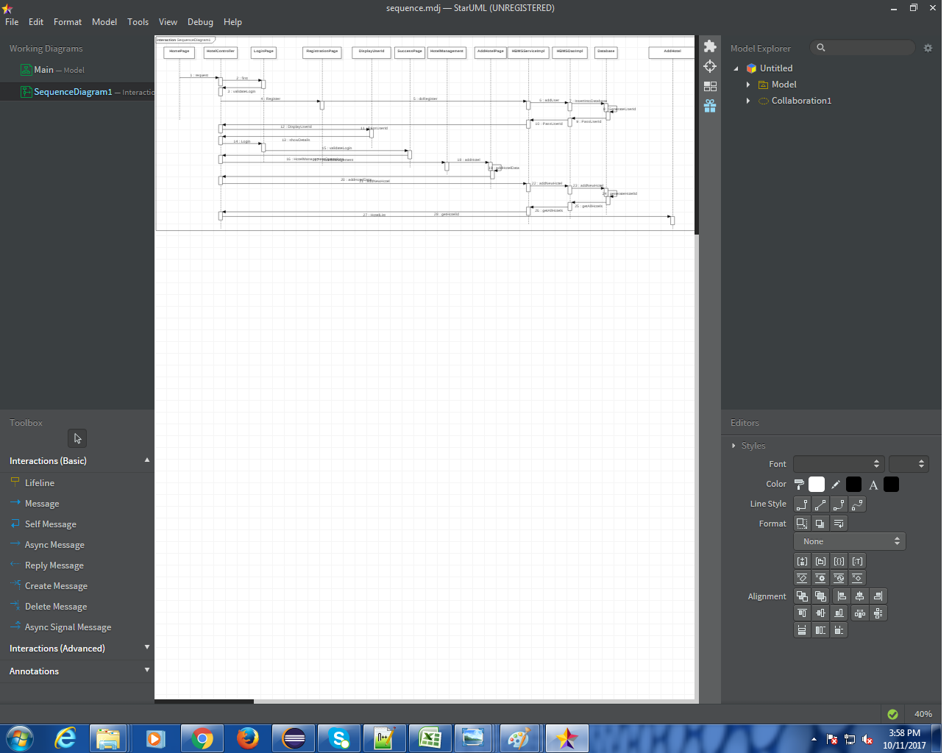
Sequence Diagram

Slide 9
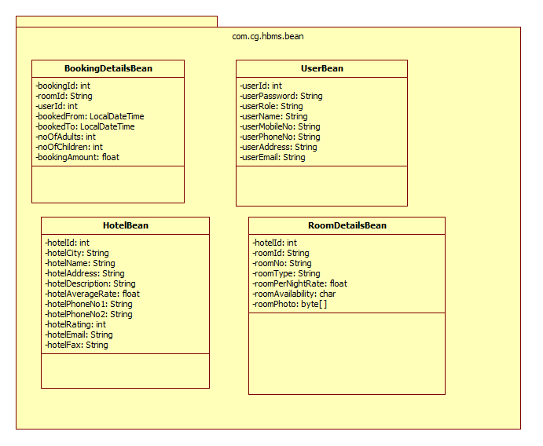
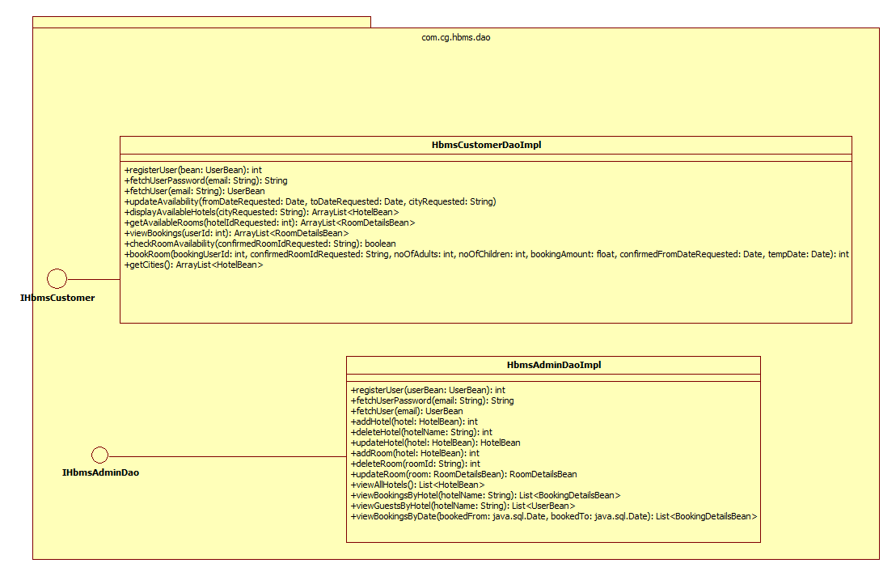
Class Diagram

Slide 10
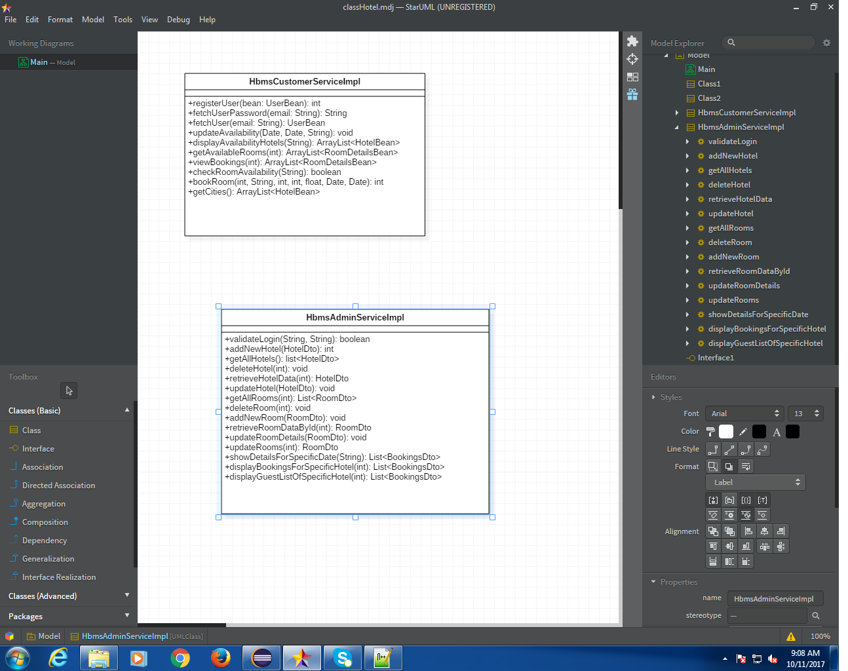
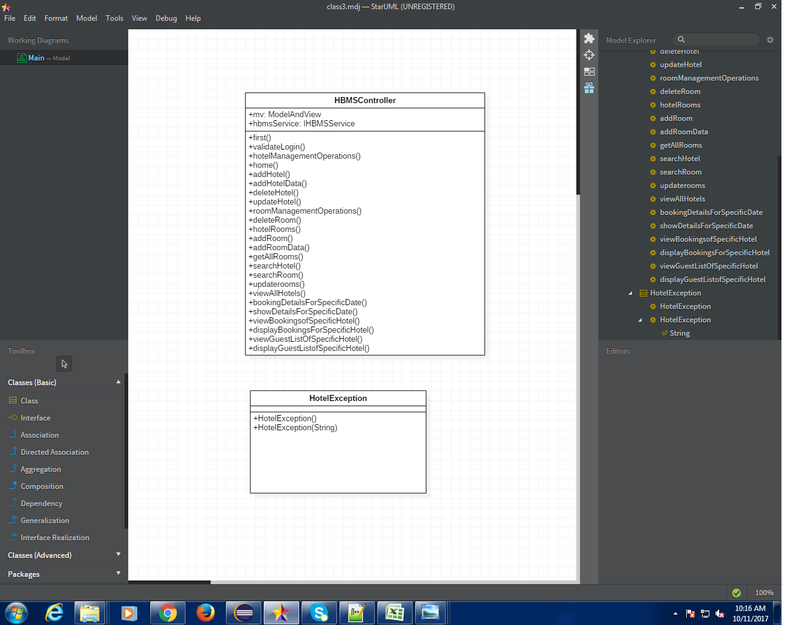

Slide 11
Oracle Database
Users: This contains the list of valid users with details like address, email etc.
Hotel: This will contain the list of hotels and places where they are located.
RoomDetails: This will contain the details of all the rooms available in all the hotels like room type, rate per night etc.
BookingDetails: This will contain the list of booked rooms and their details like dates to book room, amount etc.

Slide 12
Implementation
We have implemented admin part of the project.
This is based on the Spring MVC framework.
The request will go to the Dispatcher Servlet.
DispatcherServlet starts by querying one or more HandlerMappings. A HandlerMapping typically maps URL patterns to Controller objects.
Once the DispatcherServlet has a Controller object, it dispatches the request to the Controller which performs the business logic.

Slide 13
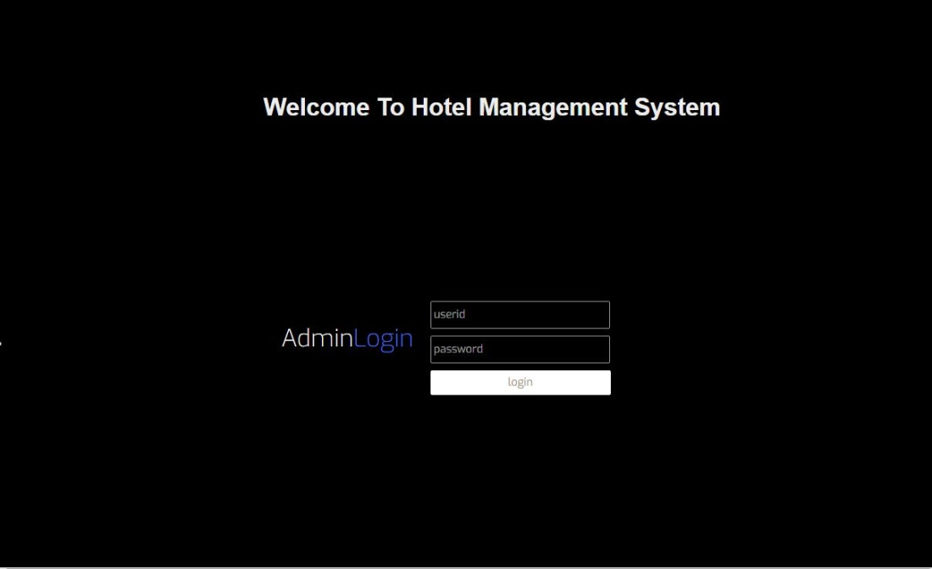
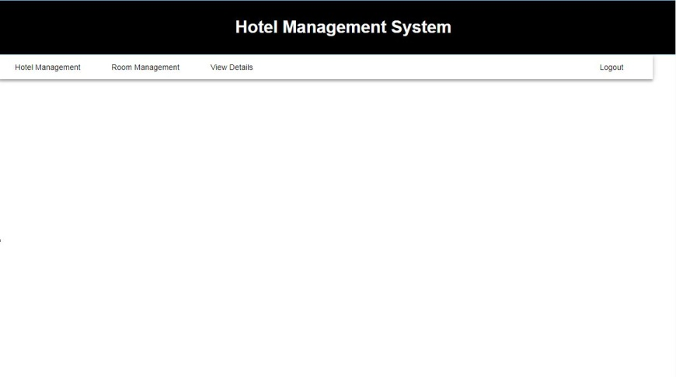

Slide 14
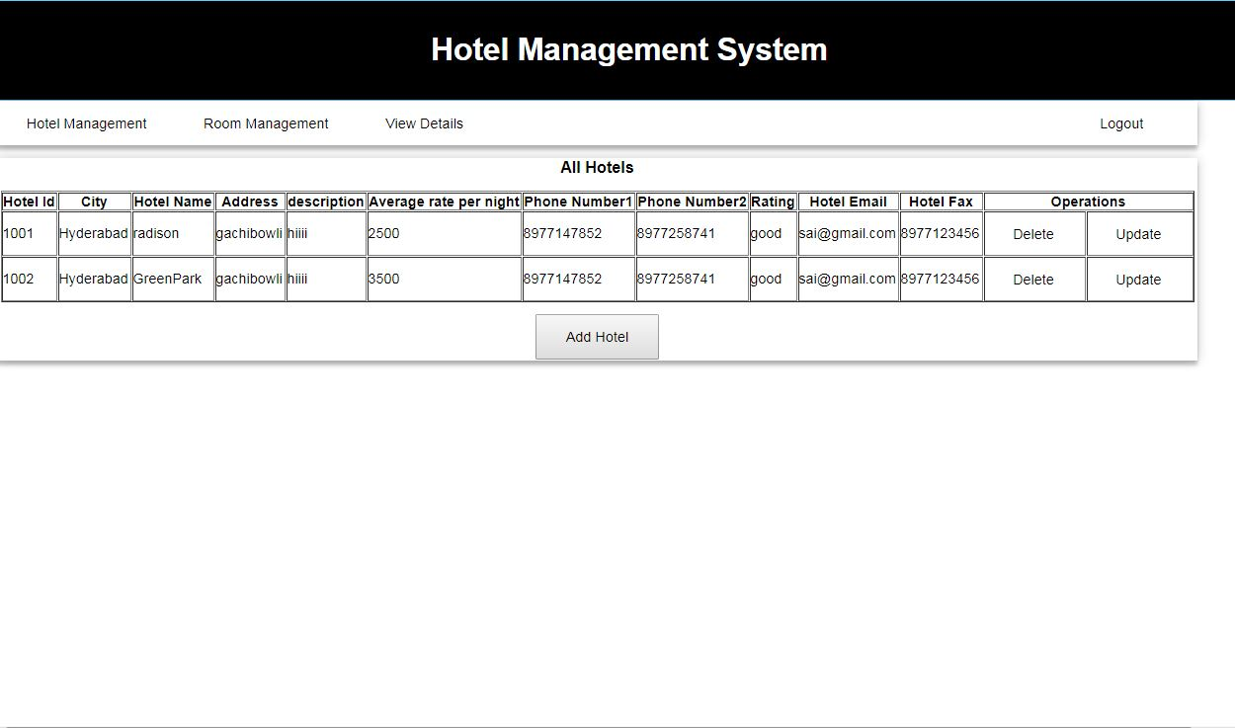

Slide 15
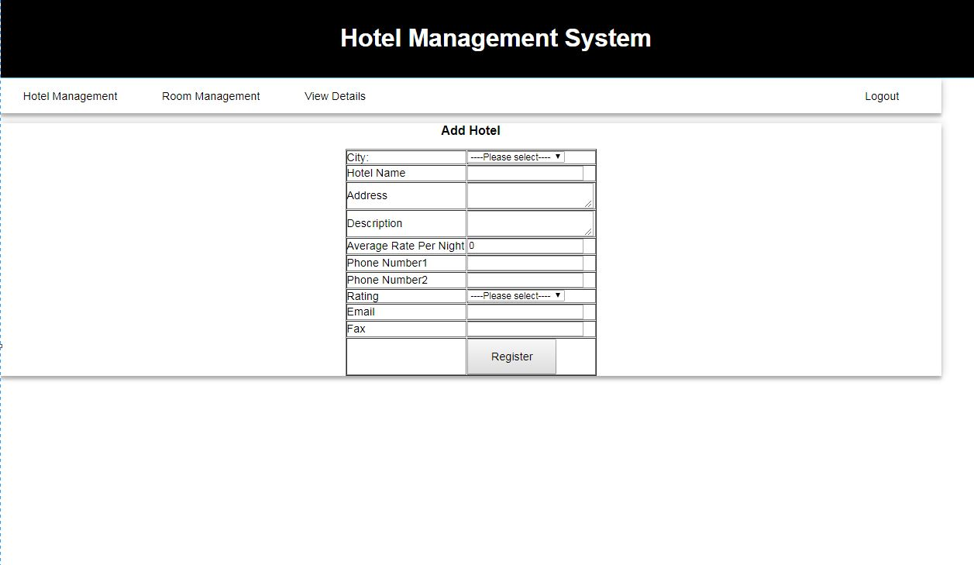

Slide 16
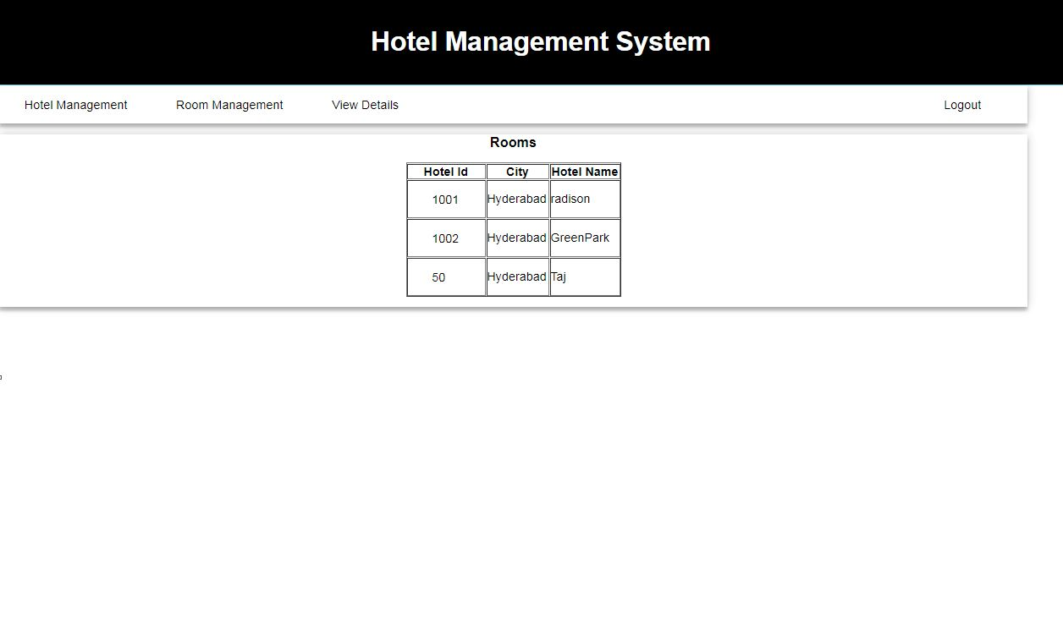

Slide 17
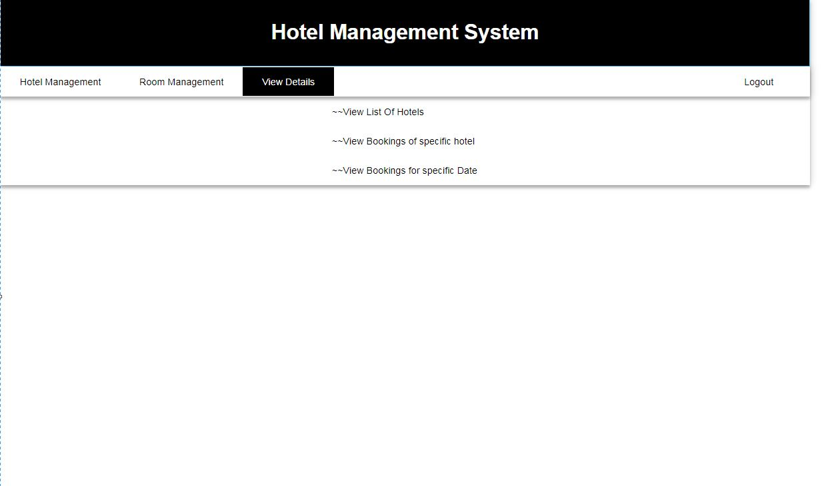

Slide 18
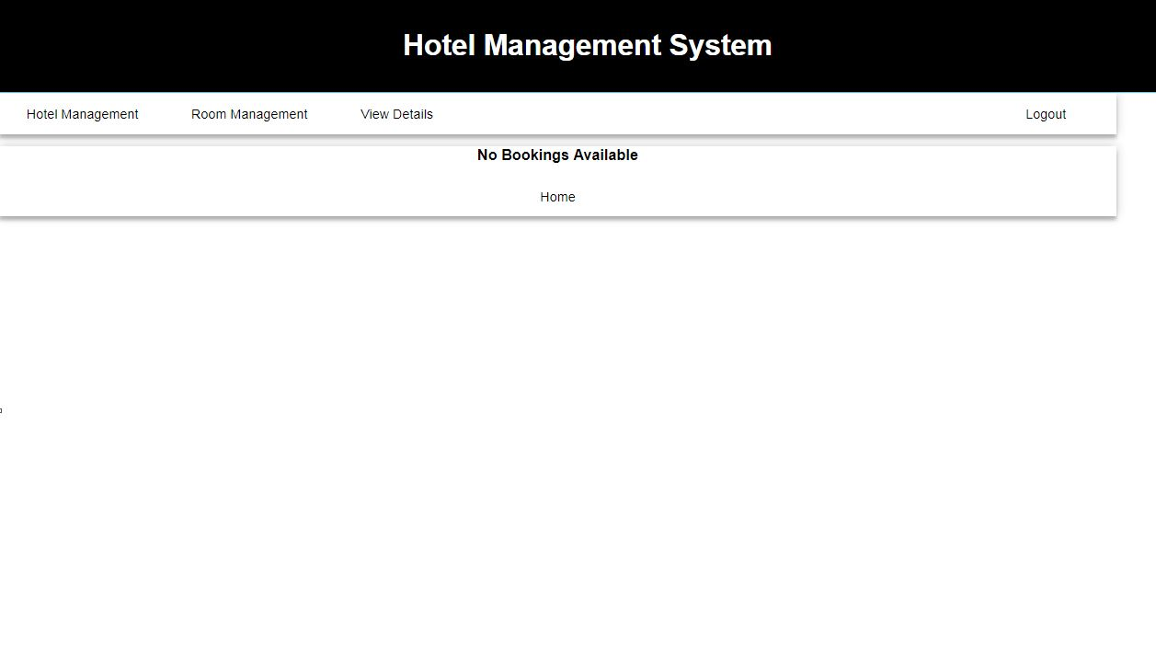

Slide 19
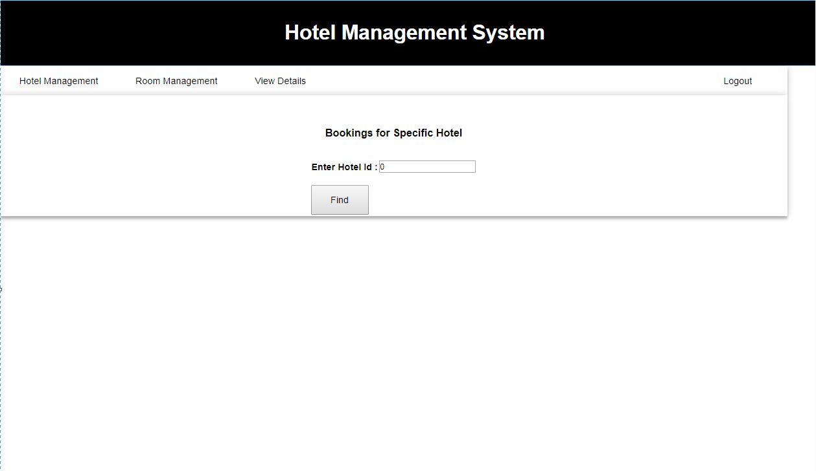

Slide 20
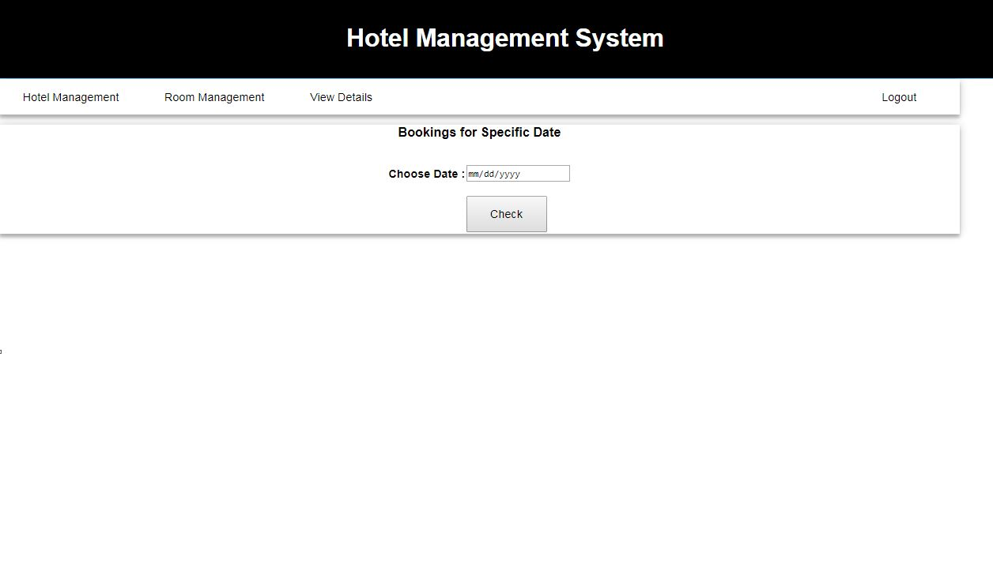

Slide 21


