Slide 1


Hotel Booking Management System
Group 4:
Veena 140193
Jayapratap 140195
Praveena 140192
Akhil 140206
Sai chand 140203
Rohith 139412

Slide 2
Contents
Introduction
Technology Used
Diagrams
Use-case diagram
Class diagram
Database
Implementation
Screenshots

Slide 3
Introduction
This project is aimed at developing an online Hotel Bookings Management System (HBMS).
This is based on J2EE.
This is providing a convenient way to search hotel rooms at different locations.
This system can be used to search for Hotel rooms and reserve them.
There are two categories of people who would access the system.
Customer
Employee

Slide 4
Customer
Register into the system.
Login to the system using his/her credentials.
After login ,user can perform following-
Search for hotel rooms.
Book hotel rooms.
View Booking Status

Slide 5
Customer
Register into the system.
Login to the system using his/her credentials.
After login ,user can perform following-
Search for hotel rooms.
Book hotel rooms.
View Booking Status

Slide 6
Technology Used
Business Logic Components and Services :-
Java Beans
Front End & Web Components:–
HTML/JavaScript
Servlets
JSP
Application Servers :-
WildFly
Databases:-
Oracle 9i

Slide 7
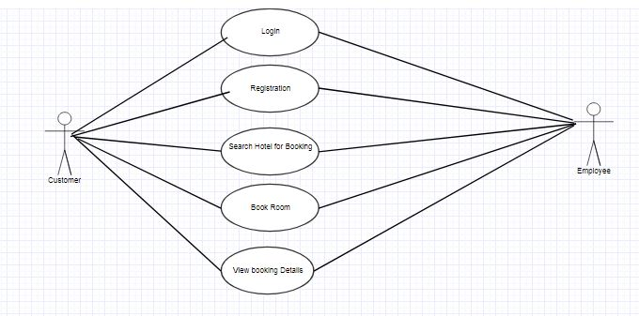
Use Case Diagram

Slide 8
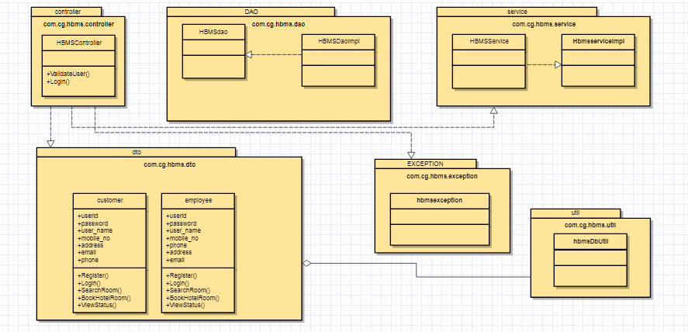
Class Diagram

Slide 9
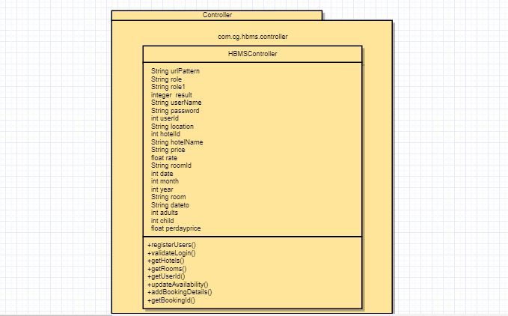
Class Diagram

Slide 10
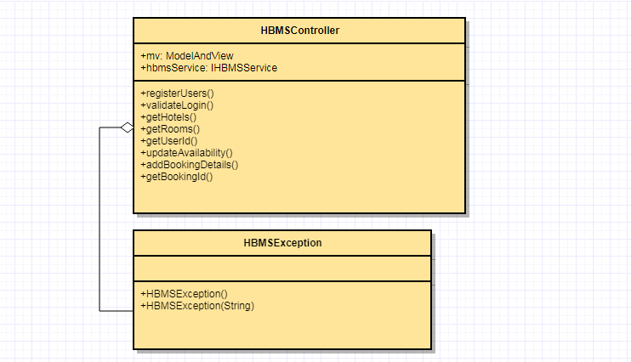
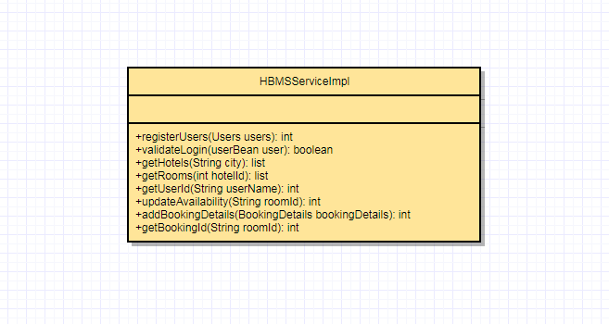
Class Diagram

Slide 11
Oracle Database
Users: This contains the list of valid users with details like address, email etc.
Hotel: This will contain the list of hotels and places where they are located.
RoomDetails: This will contain the details of all the rooms available in all the hotels like room type, rate per night etc.
BookingDetails: This will contain the list of booked rooms and their details like booked from and to dates, amount, no.of adults and children etc.

Slide 12
Implementation
We have implemented admin part of the project.
This is based on the MVC Layered Architecture.
The request will go to the Dispatcher Servlet.
DispatcherServlet starts by querying one or more HandlerMappings. A HandlerMapping typically maps URL patterns to Controller objects.
Once the DispatcherServlet has a Controller object, it dispatches the request to the Controller which performs the business logic.

Slide 13
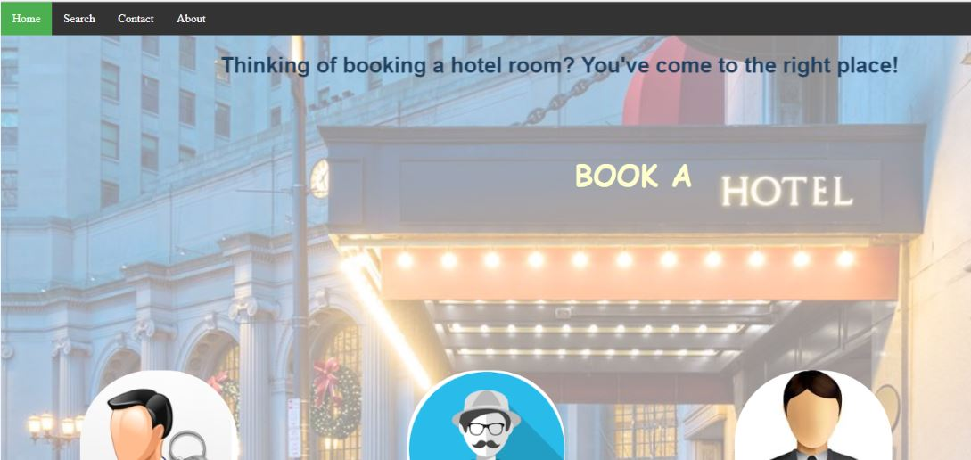
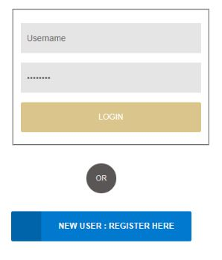

Slide 14
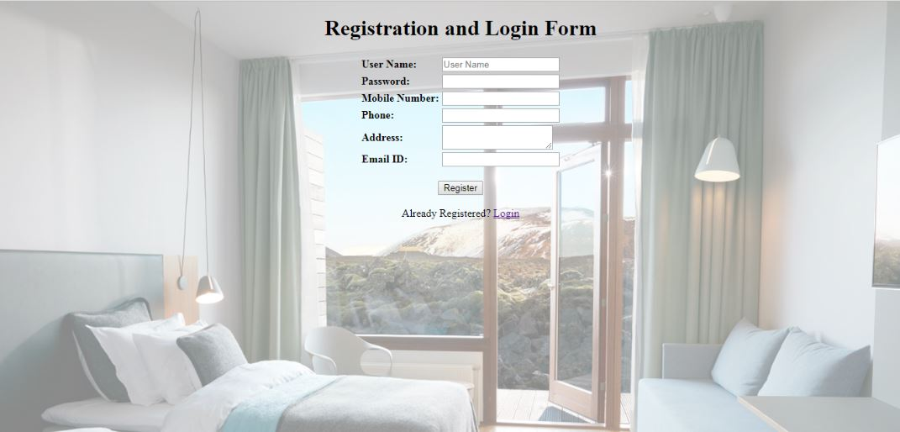

Slide 15
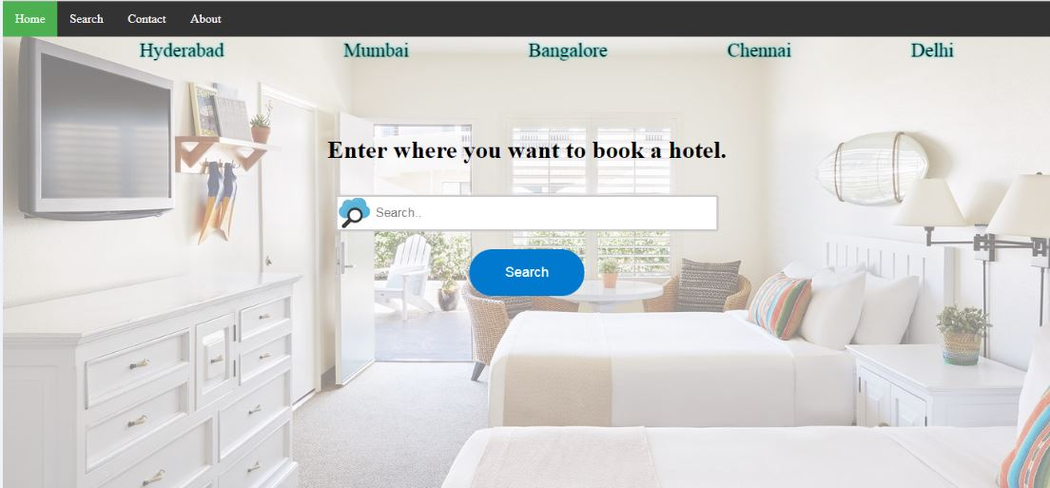
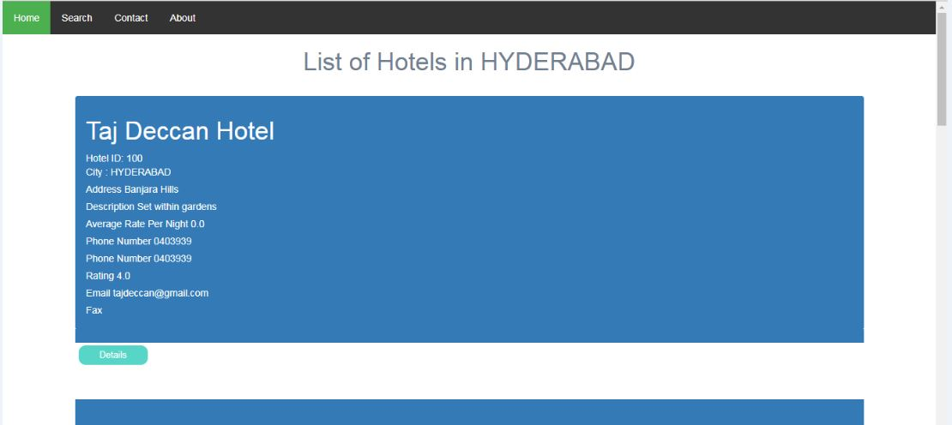

Slide 16
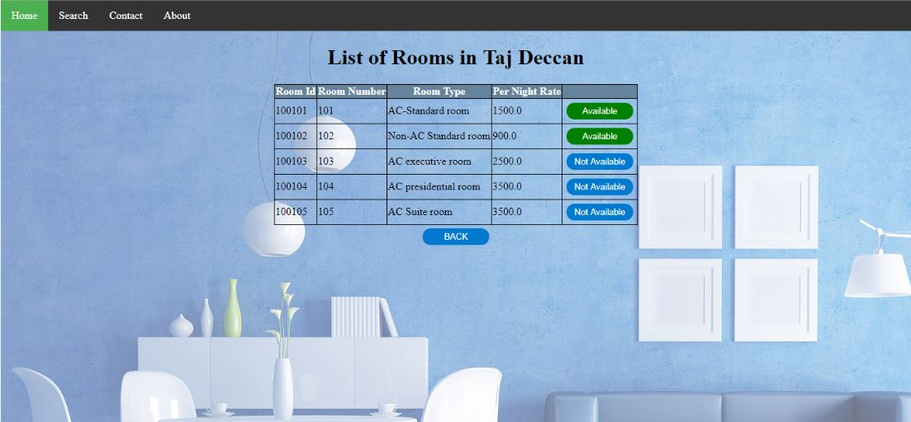

Slide 17
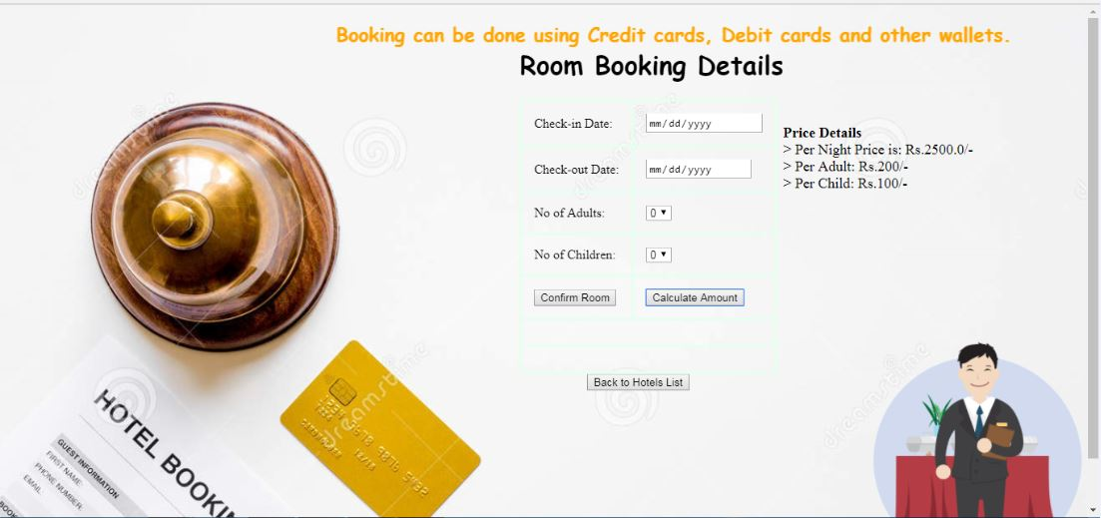
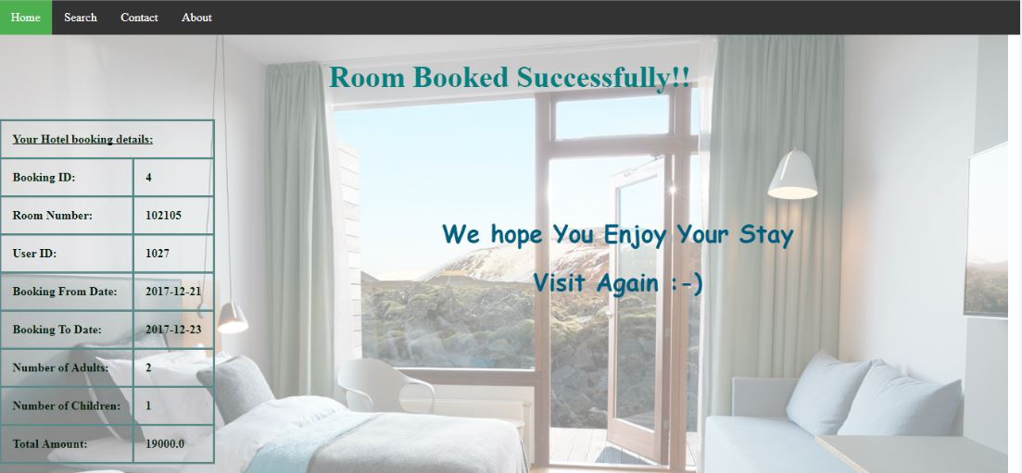

Slide 18


