Slide 1
VEENA M SHELLIKERI
ENROLL NO:EBEONO921446076
BATCH:6141
PROJECT NAME:LIBRARY MANAGEMENT SYSTEM

Slide 2
CONTENT
Problem statement
Introduction
Features
System Requirements Specification
Advantage
Project Output
Conclusion

Slide 3
PROBLEM STATEMENT
The library Management system is an infrastructure that allows users to search books and book content,remove/add. To overcome this I have used to find a specific book or keywords within a book given continuously in library.

Slide 4
introduction
The library management system used for monitoring and controlling operations in the library.
The library Management is used to manage the new student details, new books, searching books and returning the books.

Slide 5
Features
The Library Management System is an application to provide Book details and storing the details .
This projects contain mainly these modules
Student Module
Book Module
Issue Module
Return Module
Search Module

Slide 6
System requirement specification
Software: Eclipse
Language used: core java
Windows 8

Slide 7
Advantage
Simple and easy to use
Helps in maintaining records
Innovation
Highly secure

Slide 8
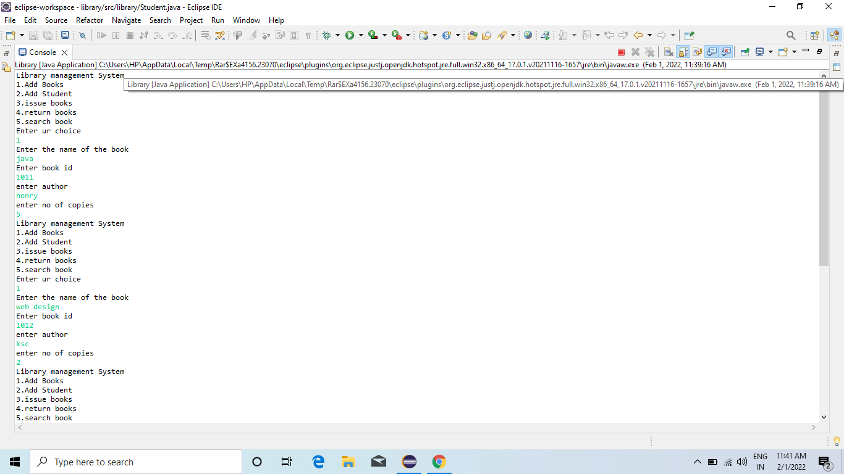
Output

Slide 9
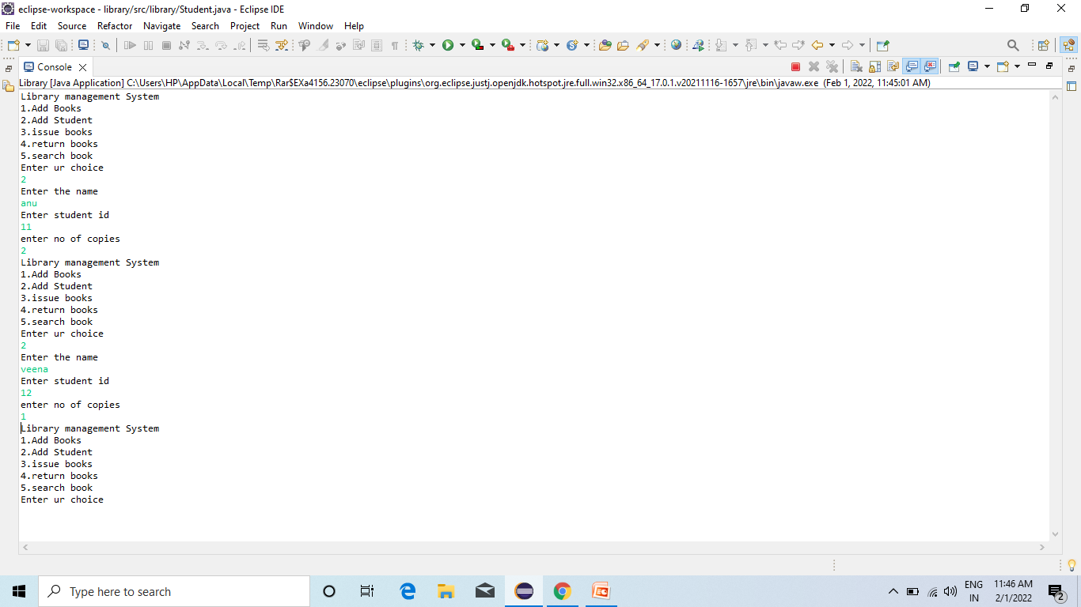

Slide 10
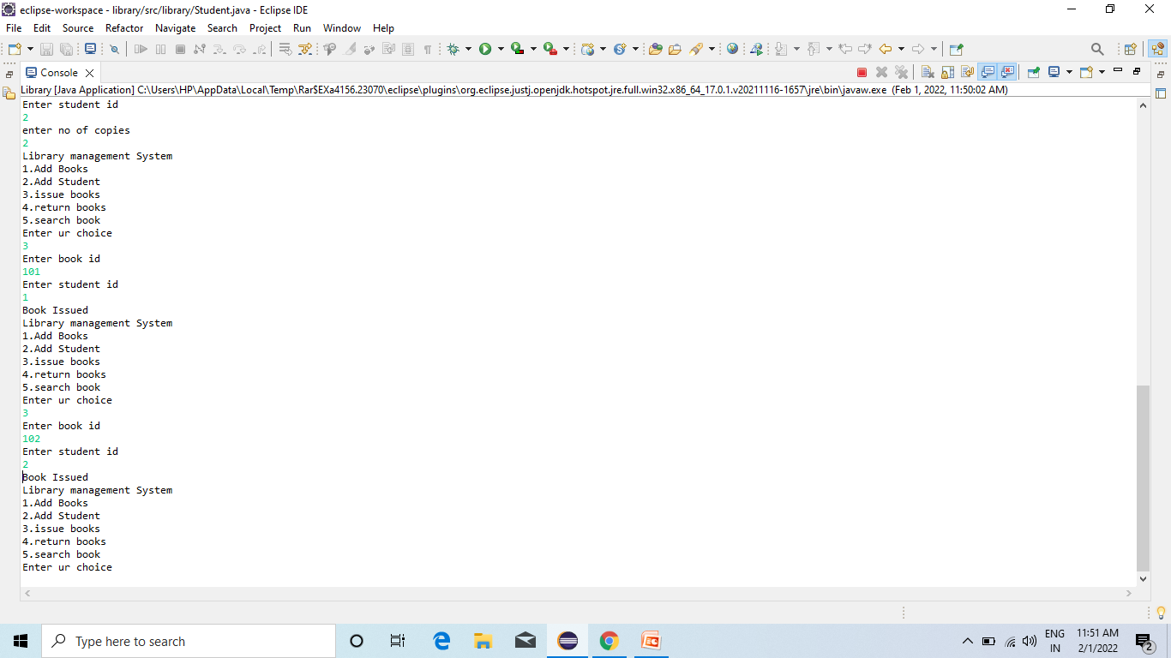

Slide 11
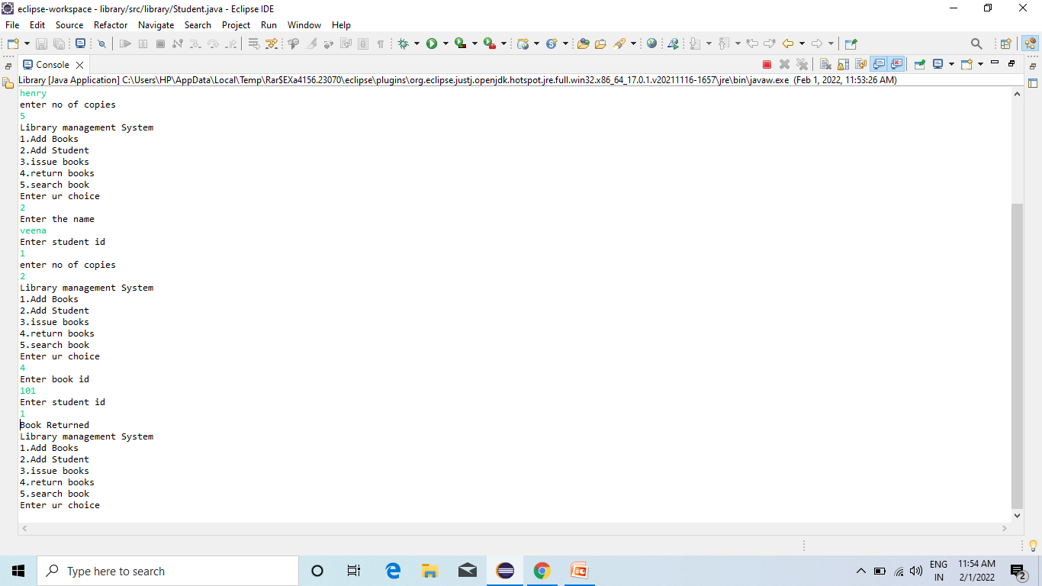

Slide 12
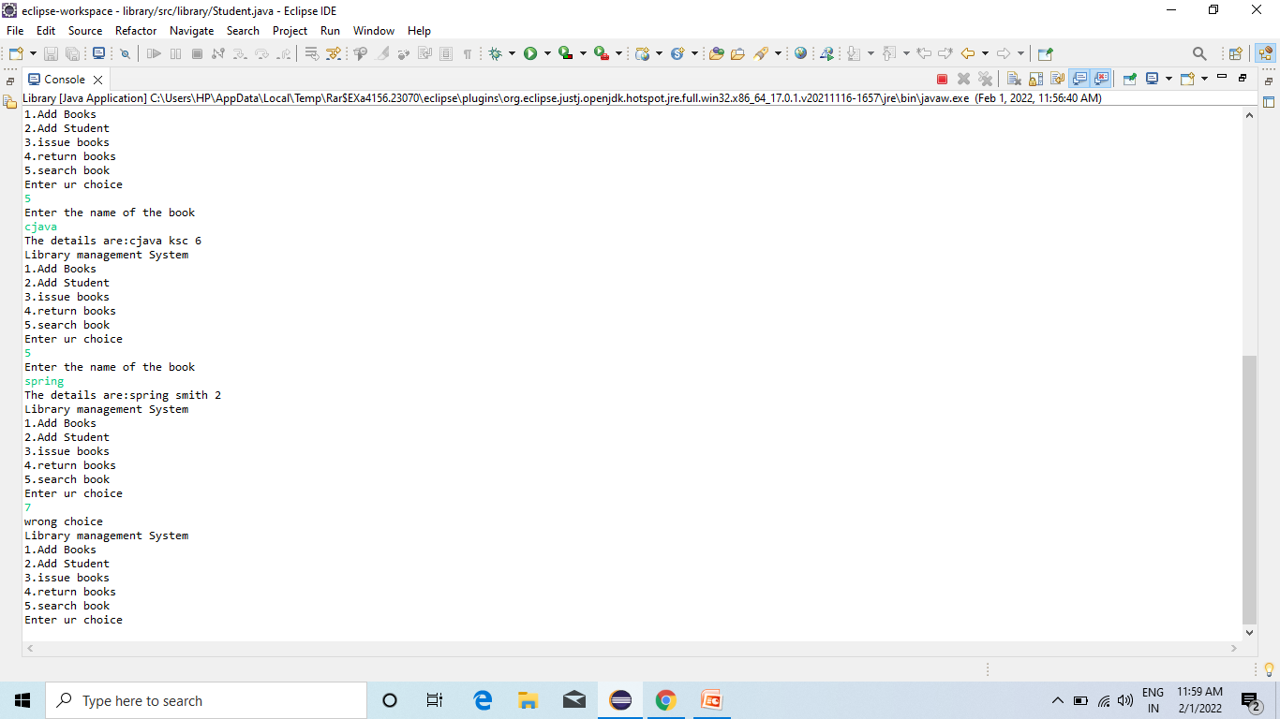

Slide 13
Conclusion
Library Management system are a great way to monitor books, add them, update information in it, search for suitable one ,issue it, return it when needed.

