Slide 1
Machine Learning
Internship Project - 2

Slide 2
Housing – Price Prediction

Slide 3
df_train.describe()
Id MSSubClass LotFrontage LotArea OverallQual OverallCond YearBuilt YearRemodAdd MasVnrArea BsmtFinSF1 ... WoodDeckSF OpenPorchSF EnclosedPorch 3SsnPorch ScreenPorch PoolArea MiscVal MoSold YrSold SalePrice
count 1168.000000 1168.000000 954.00000 1168.000000 1168.000000 1168.000000 1168.000000 1168.000000 1161.000000 1168.000000 ... 1168.000000 1168.000000 1168.000000 1168.000000 1168.000000 1168.000000 1168.000000 1168.000000 1168.000000 1168.000000
mean 724.136130 56.767979 70.98847 10484.749144 6.104452 5.595890 1970.930651 1984.758562 102.310078 444.726027 ... 96.206336 46.559932 23.015411 3.639555 15.051370 3.448630 47.315068 6.344178 2007.804795 181477.005993
std 416.159877 41.940650 24.82875 8957.442311 1.390153 1.124343 30.145255 20.785185 182.595606 462.664785 ... 126.158988 66.381023 63.191089 29.088867 55.080816 44.896939 543.264432 2.686352 1.329738 79105.586863
min 1.000000 20.000000 21.00000 1300.000000 1.000000 1.000000 1875.000000 1950.000000 0.000000 0.000000 ... 0.000000 0.000000 0.000000 0.000000 0.000000 0.000000 0.000000 1.000000 2006.000000 34900.000000
25% 360.500000 20.000000 60.00000 7621.500000 5.000000 5.000000 1954.000000 1966.000000 0.000000 0.000000 ... 0.000000 0.000000 0.000000 0.000000 0.000000 0.000000 0.000000 5.000000 2007.000000 130375.000000
50% 714.500000 50.000000 70.00000 9522.500000 6.000000 5.000000 1972.000000 1993.000000 0.000000 385.500000 ... 0.000000 24.000000 0.000000 0.000000 0.000000 0.000000 0.000000 6.000000 2008.000000 163995.000000
75% 1079.500000 70.000000 80.00000 11515.500000 7.000000 6.000000 2000.000000 2004.000000 160.000000 714.500000 ... 171.000000 70.000000 0.000000 0.000000 0.000000 0.000000 0.000000 8.000000 2009.000000 215000.000000
max 1460.000000 190.000000 313.00000 164660.000000 10.000000 9.000000 2010.000000 2010.000000 1600.000000 5644.000000 ... 857.000000 547.000000 552.000000 508.000000 480.000000 738.000000 15500.000000 12.000000 2010.000000 755000.000000
8 rows × 38 columns

Slide 4
Df_test.describe()
Id MSSubClass LotFrontage LotArea OverallQual OverallCond YearBuilt YearRemodAdd MasVnrArea BsmtFinSF1 ... WoodDeckSF OpenPorchSF EnclosedPorch 3SsnPorch ScreenPorch PoolArea PoolQC MiscVal MoSold YrSold
count 292.000000 292.000000 247.000000 292.000000 292.000000 292.000000 292.000000 292.000000 291.000000 292.000000 ... 292.000000 292.000000 292.000000 292.000000 292.000000 292.0 0.0 292.000000 292.000000 292.000000
mean 755.955479 57.414384 66.425101 10645.143836 6.078767 5.493151 1972.616438 1985.294521 109.171821 439.294521 ... 86.397260 47.061644 17.708904 2.489726 15.099315 0.0 NaN 28.184932 6.232877 2007.859589
std 442.565228 43.780649 21.726343 13330.669795 1.356147 1.063267 30.447016 20.105792 175.030021 429.559675 ... 121.898836 65.865449 51.892906 30.247488 58.483473 0.0 NaN 224.036218 2.774556 1.322867
min 6.000000 20.000000 21.000000 1526.000000 3.000000 3.000000 1872.000000 1950.000000 0.000000 0.000000 ... 0.000000 0.000000 0.000000 0.000000 0.000000 0.0 NaN 0.000000 1.000000 2006.000000
25% 377.750000 20.000000 53.500000 7200.000000 5.000000 5.000000 1954.000000 1968.000000 0.000000 0.000000 ... 0.000000 0.000000 0.000000 0.000000 0.000000 0.0 NaN 0.000000 4.000000 2007.000000
50% 778.000000 50.000000 65.000000 9200.000000 6.000000 5.000000 1976.000000 1994.000000 0.000000 369.500000 ... 0.000000 28.500000 0.000000 0.000000 0.000000 0.0 NaN 0.000000 6.000000 2008.000000
75% 1152.250000 70.000000 79.000000 11658.750000 7.000000 6.000000 2001.000000 2003.250000 180.000000 700.500000 ... 149.250000 66.000000 0.000000 0.000000 0.000000 0.0 NaN 0.000000 8.000000 2009.000000
max 1456.000000 190.000000 150.000000 215245.000000 10.000000 9.000000 2009.000000 2010.000000 1031.000000 1767.000000 ... 728.000000 418.000000 330.000000 407.000000 396.000000 0.0 NaN 3500.000000 12.000000 2010.000000
8 rows × 38 columns

Slide 5
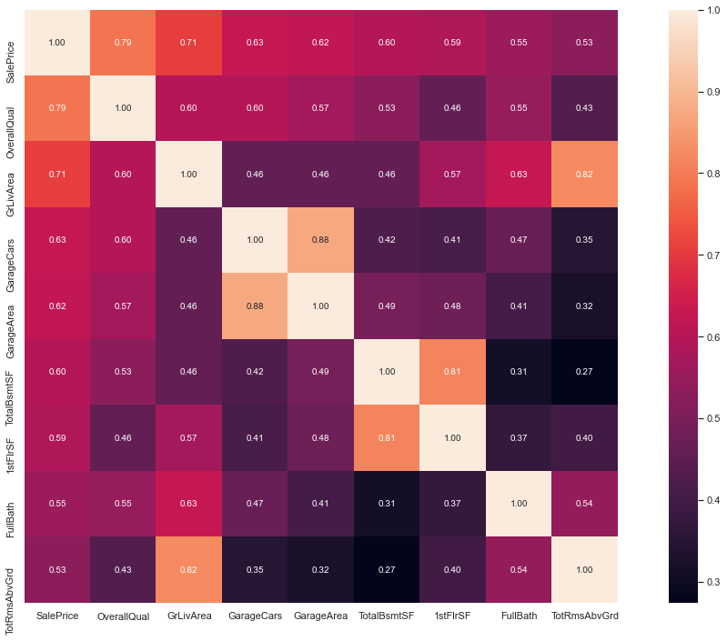
Correlation

Slide 6
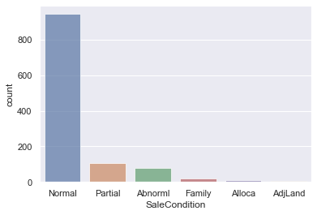
Data Visualization between SaleCondition

