Slide 1
Machine Learning
Internship Project - 1

Slide 2
Flight Prediction

Slide 3
df.describe()
count 10683.000000
mean 9087.064121
std 4611.359167
min 1759.000000
25% 5277.000000
50% 8372.000000
75% 12373.000000
max 79512.000000

Slide 4
df.isnull().sum()
Airline 0
Date_of_Journey 0
Source 0
Destination 0
Route 1
Dep_Time 0
Arrival_Time 0
Duration 0
Total_Stops 1
Additional_Info 0
Price 0
dtype: int64

Slide 5
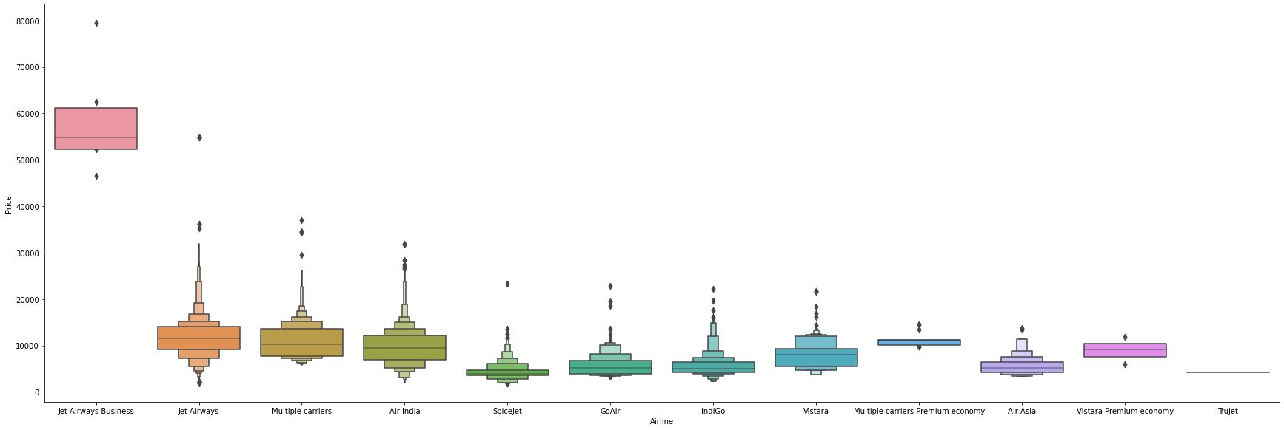
Data Analysis

Slide 6
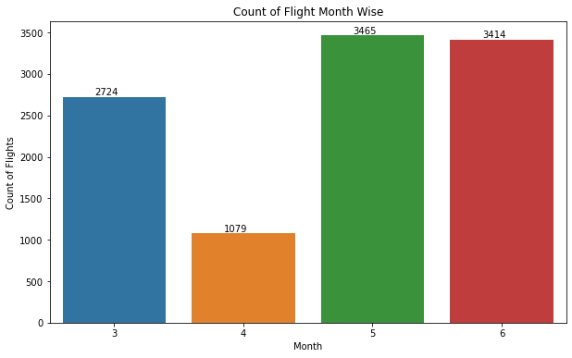
Analysis based on various factors

Slide 7
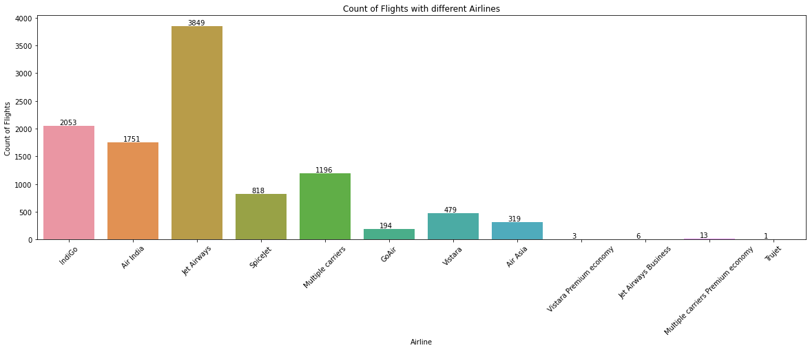
Counting flights with different Airlines:

Slide 8
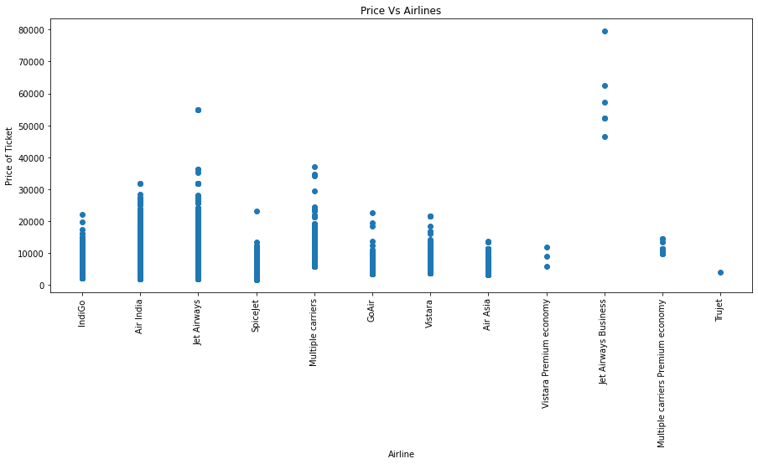
Airline Price

Slide 9
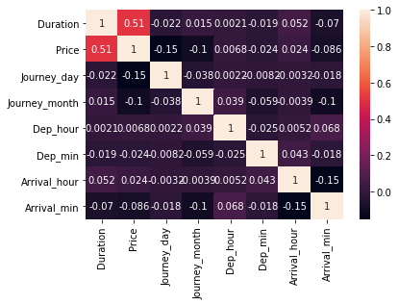
Correlation

Slide 10
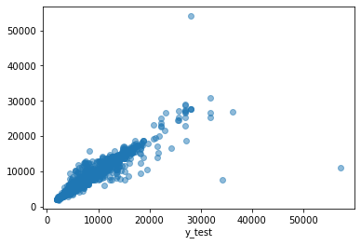
Random Forest Regression

