Slide 1
Machine Learning
Internship Project

Slide 2
Car – Price Prediction

Slide 3
df.describe()
Unnamed: 0 | Year | Kilometers_Driven | Seats | Price
count | 6019.000000 | 6019.000000 | 6.019000e+03 | 5977.000000 | 6019.000000
mean | 3009.000000 | 2013.358199 | 5.873838e+04 | 5.278735 | 9.479468
std | 1737.679967 | 3.269742 | 9.126884e+04 | 0.808840 | 11.187917
min | 0.000000 | 1998.000000 | 1.710000e+02 | 0.000000 | 0.440000
25% | 1504.500000 | 2011.000000 | 3.400000e+04 | 5.000000 | 3.500000
50% | 3009.000000 | 2014.000000 | 5.300000e+04 | 5.000000 | 5.640000
75% | 4513.500000 | 2016.000000 | 7.300000e+04 | 5.000000 | 9.950000
max | 6018.000000 | 2019.000000 | 6.500000e+06 | 10.000000 | 160.000000

Slide 4
Df.info()
<class 'pandas.core.frame.DataFrame'>
RangeIndex: 6019 entries, 0 to 6018
Data columns (total 14 columns):
# Column Non-Null Count Dtype
--- ------ -------------- -----
0 Unnamed: 0 6019 non-null int64
1 Name 6019 non-null object
2 Location 6019 non-null object
3 Year 6019 non-null int64
4 Kilometers_Driven 6019 non-null int64
5 Fuel_Type 6019 non-null object
6 Transmission 6019 non-null object
7 Owner_Type 6019 non-null object
8 Mileage 6017 non-null object
9 Engine 5983 non-null object
10 Power 5983 non-null object
11 Seats 5977 non-null float64
12 New_Price 824 non-null object
13 Price 6019 non-null float64
dtypes: float64(2), int64(3), object(9)
memory usage: 658.5+ KB

Slide 5
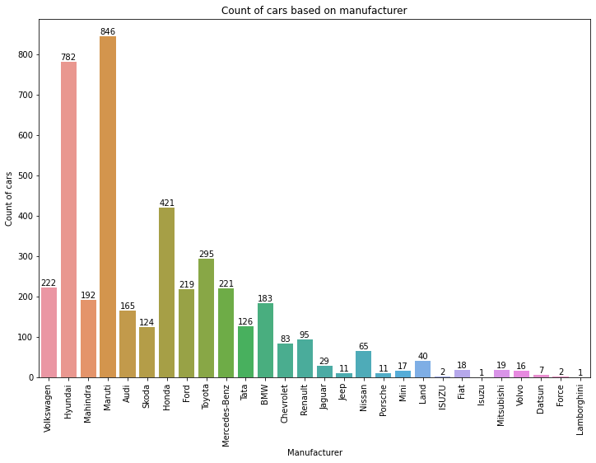
Data Visualization

