Slide 1
Machine Learning
Internship Project - 1

Slide 2
Rating Prediction

Slide 3
df.describe()
Rating Reviews Size Price
count9367.000000 1.084100e+04 9146.000000 800.000000
mean4.191513 4.441119e+05 19577.279477 13.920837
std 0.515735 2.927629e+06 24041.618956 57.195358
min 1.000000 0.000000e+00 1.000000 0.990000
25% 4.000000 3.800000e+01 5.600000 1.490000
50% 4.300000 2.094000e+03 13000.000000 2.990000
75% 4.500000 5.476800e+04 30000.000000 4.990000
max 5.000000 7.815831e+07 100000.000000 400.000000

Slide 4
df.info()
<class 'pandas.core.frame.DataFrame'>
RangeIndex: 10841 entries, 0 to 10840
Data columns (total 13 columns):
# Column Non-Null Count Dtype
--- ------ -------------- -----
0 App 10840 non-null object
1 Category 10841 non-null object
2 Rating 9367 non-null float64
3 Reviews 10841 non-null object
4 Size 10841 non-null object
5 Installs 10841 non-null object
6 Type 10840 non-null object
7 Price 10841 non-null object
8 Content Rating 10840 non-null object
9 Genres 10841 non-null object
10 Last Updated 10841 non-null object
11 Current Ver 10833 non-null object
12 Android Ver 10838 non-null object
dtypes: float64(1), object(12)
memory usage: 1.1+ MB

Slide 5
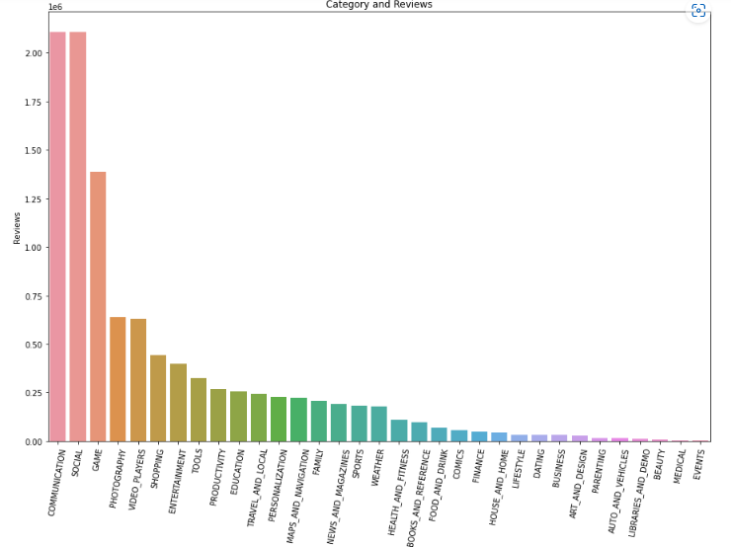
Category and Reviews:

Slide 6
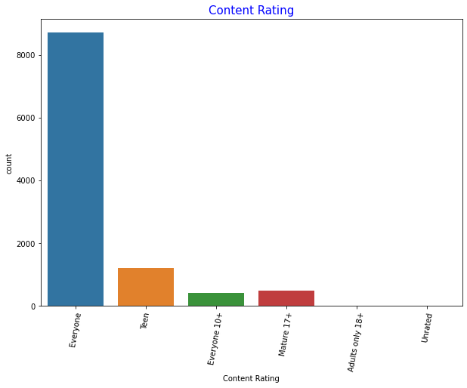
Content Rating

Slide 7
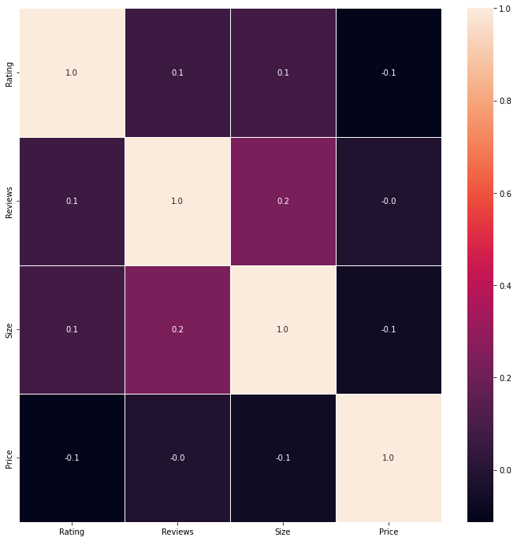
Correlation

