Slide 1
Student Registration System
Harshal Sakpal
Manjunath Shivanna
Shashank Bharadwaj
Neha Thiyagarajan
Veenu Agarwal

Slide 2
Objective
To design a 3 tier application that implements the functions of a simple Student Registration System.
Client
Tier 1
Web Service
Tier 2
Java Service Class
Tier 3
Java Service Implementation Class
Database
Java DAO

Slide 3
Client
Web Service
Student Registration System
DAO
DAL
Database

Slide 4
Discussing Scalability and Performance
Connection Pooling
Prepared Statement
Batch Updates
De-Normalization of the tables
Object caching

Slide 5
Heavyweight Resource Handling
Capable of handling large number of parallel requests
Achieved through use of:
Connection pooling
Using de-normalization technique for the DB
Object Caching

Slide 6
Object Management
Use of JavaBean objects
Three basic objects: Student, Course and Transaction
Sync between JavaBean objects and the corresponding tables in the database (Better naming conventions ; no confusion between the object and corresponding values)
Use of getter-setter methods

Slide 7
Test Cases
JUnit test cases were written for all operations in the service layer to test the functionality of the application.
The TDD approach identified early errors detection and correction resulting in more focused approach in available time towards performance enhancement techniques.
J Meter testing was used to measure performance considering various parameters.

Slide 8
Performance Optimization

Slide 9
Object Caching

Slide 10
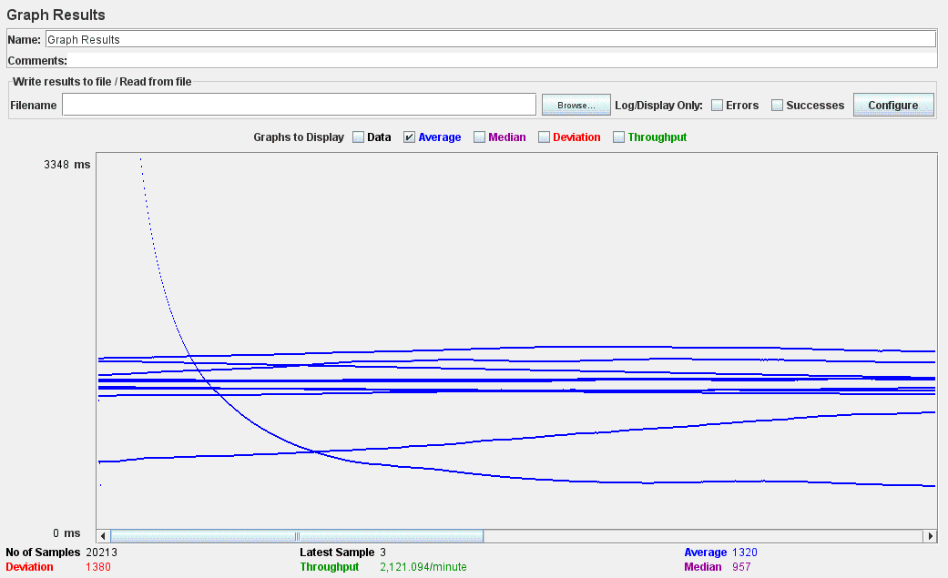
J Meter Testing - Fetching Students Details

