Slide 1

Social Media Usage(Gui)
Python End Term Project
Name – Veer Singh
Reg. No-12324308

Slide 2
Context Setting
Description
.
This project is a Social Media Usage Survey app that allows users to sign up, log in, and complete a survey about their social media habits. The app stores responses in an SQLite database, and users can view their data through graphs, such as platform usage, active times, and devices used. It uses Tkinter for the interface, SQLite for storage, Matplotlib for graphs, and Hashlib for secure password storage. Input validation ensures data accuracy, and error messages are shown if required fields are missing or incorrect.

Slide 3
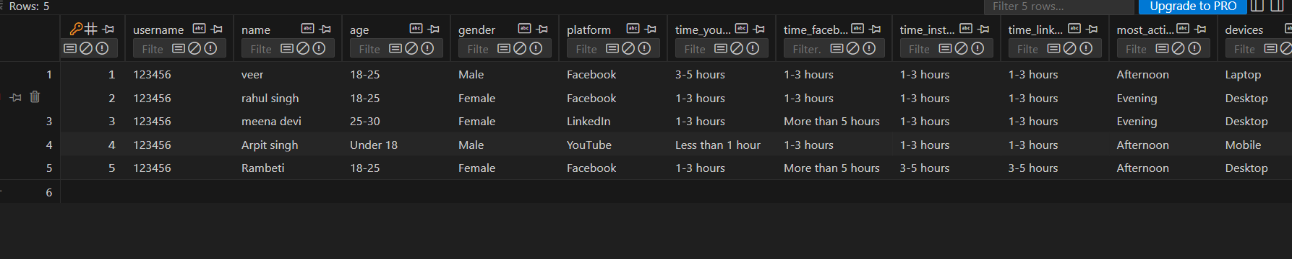
Data stored in database

Slide 4
Objective
The objective of this project is to create a Social Media Usage Survey app that allows users to track and analyze their social media habits. The app aims to provide a platform for users to share their usage patterns, including the platforms they use, their active times, and devices, while ensuring data privacy and security. It also aims to generate visual insights through graphs, helping users compare their usage with others and understand trends in social media consumption. The project utilizes a user-friendly interface, secure login, and efficient data storage to enhance the user experience.

Slide 5
Key Functions and Features of the Survey Platform
1.User Authentication: Allows users to sign up with a username and password, and securely log in using hashed passwords for privacy protection.
2.Survey Form: Collects detailed information from users about their social media habits, including the platforms they use, the time spent on each platform, their most active time of day, age, gender, and the devices used.
3.Data Validation: Ensures that all required fields are filled correctly, with checks for valid email addresses and matching passwords during sign-up.
4.Database Integration: Saves users’ survey responses in an SQLite database, ensuring that the data is securely stored and linked to their user account.
5.Data Visualization: After survey submission, users can view graphs and charts displaying their responses, such as the most used platforms, most active times, and devices used, helping them analyze and compare their usage patterns.

Slide 6
Key Functions and Features of the Survey Platform
6.Error Handling: Displays error messages if any field is missing or incorrect, guiding the user through the process with clear feedback.
7.Matplotlib Integration: Uses Matplotlib to generate visual graphs, providing easy-to-understand insights into the users' social media usage habits.
8.User Experience: Built using Tkinter for a simple, interactive graphical user interface, ensuring ease of use and a smooth user experience

Slide 7
Key Functions and Features of the Survey Platform
8. submit_form()
Purpose: Collects all user inputs, validates them, and saves the data into the database.
Why it’s useful: Ensures the data entered is complete and correct before storing it.
9. HoverButton (Custom Class)
Purpose: Adds a hover effect to buttons, changing their background color when the mouse pointer is over them.
Why it’s useful: Makes the interface more interactive and user-friendly.

Slide 8
Key Functions and Features of the Survey Platform
Additional Features in the UI
Login Page: Provides a secure entry point to the survey.
Survey Form: Collects user responses to questions about their learning habits.
Submit Button: Saves the data to the database.
Show Graphs Button: Displays visual insights from the survey responses

Slide 9
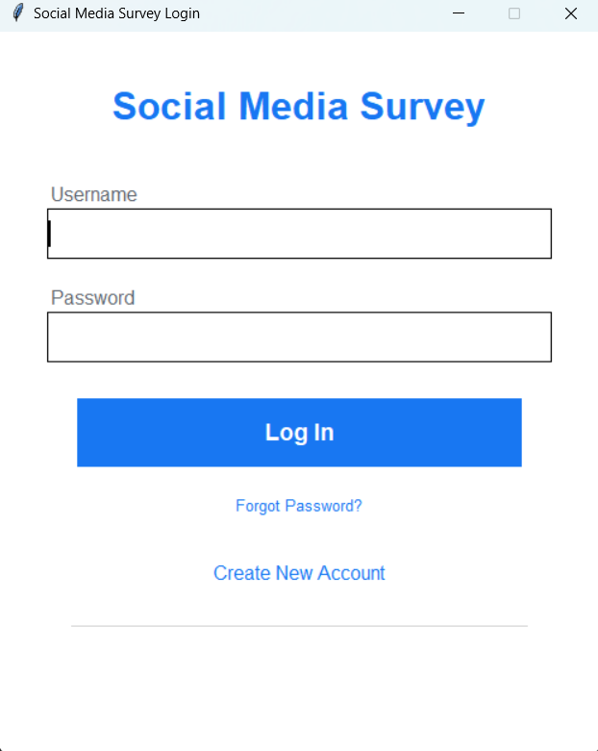
Login PAGE INTERFACE

Slide 10
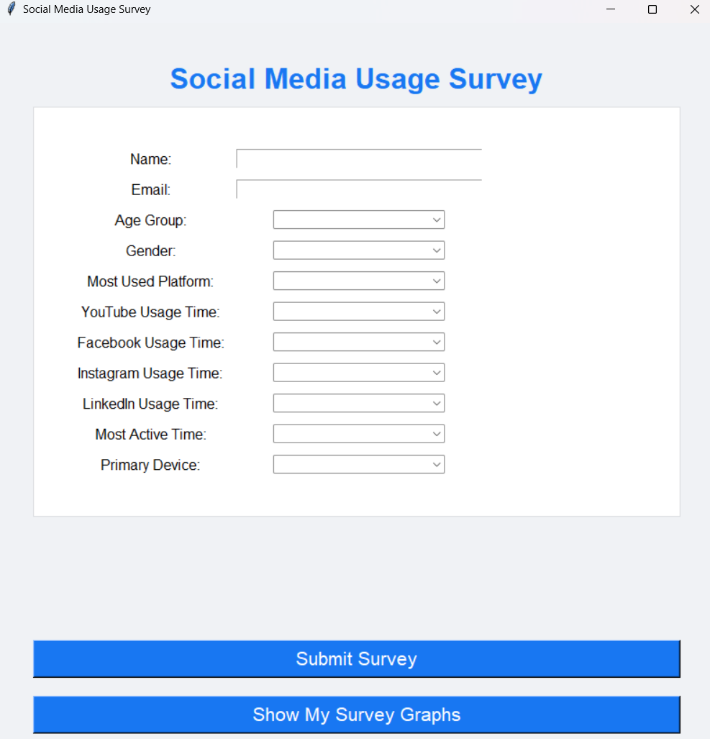
Survey PAGE INTERFACE

Slide 11
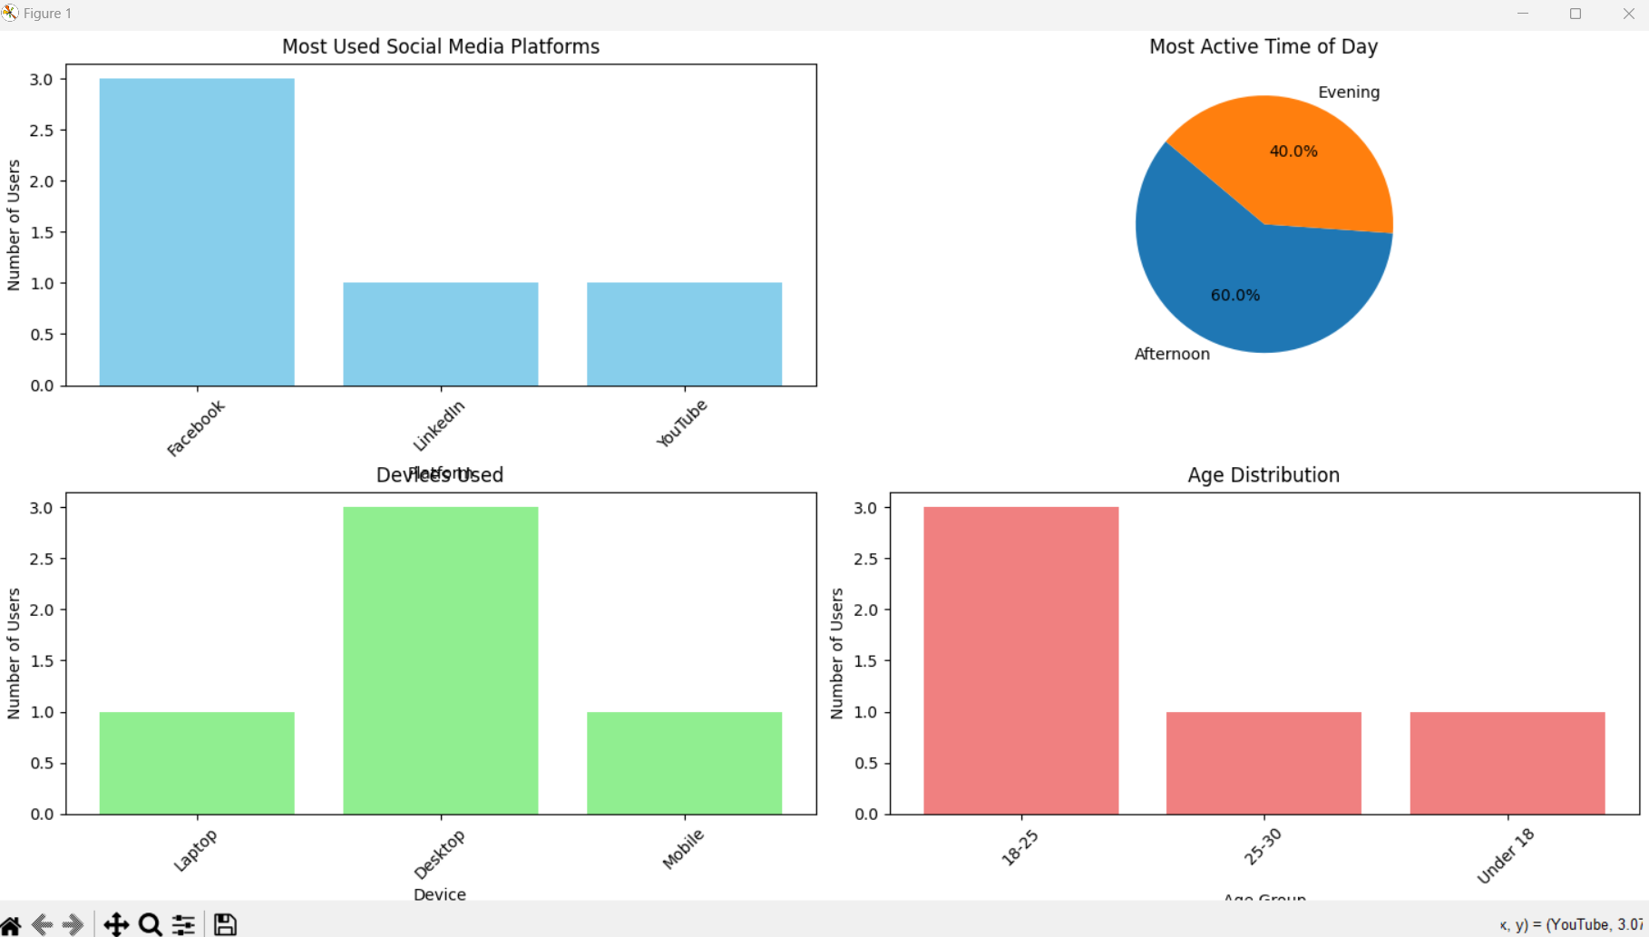
Data visualization

Slide 12
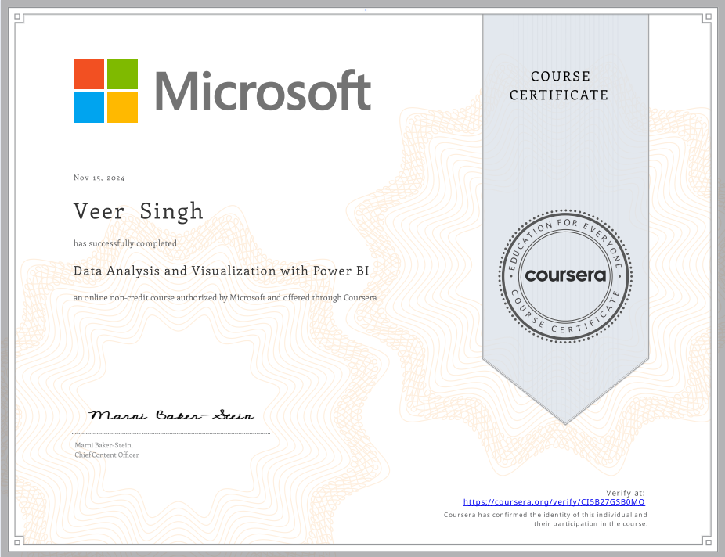
Microsoft Power bi certificate

Slide 13
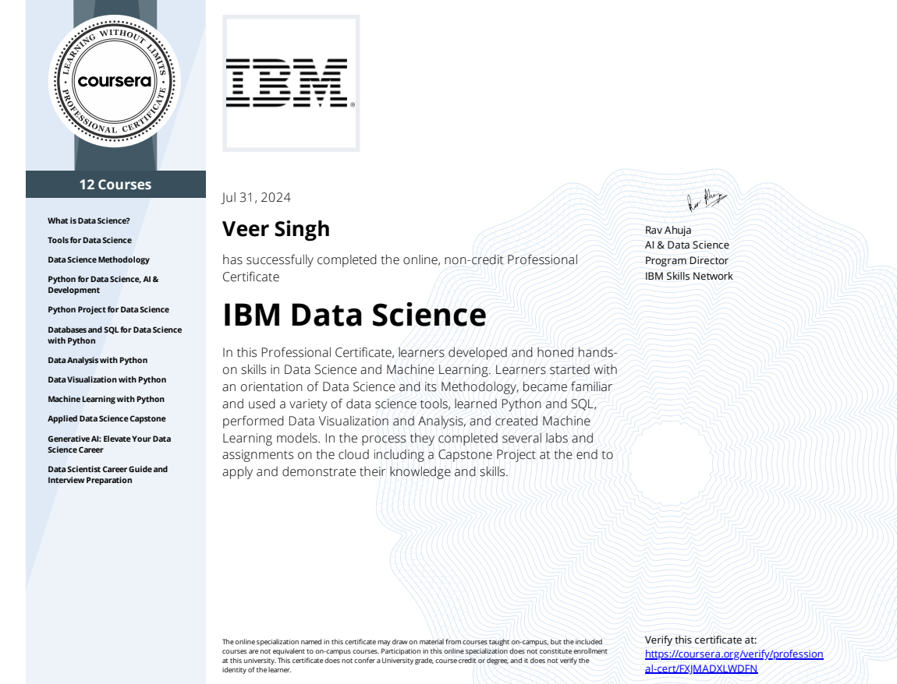
IBM DATA Science python certificate

Slide 14
Thank You!

