Slide 1

Sprocket Central Pty Ltd
Data analytics approach
[Division Name] - [Engagement Manager], [Senior Consultant], [Junior Consultant]

Slide 2
Agenda
Introduction
Data Exploration
Model Development
Interpretation

Slide 3
Introduction
It’s aim to provide a clear and concise overview of the project and objectives for the analysis.
Extracting valuable knowledge and insights from data that can support businesses, organizations, and individuals in various fields. By applying statistical and quantitative techniques, data analytics helps identify patterns, correlations, and relationships within datasets, enabling better understanding and prediction of future outcomes. There are range of approaches, including descriptive, diagnostic, predictive, and prescriptive analytics.
We can use historical data and statistical modeling techniques to make predictions about future outcomes.

Slide 4
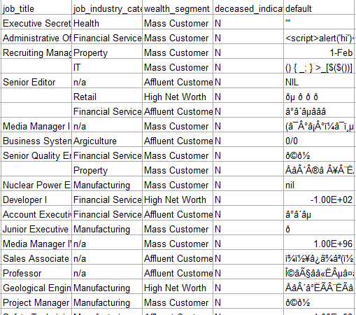
Data Exploration
Gain an understanding of the dataset and checking the quality as well as identify patterns or insights of the data.
In customer demographic, customer address, and transactions table, there are data quality issues, there are lots of blank (missing data). Issues in data accuracy.
Duplicate data in customer_id in “Transaction table” and “Customer Address table”.
Inconsistent values for the same attribute in “CustomerDemographic” (Female being represented as “F”, “Female”, “Femal” and Male being represented as “M”, “Male”.

Slide 5
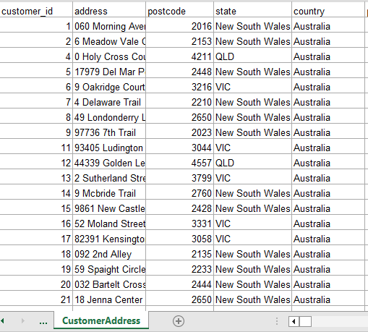
Data Exploration
Gain an understanding of the dataset and checking the quality as well as identify patterns or insights of the data.
Inconsistent data type for the same attribute, in table “CustomerDemographic” Default column has numeric values for some fields and strings for others.

Slide 6
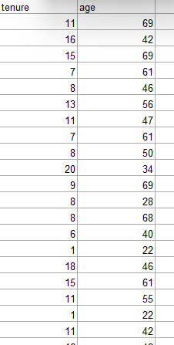
Model Development
Improve the given dataset in a form that will lead develop consinee the data by area & month to get the 1000 new customers within that region.
Create a calculated filled based on the dataset like convert the D.O.B in an age bracket.
By performing a hypothesis on the given set of data and get the statistical data to get the relation between the customers to focus on the particular group of customers.
Place any supporting images, graphs, data or extra text here.

Slide 7
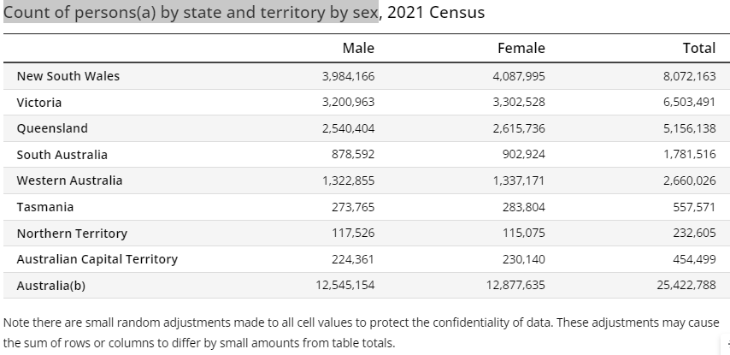
Interpretation
It involves extracting valuable information from the data and translating it into actionable knowledge or decision-making.
In this, we analyze the data, according to your information, we changed the DOB to age and found some external data from the external source (ABS) which helps me to make a relationships between tables and provide some important insight on the data like Count of persons by state and territory by gender. And also found some uncover patterns like count of the people who are most likely customers of your company from different territory. This is my report.
Place any supporting images, graphs, data or extra text here.

Slide 8
Appendix

Slide 9
Appendix
The supporting items are :
MS Excel
Power BI
MS PowerPoint

