Slide 1

NETRA
Sanskrit for "eye"
City-wide number plate recognition and crime tracking
Smart India Hackathon | Team NETRA
Notes:
NETRA means eye in Sanskrit. We read number plates from existing CCTV and track vehicles across a city to detect crime. The one thing to remember from this deck: we never publish a plate we are not sure about.

Slide 2
THE PROBLEM
Cameras everywhere. Almost none of them watching.
1
Nobody watches in real time
A stolen vehicle passes a camera and nothing happens until someone reviews the tape days later.
2
Plate cloning is invisible
A criminal copies a legitimate plate onto a second vehicle. No single camera can detect this - it only shows up when you compare sightings across cameras and time.
3
OCR alone cannot be trusted
Single-frame plate reading peaks at 95-98% outdoors. At city scale that is thousands of wrong plates a day - and a wrong plate puts an innocent citizen under suspicion.
Notes:
Three failures. The third is the one that makes ANPR products untrustworthy, and it is the one we solve.

Slide 3
OUR CORE IDEA
Temporal Voting
One frame gives one guess. A tracked vehicle gives thirty looks at the same plate - and the errors between frames are independent. Glare in frame 7 is not there in frame 22.
1
2
3
4
Accumulate
Weight
Combine
Repair
Every frame of one tracked vehicle votes.
Each vote scaled by plate size, sharpness, angle, detector confidence.
Geometric mean per character - one bad character sinks the plate, because one wrong character IS a wrong plate.
Indian plate grammar fixes O/0, I/1 and B/8 by position.
This is the part that is genuinely ours. Everything else is integration.
Notes:
Emphasise: this is our contribution. YOLO and OCR are off the shelf. The voting engine, the plate grammar and the decision policy are ours.

Slide 4
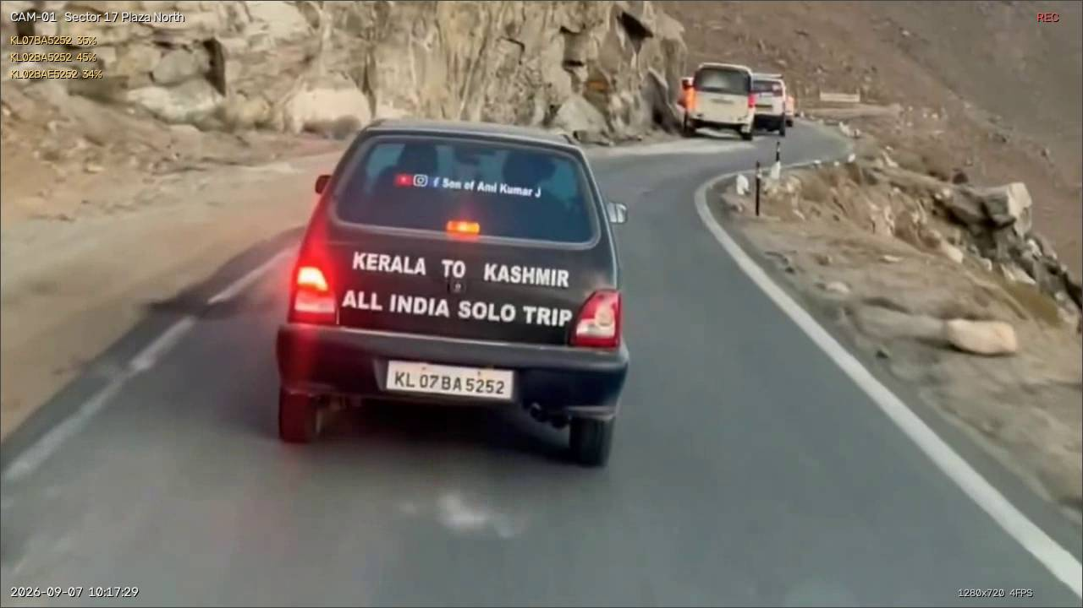
PROOF - REAL INDIAN FOOTAGE
Every frame read it wrong. The consensus was right.
WHAT INDIVIDUAL FRAMES READ
VOTED RESULT
GXISOGJ GXI50GJ GXIS0GJ
GX15OGJ
0G65ZFX WG65ZFX
OG65ZFX
KHO6KSU RH06KSU
KH06KSU
Live detection: plate located, read and written to the database.
Individual reads are noisy because the plate is only ~90 px wide. Voting recovers the truth.
Notes:
These are genuine outputs from Indian traffic footage running through our pipeline, not mock-ups.

Slide 5
THE ACCURACY CLAIM
We never publish a plate we are not sure about.
>= 0.90
0.55 - 0.90
< 0.55
PUBLISHED AS FACT
SENT TO A HUMAN
DISCARDED
"100% accuracy" is not a model metric - it is an operational property. We report precision on the auto-accepted set and its coverage, never one without the other.
48.6%
100%
97.5%
single-frame accuracy
precision when published
auto-accept coverage
Reproduce: pytest apps/edge/tests/test_voting.py - 14 tests, all passing. Controlled simulation of the mechanism, not a field figure.
Notes:
Be explicit that the 100% is precision on what we choose to publish, measured in simulation. Judges respect the distinction.

Slide 6
CRIME DETECTION
Reading plates is table stakes. The value is the reasoning.
1
Cloned plate
2
Speeding
The same plate cannot be in two places at once. We compute the implied speed between cameras - above what is physically possible, the plate exists twice.
Average speed over a surveyed camera-to-camera segment. Reported as indicative, not legally defensible.
3
Loitering / casing
4
Watchlist hit
5+ passes through a zone in 30 minutes, sustained over 8 minutes. Ordinary traffic passes through; it does not circle.
Exact match plus one-character-off fuzzy - the residual OCR error on a stolen vehicle is what you cannot afford to miss.
Measured: 327 background sightings -> 0 false positives. 6 alerts, every one real.
Notes:
A command centre that cries wolf gets switched off. Zero false positives is the number that matters here.

Slide 7
ARCHITECTURE
How it fits together
CAPTURE
DETECT
READ + VOTE
REASON
OPERATE
RTSP / video
One decoder thread
per camera
YOLOv8n vehicles
ByteTrack IDs
YOLO11n plate
EasyOCR crop
Temporal voting
Decision policy
Rules engine
Alerts + evidence
Audit log
Live wall | map
Search | review
SSE real time
>
>
>
>
One process, shared models
Display decoupled from inference
SQLite, PostGIS-ready
Ten separate workers each load their own YOLO and OCR and thrash the machine. Shared: 2.2 GB for the whole network.
Every camera keeps showing smooth video even while inference is busy elsewhere.
No server, no account, no network - the demo survives dead venue wifi.
Notes:
Each design decision was forced by measurement, not preference.

Slide 8
WHAT WE ARE USING
Technology stack
AI / COMPUTER VISION
BACKEND
FRONTEND
YOLOv8n - vehicle detection
ByteTrack - persistent track IDs
YOLO11n - licence plate localisation
EasyOCR - plate text recognition
Temporal Voting - ours, pure Python
PyTorch CPU / ONNX + DirectML
FastAPI + Uvicorn
Pydantic v2 - OpenAPI source of truth
SQLite (WAL), PostGIS-ready
Server-Sent Events - live feed
Rules engine - pure Python
Docker - deploy anywhere
Next.js 15 App Router + React 19
TypeScript
Tailwind CSS v3 over CSS tokens
Leaflet + OpenStreetMap (no key)
Inline SVG charts (no chart lib)
Command palette, keyboard-first
Optional cloud AI arbitration (Gemini / OpenAI / Anthropic / Grok) - off by default. Local models do 100% of per-frame volume; the API is a bounded escalation path.
Notes:
If asked 'did you just wrap an API' - local models handle all per-frame volume at zero marginal cost. Hosted AI is optional and off.

Slide 9
WHAT WE BUILT
A working system, not a prototype
8,557
12
25
14
lines of code
database tables
API operations
automated tests
ELEVEN DASHBOARD SCREENS
OPERATOR FEATURES
Overview with live KPIs and traffic sparkline
Live camera wall + full-screen camera view
Map with incidents and geofences
Audited plate search
Vehicle trajectory with time playback
Alert triage and evidence view
Human review queue | camera health | audit log
Ctrl-K command palette
g + key vim-style navigation
Live alert toasts over SSE
Density switch - laptop or wall display
Keyboard-first review queue
One-command start, auto-sized to the hardware
Docker deploy to any cloud
Notes:
Everything listed here runs. The status slide names what does not.

Slide 10
PRIVACY & ACCOUNTABILITY
It is a surveillance system. We engineered it like one.
1
No owner PII in the sighting stream
Plate -> owner is a separate, audited lookup. A plate search cannot silently become an identity lookup.
2
Every search is logged before results return
Operator, query and stated reason. "Who searched this plate, and why" is the most important record in the system.
3
Watchlist entries expire
Purpose-bound with an expiry date. An entry that never expires is how a watchlist becomes permanent surveillance.
4
Alerts are advisory - a human always decides
No automated enforcement, ever. Cloned-plate alerts need high confidence on both sightings.
Framed against India's DPDP Act 2023.
Notes:
This slide wins trust. Most ANPR pitches ignore privacy entirely.

Slide 11
HONEST STATUS
What works, and what does not
WORKING TODAY
NOT YET REAL
Temporal voting + Indian plate grammar (unit tested)
Rules engine - 0 false positives on 327 sightings
REST API, SSE live feed, audit log
Dashboard, map, trajectory, review queue
Real ANPR on Indian footage - publishes real plates
Multi-camera live wall with CCTV overlay
Auto-sizing to available hardware
Video anomaly detection - ingest and alerting done, the detector is not trained
Cloud AI arbitration - code complete, off by default, needs an API key
Threshold calibration on a labelled Indian dataset
A demo that claims more than it does is a demo that dies under questioning.
Notes:
Volunteering the gaps buys credibility for everything else on the working side.

Slide 12
NETRA
The system never publishes a plate it is not sure about.
That single property is what separates an ANPR demo from an ANPR system a police force could actually be given. Everything else - the cross-camera cloning detection, the audited search, the human review queue - follows from taking it seriously.
python scripts/start.py -> localhost:3000
Smart India Hackathon | Team NETRA
Notes:
Close on the operational property. Then offer the live demo.

