Slide 1
VK TRAVEL
WEB PROJECT
PROPOSAL
-VEER KHATRI

Slide 2
TABLE OF CONTENTS
01
04
About the Project
Sneak Peek
02
05
Major Requirements
Project Stages
03
06
Project Goals
Our Team
A comprehensive guide to the world's best travel destinations, its print heritage back 3 years,
Try to do best Performance in website
Begin your cultural tour of Qatar by planning well – because there is plenty to experience
Choose The Niche. The niche defines the type, features, and technologies for the future website
Need a travel website for or travel portal as customers' solution? We'll show and best practices examples
The Travel Team is a full service travel provider committed to delivering exceptional travel experiences

Slide 3

OUR COMPANY
VK TRAVEL
A travel agency is a private retailer or public service that provides travel and tourism-related services to the general public on behalf of accommodation or travel suppliers to offer different kinds of travelling packages for each destination.

Slide 4
WHAT WE ARE WORKING ON
SECURE
ACCESSIBLE
FAST AND RELIABLE
Mercury is the closest planet to the Sun
Despite being red, Mars is a cold place, not hot
Neptune is the farthest planet from the Sun

Slide 5
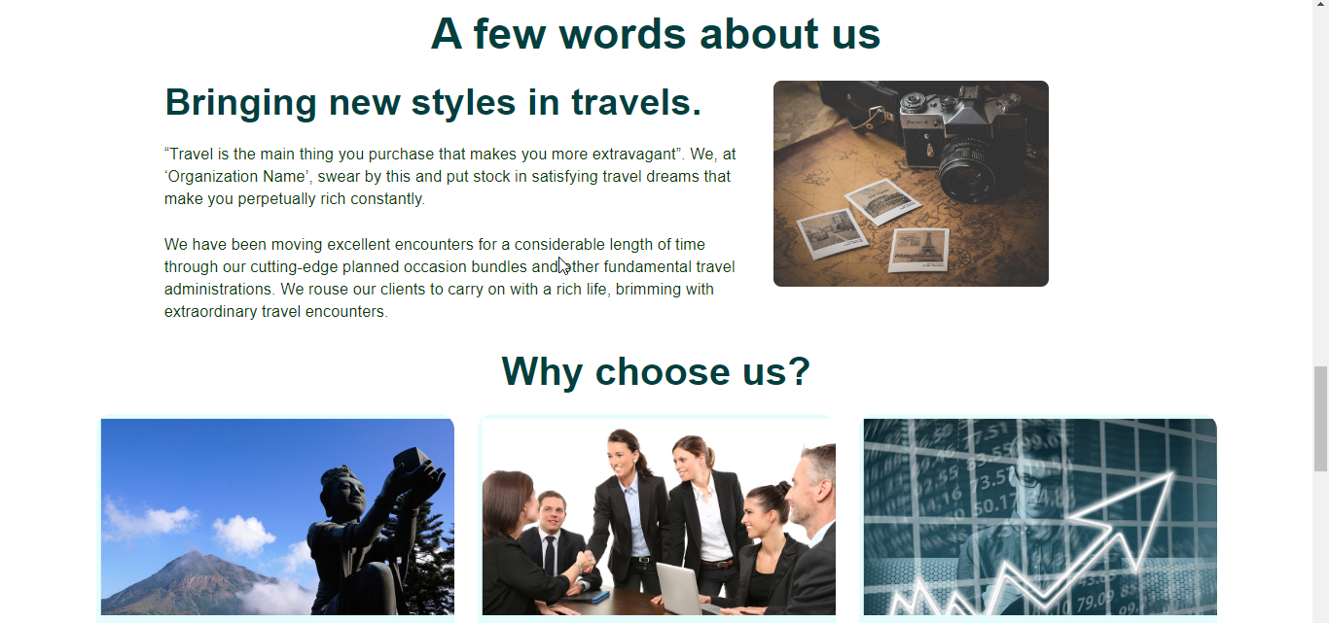
ABOUT THE PROJECT
A Travel Agent is a professional who plans your next vacation. They'll help clients find their desired vacation. The Travel Agent is responsible for booking flights, hotels, and tours for their clients. They also handle details like insurance coverage

Slide 6
—VEER KHATRI
“Remember that happiness is a way of travel, not a destination.”

Slide 7
ADVANTAGES
24*7 Service. ...
Tailor-made Holidays. ...
Time Saving. ...

Slide 8
FUTURE
The travel agency business is one of the most lucrative industries in terms of revenue. It has been around for a long time and continues to grow with every passing year. Travel agencies have to be on top of everything, as they constantly strive to stay competitive and grow their business.

Slide 9
OUR GOALS
EXPANSION
POSITIONING
USABILITY
Neptune is the fourth-largest planet in our Solar System
Venus has a beautiful name and is the second planet from the Sun
Despite being red, Mars is a cold place, not hot. It’s full of iron oxide dust

Slide 10
THANKS!
Does anyone have any question?
addyouremail@freepik.com
+91 123 123 123
veerkhatri67@gmail.com

