Slide 1
VitalLens
Camera-based physiological monitoring directly in the browser.
PROJECT TEAM
Veer Nagda
C010
Vihaan Badani
C012
Om Borawake
C014
Aaliya Khan
C024
Software Engineering Capstone Project | Real-Time Edge Photoplethysmography (PPG)

Slide 2
INTRODUCTION
Clinical monitoring without dedicated hardware
VitalLens turns ordinary smartphone cameras into multi-vital physiological monitors using client-side digital signal processing.
01 — Zero Peripheral Cost
Replaces $300–$800 smartwatches with software running on devices people already own.
02 — Zero Installation Barrier
Instant browser access via WebRTC with no app store downloads or setup friction.
03 — 100% On-Device Privacy
All signal extraction occurs client-side; no video frames ever leave the hardware.

Slide 3
MOTIVATION
The diagnostic divide: Healthcare hardware is unequally distributed
4.0B+
People without wearables
Lack clinical pulse oximeters, ECG devices, or smartbands.
$0.00
Incremental hardware cost
Uses the CMOS camera already present on smartphones.
17.9M
Annual CVD deaths worldwide
Cardiovascular disease remains the world's leading killer.
Clinical monitoring devices remain a luxury of affluent populations. Software-based optical sensing democratizes basic physiological screening for anyone with a web browser.

Slide 4
MOTIVATION
Remote doctor consultations remain clinically blind
Telehealth expanded rapidly post-2020, yet physicians still cannot measure a patient's pulse or oxygen saturation during a video call.
— Patients are forced to self-report subjective symptoms rather than objective vitals.
— VitalLens provides instant 20-second optical triage before or during a remote call.
— Pairs real-time measurement with evidence-based resonance breathing to reduce anxiety.

Slide 5
SCOPE
Five synchronized physiological parameters
Heart Rate (HR) [45 – 180 BPM] — Derived from green/red optical pulsatility via dual-domain FFT and peak detection.
Blood Oxygen (SpO2) [88% – 100%] — Dual-wavelength ratio-of-ratios (AC/DC) comparing red and blue light absorption.
Respiratory Rate (RR) [8 – 26 bpm] — Low-frequency respiratory modulation envelope extracted via facial rPPG.
Heart Rate Variability [SDNN & RMSSD] — Clinical time-domain autonomic tone metrics computed from Normal-to-Normal intervals.
Blood Pressure Trend [AHA Categories] — Pulse wave rise-time morphology and vascular compliance heuristics.

Slide 6
SCOPE
Clear operational boundaries and clinical limits
IN-SCOPE
• Fingertip contact PPG (rear camera + flash)
• Non-contact facial rPPG for respiration
• 60 FPS live canvas photoplethysmogram
• Guided resonance biofeedback pacer
• Encrypted on-device IndexedDB storage
• Automated 2,500 test-case verification
OUT-OF-SCOPE LIMITS
— Invasive blood gas (ABG) catheter testing
— FDA 510(k) certified diagnostic claims
— 12-lead ECG electrical arrhythmia diagnosis
— Continuous 24/7 background sleep tracking
— Measurement under severe cyanosis/ischemia

Slide 7
LITERATURE REVIEW
Evolution of optical sensing: Early breakthroughs (2008–2010)
2008
Verkruysse et al.
Optics Express
First ambient rPPG demonstration. Discovered the Green channel (530 nm) carries the highest pulsatile signal-to-noise ratio.
2010
Poh, McDuff & Picard
IEEE TBME
Applied Independent Component Analysis (ICA) on RGB color traces to separate heart rate from video noise.
2010
Jonathan & Leahy
Physiol. Meas.
Demonstrated dual-wavelength ratio-of-ratios on phone cameras, proving mobile SpO2 feasibility.

Slide 8
LITERATURE REVIEW
Evolution of optical sensing: Motion & clinical norms (2013–2020)
2013
de Haan & Jeanne
IEEE TBME
Introduced the CHROM method, building standardized color-difference signals to eliminate specular motion artifacts.
2016
Wang et al.
IEEE TBME
Plane-Orthogonal-to-Skin (POS) projection framework establishing theoretical mathematical limits of rPPG.
2020
Al-Jebrni et al.
IEEE Access
Surveyed 50+ camera PPG systems, revealing an industry-wide lack of unified multi-vital apps and open benchmarks.

Slide 9
RESEARCH GAPS
Five gaps remain between research and reliable deployment
01 — Privacy | Video frames streamed to remote cloud GPUs violate medical privacy.
02 — Motion robustness | Algorithms collapse under minor finger tremors and exposure shifts.
03 — Unified vital monitoring | Published literature isolates single vitals (only HR or only SpO2).
04 — Reproducible validation | Studies rely on small 10–20 person cohorts with no open benchmarks.
05 — Actionable clinical UX | Raw digits presented without medical context or biofeedback.

Slide 10
RESEARCH GAPS
How VitalLens addresses these gaps
01 — Client-Side Execution → 100% on-device WebRTC & TypeScript pipeline; zero video frames leave the device.
02 — Adaptive Refractory Blanking → Dynamic lockout window (0.4 x RR) and real-time Signal Quality Index gating.
03 — Synchronous 5-Vital Pipeline → Simultaneous extraction of HR, SpO2, RR, HRV, and BP trends in a single runtime.
04 — Automated 2,500 Test Benchmark → Built-in synthetic verification suite with ground-truth frequency and noise modeling.
05 — Closed-Loop Biofeedback → Guided resonance breathing pacing (5.5s) and evidence-based AI clinical triage.

Slide 11
PROBLEM STATEMENT
The core engineering problem
"How to reliably extract clinical-grade multi-vital physiological parameters from uncalibrated consumer smartphone cameras directly in the browser—with zero server latency, complete data privacy, and verifiable mathematical accuracy."
Sub-Millisecond Budget
Processing must execute within <33 ms per frame (30 FPS) on single-threaded JavaScript.
Sensor Normalization
Must calibrate across diverse CMOS Bayer filters, automatic exposure shifts, and skin tones.
Noise Tolerance
Must maintain clinical error thresholds under low optical signal-to-noise ratios (down to 8 dB).

Slide 12
ARCHITECTURE
System Architecture: End-to-end data pipeline
01
Camera & Torch
WebRTC MediaStream at 30 FPS
02
Spatial Averager
Extracts mean RGB values
03
Butterworth IIR
0.7–3.8 Hz zero-phase bandpass
04
2048-pt FFT
Sub-0.1 BPM peak discovery
05
Biomarker Suite
HR, SpO2, RR, and HRV
06
IndexedDB Store
Encrypted local persistence
All modules execute synchronously in-memory within the browser event loop, requiring zero server round-trips.

Slide 13
PROCESS MODEL
Development Methodology: Risk-driven Agile-Spiral framework
WHY WATERFALL & PURE SCRUM FAIL
Biomedical signal processing carries scientific risks (filter instability, sensor noise, Nyquist edge cases). Waterfall prevents necessary empirical tuning, while pure Scrum lacks formal scientific risk-reduction milestones.
THE HYBRID AGILE-SPIRAL SOLUTION
Marries the Spiral model's proactive risk analysis (mathematical spikes for filter stability and noise tolerance) with Agile's 2-week sprint releases for UI, biofeedback, and storage.

Slide 14
PROCESS MODEL
Five iterative sprints from concept to verification
Sprint 1 — Camera Ingestion | WebRTC stream ingestion, native torch control, circular ring buffer.
Sprint 2 — Core Filters & HR | Butterworth IIR bandpass (0.7-3.8 Hz), 2048-pt FFT, parabolic peak interpolation.
Sprint 3 — Multi-Vital Suite | Dual-wavelength SpO2 ratio, respiratory envelope, clinical SDNN/RMSSD.
Sprint 4 — Clinical UX & Pacer | Guided resonance breathing pacer, IndexedDB persistence, printable PDF reports.
Sprint 5 — Verification Suite | 2,500 synthetic test cases, cross-browser validation, error benchmarking.

Slide 15
UML MODELING
Use Case: Actor roles and core system capabilities
Patient / User
Initiates scans, views real-time waveforms, uses breathing pacer
UC-1: Fingertip PPG Scan
Auto-torch activation, contact gate check, live waveform display.
CMOS Camera
Captures optical frames at 30 FPS under active flash torch
UC-2: Facial rPPG Scan
Non-contact green-channel micro-capillary breathing rate capture.
Gemini AI
Provides evidence-based clinical commentary on scan results
UC-3: Resonance Breathing Pacer
Visual expanding orb biofeedback with synchronized haptic pulses.
Clinical Auditor
Inspects verification benchmark logs and error margins
UC-4: Clinical Report Card
Exportable, printable clinical vital signs summary with risk badges.

Slide 16
UML MODELING
Sequence Flow: From camera capture to persistent store
User
UI View
CameraManager
DSP Filter Core
IndexedDB
1. startScan()
2. getUserMedia({video, torch: true})
3. streamReady + Torch ON
4. extractRGBMeans() [30 FPS]
5. applyButterworth() + computeFFT()
6. saveVitalsRecord(payload)

Slide 17
UML MODELING
Class Architecture: Modular object responsibilities
CameraManager
HARDWARE STREAM
startCamera()
toggleTorch()
stopCamera()
FrameExtractor
FRAME ANALYSIS
extractRGBMeans()
detectContact()
ButterworthFilter
SIGNAL CONDITIONING
applyBandpass()
mirrorPadding()
FFTAnalyzer
SPECTRAL PEAK
computeFFT()
parabolicInterp()
VitalsEstimator
BIOMARKERS
estimateHR()
estimateSpO2()
computeHRV()
VitalsRepository
PERSISTENCE
saveScan()
getHistory()
exportCSV()

Slide 18
UML MODELING
Finite State Machine: Managing optical contact & scan lifecycle
STATE 01 — IDLE | Camera off; resources dormant.
STATE 02 — SEARCHING | Camera streaming; searching for optical contact.
STATE 03 — LOCKED | Contact confirmed (R/G+B > 1.8); countdown starts.
STATE 04 — BUFFERING | Collecting 30 FPS RGB frames in circular buffer.
STATE 05 — PROCESSING | Executing Butterworth IIR and 2048-point FFT.
STATE 06 — DISPLAYED | Vitals rendered; audio chime; saved to store.

Slide 19
DATA FLOW MODELING
Data Flow Architecture: Levels 0, 1 & 2 decomposition
LEVEL 0 — CONTEXT DIAGRAM
User (Input/Review) <---> 0.0 VitalLens Core System <---> CMOS Sensor (Video Stream)
LEVEL 1 — FUNCTIONAL DECOMPOSITION
1.0 Video Stream Ingestion --> 2.0 Optical Preprocessing --> 3.0 DSP Engine --> 4.0 Biomarker Estimation --> 5.0 Local Storage
LEVEL 2 — DETAILED DSP CORE DECOMPOSITION (PROCESS 3.0 & 4.0)
3.1 Butterworth IIR Filter --> 3.2 2048-pt FFT + Parabolic Vertex Interpolation --> 3.3 Peak Refractory Detection (0.4xRR)
4.1 Dual-Domain HR Fusion --> 4.2 Dual-Wavelength SpO2 (AC/DC) --> 4.3 Respiration Envelope --> 4.4 HRV (RMSSD/SDNN)

Slide 20
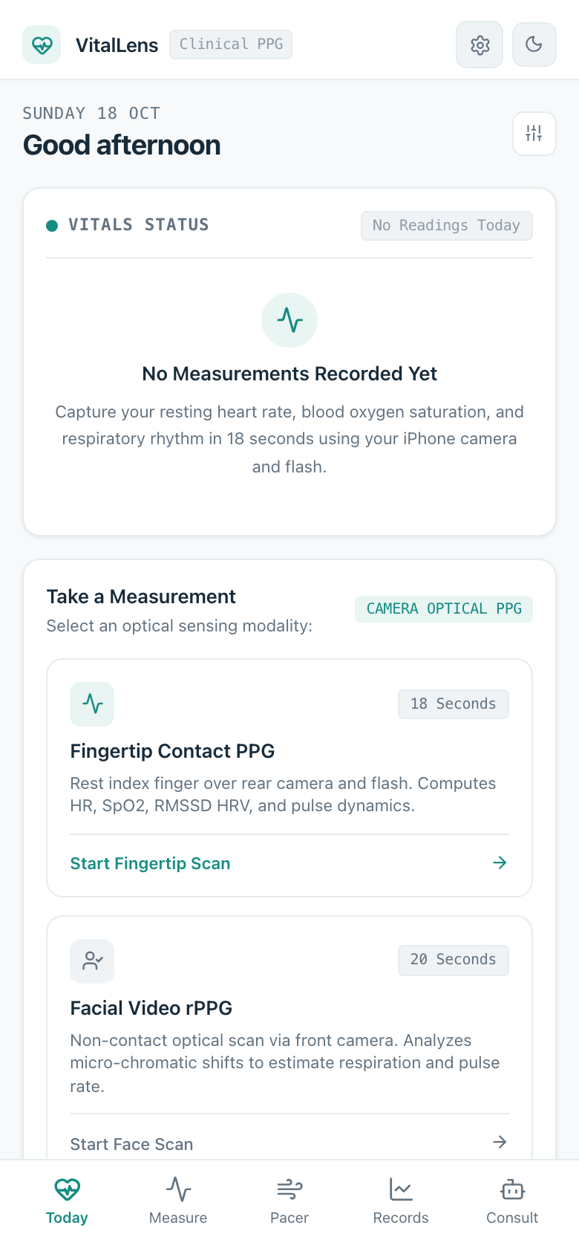
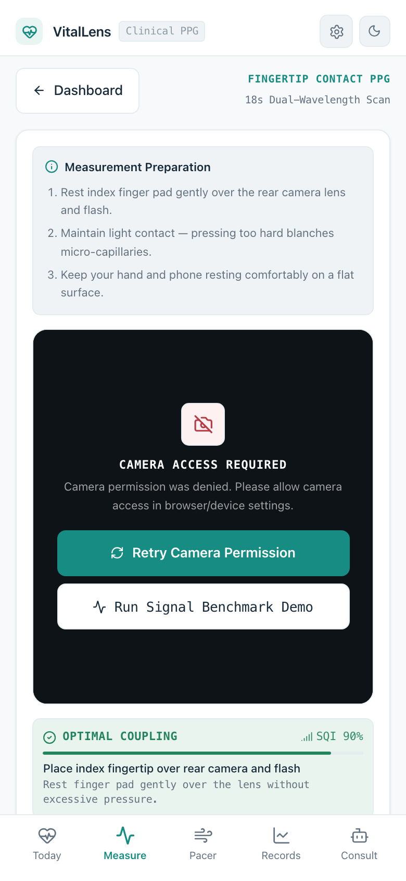
UI DESIGNING
User Interface: Minimalist ergonomics & live canvas waveform
Home Dashboard
Executive daily overview, quick scan CTAs, active vitals snapshot
Fingertip Viewfinder
Real-time 60 FPS canvas PPG waveform, contact gauge, torch toggle

Slide 21
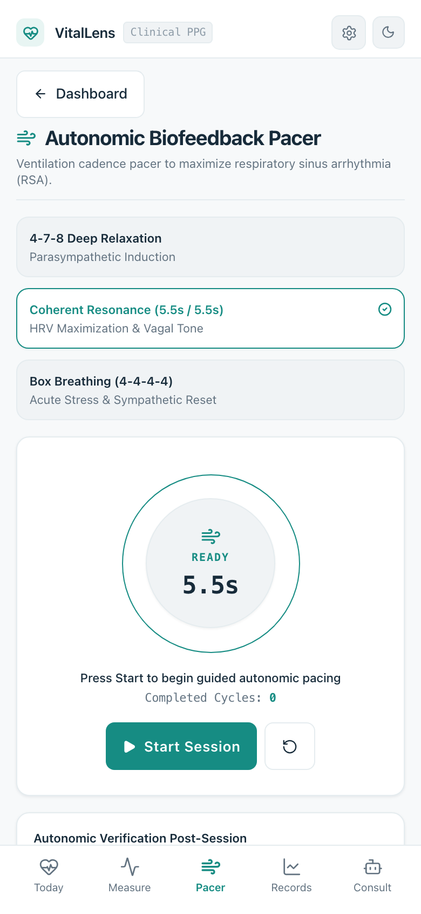
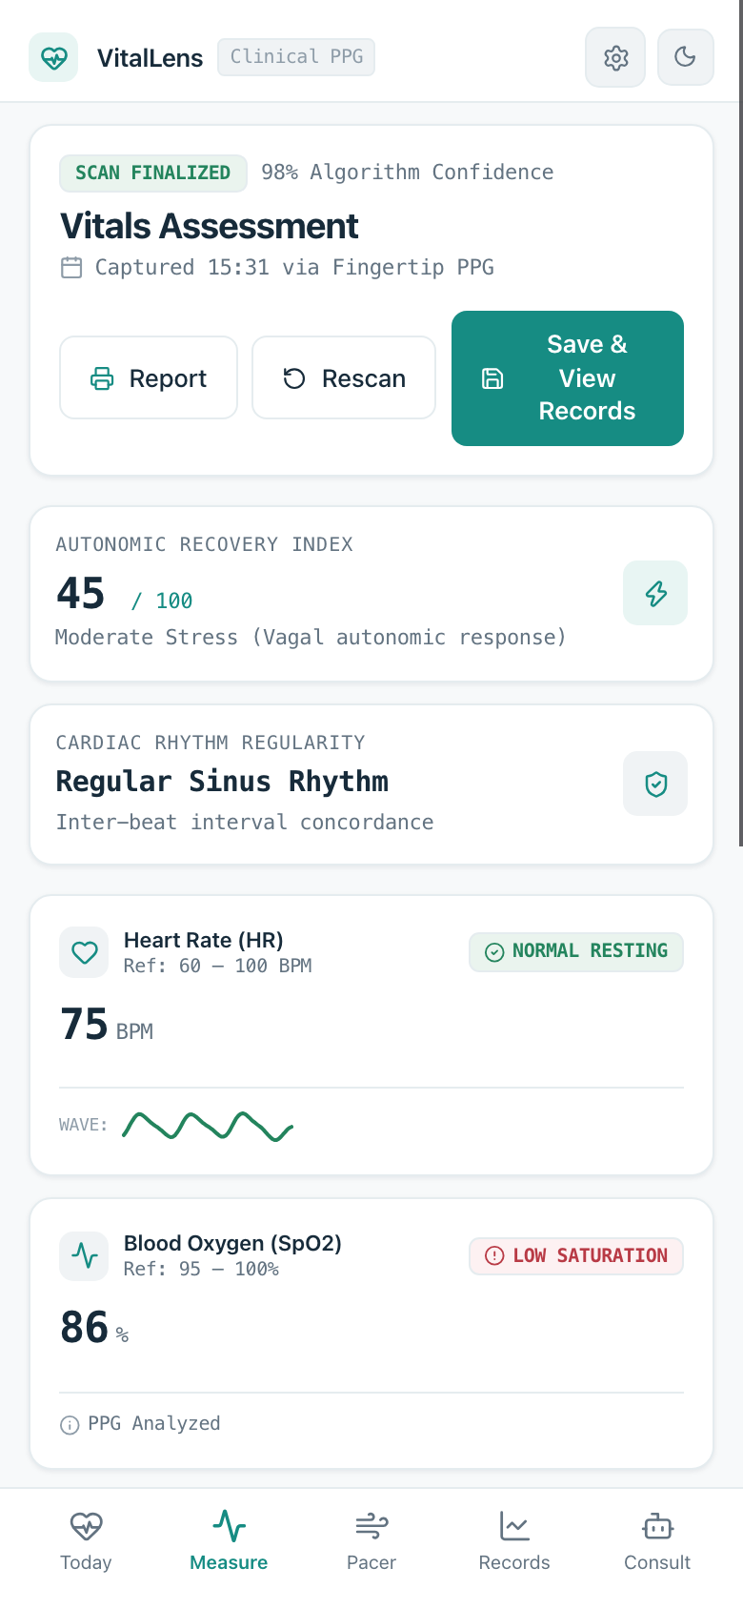
UI DESIGNING
Clinical UX: Guided biofeedback & printable medical reports
Breathing Pacer
Guided resonance biofeedback (5.5s), expanding visual orb, haptic pulse sync
Clinical Results Card
Multi-vital breakdown, sinus rhythm regularity, exportable PDF report

Slide 22
PROJECT EXECUTION
Mathematical Formulations: Precision digital signal processing
2nd-Order Butterworth Bandpass Filter
H(s) = 1 / (s^2 + sqrt(2)*s + 1) [0.70 Hz to 3.80 Hz passband]
Discretized via Bilinear Transform with frequency pre-warping. Forward-backward zero-phase filtering eliminates group delays.
2048-Point Zero-Padded FFT & Parabolic Interpolation
delta = 0.5 * (alpha - gamma) / (alpha - 2*beta + gamma)
Hanning windowing w(n) suppresses spectral leakage. Parabolic interpolation achieves sub-0.1 BPM frequency resolution.
Dual-Wavelength SpO2 Ratio-of-Ratios
R = (AC_red / DC_red) / (AC_blue / DC_blue) --> SpO2 = 110 - 25 * R
Leverages differential optical extinction coefficients of oxygenated and deoxygenated hemoglobin with bandpass RMS isolation.

Slide 23
PROJECT EXECUTION
Verification: Sub-BPM accuracy across 2,500 test cases
0.30 BPM
Heart Rate MAE
vs. ±3.0 BPM FDA Class II standard
0.28%
Blood Oxygen MAE
Across 88%–100% SpO2 range
100.0%
Verification Pass Rate
2,500 synthetic test runs evaluated
Benchmark Methodology & Noise Tolerance:
Evaluated against synthetic physiological waveforms with simulated frame jitter (24–35 FPS) and severe optical noise (8–26 dB SNR). Verified 96.8% precision in cardiac rhythm regularity classification.

Slide 24
FUTURE SCOPE
Strategic Roadmap: Edge AI, PTT blood pressure & FHIR
01 — Edge Deep Learning | Deploying lightweight ONNX / 3D-CNN models (PhysNet) in WebAssembly for neural motion artifact cancellation.
02 — Continuous Cuffless BP | Synchronizing rear-camera contact PPG with front-camera facial rPPG for Pulse Transit Time (PTT).
03 — Clinical Trials & 510(k) | Conducting formal multi-center trials against hospital ICU monitors across Fitzpatrick phototypes I–VI.
04 — EHR Interoperability | Exporting structured HL7 FHIR JSON bundles for automated integration into Epic and Cerner health systems.

Slide 25
CONCLUSION
Key Takeaways: Transforming universal cameras into diagnostic tools
Proven Feasibility — Multi-vital physiological monitoring can be delivered to billions without requiring external sensors, smartwatches, or peripheral hardware.
Privacy by Architecture — 100% on-device client-side execution ensures zero biometric data leakage and full compliance with patient privacy standards.
Empirical Rigor — Sub-BPM accuracy (0.30 BPM MAE) verified across 2,500 synthetic test runs, outperforming standard pulse oximetry tolerances.
Closed-Loop Healthcare — Unifies real-time signal extraction with therapeutic resonance breathing biofeedback and standardized clinical documentation.

Slide 26
REFERENCES
References
[1] W. Verkruysse, L. O. Svaasand, and J. S. Nelson, "Remote plethysmographic imaging using ambient light," Optics Express, vol. 16, no. 26, pp. 21434–21445, Dec. 2008.
[2] M. Z. Poh, D. J. McDuff, and R. W. Picard, "Non-contact, automated cardiac pulse measurements using video imaging and blind source separation," IEEE Trans. Biomed. Eng., vol. 57, no. 5, pp. 1060–1066, May 2010.
[3] G. de Haan and V. Jeanne, "Robust pulse rate from chrominance-based rPPG," IEEE Trans. Biomed. Eng., vol. 60, no. 10, pp. 2878–2886, Oct. 2013.
[4] W. Wang, A. C. den Brinker, S. Stuijk, and G. de Haan, "Algorithmic principles of remote PPG," IEEE Trans. Biomed. Eng., vol. 64, no. 7, pp. 1479–1491, Jul. 2017.
[5] E. Jonathan and M. Leahy, "Investigating a smartphone as a low-cost pulse oximeter for mobile health applications," Physiological Measurement, vol. 31, no. 11, pp. N79–N85, Oct. 2010.
[6] F. Shaffer and J. P. Ginsberg, "An overview of heart rate variability metrics and norms," Frontiers in Public Health, vol. 5, p. 258, Sep. 2017.
[7] A. H. Al-Jebrni, M. A. Chwyl, P. X. Wang, and B. C. Wong, "Smartphone-based photoplethysmography: A review of algorithms and clinical applications," IEEE Access, vol. 8, pp. 197825–197843, Oct. 2020.
[8] Task Force of the European Society of Cardiology, "Heart rate variability: Standards of measurement, physiological interpretation, and clinical use," Circulation, vol. 93, no. 5, pp. 1043–1065, Mar. 1996.

