Slide 1
CourseCritique
Mannan Gosrani B136
Neel Mhatre B150
Veer Shah B151
Yashaswini Kathi B155

Slide 2
Project Overview
Purpose
Intended Use
Product Scope
The purpose of this project is to build an online system for course reviewing to better help students understand their courses.
This project is a prototype for a course review system .This project is useful for the students to decide their elective subjects/academic paths and also for faculty members who are involved in offering the electives and need to manage schedules, enrollments, etc.
This project offers tremendous utility as well as monetary scope. This product can be scaled up and generalised to create a boilerplate review system that colleges, besides MPSTME, can purchase and implement (e.g., Moodle CMS)

Slide 3




Software Requirements
MongoDB
ExpressJS
ReactJS
NodeJS

Slide 4
Web Pages Overview

Slide 5

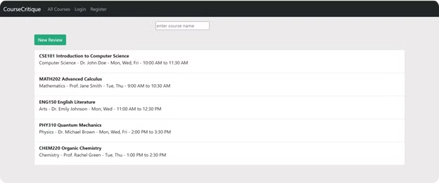
Home Page
The welcoming interface presents a comprehensive view of all available courses while offering intuitive navigation options. Users can easily search through the course catalogue using the name-based search functionality, and they have the opportunity to contribute their insights by adding new reviews through a dedicated button. This streamlined layout ensures a seamless experience for users exploring the educational offerings.

Slide 6

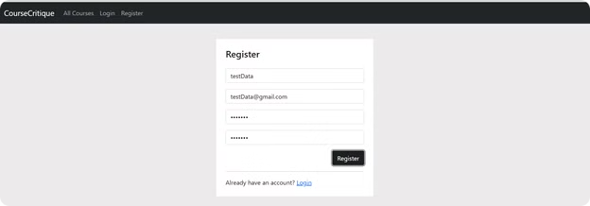
Register Page
The registration portal provides a straightforward pathway for newcomers to join our community. Through this dedicated interface, prospective users can create their personal accounts and establish their presence in the system. The streamlined process enables smooth user registration, making it effortless for individuals to become active members of the platform.

Slide 7

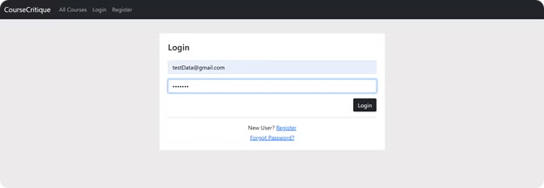
Login Page
The login gateway serves as a secure entry point for existing members to access their accounts. Through this authenticated interface, registered users can seamlessly reconnect with the platform using their established credentials. This dedicated access point ensures a smooth return experience for all members of our community.

Slide 8

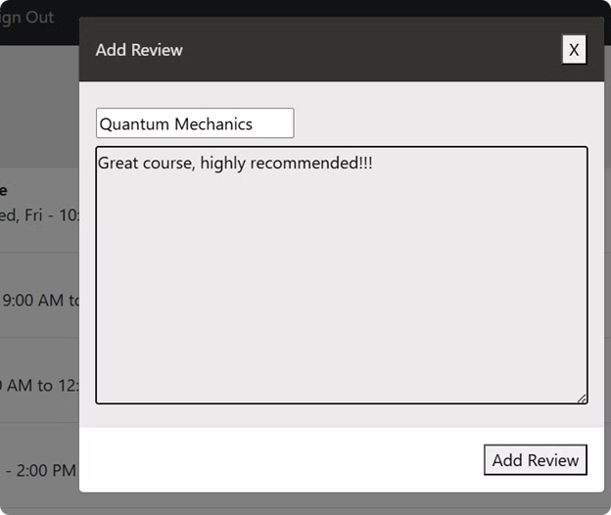
Add Review Page
The review submission interface empowers users to share their valuable experiences and insights about specific courses. Through this dedicated portal, members can select their chosen course from the catalogue and articulate their thoughts, creating meaningful feedback that enriches the learning community. This interactive feature ensures that prospective students can benefit from authentic, user-generated course evaluations.

Slide 9

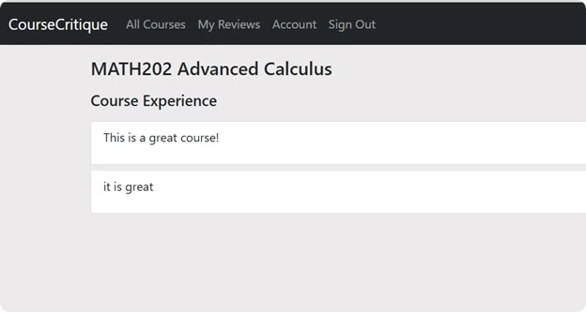
View Course Reviews Page
The course review dashboard serves as a comprehensive repository where users can explore detailed feedback for any specific course of interest. This dedicated section enables learners to access authentic insights and experiences shared by fellow students, providing valuable perspectives on their chosen course. Through this transparent viewing interface, prospective students can make well-informed decisions based on the collective wisdom of the learning community.

Slide 10

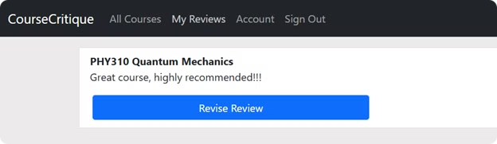
Update Your Review Page
The review modification interface provides users with the flexibility to refine and revise their previously submitted course feedback. This thoughtfully designed section empowers members to update their existing reviews, ensuring their documented experiences remain current and accurate. Through this dynamic platform, users can easily adjust their perspectives, reflecting any changes in their assessment of the course over time.

Slide 11
Databases and Diagrams

Slide 12
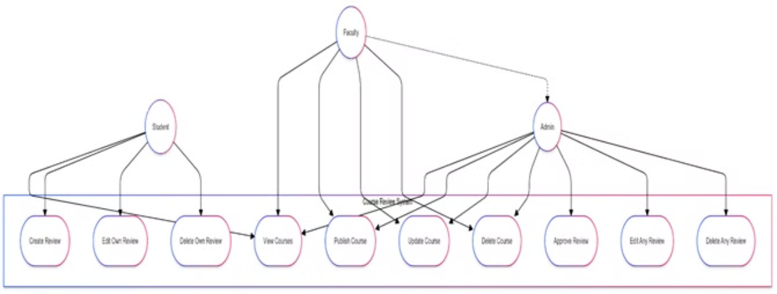
Use Case Diagram

Slide 13
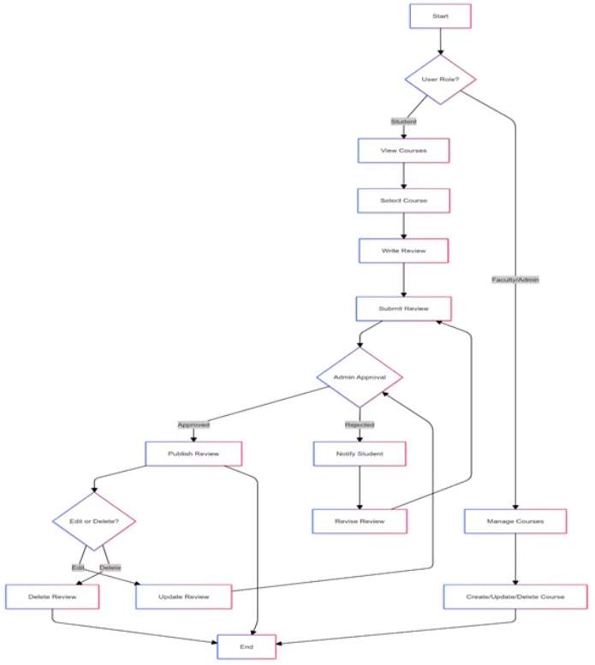
Activity Diagram

Slide 14
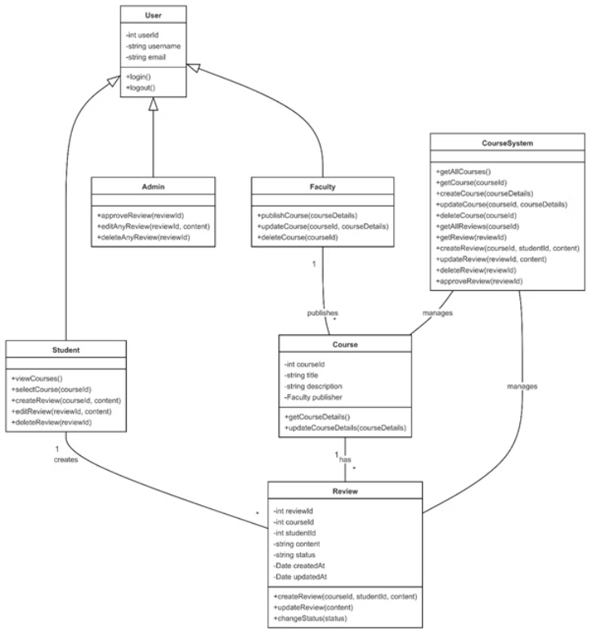
Class Diagram

Slide 15
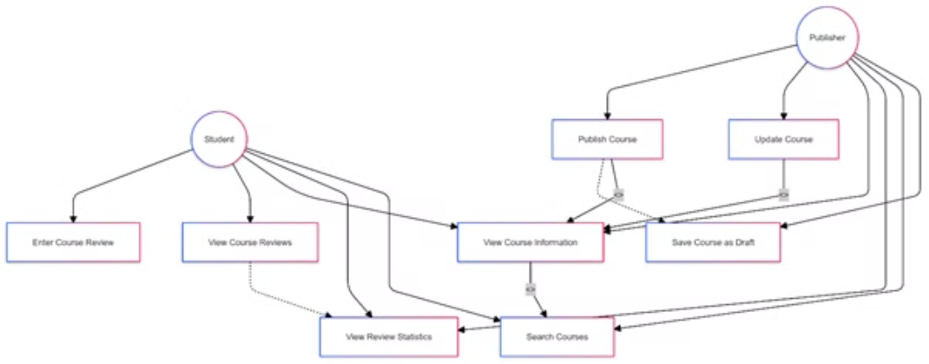
State Diagram

Slide 16
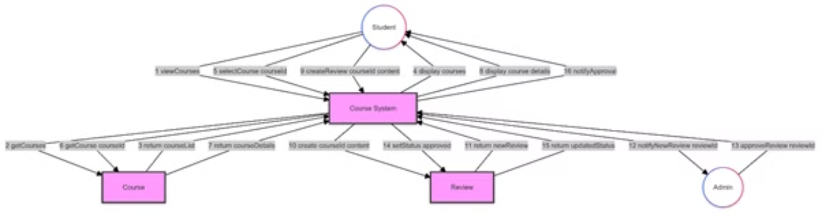
Collaboration Diagram

