Slide 1


The Software Services
Yours !
Veera Raghava

Slide 2
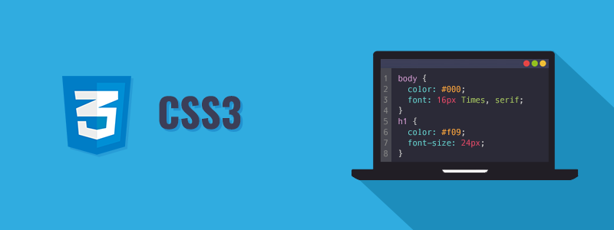
Welcome to CSS-3 Tutorials

Slide 3
What is CSS ?
CSS = Cascading Style Sheets
CSS-3 = 3 refers to latest version of CSS
CSS is used to Style the appearance of Web Pages written in HTML
CSS was introduced by W3C due to difficulties in styling with HTML formatting
CSS is easier and flexible way of Styling Web Pages when compared to HTML formatting
The Bottom Line of CSS is
1- Select Html Elements of Web Page and
2- Apply desired properties to those elements. (its like painting a house after construction)

Slide 4
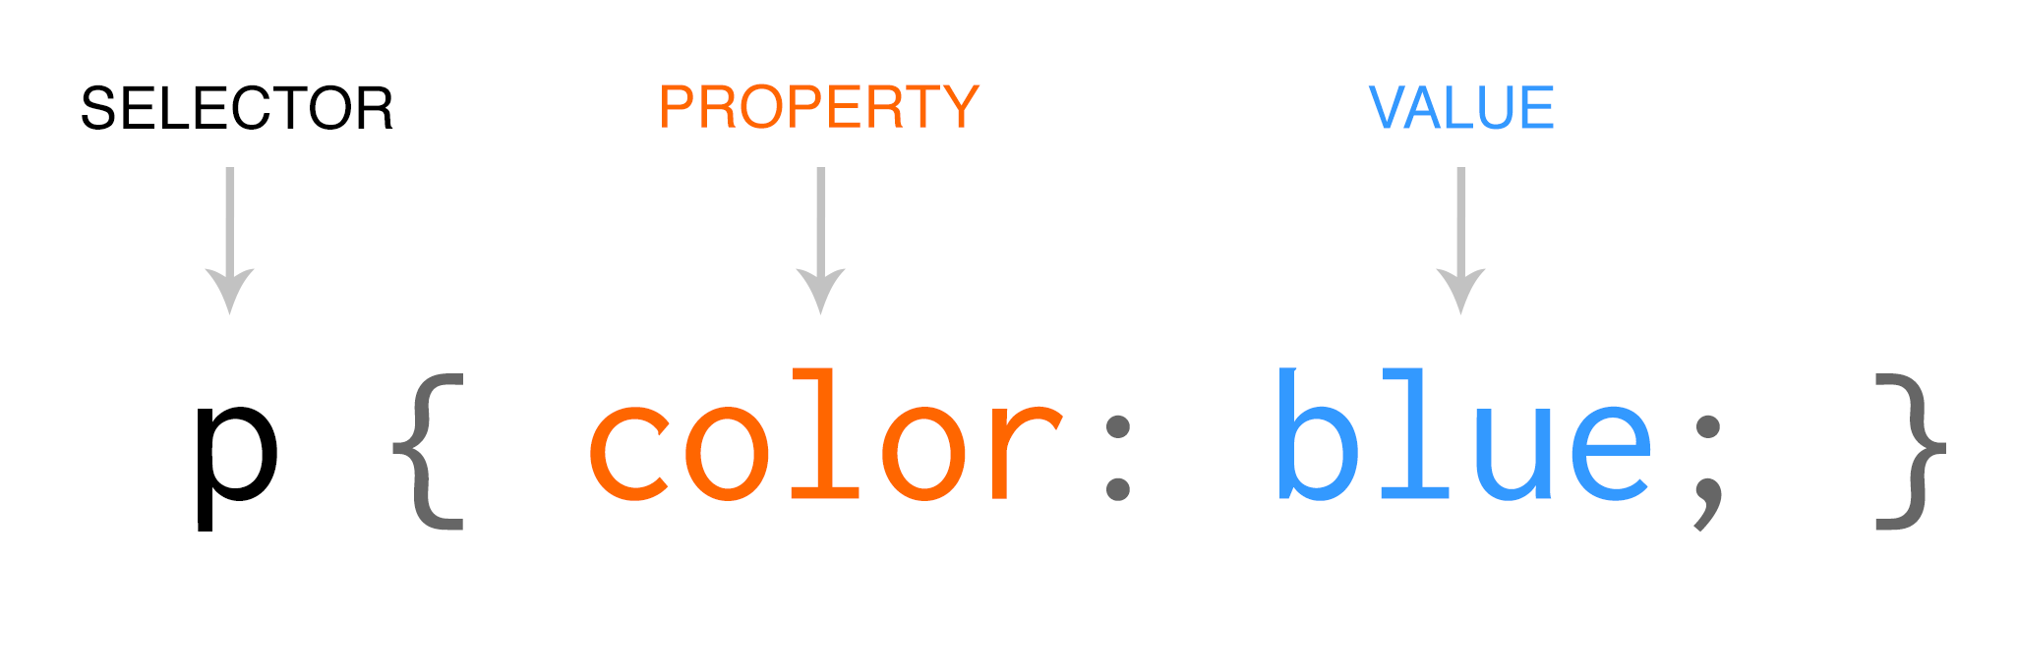
3 Ways to insert CSS in HTML:
CSS Syntax :
1) Inline CSS ( CSS Styles are written inside the HTML Element itself , used for small styling)
Ex: <h1 style = “ color : red ; font-size : 20px ;” > Hello World </h1>
2) Internal CSS ( CSS Styles are written inside the Head Section using <script> tags , used for medium styling )
Ex:
<style>
h1 { color : red ; font-size : 20px ; }
</style>
3) External CSS ( CSS Styles are written in a separate file with extension .css and linked, used for large styling )
Ex: <link rel=“stylesheet” href=“/mystyles.css”>

Slide 5
CSS Selectors:
Simple Selectors
Element name based selection
Id based selection
Class based selection
Universal selection
Group Selection
Attribute Selectors
Combinator Selectors
Pseudo Class Selectors
Pseudo Element Selectors
Note : JQuery also uses CSS Selector concepts to select Html Elements to apply JS

Slide 6
CSS Simple Selectors:
Element name based selection :
Ex: p { text-align: center; color: green; } → selects and modifies all p elements
Id based selection :
Ex: #hello { text-align: center; color: red; } → selects and modifies only element having id as ‘hello’
Class based selection :
Ex: .hai { text-align: center; color: blue; } → selects and modifies all element having class as ‘hai’
Universal selection :
Ex: * { text-align: center; color: blue; } → selects and modifies all elements in document
Group Selection :
Ex: h1, h2, p { text-align: center; color: red; } → selects and modifies specified elements

Slide 7
CSS Attribute Selectors:
CSS [attribute] Selector : it is used to select elements with a specified attribute.
Ex: a[target] {background-color: green;}
CSS [attribute="value"] Selector : it is used to select elements with a specified attribute and value.
Ex: a[target="_blank"] { background-color: green;}
CSS [attribute~="value"] Selector : it is used to select elements with an attribute value containing a specified word which is space separated.
Ex: [title~="flower"] {border: 5px solid green;}
CSS [attribute|="value"] Selector : is used to select elements with the specified attribute starting with the specified value.
Ex: [class|="top"] {background: green;}
CSS [attribute^="value"] Selector : is used to select elements whose attribute value begins with a specified value.
Ex: [class^="top"] {background: green;}
CSS [attribute$="value"] Selector : is used to select elements whose attribute value ends with a specified value.
Ex: [class$="test"] {background: green;}
CSS [attribute*="value"] Selector : is used to select elements whose attribute value contains a specified value.
Ex: [class*="te"] {background: green;}

Slide 8
CSS Combinator Selectors:
Combinator Selectors selects elements based on relationship between elements.
1. Descendant selector (space) : it is used to select all elements that are descendants of a specified element.
Ex: div p {background-color: pink;}
2. Child selector (>) : it is used to select all elements that are the children of a specified element.
Ex: div > p {background-color: pink;}
3. Adjacent sibling selector (+) : it is used to selects all elements that are the adjacent siblings of a specified element.
Ex: div + p {background-color: pink;}
4. General sibling selector (~) : it is used to selects all elements that are siblings of a specified element.
Ex: div ~ p {background-color: pink;}

Slide 9
CSS Psuedo Class Selectors:
A pseudo-class is used to define a special state of an element based on events.
Ex:
Style an element when a user mouses over it
Style visited and unvisited links differently
Style an element when it gets focus
Syntax : selector:pseudo-class { property:value; }

Slide 10
CSS Psuedo Class Selectors:
Anchor Pseudo-classes :
Ex:
/* unvisited link */ a:link { color: #FF0000; } /* visited link */ a:visited { color: #00FF00; } /* mouse over link */ a:hover { color: #FF00FF; } /* selected link */ a:active { color: #0000FF; }

Slide 11
CSS Psuedo Class Selectors:
Hover on <div> :
Ex : div:hover { background-color: blue;}
The :first-child Pseudo-class : selects a specified element that is the first child of another element
Ex : p:first-child {color: blue;}

Slide 12
CSS Pseudo Element Selectors:
Pseudo Element Selectors : it is used to style specified parts of an element.
Ex: Style the first letter, or line, of an element
Insert content before, or after, the content of an element
Syntax : selector :: pseudo-element { property:value; }
The ::first-line Pseudo-element : it is used to add a special style to the first line of a text.
Ex: p::first-line {color: #ff0000; font-variant: small-caps;}
The ::first-letter Pseudo-element : it is used to add a special style to the first letter of a text.
Ex: p::first-letter {color: #ff0000; font-size: xx-large;}

Slide 13
CSS Priority :
CSS follows priority when applying styles to HTML Elements.
1st Priority → Inline CSS
2nd Priority → Internal or External CSS which ever comes first at ending head tag.
Ex:
<head>
<link rel=stylesheet href=“mystyles.css”>
<style>
p {color:red;}
</style>
</head>
<body>
<p style=“color: green;”> Hello Good Morning </p>
</body>
3rd priority
2nd priority
1st priority

Slide 14
CSS Colors :
CSS colors are used to add color to your Web Page.
CSS colors are defined in 6 different ways.
COLOR NAME : Standard color name
Ex : background-color : green;
RGB : (Red value( 0 to 255 ) , Green value (0 to 255) , Blue value (0 to 255) )
Ex : color : rgb(60,40,20);
HEX : #rrggbb ( value of rr or gg or bb = 00 to ff (which is 00=0 & ff = 255 ))
Ex : border : 2px #ff25ac;
HSL : (Hue (in degrees) , Saturation (in % ), Lightness (in %))
Ex : background-color : hsl(10,50%,80%)
RGBA : rgba(red,green,blue,alpha) alpha refers to opacity(0 to 1)
Ex : background-color : rgba(70,60,85,0.5)
HSLA : hsla(hue,saturation,lightness,alpha)
Ex : background-color : hsla(45,60%,80%,0.2)

Slide 15
CSS Backgrounds:
CSS Background Image : background-image: url("paper.gif");
CSS Backgound Repeat : background-repeat: repeat-x or repeat-y or no-repeat
CSS Background Position : background-position: right top;
CSS Background Attachment : background-attachment: fixed or scroll;
CSS Background Shorthand Notation :
background: yellow url("img_tree.png") no-repeat fixed right top;

Slide 16
CSS Borders :
CSS Border Style : border-style: dotted;
dotted,dashed,solid,double,groove,ridge,inset,outset,none,hidden
CSS Border Width :border-width: 5px;
or
border-width: 2px 10px 4px 20px; (top->right->bottom->left)
CSS Border Color : border-color: red;
or
border-color: red green blue yellow;
CSS Shorthand Notation : border: 5px solid red;(width, style, color)
CSS Rounded Borders : border-radius: 5px;

Slide 17
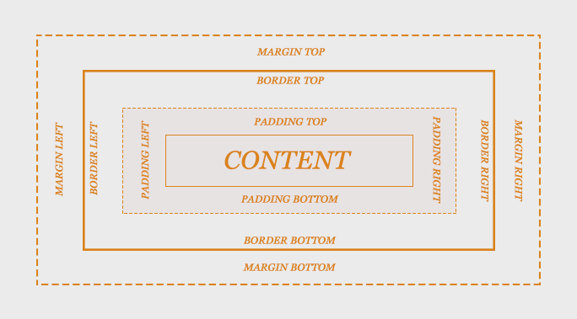
CSS Box Model :

Slide 18
CSS Box Model :
Ex:
div { width: 300px; border: 15px solid green; padding: 50px; margin: 20px; }

Slide 19
CSS Margins :
CSS Margins :
margin-top: 100px;
margin-right: 150px; margin-bottom: 100px; margin-left: 80px;
CSS Auto Margin : margin: auto;
CSS Inherit Margin : margin-left: inherit
CSS Shorthand Notation : margin: 100px 100px 150px 80px; (top,right,bottom,left)
margin: 25px 50px 75px; (top=25,right=left=50,bottom=75)
margin: 25px 50px; (top=bottom=25,right=left=50)
margin: 25px; (all sides=25)

Slide 20
CSS Padding :
CSS Padding is used to insert space b/w the content and its border.
padding-top: 50px; padding-right: 30px; padding-bottom: 50px; padding-left: 80px;
CSS Shorthand Notation :
padding: 25px 50px 75px 100px;
padding: 25px 50px 75px;
padding: 25px 50px;
padding: 25px;

Slide 21
CSS Width and Height:
CSS Width and Height properties are used to set width and height of element excluding element paddings,borders and margins.
div { width: 500px;
height: 200px;
background-color: yellow; }
div { max-width: 500px;
height: 200px;
background-color: yellow; }

Slide 22
CSS Outlines :
CSS Outlines are used to draw a outlines around element borders to hightlight it
outline-style: solid;
outline-color: red;
outline-width: thick;
outline-offset: 15px;
CSS Shorthand Notation :
outline: 5px solid yellow; (width, style, color)

Slide 23
CSS Text :
CSS Text Color : color : red or #ff2512 or RGB(25,45,60);
CSS Text Alignment : text-align: center or left or right or justify;
CSS Text Decoration : text-decoration: none or overline or underline or line-through;
CSS Text Transform : text-transform: uppercase or lowercase or capitalize;
CSS Text Indentation : text-indent: 50px;
CSS Letter Spacing : letter-spacing: 3px;
CSS Word Spacing : word-spacing: 10px;
CSS Line Height : line-height: 0.8;
CSS Text Shadow : text-shadow: 3px 2px red;

Slide 24
CSS Fonts :
CSS Font Family : font-family: "Times New Roman", Times, serif;
CSS Font Style : font-style: normal or italic;
CSS Font Size : font-size: 30px;
CSS Font Weight : font-weight: normal or bold;

Slide 25
CSS Icons :
Icons can be inserted to a web page using font awesome icon library or bootstrap css framework.
Font Awesome Icons :
<script src="https://kit.fontawesome.com/a076d05399.js"></script>
<i class="fas fa-cloud"></i> <i class="fas fa-heart"></i> <i class="fas fa-car"></i> <i class="fas fa-file"></i> <i class="fas fa-bars"></i>
BootStrap Icons :
<link rel="stylesheet" href="https://maxcdn.bootstrapcdn.com/bootstrap/3.3.7/css/bootstrap.min.css">
<i class="glyphicon glyphicon-cloud"></i> <i class="glyphicon glyphicon-remove"></i> <i class="glyphicon glyphicon-user"></i> <i class="glyphicon glyphicon-envelope"></i> <i class="glyphicon glyphicon-thumbs-up"></i>
Google Icons :
<link rel="stylesheet" href="https://fonts.googleapis.com/icon?family=Material+Icons">
<i class="material-icons">cloud</i> <i class="material-icons">favorite</i> <i class="material-icons">attachment</i> <i class="material-icons">computer</i> <i class="material-icons">traffic</i>

Slide 26
CSS Links :
We can style links as we like with different CSS properties.
Link Color : a {color:red}
Link State :
Link → unvisited link
Visited → visited link
Hover → when mouse points to the link
Active → when user clicks on the link
/* unvisited link */ a:link { color: red; } /* visited link */ a:visited { color: green; } /* mouse over link */ a:hover { color: hotpink; } /* selected link */ a:active { color: blue; }

Slide 27
CSS Links :
Link Text Decoration :
a:link { text-decoration: none;
background-color:orange; } a:visited { text-decoration: none;
background-color:green; } a:hover { text-decoration: underline;
background-color:pink; } a:active { text-decoration: underline;
background-color:yellow; }

Slide 28
CSS Links :
Styling a Link as Button :
a:link, a:visited { background-color: #f44336; color: white; padding: 14px 25px; text-align: center; text-decoration: none; display: inline-block; } a:hover, a:active { background-color: red; }

Slide 29
CSS Lists :
Lists are 2 types, Ordered List and Unordered List.
Ex: Ordered List :
<ol>
<li>HTML</li>
<li>CSS</li>
<li>JavaScript</li>
</ol>
HTML
CSS
JavaScript
Ex: Unordered List :
<ul>
<li>HTML</li>
<li>CSS</li>
<li>JavaScript</li>
</ul>
HTML
CSS
JavaScript

Slide 30
CSS Lists :
list-style-type: circle or square or upper-roman or lower-alpha;
list-style-image: url(‘image.gif');
list-style-position: outside or inside;
list-style-type: none; (remove defaults)
Styling List backgrounds :
ol { background: #ff9999; padding: 20px; } ul { background: #3399ff; padding: 20px; }

Slide 31
CSS Tables:
Table Borders : table, th, td {border: 1px solid black;}
Table Border Collapse : table {border-collapse: collapse;}
Table Header Color : th {background-color: #4CAF50; color: white;}
Table Width and Height : table {width: 100%;}
Table Padding : th, td {padding: 15px; text-align: left;}
Table Horizontal Dividers : th, td {border-bottom: 1px solid #ddd;}
Table Hover : tr:hover {background-color: #f5f5f5;}
Stripped Table : tr:nth-child(even) {background-color: #f2f2f2;}
Responsive Table : <div style="overflow-x:auto;"> <table> contents </table> </div>

Slide 32
CSS Forms :
Styling input fields : input { width : 100% }
input[type=text] { width : 100%}
Padding input fields : input { padding : 10px 15px }
Bordering input fields : input {border : 1px solid green ; border-radius : 10px}
Coloring input fields : input {background-color: pink;color : white}
Iconic input fields : input {background-image:url(‘icon_path.jpg’)
Styling Buttons : input [type=button] { background-color: green }

Slide 33
CSS Properties for Web Layout:
CSS Display
CSS Position
CSS Overflow
CSS Float
CSS Clear

Slide 34
CSS Display:
CSS Display property is used to specify how an element is displayed.inline/block/none. It is widley is used in desigining page layout.
Block Level Elements :
<div>
<h1> - <h6>
<p>
<ol>,<ul>,<li>
<form>
<header>
<footer>
<section>

Slide 35
CSS Display :
Inline Level Elements :
<span>
<a>
<img>
Display None : display: none → used to not to display an element
Display Inline : display: inline → used to display element in inline format
Display Block : display : block → used to display element in block format
We can override elements default display behavior with display property.
Ex: li {display: inline;} → by default <li> is block level element but it will be displayed as inline
span {display: block;} → by default <span> is inline level element but it will be displayed as block
h1 {display: none;} → h1 element will hidden.
h1 {visibility: hidden;} →h1 element will be hidden and affects web page layout.

Slide 36
CSS inline-block:
When compared to display : inline , display : inline-block allows us to set width and height of on the element
When compared to display : block , display : inline-block does not insert line break at the end.
This CSS method is frequently used for designing navigation bars.
Ex:
.nav { background-color: yellow; list-style-type: none; text-align: center; padding: 0; margin: 0; } .nav li { display: inline-block; font-size: 20px; padding: 20px; }

Slide 37
CSS Position:
CSS Position is used to place an element at specified position on web page.
position : static → default method , places an element as per normal flow of page
position : relative → places an element relative to its normal postion
position : fixed → places an element relative to viewport and it stays fixed when page scrolls
position : obsolute → places an element relative to its ancestor
position : sticky → element toggles between relative and fixed until an offset is reached
z-index : 1 → used to specify stack order of elements when elements become overlapped

Slide 38
CSS Overflow :
CSS Overflow property is used what to do when content exceeds screen width and height.
overflow : visible → Default. The overflow is not clipped. The content renders outside the element's box.
overflow : hidden → The overflow is clipped, and the rest of the content will be invisible
overflow : scroll → The overflow is clipped, and a scrollbar is added to see the rest of the content
overflow : auto → adds scrollbars only when necessary
overflow-x: hidden → Hide horizontal scrollbar
overflow-y: scroll → Add vertical scrollbar

Slide 39
CSS Float & Clear:
CSS Float and Clear properties are used for positioning and formatting of content
Float property specifies to which side content should float
Clear property specifies whether to allow or not allow an element to float
float : right or left or inherit or none(default)
clear : right or left or both or inherit or none(default)
clearfix :
.clearfix::after {
content: " ";
clear: both;
display: table;
}

Slide 40
CSS Navigation Bars:
We can style unordered list of links to make Navigation Bars.
Ex: <ul>
<li> <a href="/java.html">Java</a> </li>
<li> <a href="/python.html">Python</a> </li>
<li> <a href="/php.html">PHP</a> </li>
<li> <a href="/node.html">Node JS</a> </li>
</ul>
Navigation Bars are two types :
Horizontal navigation bars
Vertical navigation bars

Slide 41
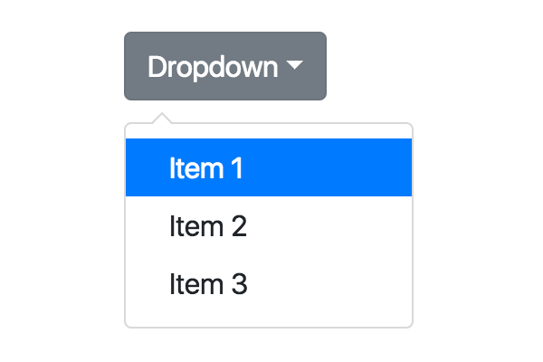
CSS Dropdowns:
With CSS Styles we can make hoverable Drop Down Menu using display:none and display:block properties.

Slide 42
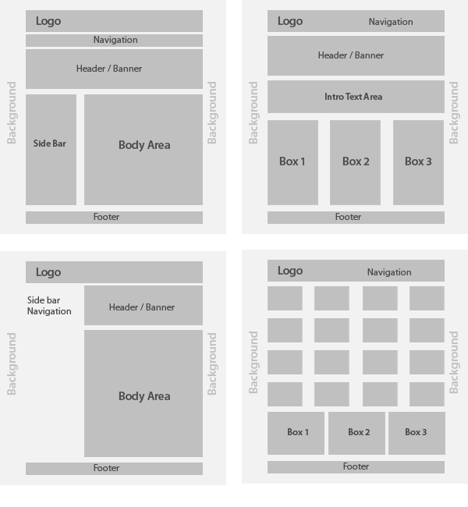
CSS Designing Page Layout :

Slide 43
CSS Grid Layout:
CSS Grid Layout is good choice to use for designing page layout when compared to float and clear.
CSS Grid consists of parent elements(grid-container) and child elements(grid-item)
Ex:
<div class="grid-container"> <div class="grid-item">1</div> <div class="grid-item">2</div> <div class="grid-item">3</div>
</div>
Grid Display : A html element becomes a grid container when its display property is set to grid or inline-grid.
Ex: .grid-container { display:grid or inline-grid;}
1 | 2 | 3 | 4 | 5
6 | 7 | 8 | 9 | 10
11 | 12 | 13 | 14 | 15

Slide 44
CSS Grid Layout:
Grid Template Columns : property defines the number of columns in your grid layout, and it can define the width of each column inside grid.
Grid Template Rows : property defines the height of each row inside grid.
justify-content property is used to align the whole grid inside the container.
Ex : justify-content: space-evenly or space-around or space-between or center or start or end
align-content property is used to vertically align the whole grid inside the container.
Ex : align-content: space-evenly or space-around or space-between or center or start or end
Grid items : A grid container contains grid items.
Grid-column : property defines on which column(s) to place an item.
Grid-row : property defines on which row to place an item.
Grid-area : property can be used as a shorthand property for the grid-row-start, grid-column-start, grid-row-end and the grid-column-end properties.

Slide 45
BootStrap Framework :
What is Bootstrap?
Bootstrap is a free readymade front-end framework for faster and easier web development
Bootstrap was developed by Twitter in 2011.
Bootstrap includes HTML and CSS based design templates for typography, forms, buttons, tables, navigation, modals, image carousels and many other, as well as optional JavaScript plugins
Bootstrap also gives you the ability to easily create responsive designs
If you want total custom defined css styles for your web page then
you don’t require BootStrap Framework.

Slide 46
BootStrap Framework :
What is Responsive Web Design?
Responsive web design is about creating web sites which automatically adjust themselves to look good on all devices, from small phones to large desktops.
Why Use Bootstrap?
Advantages of Bootstrap:
Easy to use: Anybody with just basic knowledge of HTML and CSS can start using Bootstrap
Responsive features: Bootstrap's responsive CSS adjusts to phones, tablets, and desktops
Mobile-first approach: In Bootstrap 3, mobile-first styles are part of the core framework
Browser compatibility: Bootstrap is compatible with all modern browsers (Chrome, Firefox, Internet Explorer, Edge, Safari, and Opera)

Slide 47
BootStrap Framework :
Where to Get Bootstrap & How to use it ?
There are two ways to start using Bootstrap on your own web site.
You can:
Download Bootstrap from getbootstrap.com
Include Bootstrap from a CDN ( Content Delivery Network )
Ex :
<!-- Latest compiled and minified CSS --> <link rel="stylesheet" href="https://maxcdn.bootstrapcdn.com/bootstrap/3.4.0/css/bootstrap.min.css"> <!-- jQuery library --> <script src="https://ajax.googleapis.com/ajax/libs/jquery/3.4.1/jquery.min.js"></script> <!-- Latest compiled JavaScript --> <script src="https://maxcdn.bootstrapcdn.com/bootstrap/3.4.0/js/bootstrap.min.js"></script>

