Slide 1

The Software Services
Yours !
Veera Raghava

Slide 2

Welcome to Django Tutorials

Slide 3
What is Django ?
Django is an open source Python based Web Framework for developing Dynamic Web Applications.
Django makes web development rapid,clean with pragmatic design.
Django Framework is "batteries-included" philosophy.
The principle behind batteries-included is that the common functionality for building web applications should come with the framework instead of installing as a separate libraries.
History of Django :
2003 − Started by Adrian Holovaty and Simon Willison as an internal project at the Lawrence Journal-World newspaper.
2005 − Released July 2005 and named it Django, after the jazz guitarist Django Reinhardt.
2005 − Mature enough to handle several high-traffic sites.
Current − Django is now an open source project with contributors across the world.

Slide 4
Why Django Web framework ?
Ridiculously Fast : Django was designed to help developers take applications from concept to completion as quickly as possible.
Fully Loaded : Django includes dozens of extras you can use to handle common Web development tasks. Django takes care of user authentication, content administration, site maps, RSS feeds, and many more tasks — right out of the box.
Reassuringly Secure : Django takes security seriously and helps developers avoid many common security mistakes, such as SQL injection, cross-site scripting, cross-site request forgery and clickjacking. Its user authentication system provides a secure way to manage user accounts and passwords.
Exceedingly Scalable : Some of the busiest sites on the planet use Django’s ability to quickly and flexibly scale to meet the heaviest traffic demands.
Incredibly Versatile : Companies, organizations and governments have used Django to build all sorts of things — from content management systems to social networks to scientific computing platforms.

Slide 5
Why Django Web framework ?
Object Relational Mapping (ORM) Support : Django provides a bridge between the data model and the database engine, and supports a large set of database systems including MySQL, Oracle, Postgres,NoSQL etc.
Multilingual Support : Django supports multilingual websites through its built-in internationalization system. So you can develop your website, which would support multiple languages.
Framework Support : Django has built-in support for Ajax, RSS, Caching and various other frameworks.
Admin Interface Support : Django provides a nice ready-to-use ADMIN interface for administrative activities.
Built in Web Server Support : Django comes with a lightweight web server to facilitate end-to-end application development and testing.

Slide 6
HOW to use Django ?
Django Setup :
Install Anaconda Python Package Management Software (www.anaconda.org)
Anaconda makes all python packages installations easy and it is a recommended way.
Add Anaconda executables to Environmental Variables.
[C:\Anaconda;C:\Anaconda\python.exe;C:\Anaconda\Scripts;]
3. Open Command Terminal
c:/> conda create - - name [virtual_environment_name] [package_name]
c:/> conda activate [virtual_environment_name]
c:/> conda info
c:/> conda deactivate [virtual_environment_name]
Main Installation
Environment
Virtual Installation
Environment
Isolated container
of pakages

Slide 7
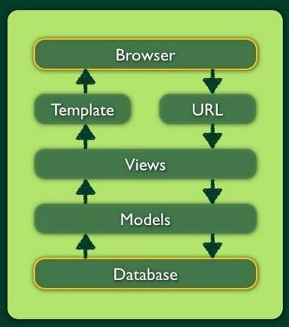
Django MVT Mechanism :
Step-1 ) User Requests a Web Page from a Browser by
typing Web Page URL address.
Step-2 ) Django checks given URL address in its URLS.PY file.
URL.PY file → it contains URL Routes which point to
corresponding VIEW Functions.if the given url address
matches with the Routes in URL.PY file then Django
forwards user request to corresponding View Function
otherwise Django drops the Request.
Step-3 ) VIEW.PY File → it contains Functions to be executed
upon receiving the User Request.it defines Business Logic.
if the view function requires Data then it will access
its Models.
Step-4 ) MODELS.PY File → it contains Models of the Data (DB Tables)
Step-5 ) TEMPLATES → contains HTML files which will be served with
necessary Data to user after performing required
Business Logic by View Function.
ORM Support

Slide 8
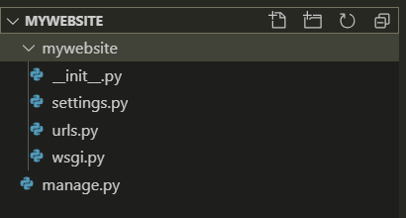
STARTing Django WEB project
To Start Django Web Project use the following command :
django-admin startproject [project name]
→ This command will create Basic Django Web Project File Structure for developing a web site.
To Run Development Web Server use the following command :
python manage.py runserver
Project Main Folder
Project Sub Folder
_init_ indicates this Folder as a Python Package
Project Settings File
URL Routing File
Command Line Utility
Interface b/w Web Application & Web Server

Slide 9
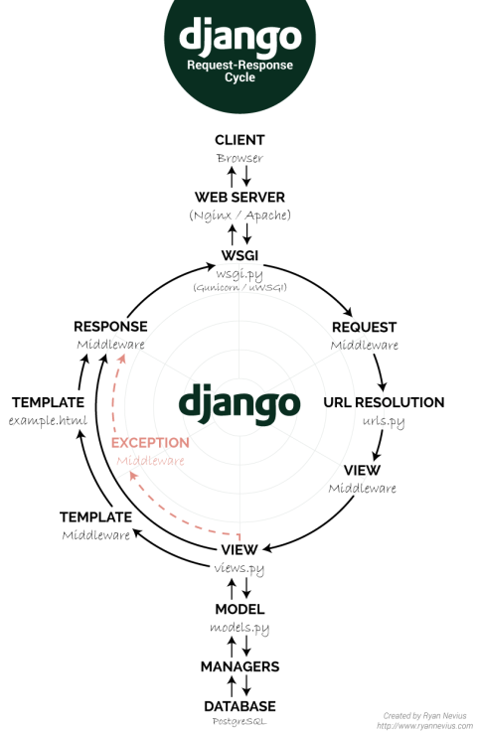
Django Request to Response Cycle

Slide 10
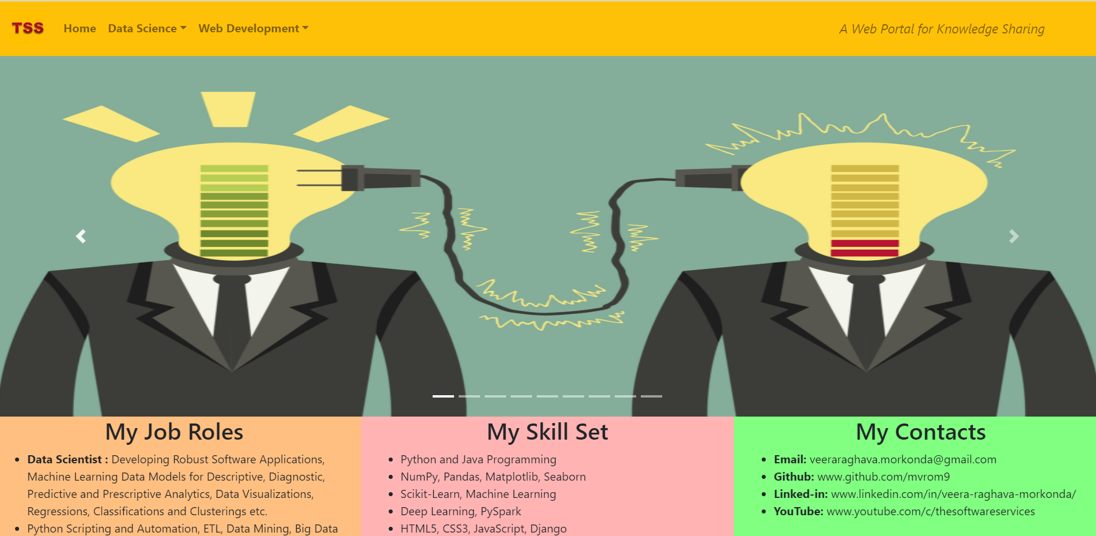
Django web application
The Total Django Web Project is sub divided into certain sections, each section may called as an Application.
These individual Applications put together will make a Total Web Project or Web Site.
We can copy the Application code and used in other Django web projects also.(Ex: Registration app)
To Start a Application :
django-admin startapp [app_name]

Slide 11
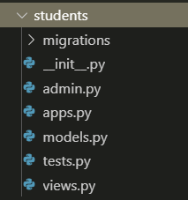
Starting Django web application
After execution the django-admin startapp [app_name] command , a new application file structure will be created automatically in main project folder as show below :
Application File Structure :
Application Name
DB migrations (changes in DB models updated in DB)
_init_ indicates this Folder as a Python Package
Models should be registered in this file for Admin Interface
Application specific configurations
DB Model configurations
Test Functions for testing
View Functions that handle HTTP requests and return responses.

Slide 12
application Routine Tasks
Routine Tasks to make Application Live :
1) Create an Application with django-admin startapp [app_name]
(basic application file structure will be created in main project folder)
2) Register the application name in settings.py file in the variable called INSTALLED_APPS
3) Write a view function(business logic) for that application in its VIEW.PY file
4) Add the desired web path(i.e; web page address) and the name of its Application View function to urlpatterns variable in URLS.PY file
5) Open web browser and type the configured web path in the address bar and it should display the output of View Function data to the browser screen.
Note : if you didn’t receive the output of view function on the browser screen then you need to debug above steps.

Slide 13
Django Templates SETUP
Django Templates enables developer to write HTML code in separate HTML Files and place them in separate folder called TEMPLATES.
Django will use HTML Files in TEMPLATES Folder for Sending Responses to Browser.
→ Create Templates folder in project level directory and add its path to settings.py after BASE_DIR variable as shown below:
TEMPLATES_DIR = os.path.join(BASE_DIR,'templates’)
and insert “TEMPLATES_DIR” as a value to “DIRS” key in TEMPLATES variable as shown below :
TEMPLATES = [{
'BACKEND': 'django.template.backends.django.DjangoTemplates',
'DIRS': [TEMPLATES_DIR,],
'APP_DIRS': True,
'OPTIONS': {
'context_processors': [
'django.template.context_processors.debug',
'django.template.context_processors.request',
'django.contrib.auth.context_processors.auth',
'django.contrib.messages.context_processors.messages', ],},},]

Slide 14
Django Static files Setup
A Web Site requires different types of files such as image files, video files, css files, javascript files etc for proper working of web page.In Django these files are called STATIC FILES.
We need to create a new folder called STATIC in project main directory and store all those static files inside new folder and we should add path in settings.py file so that Django will recognize Static Files.
→ To store static files of css,js,images etc create Static folder in project level directory and add its path to settings.py after TEMPLATES_DIR as shown below :
STATIC_DIR = os.path.join(BASE_DIR,'static')
→ add a variable STATICFILES_DIRS below STATIC_URL variable as shown below :
# Static files (CSS, JavaScript, Images)
# https://docs.djangoproject.com/en/2.1/howto/static-files/
STATIC_URL = '/static/'
STATICFILES_DIRS = [ STATIC_DIR,]

Slide 15
Django Static files Setup
Inorder to use the static files in the HTML Templates we should use TEMPLATE TAGS.
DTL(Django Template Language) :- Django uses a Template Language called JINJA to inject data into HTML Template.
Insert {% load staticfiles %} after <!DOCTYPE html> to load static files from project level static folder.
For loading CSS file insert link href in head section of html as shown below :
<link href="{% static ‘mystyles.css' %}" rel="stylesheet">
For loading JavaScript file insert script source in head section of html as shown below :
<script src="{% static ‘myscript.js' %}"></script>
For loading IMAGE file insert image source in head section of html as shown below :
<img src="{% static ‘myimage.jpg' %}">
For injecting view function output data to html template we should use jinja template tags in html template as show below :
{{ variable name }} → normal variable
{% if variable name %} code part {% endif %} → if condition
{% for iter_var_name in variable name %} code part {% endfor %} → for loop

Slide 16
Django URL Mappings
URL Mapping to View Functions can be done in 3 different ways :
1) Function views
1. Add an import: from my_app import views
2. Add a URL to urlpatterns: path('', views.home, name='home’)
2) Including another URLconf
1. Import the include() function: from django.urls import include, path
2. Add a URL to urlpatterns: path('blog/', include('blog.urls'))
3) Class-based views
1. Add an import: from other_app.views import Home
2. Add a URL to urlpatterns: path('', Home.as_view(), name='home’)

Slide 17
Django Template Language
Django uses JINA Template Language to inject Dynamic Data from View Function to HTML Template.
For injecting view function output data to html template we should use jinja template tags in html file as show below :
Template Tags :
1) Variable Tags : {{ variable_name }} → for injecting normal variable data
2) IF Tags : {% if variable_name %} → for injecting data based on condition
code content…
{% endif %}
3) FOR Tags : {% for iter_var_name in sequence %} → for injecting data based on loops
code content …
{% endfor %}

Slide 18
Django Template inheritance
Block and Extends Tags :
Django has Template Inheritance facility to avoid writing repeated common HTML code in HTML Files.
If we want to access same header and footer styles of home page in other web pages then we will make use of Django Template Inheritance to avoid re writing same header and footer styles to other web pages.
We will define a basic HTML Template or File with BLOCK Tags called BASE TEMPLATE with required styles and then we will make use of that BASE TEMPLATE in all the other HTML Templates by using EXTENDS Tag and BLOCK Tags.
Portions which was declared as a block with BLOCK tags tells the Django that “This Portions can be Replaced by (or) Overrided by any other HTML Files by using TEMPLATE INHERITANCE concept.

Slide 19
Django Template inheritance
Students.html
Colleges.html
<html>
<head>
<title>
{% block title %} Students Page {% endblock %}
</title>
</head>
<body>
{% block content %}
<h1> Iam Students Home Page <h1>
{% endblock %}
</body>
</html>
{% extends “Students.html” %}
{% block title %}
Colleges Page
{% endblock %}
{% block content %}
<h1> Iam Colleges Page <h1>
{% endblock %}

Slide 20
Django ADMIN INTERFACE
Django provides beautiful graphical ADMIN INTERFACE for all Administrative and Database related activities.
Using ADMIN INTERFACE we can create, modify and delete superusers and users for managing our WEB Project.
Using ADMIN INTERFACE we can create, modify and delete groups.
Using ADMIN INTERFACE we can view created DB Models and we can search,modify and delete records of Models.
Activating ADMIN INTERFACE :
After creation web project run following commands at command prompt :-
python manage.py migrate
python manage.py createsuperuser
( provide username,email & password )
3) Open browser and type ‘127.0.0.1:8000/admin’ to open ADMIN INTERFACE Page

Slide 21
Django models
Django have Model Layer for Data Management (CRUD) tasks in a DataBase.
Django provides inbuilt SQLITE3 Database for development purposes.
The View Layer will make use of Model Layer for all Data requirements and then return the Processed Data to Template Layer.
Django provides ORM Support (Object Relational Mapping) which gives flexibility to developer to write python statements for defining DB Tables instead of writing statements in Native DB Language. ORM will inturn convert python statements to native DB statements internally.
Creating a Model :
After creation of web project and a web app follow below steps:-
Open MODELS.PY file in Application folder and create a DB Table by writing Python Classes
Register the defined model in ADMIN.PY file to make the model appear in ADMIN INTERFACE
3) Define the necessary VIEW function to access the Model Data and inject accessed data into a HTML Template.

Slide 22
Django bypassing model layer
Django does not force you to compulsory define your DB Tables and DB Transactions with its Models & ORM Support. Its upto the developer wish to use the ORM support or not.
Django provides you the flexibility to directly connect to Native Database by complete bypassing its Model Layer and ORM support.
You can execute direct Native DB Language commands to query the Database and can perform CRUD operations with your own PDBC Code.
You can setup your Database in settings.py file.
MySQL Database (custom DB) :
DATABASES = {
'default': {
'ENGINE': 'django.db.backends.mysql',
'NAME’: ’name of your DB',
'HOST': 'localhost',
'USER': 'root',
'PASSWORD': ‘’, }
}
SQLITE3 Database (inbuilt DB) :
DATABASES = {
'default': {
'ENGINE': 'django.db.backends.sqlite3',
'NAME': os.path.join(BASE_DIR, 'db.sqlite3'),
}
}

Slide 23
Django Storing HTML Form data in db
HTML Forms are the common method to collect the user data from the front end web page.
The Method attribute in the HTML Form specifies which method (GET or POST) is used to transfer the HTML Form data to Web Server.(GET- Unsecure Data Transfer, POST- Secure Data Transfer)
The Action attribute in the HTML Form specifies Server Side Script that handles user data.
HTML FORM (Front End):
<form action="/insert/“ method=“post”>
{% csrf_token %}
Roll No: <br>
<input type="text" name="roll" ><br>
Name: <br>
<input type="text" name="name"><br>
Branch: <br>
<input type="text" name="branch" > <br><br>
<input type="submit" value="Submit">
</form>
Server Side Back End Script (Django View Function) :
def insert(request):
sd = studentdata()
sd.rollno = request.POST["roll"]
sd.name = request.POST["name"]
sd.branch = request.POST["branch"]
sd.save()
return render(request,"index.html",context={'status':'records saved'})

Slide 24
Django FORMS
Django have inbuilt FORM Class which provides all the functionalities of HTML Forms.
Using Django inbuilt Forms we can do form validation automatically but incase of HTML Forms we need to do form validation manually with javascript.
Django Forms acts similar to Models except Forms will render towards Front End Page and Models deals with Database Tables at Back End.
Its Developer wish to use or not to use Django inbuilt Forms.
If Developer wishs to use common HTML Forms he can always use it by avoiding Django inbuilt Forms but developer should take care of all errors and validation checks manually.

Slide 25
Django forms
DJANGO FORMS :
from django import forms
class student_form(forms.Form):
RollNo = forms.IntegerField()
Name = forms.CharField(max_length=50)
Branch = forms.CharField(max_length=10)
DJANGO VIEW Function :
def getdata(request):
if request.method == "POST":
form = student_form(request.POST)
if form.is_valid():
sd = studentdata()
sd.rollno = form.cleaned_data["RollNo"]
sd.name = form.cleaned_data["Name"]
sd.branch = form.cleaned_data["Branch"]
sd.save()
return render(request,'test.html',context={'status':'data inserted'})
else:
form = student_form()
return render(request,'test.html',context={'form':form})

Slide 26
Django CRUD operations in DB
CRUD operations means CREATE-READ-UPDATE-DELETE operations in a Database
CREATE means inserting some data into a Database
READ means accessing required data from Database
UPDATE means updating or modifying the data which was already existed in a Database
DELETE means deleting or erasing unnecessary data from a Database
CRUD operations are very common type of DB operations which we can perform
Inorder to perform CRUD operations we need to write server side script that can interact with DB and accomplish specified DB Tasks
So, in Django we will write appropriate VIEW Functions which acts as a server side script for each of the CRUD i.e each view function for CREATE, READ, UPDATE, DELETE operations

Slide 27
Django CRUD operations in DB
CREATE :
def create(request):
sd = studentdata()
sd.rollno = request.POST["roll"]
sd.name = request.POST["name"]
sd.branch = request.POST["branch"]
sd.save()
return render(request,"create_records.html",context={'create_std':'Record saved successfully’})
READ :
def read(request):
data = studentdata.objects.all() # ORM support language
return render(request,"read_records.html",context={'read_std':data})
UPDATE :
def update(request):
data = studentdata.objects.filter().update(branch='cse')
return render(request,"update_records.html",context={'update_std':data})
DELETE :
def delete(request):
data = studentdata.objects.filter(branch='cse').delete()
return render(request,"delete_records.html",context={'delete_std':data})

Slide 28
Django USER REGISTRATION
User Registration, Login, Logout, is required to provide user specific data to the end user instead of giving full access to everything in your website.
You need to secure your website from intruders and hackers with proper user authentication
Requirements for User Registration :
1. Home Page
2. Registration Link on Home page & Registration Page
3. Login Link on Home page & Login Page
4. Logout Link on Home page
5. Backend Programming Logic for all the above tasks

Slide 29
Django USER REGISTRATION
Creation of Registration Link & Registration Page & Backend Logic :
Registration Page :
<form action='' method='post'>
{% csrf_token %}
<p>First Name : <input type=text name='fname' placeholder="First Name"> </p>
<p>Last Name : <input type=text name='lname' placeholder="Last Name"> </p>
<p>Email : <input type=email name='email' placeholder=“Email"> </p>
<p>Username : <input type=text name='uname' placeholder="User Name"> </p>
<p>Password : <input type=password name='password' placeholder="Password"> </p>
<p>Confirm Password : <input type=password name='cpassword' placeholder="Confirm Password"> </p> <p> <input type=submit > </p> </form>
{% for i in messages %}
<h3> {{ i }} </h3>
{% endfor %}

Slide 30
Django USER REGISTRATION
Backend Logic (View Fucntion):
def register(request):
if request.method == "POST":
fistname = request.POST["fname"]
lastname = request.POST["lname"]
email = request.POST["email"]
username = request.POST["uname"]
password = request.POST["password"]
cpassword = request.POST["cpassword"]
# validations
if password != cpassword:
messages.info(request,"Password not matched")
return redirect('register')
Backend Logic (View Fucntion): continuation
else:
if User.objects.filter(username=username).exists():
messages.info(request,"uname already taken")
return redirect('register')
elif User.objects.filter(email=email).exists():
messages.info(request,"email already taken")
return redirect('register')
else:
user = User.objects.create_user(username=username,password=password,email=email,first_name=fistname,last_name=lastname)
user.save()
messages.info(request,"User Successfully Registered")
return redirect('/home')
else:
return render(request,'registration.html’)
from django.shortcuts import render,redirect
from django.contrib.auth.models import User,auth

Slide 31
Django USER LogIN
Creation of Login Link & Login Page & Backend Logic :
Login Page :
<form action='' method='post’>
{% csrf_token %}
<p>Username : <input type=text name='uname'></p>
<p>Password : <input type=password name='pass'></p>
<input type=submit name="Login">
</form>
{% for i in messages %}
<h3> {{ i }} </h3>
{% endfor %}
Backend Logic (View Function):
def login(request):
if request.method == 'POST':
username = request.POST["uname"]
password = request.POST["pass"] user = auth.authenticate(username=username,password=password)
if user is not None:
auth.login(request,user)
messages.info(request,"Login Success")
return redirect("/home")
else:
messages.info(request,"Login Fail")
return redirect("/login") else:
return render(request,"login.html")
from django.shortcuts import render,redirect
from django.contrib.auth.models import User,auth

Slide 32
Django USER LOGout
Creation of Logout Link & Backend Logic :
Backend Logic (View Fucntion):
def logout(request):
auth.logout(request)
messages.info(request,"Logout Success")
return redirect("/home")
We need to display Registration Link and Login Link on home page only if user doesn’t logged in.
If user logged in then we no need to display Registration Link and Login Link instead we need to display Logout Link on home page for logging out the user from website.

Slide 33
Django USER logout
Home Page (Adding & Removing Registration & Login link dynamically as per user login status):
<ul>
<li><a class="active" href="#home">Home</a></li>
{% if user.is_authenticated %}
<li>Hello {{user.first_name}}</li>
<li><a href="/logout">Logout</a></li>
{% else %}
<li>Hello Guest</li>
<li><a href="/register">Register</a></li>
<li><a href="/login">Login</a></li>
{% endif %}
<li style="float:right"><a href="#about">About</a></li>
</ul>
<h1>Hello {{ user.fist_name }} Welcome to Home Page</h1>
{% for i in messages %}
<h3> {{ i }} </h3>
{% endfor %}

Slide 34
Django
Django

Slide 35
Django
Django

Slide 36
Django
Django

Slide 37
Django
Django

Slide 38
Django
Django

Slide 39
Django
Django

Slide 40
Django
Django

Slide 41
Django
Django

Slide 42
Django
Django

Slide 43
Django
Django

Slide 44
Django
Django

Slide 45
Django
Django

Slide 46
Django
Django

Slide 47
Django
Django

Slide 48
Django
Django

Slide 49
Django
Django

Slide 50
Django
Django

Slide 51
Django
Django

Slide 52
Django
Django

