Slide 1

The Software Services
Yours !
Veera Raghava

Slide 2


Welcome to HTML5 Tutorials

Slide 3
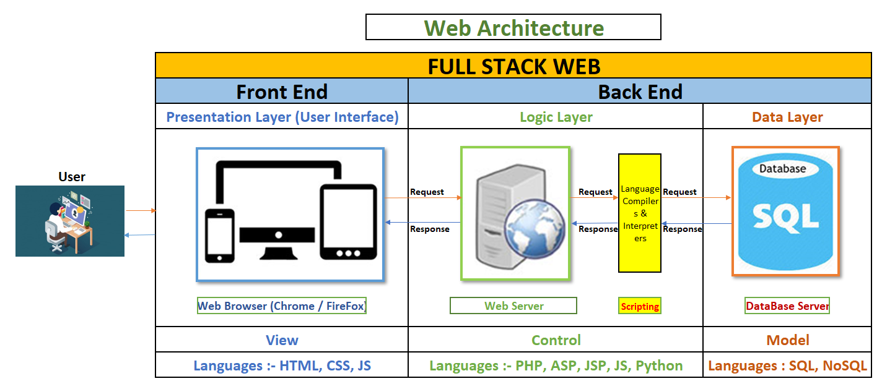
Intro to WWW (Big Picture):
How WWW (Internet) Works ?

Slide 4
Front End Languages :
HTML : Hyper Text Markup Language :- Used for Building the Web Pages
CSS : Cascading Style Sheet :- Used for Styling the Web Pages
JS : JavaScript :- Used for Programming the Web Pages for interaction with
the User.

Slide 5
Back End Languages :
For Scripting the Web Pages :
PHP :- Hypertext Pre-Processor (Codeignitor, Laravel, Symphony etc)
ASP :- Active Server Page (ASP.NET MicroSoft Technology)
JSP :- Java Server Page (Servlets, Spring, SpringBoot Java Technology)
JS :- Java Script (Node JS, Express JS)
Python :- (Django, Flask)
For DataBase Access :
SQL :- Structured Query Language (RDBMS)
NoSQL :- Not Only SQL (Non-RDBMS)

Slide 6
Static & Dynamic Web Pages:
Static Web Page :- 1. Static Web Pages are developed using only HTML, CSS, JS.
2. Static Web Page Content is readily available in the Web Server Root Directory
for Serving to User’s Request.
3. Static Web Pages does not access Data Base Server.
4. Static Web Pages are Simple.
Dynamic Web Page :- 1. Dynamic Web Pages are developed using PHP/ASP/JSP/JS/Python etc in addition to
HTML, CSS, JS. This Process is called Scripting (Program Statements).
2. Dynamic Web Page Contents are not available readily for user requests, they will be
generated on demand and changes user to user using Scripting.
3. Dynamic Web Pages access Data Base Server and access Data using Scripting.
4. Dynamic Web Pages are Complex.

Slide 7
What is HTML ?
HTML stands for Hyper Text Markup Language
HTML is the standard markup language for creating Web pages.
HTML describes the structure of a Web page
HTML consists of a series of elements
HTML elements tags tell the browser how to display the content
Browsers do not display the HTML tags, but use them to render the content of the page

Slide 8
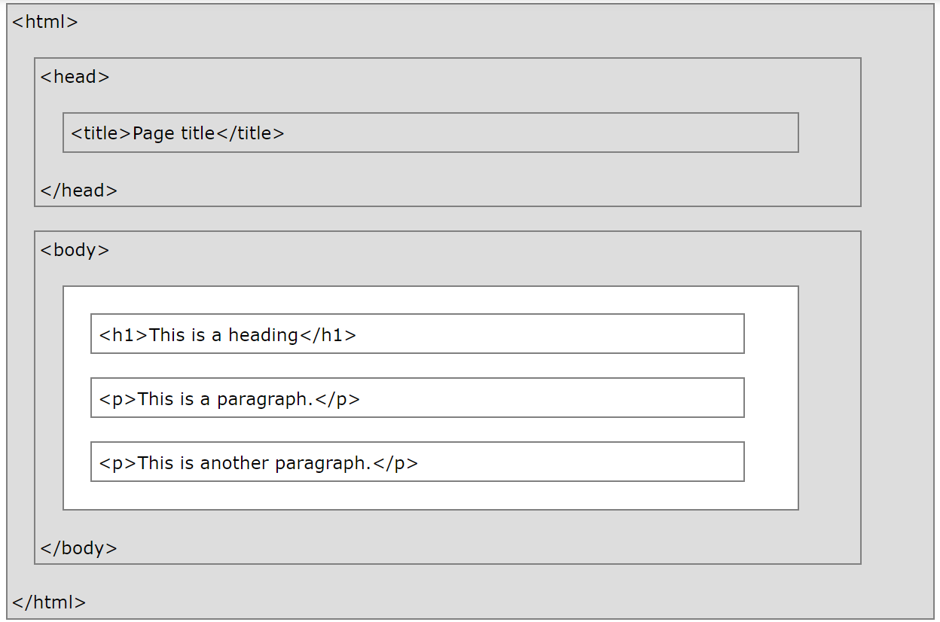
HTML Page Structure :

Slide 9
IDE Setup for HTML :
Install Visual Studio Code IDE and Live Server extension

Slide 10
History of HTML :
HTML was originally developed by Tim Berners-Lee in 1990. He is also known as the father of the web.
In 1996, the World Wide Web Consortium (W3C) became the authority to maintain the HTML specifications.
HTML also became an international standard (ISO) in 2000.
HTML5 is the latest version of HTML. HTML5 provides a faster and more robust approach to web development.
Version | Year
HTML | 1991
HTML 2.0 | 1995
HTML 3.2 | 1997
HTML 4.01 | 1999
XHTML | 2000
HTML5 | 2014

Slide 11
HTML Syntax:
<tagname> Content </tagname>
<tagname attribute=“value”> Content </tagname>
Ex :-
<p> Hello World </p>
<p style=“color:red”> Hello World </p>

Slide 12
HTML Element:
Html Opening Tag Html Closing Tag
<tagname> Content </tagname>
-----------HTML Element---------------

Slide 13
Some HTML Tags:
HTML Heading Tags : <h1> to <h6>
HTML Paragraph Tags : <p>
HTML Link Tags : <a>
HTML Image Tags : <img>
HTML Button Tags : <button>
HTML List Tags : <ul> , <ol> , <li>

Slide 14
HTML Empty Elements:
HTML Empty Elements does not have content and does not have closing tags.
HTML Empty Elements only have a opening tag and relevant attributes inside the opening tag.
Ex:
<br> → Line Break tag
<hr> → Horizontal Rule tag
<img> → Image tag
<input> → Input tag
<link> → Link tag
<meta> → Meta tag

Slide 15
HTML Attributes:
HTML Attributes convey additional information of an element.
HTML Attributes are always placed inside the Opening Tag.
HTML Attributes are in the form of Name = “Value” or Name:Value(CSS) Pairs.
Ex:
<p style = “color:red ; font-weight:bold”> my paragraph </p>
<img src = “path of image file” width = “200” height = “300”>
<a href="https://www.google.com">This is a Google link</a>
<p title="I’m HTML" >HTML is Easy.</p>
<html lang=“en-US”>

Slide 16
HTML Comments:
<!-- Write your comments here -->
Comments are very much recommended to remember
what the code is doing for latter reference.
Comments are useful for code debugging also by making
the code not to execute with stage by stage breakpoints.

Slide 17
HTML Headings :
HTML Headings are used to mark the text as headings with Heading Tags.
Heading Tags are <h1> to <h6>
Where h1 tag is most important and big size, h6 tag is least important and small size.
Ex:
<h1> Iam Heading h1 </h1> <h2> Iam Heading h2 </h2> <h3> Iam Heading h3 </h3> <h4> Iam Heading h4 </h4> <h5> Iam Heading h5 </h5> <h6> Iam Heading h6 </h6>
<h1 style="font-size:80px;"> Good Morning </h1>

Slide 18
HTML Paragraphs:
<p> paragraph content </p>
Paragraph tags ignores additional white spaces and display the
content normally without additional spaces.
Ex:- <p> iam going to school iam studying 3rd class iam interested in games </p>
Paragraph tags ignores multiple lines and display the content in a single line
Ex:- <p> iam going to school
iam studying 3rd class
iam interested in games </p>

Slide 19
HTML Paragraphs:
Line Breaks in between Paragraph :
Ex :
<p> iam going to school <br> iam studying 3rd class <br> iam interested in games </p>
Pre-Formatted tags for preserving spaces and line breaks as it is :
Ex :
<pre> iam going to school
iam studying 3rd class
iam interested in games </pre>

Slide 20
HTML Styles:
Styles are used to make the Web Page Content look great.
Syntax : <tagname style="property:value;"> content </tagname>
Background Color : style="background-color:green;“
Text Color : style="color:blue;“
Fonts : style="font-family:verdana;“
Text Size : style="font-size:20px;“
Text Alignment : style="text-align:center;“

Slide 21
HTML Formatting:
Formatting is used to display text in desired format.
Formatting tags:
<b> - Bold text
<strong> - Important text
<i> - Italic text
<em> - Emphasized text
<mark> - Marked text
<small> - Small text
<del> - Deleted text
<ins> - Inserted text
<sub> - Subscript text
<sup> - Superscript text

Slide 22
HTML Quotations & Citations :
Tag | Description
<q> | Defines a short inline quotation
<blockquote> | Defines a section that is quoted from another source
<abbr> | Defines an abbreviation or acronym
<address> | Defines contact information for the author/owner of a document
<cite> | Defines the title of a work
<bdo> | Defines the text direction

Slide 23
HTML Colors :
HTML colors are used to add color to your Web Page.
HTML colors are defined in 6 different ways.
COLOR NAME : Standard color name
Ex : background-color : green
RGB : (Red value( 0 to 255 ) , Green value (0 to 255) , Blue value (0 to 255) )
Ex : background-color : rgb(60,40,20)
HEX : #rrggbb ( value of rr or gg or bb = 00 to ff (which is 00=0 & ff = 255 ))
Ex : background-color : #ff25ac
HSL : (Hue (in degrees) , Saturation (in % ), Lightness (in %))
Ex : background-color : hsl(10,50%,80%)
RGBA : rgba(red,green,blue,alpha) alpha refers to opacity(0 to 1)
Ex : background-color : rgba(70,60,85,0.5)
HSLA : hsla(hue,saturation,lightness,alpha)
Ex : background-color : hsla(45,60%,80%,0.2)

Slide 24
HTML Links:
HTML Links are used in a web page to navigate from one web page to other
web page or to the other art of the same web page.
Syntax : <a href="url address">content</a>
Ex: <a href="https://www.flipkart.com">Flipkart Web Site</a>
<a href="https://www.flipkart.com" target="_blank"> Flipkart Web Site</a>
<a href="https://www.flipkart.com"><img src=“image.jpg" alt=“e-commerce"></a>
Making Bookmarks :
<h2 id=“jump">content</h2>
<a href="#jump">navigate to specified id element</a>

Slide 25
HTML Images :
<img> tags are used to insert images into a web page.
Syntax : <img src=“image file path“>
Ex:
<img src=“image.jpg" alt=“coffe"> →alt attribute is used as a alternate text about image if it breaks.
<img src="image.jpg" alt=“tiffen" style="width:500px;height:600px;"> → width and height of image
<body style="background-image:url(image.jpg);"> → setting background image for a web page

Slide 26
HTML Tables:
Tag | Description
<table> | Defines a table
<th> | Defines a header cell in a table
<tr> | Defines a row in a table
<td> | Defines a cell in a table
<caption> | Defines a table caption
<colspan> | Spans across columns
<rowspan> | Spans across rows
Name | Job | Company
Sriram | AI Eng | Google
Siva | ML Eng | Microsoft
Virat | Data Scientist | Amazon

Slide 27
HTML Lists:
There are two types of lists in HTML
Ordered List (ol)
Unordered List (ul)
Ex:
Unordered list : style="list-style-type:disc or circle or square;"
<ul> <li>HTML</li> <li>CSS</li> <li>JavaScript</li> </ul>
Ordered list : type=1 or A or a or I or i
<ol> <li>HTML</li> <li>CSS</li> <li>JavaScript</li> </ol>

Slide 28
HTML Block Level & Inline Level Elements:
Block Level Elements :
Block level Elements are used to define the Block structure of web page
Block level Elements occupies 100% of the available width and it is rendered with a line break
before and after.
Ex: <div> , <p> , <h1> to <h6>, <form> , <ol> , <ul> , <li> etc
Inline Level Elements :
Inline level Elements are used to define the contents inside a Block
Inline level Elements only occupies needed space but not all.
Ex: <img> , <a> , <span> , <strong> , <b> , <em> , <i> , <code> , <input> , <button> etc
Note : Block level elements should not be placed inside the inline level elements.

Slide 29
HTML Classes:
HTML Class Attribute is used to group HTML elements and apply some common functionality
to the group of elements simultaneously.
Ex:
<div class=“food"> <h2>Idly</h2> <p>Idly and Vada sambar is good </p> </div> <div class=“food"> <h2>Dosa</h2> <p>Dosa is super </p> </div>

Slide 30
HTML Id :
HTML “id” Attribute is used to uniquely identify HTML elements and apply unique
Functionality to that particular element or block of elements.
Difference between Class & id :
Classes can have same class names for multiple elements(uses “.” notation)
Id can only have unique id for elements (uses “#” notation)
Ex:
<div id=“tiffen1"> <h2>Idly</h2> <p>Idly and Vada sambar is good </p> </div> <div id=“tiffen2"> <h2>Dosa</h2> <p>Dosa is super </p> </div>

Slide 31
HTML iframes:
HTML iframe (inline frame) is used to embed a web page within another
web page.
Syntax : <iframe src=“path.html" height="200" width="300"></iframe>
<iframe width="967" height="544" src="https://www.youtube.com/embed/hb7Q33ysCwI" frameborder="0" allow="accelerometer; autoplay; encrypted-media; gyroscope; picture-in-picture" allowfullscreen></iframe>

Slide 32
HTML JavaScript :
JavaScript is client side programming language which is used to program the web page
For manipulating various HTML Elements like images,text,colours,pop ups.
JavaScript makes web page interactive.
JavaScript mostly uses document.getElementById() method to access HTML elements for manipulation.
Ex:
<script> function my_func(){ document.getElementById('wish').innerHTML = 'Good Morning' } </script>
<button onclick="my_func()"> Hello Click me to wish u </button>
<p id="wish"> </p>

Slide 33
HTML Head Tags:
Tag | Description
<head> | Defines information about the document
<title> | Defines the title of a document
<link> | Defines the relationship between a document and an external resource
<meta> | Defines metadata about an HTML document
<script> | Defines a client-side script
<style> | Defines style information for a document
<title>Web Page Title</title>
<link rel="stylesheet" href=“myfile.css">
<script> function myFunction { document.getElementById(“wish").innerHTML = "Hello Gud Morning";} </script>
<style>body {background-color: powderblue;} </style>

Slide 34
HTML Head Tags:
<meta charset="UTF-8"> → defines character set of web page
<meta name="description" content="Free Web tutorials"> → defines description of web page
<meta name="keywords" content="HTML, CSS, XML, JavaScript"> → defines keywords
<meta name="author" content="John Doe"> → defines author
<meta http-equiv="refresh" content="30"> → defines timed page refresh
<meta name="viewport" content="width=device-width, initial-scale=1.0"> →defines automatic fit of web page

Slide 35
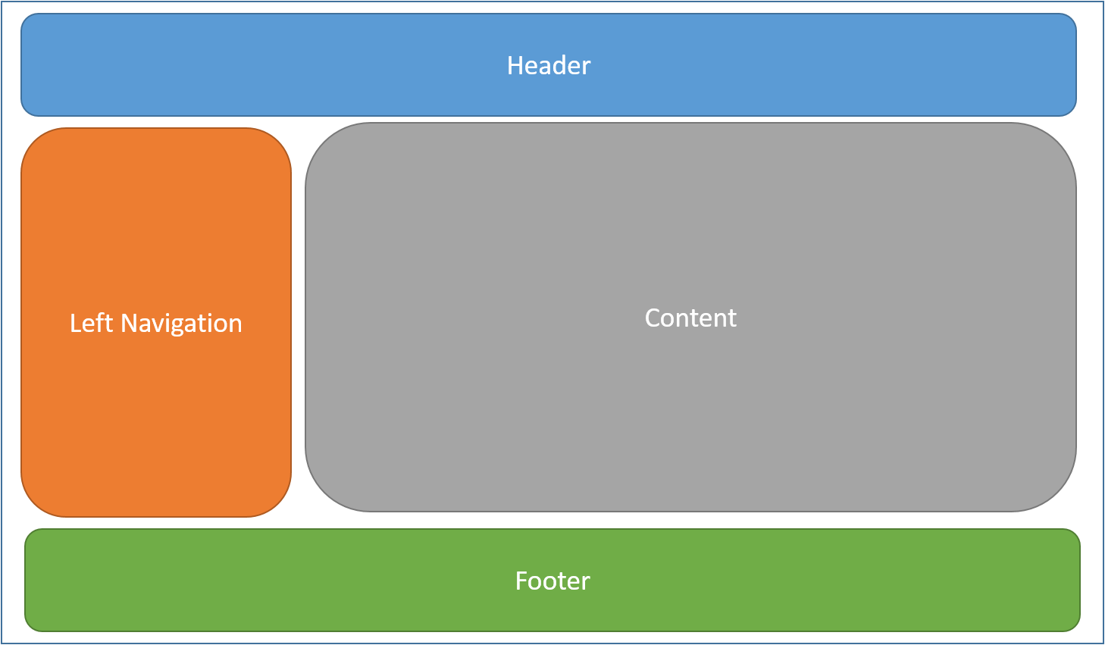
HTML Layouts:
While Designing a Web Page we need to first plan a Layout in which different HTML Element
should accommodate.
There are different ways to define HTML Page Layout structure.
HTML tables (not recommened)
CSS float property
CSS framework
CSS grid
CSS flexbox

Slide 36
HTML Entities :
HTML Entities are special characters that are reserved in HTML. Ex: <,> etc
If we want to use those special characters inside HTML Doc we need to use HTML Entity codes
Result | Description | Entity Name | Entity Number
 | non-breaking space | &nbsp; | &#160;
< | less than | &lt; | &#60;
> | greater than | &gt; | &#62;
& | ampersand | &amp; | &#38;
" | double quotation mark | &quot; | &#34;
' | single quotation mark (apostrophe) | &apos; | &#39;
© | copyright | &copy; | &#169;
® | registered trademark | &reg; | &#174;

Slide 37
HTML Symbols:
If we want to type some characters that are not available in our Keyboard then we can make use
of HTML Entity symbols.
₨ | &#8360 | 20A8 | RUPEE SIGN
₹ | &#8377 | 20B9 | INDIAN RUPEE SIGN
∀ | &#8704; | &forall; | FOR ALL
∂ | &#8706; | &part; | PARTIAL DIFFERENTIAL
∃ | &#8707; | &exist; | THERE EXISTS
∅ | &#8709; | &empty; | EMPTY SETS
∇ | &#8711; | &nabla; | NABLA
∈ | &#8712; | &isin; | ELEMENT OF
∉ | &#8713; | &notin; | NOT AN ELEMENT OF
∋ | &#8715; | &ni; | CONTAINS AS MEMBER
∏ | &#8719; | &prod; | N-ARY PRODUCT
∑ | &#8721; | &sum; | N-ARY SUMMATION

Slide 38
URL Format :
URL – Uniform Resource Locator → refers to complete address of web page or resource.
url format : scheme://prefix.domain:port/path/filename
Ex: http://www.google.com:80/images/flower.jpg
scheme - defines the type of Internet service (most common is http or https or ftp etc)
prefix - defines a domain prefix (default for http is www)
domain - defines the Internet domain name (like google.com)
port - defines the port number at the host (default for http is 80)
path - defines a path at the server (If omitted: the web server root directory will be default path)
filename - defines the name of a document or resource

Slide 39
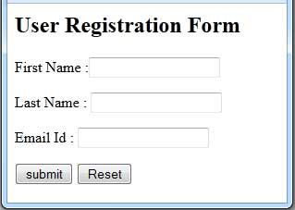
HTML Forms:
HTML Forms are used to collect data from the user.
The collected user data is stored in a Database for further processing at
server side using scripting languages like python,php,java etc.
Syntax : <form>
form elements
</form>
HTML Form Elements :
1 ) input
2 ) select
3 ) textarea
4 ) button
5 ) datalist
6 ) fieldset
7 ) legend

Slide 40
HTML input tag:
HTML input tag is very important tag used to collect various forms of user data.
Text Input : <input type="text" name="firstname"> (if we miss name attribute then data will not sent)
Radio Button Input : <input type="radio" name="gender" value="male"> Male
Check Box Input : <input type="checkbox" name=“food" value=“poori"> POORI <br>
Submit Button Input : <input type="submit" value=“Enter">
<input type="button">
<input type="checkbox">
<input type="color">
<input type="date">
<input type="datetime-local">
<input type="email">
<input type="file">
<input type="hidden">
<input type="image">
<input type="month">
<input type="number">
<input type="password">
<input type="radio">
<input type="range">
<input type="reset">
<input type="search">
<input type="submit">
<input type="tel">
<input type="text">
<input type="time">
<input type="url">
<input type="week">

Slide 41
HTML Form Attributes :
Action Attribute : <form action="/server_side_script.php">
Method Attribute : <form action="/server_side_script.php“ method = “get”> ( default method )
-- unsecured (used for collecting small data such as query strings)
<form action="/server_side_script.php“ method = “post”>
-- secured (used for collecting large data)
Target Attribute : <form action="/server_side_script.php“ target=“_blank”>

Slide 42
HTML Drop Down :
Select tag is used for drop down selection of choice.
Syntax :
<select name=“food"> <option value=“idly"> IDLY </option> <option value=“poori"> POORI </option> <option value=“dosa"> DOSA </option> <option value=“pongal"> PONGAL </option> </select>
Select attribute : size (for visible options)
Option attribute : selected (for pre selecting a specific option)

Slide 43
HTML Text Area:
Text Area tag is used to collect multiple lines of text from the user.
Syntax:
<textarea name=“information" rows=“20" cols=“20">
HTML is front end Markup Language
CSS is front end Styling
JS is front end programming
</textarea>

Slide 44
HTML Buttons:
Buttons are used for clickable button as an event to carry out specific
functions on click.
Syntax:
<button type="button" onclick="alert('Hello World!’)”> click here </button>

Slide 45
HTML Datalist:
Datalist tag is used to pre defined options for an input.
Syntax :
<input list=“food" name=“food_type">
<datalist id=“food">
<option value=“idly">
<option value=“poori">
<option value=“dosa">
<option value=“pongal">
<option value=“vada">
</datalist>
<input type="submit">

Slide 46
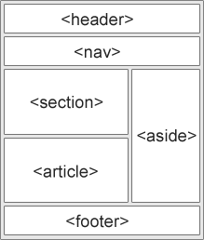
HTML5 New Elements:
Tag | Description
<article> | Defines an article
<aside> | Defines content aside from the page content
<details> | Defines additional details that the user can view or hide
<figcaption> | Defines a caption for a <figure> element
<figure> | Specifies self-contained content, like illustrations, diagrams, photos, code listings, etc.
<footer> | Defines a footer for a document or section
<header> | Specifies a header for a document or section
<main> | Specifies the main content of a document
<mark> | Defines marked/highlighted text
<nav> | Defines navigation links
<section> | Defines a section in a document
<summary> | Defines a visible heading for a <details> element
<time> | Defines a date/time

Slide 47
HTML nav tag:
HTML nav tag is used to navigation to different links which are grouped
in Menu Bar.
Syntax :
<nav>
<a href="/python.html" target="_blank">PYTHON</a> |
<a href="/php.html/" target="_blank">PHP</a> |
<a href="/java.html/" target="_blank">JAVA</a> |
<a href="/node.html/" target="_blank">NODE JS</a>
</nav>

Slide 48
HTML Video :
HTML Video tags are used to insert video content into a Web page.
Syntax :
<video width="500" height="400" controls>
<source src="/earth.mp4" >
Your browser does not support the video tag.
</video>
(or)
<object width="500" height="300" data="earth.mp4"></object>

Slide 49
HTML Audio :
HTML Audio tag is used to insert audio content into a Web page.
Syntax :
<audio controls>
<source src=“music.mp3" type="audio/mp3">
Your browser does not support the audio element.
</audio>
(or)
<object width="500" height="500" data="music.mp3"></object>

Slide 50
HTML File Downloads :
We can give access to files like pdf,excel,word etc with HTML Anchor tag.
Syntax :
<a href=“filepath”> click to open this file </a> → it will open the file with suitable software in ur pc.
<a href=“filepath” download> click to download this file </a> → it will download the file

Slide 51
HTML File Uploads:
We can upload files to the Web Server using input tag.
Syntax :
<form action="/server_side_script.php“ method = “post” enctype=“multipart/form-data”>
Select PDF Files : <input type="file" name=“pdf" multiple>
<input type="submit">
</form>

Slide 52
How to Host a Web Site in Local Computer ?
Step:- 1 ) Download and install XAMPP from https://www.apachefriends.org/download.html
X → Cross Platform ( can be used in windows, linux , mac )
A → Apache Web Server
M → MySQL DataBase Server
P → PHP Scripting Support
P → PEARL Scripting Support
Note : XAMPP makes your local computer to act like a Web Server and Data Base Server with Scripting Support.
Note : “XAMPP is a good full stack web setup that suits only for Development and Testing of Web Sites & Web Pages in our local computer but
it may not be suitable for Real time Production Environments.”
Step:- 2 ) Open xampp folder in c drive and then open “HTDOCS” folder.
Step:- 3 ) Put your web page source code files in HTDOCS folder.
Step:- 4 ) Open Web Browser and type the Web Page name as shown below
http://localhost/webpage-name.html
or
http://127.0.0.1/webpage-name.html

Slide 53
How to Host a Web Site in Internet ?
Client Side or Front End Setup
Server Side or Back End Setup
Normal Computer-1
[Client or Guest or User or Browser]
Response
High Config Host Computer
Request
Normal Computer-2
[Client or Guest or User or Browser]
Web Server
(Root Directory) [DNS IP Address]
DataBase
Server
Normal Computer-3
[Client or Guest or User or Browser]
HTML+CSS+JS
Files
Script Files
PHP + MySQL
www.example.com
151.65.87.214
Web Site Name
DNS IP Address

Slide 54
How to Host a Web Site in Internet ?
Step:- 1 ) Write Source Code for your Web Pages
For Static Web Pages HTML+CSS+JS is enough.
For Dynamic Web Pages which needs to access DataBase we need all (HTML+CSS+JS+PHP+MySQL).
Step:- 2 ) Buy a Domain Name (site name in a particular domain) from the Internet Corporation for Assigned Names and Numbers (ICANN) or from its registered resellers like GoDaddy or Bluehost etc…
www.sitename.domain ex: www.flipkart.com , www.python.org , www.php.net etc
Step:- 3 ) Buy Disk Space+RAM+DB Space in a Web Server (Host) to put your web page source code files
from Hosting Providers like GoDaddy or Bluehost etc..
Step:- 4 ) Map your Domain Name(Site Name) to DNS IP Address of Web Server.
Step:- 5 ) Put your web page source code files into Web Server Root Directory using Cpanel.
Step:- 6 ) Open your browser and type your site name. Your website will be displayed on your browser according to
your HTML+CSS+JS source code.

Slide 55
HTML :

