Slide 1


Yours !
Veera Raghava
The Software Services

Slide 2
Welcome
to
MySQL Database Tutorials
in
Telugu
The Software Services

Slide 3

What is a Database ?
A Database is a collection of organized and structured data stored and accessed from a computer memory.
What is Organized and Structured Data ?
Raw Data is organized and stored in the form of Tables in a DB which consists of Rows and Columns related to each other.
Column-1
Column-2
Column-3
Row-1
Data
Data
Data
Row-2
Data
Data
Data
Row-3
Data
Data
Data
Row-4
Data
Data
Data
Data
Data
Data
Row-5
The Software Services

Slide 4
MySQL Introduction :
Relational Database Management System (RDBMS): MySQL is a relational database management system.
Easy to use: MySQL is easy to use. You have to get only the basic knowledge of SQL. You can build and interact
with MySQL with only a few simple SQL statements.
Secure: MySQL consist of a solid data security layer that protects sensitive data from intruders. Passwords are
encrypted in MySQL.
Client/ Server Architecture: MySQL follows a client /server architecture. There is a database server (MySQL)
and arbitrarily many clients (application programs), which communicate with the
server; that is, they query data, save changes, etc.
Open Source: MySQL is free to use and you can download it from MySQL official website.
Scalable: MySQL can handle almost any amount of data, up to as much as 50 million rows or more. The default
file size limit is about 4 GB.
Compatibale on many operating systems: MySQL is compatible to run on many operating systems
Allows Roll-back: MySQL allows transactions to be rolled back, commit and crash recovery.
High Performance: MySQL is faster, more reliable and cheaper because of its unique storage engine architecture.
MySQL was created by a Swedish company, MySQL AB, founded by David Axmark, Allan Larsson and Michael "Monty" Widenius. Original development of MySQL by Widenius and Axmark began in 1994. The first version of MySQL appeared on 23 May 1995.
The Software Services

Slide 5
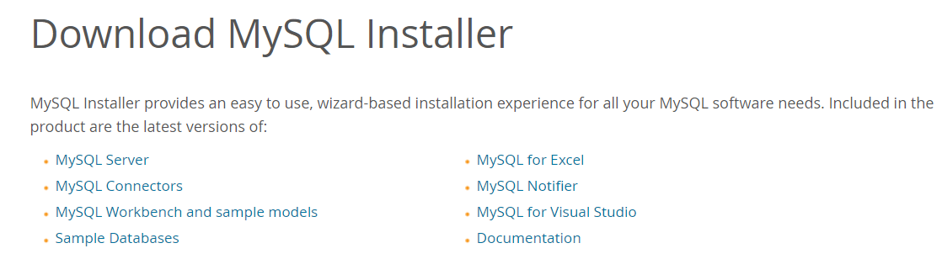
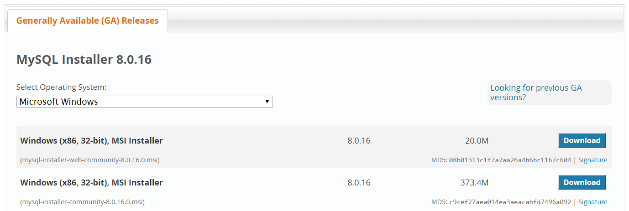
MySQL DB Installation :
Open the link of MySQL website : https://dev.mysql.com/downloads/installer/
The Software Services

Slide 6
MySQL Command Mode :
Setup :
Right click My Computer
Click on Advanced system settings
Click on Environmental Variables
Under system variables select path
click New button and add the path to MySQL Executable
Restart PC
Goto command mode
C:/> mysql –u (username) –p enter
Enter password :
Mysql>
The Software Services

Slide 7
MySQL Data Types :
Data Types refers to which type of Data that can handle by MySQL DB.
Mainly 3 Data Types:
Numeric Data Types
String Data Types
Date and Time Data Types
TABLE
Column-1
Column-2
Column-3
Row-1
Data
Data
Data
Row-2
Data
Data
Data
Row-3
Data
Data
Data
Row-4
Data
Data
Data
Data
Data
Data
Row-5
The Software Services

Slide 8
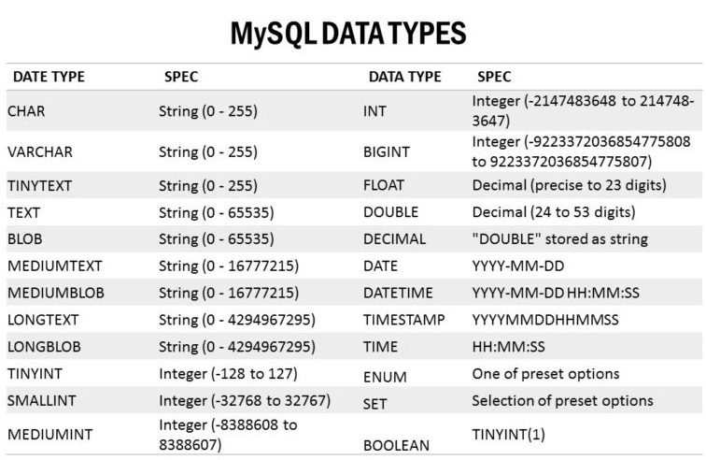
The Software Services

Slide 9
MySQL Statements:
MySQL Statements are broadly classified into 3 types namely :
Data Definition Language (DDL) Statements
Data Manipulation Language (DML) Statements
Data Control Language (DCL) Statements
Data Definition Language (DDL) Statements:
Data Definition Language (DDL) statements are used to define the database structure or schema.
Ex:
CREATE - to create objects in the database
ALTER - alters the structure of the database
DROP - delete objects from the database
TRUNCATE - remove all records from a table, including all spaces allocated for the records are removed
COMMENT - add comments to the data dictionary
RENAME - rename an object
The Software Services

Slide 10
2. Data Manipulation Language (DML) Statements:
Data Manipulation Language (DML) Statements are used to manipulate
the data in the database.
Ex:
1.INSERT - Adding new data into a Table 2.SELECT - Select and Read existing data from the Table 3.UPDATE – Update the exisiting data in the Table 4.DELETE – Delete the exisiting data in the Table
3. Data Control Language (DCL) Statements:
Data Control Langauge (DCL) Statements are used to control the database transaction.DCL statements allow you to control who has access to specific object in your database.
Ex:
GRANT – Grant permissions to commands and access privilleges to tables
REVOKE – Revoke the permissions
The Software Services

Slide 11
Create New DataBase:
To create a new database in MySQL, you should use the CREATE DATABASE statement with the following syntax:
Syntax :
CREATE DATABASE [IF NOT EXISTS] database_name
[CHARACTER SET charset_name]
[COLLATE collation_name]
Ex:
SHOW DATABASES
CREATE DATABASE customers
SHOW CREATE DATABASE customers
USE customers
The Software Services

Slide 12
DROP a DataBase:
The DROP DATABASE statement drops all tables in the database and deletes the database permanently. Therefore, you should be very careful when using this statement.
The following shows the syntax of the DROP DATABASE statement:
Syntax:
DROP DATABASE [IF EXISTS] database_name;
Ex:
SHOW DATABASES
DROP DATABASE customers
The Software Services

Slide 13
CREATE a Table :
The MySQL CREATE TABLE command is used to create a new table into the database. A table creation command requires three things:
1. Name of the Table
2. Name of Column
3. Column Data Type Declaration, data_type(length) [NOT NULL] [DEFAULT value] [AUTO_INCREMENT] etc.
Syntax :
CREATE TABLE table_name (column1 column1_type,column2 column2_type);
Ex:
CREATE TABLE fruits(
id INT AUTO_INCREMENT PRIMARY KEY,
fruit VARCHAR(10) NOT NULL,
quantity INT,
price FLOAT)
The Software Services

Slide 14
ALTER a Table :
MySQL ALTER statement is used when you want to change the name of your table or any table column. It is also used to add or delete an existing column in a table and to modify column type.
Syntax :
ALTER TABLE table_name
ADD new_column_name column_definition
[ FIRST | AFTER column_name ];
Adds New Column to existing Table
ALTER TABLE table_name
MODIFY column_name column_definition
Modify exisiting Column Type in a Table
ALTER TABLE table_name
DROP COLUMN column_name;
Drops existing Column in a Table
The Software Services

Slide 15
ALTER TABLE table_name
CHANGE COLUMN old_name new_name
column_definition
Change existing Column name
in a Table
ALTER TABLE table_name
RENAME TO new_table_name;
Rename existing Table name
in a database
The Software Services

Slide 16
TRUNCATE a Table :
The TRUNCATE TABLE statement is used when you want to delete the complete data from a table without removing the table structure.
Syntax :
TRUNCATE TABLE table_name;
The Software Services

Slide 17
DROP a Table :
The DROP TABLE statement is used when you want to delete the complete table including data and table structure.
Syntax :
DROP TABLE table_name;
The Software Services

Slide 18
INSERT Data :
INSERT statement is used to store data into a predefined Table.
Syntax :
INSERT INTO table(c1,c2,...)
VALUES (v1,v2,...);
Inserting single row of data
Syntax :
INSERT INTO table(c1,c2,...)
VALUES (v1,v2,...) , (v1,v2,…) , (v1,v2,…);
Inserting multiple rows of data
Syntax :
INSERT INTO table
VALUES (v1,v2,...);
Inserting values without columns
The Software Services

Slide 19
UPDATE Data :
UPDATE statement is used to modify exisiting data in a Table.
Syntax :
UPDATE table_name
SET
column_name1 = expr1,
column_name2 = expr2,
...
[WHERE condition];
The Software Services

Slide 20
DELETE Data :
DELETE statement is used to delete data from the MySQL table within the database. By using delete statement, we can delete records on the basis of conditions.
Syntax :
DELETE FROM table_name
[WHERE (Condition)];
The Software Services

Slide 21
SELECT Data :
SELECT statement is used to fetch exisiting data from Tables
Syntax:
SELECT expressions
FROM tables
Syntax:
SELECT * FROM tables
Syntax:
SELECT col1,col2 FROM tables
The Software Services

Slide 22
MySQL Imp Clauses :
WHERE → used to filter the records based on condition
DISTINCT → used to identify unique items
LIMIT → used to limit the records to specified rows
ORDER BY → used to sort the records
GROUP BY → used to group the records
HAVING → used with group by clause with conditions
The Software Services

Slide 23
WHERE Clause :
MySQL WHERE Clause is used with SELECT, INSERT, UPDATE and DELETE clause to filter the results. It specifies a specific position where you have to do the operation.
Syntax :
WHERE (conditions);
MySQL WHERE Clause with single condition
Ex: SELECT * FROM fruits WHERE fruit = ‘mango’
MySQL WHERE Clause with multiple conditions
Ex: SELECT * FROM fruits WHERE (fruit = ‘mango’ AND place = ‘tirupati’)
SELECT * FROM fruits WHERE (fruit = ‘mango’ OR place = ‘tirupati’)
SELECT * FROM fruits WHERE (fruit = ‘banana’) AND ((place = ‘delhi’) OR (place = ‘tirupati’))
The Software Services

Slide 24
DISTINCT Clause :
MySQL DISTINCT clause is used to remove duplicate records from the table and fetch only the unique records. The DISTINCT clause is only used with the SELECT statement.
Syntax :
SELECT DISTINCT column_names
FROM tables
[WHERE conditions];
MySQL DISTINCT Clause
Ex: SELECT DISTINCT fruit FROM fruits
The Software Services

Slide 25
LIMIT Clause :
MySQL LIMIT Clause is used to Limit the resultant records set to a specified number.
Syntax :
SELECT column_names
FROM tables
LIMIT (no.of.rows)
MySQL LIMIT Clause
Ex: SELECT * FROM fruits LIMIT 5
The Software Services

Slide 26
ORDER BY Clause :
The MYSQL ORDER BY Clause is used to sort the records in ascending or descending order.
Syntax :
SELECT expressions
FROM tables
ORDER BY column_name [ ASC | DESC ];
MySQL ORDER BY Clause
Ex: SELECT * FROM fruits ORDER BY fruit
SELECT * FROM fruits ORDER BY fruit DESC
SELECT * FROM fruits ORDER BY place ASC
The Software Services

Slide 27
GROUP BY Clause :
The MYSQL GROUP BY Clause is used to collect data from multiple records and group the result by one or more column. It is generally used in a SELECT statement.
You can also use some aggregate functions like COUNT, SUM, MIN, MAX, AVG etc. on the grouped column.
Syntax :
SELECT col1, col2, ... , aggregate_function (column)
FROM tables
GROUP BY col1,col2…
MySQL GROUP BY Clause
Ex: SELECT fruit,COUNT(fruit) FROM fruits GROUP BY fruit
The Software Services

Slide 28
HAVING Clause :
MySQL HAVING Clause is used with GROUP BY clause. It always returns the rows where condition is TRUE.
Syntax :
SELECT col1, col2, ... , aggregate_function (column)
FROM tables
GROUP BY col1,col2…
HAVING (condition)
MySQL HAVING Clause
Ex: SELECT fruit,COUNT(fruit) FROM fruits GROUP BY fruit HAVING (fruit = ‘mango’)
The Software Services

Slide 29
MySQL Conditions:
AND → AND logic
OR → OR logic
LIKE → used for Pattern Matching
IN → used to avoid multiple OR conditions
NOT IN→ Opposite to IN condition
IS NULL→ used to check for empty values
IS NOT NULL→ used to check for non empty values
BETWEEN→ used to implement range
The Software Services

Slide 30
MySQL AND Condition:
The MySQL AND condition is used with SELECT, INSERT, UPDATE or DELETE statements to test two or more conditions in an individual query.
Syntax :
WHERE condition1
AND condition2
...
AND condition_n;
MySQL AND Condition
Ex: UPDATE fruits SET price = 180 WHERE (fruit = ‘mango’) AND (place = ‘pune’)
SELECT * FROM fruits WHERE (fruit = ‘banana’) AND (place = ‘delhi’)
The Software Services

Slide 31
MySQL OR Condition:
The MySQL OR condition is used with SELECT, INSERT, UPDATE or DELETE statements to test two or more conditions in an individual query.
Syntax :
WHERE condition1
OR condition2
...
OR condition_n;
MySQL OR Condition
Ex: UPDATE fruits SET price = 180 WHERE (fruit = ‘mango’) OR (place = ‘pune’)
SELECT * FROM fruits WHERE (fruit = ‘banana’) OR (place = ‘delhi’)
The Software Services

Slide 32
MySQL LIKE Condition:
LIKE condition is used to perform pattern matching to find the correct result.
Syntax :
WHERE column_name LIKE ‘pattern’;
WILD CARDS
%
_
MySQL LIKE Condition
Ex: SELECT * FROM fruits WHERE fruit LIKE ‘ma%’
SELECT * FROM fruits WHERE fruit LIKE ‘%na’
SELECT * FROM fruits WHERE fruit LIKE ‘ma_go’
The Software Services

Slide 33
MySQL IN & NOT IN Condition:
The MySQL IN condition is used to reduce the use of multiple OR conditions in a SELECT, INSERT, UPDATE and DELETE statement.
Syntax :
WHERE column_name IN (value1,value2…);
MySQL IN & NOT IN Condition
Ex: SELECT * FROM fruits WHERE fruit IN (‘apple’,’banana’,’sapota’)
SELECT * FROM fruits WHERE fruit NOT IN (‘apple’,’banana’,’sapota’)
The Software Services

Slide 34
MySQL IS NULL & IS NOT NULL Condition:
MySQL IS NULL condition is used to check if there is a NULL value in the expression. It is used with SELECT, INSERT, UPDATE and DELETE statement.
Syntax :
WHERE column_name IS NULL;
MySQL IS NULL & IS NOT NULL Condition
Ex:
SELECT * FROM fruits WHERE fruit IS NULL
SELECT * FROM fruits WHERE fruit IS NOT NULL
The Software Services

Slide 35
MySQL BETWEEN Condition:
The MYSQL BETWEEN condition specifies how to retrieve values from an expression within a specific range. It is used with SELECT, INSERT, UPDATE and DELETE statement.
Syntax :
WHERE column_name BETWEEN (from) AND (to);
MySQL BETWEEN Condition
Ex:
SELECT * FROM fruits WHERE id BETWEEN 1 AND 5
The Software Services

Slide 36
MySQL Aggregate Functions:
COUNT( ) → used to count the items in a column
SUM ( ) → used to add the items in a column
AVG ( ) → used to get the average of items in a column
MIN ( ) → used to find minimum value in a column
MAX ( )→ used to find maximum value in a column
The Software Services

Slide 37
Syntax :
SELECT FUNCTION(column) FROM table_name
SELECT FUNCTION(column) AS alias_name FROM table_name
MySQL Aggregate Functions :
Ex:
SELECT COUNT(fruit) FROM fruits
SELECT COUNT(fruit) AS FRUIT_COUNT FROM fruits
SELECT SUM(price) FROM fruits
SELECT AVG(price) FROM fruits
SELECT MAX(quantity) FROM fruits
SELECT MIN(quantity) FROM fruits
The Software Services

Slide 38
MySQL Primary Key :
A primary key is a column or a set of columns that uniquely identifies each row in the table. You must follow the rules below when you define a primary key for a table:
A primary key must contain unique values. If the primary key consists of multiple columns, the combination of values in these columns must be unique.
A primary key column cannot contain NULL values. It means that you have to declare the primary key column with the NOT NULL attribute. If you don’t, MySQL will force the primary key column as NOT NULL implicitly.
A table has only one primary key.
The Software Services

Slide 39
MySQL Foriegn Key :
A foreign key is a column in a table that matches another column of another table.
The primary key table is called parent table or referenced table, and the foreign key table is known as child table or referencing table.
A foreign key can be a column or a set of columns. The columns in the child table often refer to the primary key columns in the parent table.
A table may have more than one foreign key, and each foreign key in the child table may refer to a different parent table.
The Software Services

Slide 40
MySQL Primary Key & Foreign Key:
STUDENTS TABLE (parent table)
Student_id (PK) | Student_name | Branch
1 | sriram | cse
2 | siva | ece
3 | virat | eee
4 | chandra | cse
5 | raghava | ece
LIBRARY TABLE (child table)
Book_id | Book_name | Student_id (FK)
10 | edc | 2
11 | mcs | 5
12 | co&os | 4
The Software Services

Slide 41
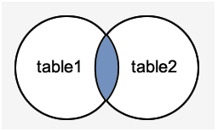
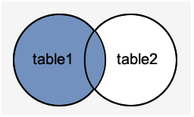
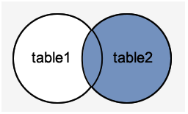
MySQL Table Joins:
MySQL JOINS are used with SELECT statement. It is used to retrieve data from multiple tables. It is performed whenever you need to fetch records from two or more tables.
There are three types of MySQL joins:
1. MySQL INNER JOIN (also called as simple join)
2. MySQL LEFT OUTER JOIN (also called as LEFT JOIN)
3. MySQL RIGHT OUTER JOIN (also called as RIGHT JOIN)
INNER JOIN
LEFT JOIN
RIGHT JOIN
The Software Services

Slide 42
MySQL INNER JOIN:
The MySQL INNER JOIN is used to return all rows from multiple tables where the join condition is satisfied. It is the most common type of join.
Syntax :
SELECT columns
FROM table1
INNER JOIN table2
ON table1.column = table2.column;
JOIN PREDICATE
MySQL INNER JOIN
Ex:
SELECT students.student_id, students.student_name, library.book_name
FROM students
INNER JOIN library
ON students.student_id = library.student_id
The Software Services

Slide 43
MySQL LEFT OUTER JOIN:
The LEFT OUTER JOIN returns all rows from the left hand table specified in the ON condition and only those rows from the other table where the join condition is fulfilled.
Syntax :
SELECT columns
FROM table1
LEFT [OUTER] JOIN table2
ON table1.column = table2.column;
JOIN PREDICATE
MySQL LEFT JOIN
Ex:
SELECT students.student_id, students.student_name, library.book_name
FROM students
LEFT JOIN library
ON students.student_id = library.student_id
The Software Services

Slide 44
MySQL RIGHT OUTER JOIN:
The MySQL Right Outer Join returns all rows from the RIGHT-hand table specified in the ON condition and only those rows from the other table where the join condition is fulfilled.
Syntax :
SELECT columns
FROM table1
RIGHT [OUTER] JOIN table2
ON table1.column = table2.column;
JOIN PREDICATE
MySQL RIGHT JOIN
Ex:
SELECT students.student_id, students.student_name, library.book_name
FROM students
RIGHT JOIN library
ON students.student_id = library.student_id
The Software Services

Slide 45
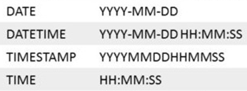
MySQL DATE & TIME Data Type:
MySQL DATE & TIME
Ex:
SELECT * FROM library WHERE booked_date BETWEEN (‘2019-5-1’) AND (‘2019-5-10’)
SELECT * FROM library WHERE booked_time BETWEEN (‘10:40:00’) AND (‘12:30:00’)
SELECT * FROM library WHERE booked_datetime BETWEEN (‘2019-5-1 10:40:00’) AND (‘2019-5-10 12:30:00’)
ALTER TABLE library add booked_timestamp TIMESTAMP DEFAULT CURRENT_TIMESTAMP
The Software Services

Slide 46
MySQL Comments :
Comments are very useful to DBA and others, which explains about QUERY.
Comments are very much recommended and it’s a good practise.
In MySQL there two types of comments :
Single Line Comment ( ‘ # ’ or “ - - ”)
2. Multi Line Comment (/* */)
The Software Services

Slide 47
MySQL Sub-Queries :
MySQL sub-query is a query nested within another query such as SELECT, INSERT, UPDATE or DELETE. In addition, a MySQL sub-query can be nested inside another sub-query.
Sub-query is called an INNER QUERY while the query that contains the sub-query is called an OUTER QUERY.
MySQL SUB-QUERY
Ex:
SELECT * FROM fruits WHERE price > ( SELECT AVG(price) FROM fruits )
OUTER QUERY
(OR)
MAIN QUERY
INNER QUERY
(OR)
SUB QUERY
The Software Services

Slide 48
MySQL Views :
MySQL View is a virtual table created by a query
Syntax :
CREATE VIEW view_name AS
SELECT columns
FROM tables
[WHERE conditions];
MySQL Views
Ex:
CREATE VIEW sample AS SELECT * FROM fruits WHERE price < 200
ALTER VIEW sample AS SELECT * FROM fruits WHERE price > 200
DROP VIEW sample
The Software Services

Slide 49
MySQL Stored Procedures :
A Stored Procedure is a segment of declarative SQL statements stored inside the database.
Syntax :
CREATE PROCEDURE procedure_name[ (parameter datatype [, parameter datatype]) ] DELIMITER $$
BEGIN
Declaration_section
Executable_section
END $$
EX :
DELIMITER $$
CREATE PROCEDURE test(from_time TIME,to_time TIME)
BEGIN
select * from library where booked_time between from_time AND to_time;
END $$
The Software Services

Slide 50
MySQL Functions:
We can define our own custom functions in MySQL and use those
Functions as and when required.
Syntax :
DELIMITER $$
CREATE FUNCTION function_name [ (parameter datatype [, parameter datatype]) ]
RETURNS return_datatype
BEGIN
Declaration_section
Executable_section
RETURN variable
END $$
EX :
DELIMITER $$
CREATE FUNCTION test(book varchar(10))
RETURNS VARCHAR(10)
BEGIN
DECLARE booked_at TIME DEFAULT " ";
SELECT booked_time INTO booked_at FROM library where book_name = book;
RETURN booked_at;
END $$
The Software Services

Slide 51
ER Model & Diagrams :
What is the ER Model ?
The ER or (Entity Relational Model) is a high-level conceptual data model diagram. Entity-Relation model is based on the notion of real-world entities and the relationship between them.
ER modeling helps you to analyze data requirements systematically to produce a well-designed database. So, it is considered a best practice to complete ER modeling before implementing your database.
What is ER Diagrams ?
Entity Relationship (ER) diagram displays the relationships of entity set stored in a database. In other words, we can say that ER diagrams help you to explain the logical structure of databases
The Software Services

Slide 52
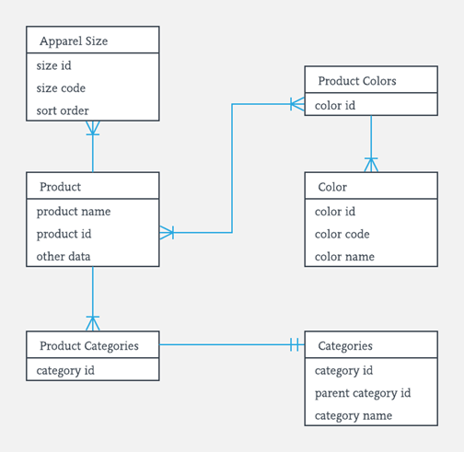
Components of the ER Diagram
ER model is based on three basic concepts:
Entities (Tables)
Attributes (Columns)
Relationships
The Software Services

Slide 53
Why use ER Diagrams?
Helps you to define terms related to entity relationship modeling
Provide a preview of how all your tables should connect, what fields are going to be on each table
Helps to describe entities, attributes, relationships
ER diagrams are translatable into relational tables which allows you to build databases quickly
ER diagrams can be used by database designers as a blueprint for implementing data in specific software applications
The database designer gains a better understanding of the information to be contained in the database with the help of ERP diagram
ERD is allowed you to communicate with the logical structure of the database to users
The Software Services

Slide 54
The Software Services

