Slide 1

The Software Services
Yours !
Veera Raghava

Slide 2
The Software Services
Welcome
to
Seaborn Tutorial

Slide 3

What is Seaborn ?
Seaborn is an open source Python data visualization library based on matplotlib. It provides a high-level interface for drawing attractive and informative statistical graphics. It is closely integrated with pandas data structures.
Data Visualization plays important role in the field of Data Science to extract important insights from Data.
A Diagram efficiently conveys more meaning when compared to spoken or written words.
With Seaborn we can plot wide vareity of attractive plots for visualising
the Data.
The Software Services

Slide 4
Why Seaborn ?
Seaborn is built on top of Python’s core visualization library Matplotlib. It is meant to serve as a complement, and not as a replacement. However, Seaborn comes with some very important features given below :
Built in themes for styling matplotlib graphics
Visualizing univariate and bivariate data
Fitting in and visualizing linear regression models
Plotting statistical time series data
Seaborn works well with NumPy and Pandas data structures
It comes with built in themes for styling Matplotlib graphics
The Software Services

Slide 5
Installing Seaborn :
Seaborn is an open source python package and freely available.
Method – 1 :
Install Anaconda (A Python Package Management Software)
---Recommended Method---
https://www.anaconda.com/distribution/
Method – 2 :
Install using PIP command at Python Prompt
pip install seaborn
The Software Services

Slide 6
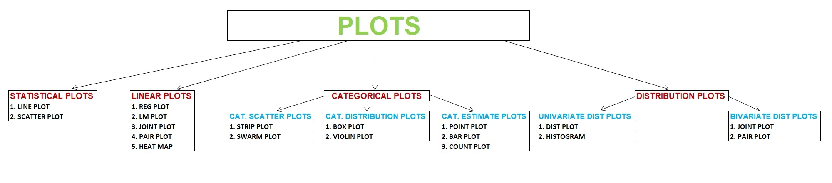
Classification of Plots :
The Software Services

Slide 7
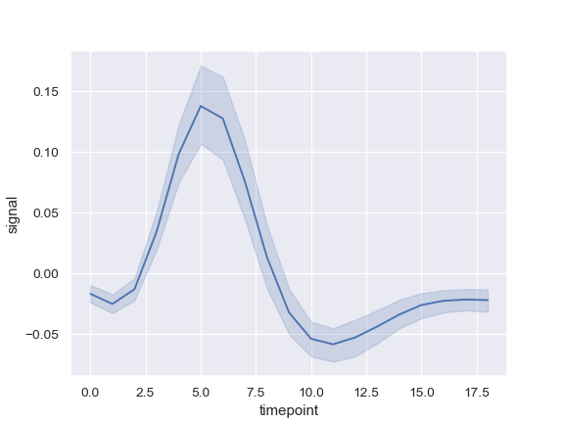
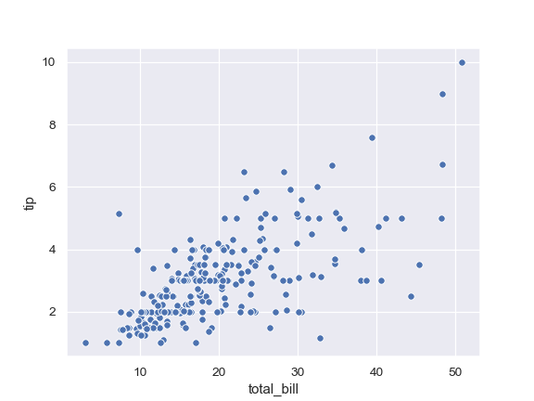
Statistical Plots
Statistical Plots are used to explore the relationship between two numerical variables. It can be used for exploring both linear and non linear relationships.
Line Plot 2. Scatter Plot
The Software Services

Slide 8
Line Plot
Ex :- Line Plot
df = sns.load_dataset('tips') # loads dataset
sns.set(style = 'whitegrid') # set plot background grid style
plt.figure(figsize=(10, 8)) # set plot size ( width and height of plot )
plt.title(‘Line Plot') # set plot title
# plotting line plot b/w x-variable vs y-variable ( both are numerical variables )
sns.lineplot(x='total_bill' , y='tip' , data = df )
The Software Services

Slide 9
Scatter Plot
Ex :- Scatter Plot
df = sns.load_dataset('tips') # loads dataset
sns.set(style = 'whitegrid') # set plot background grid style
plt.figure(figsize=(10, 8)) # set plot size ( width and height of plot )
plt.title(‘Scatter Plot') # set plot title
# plotting scatter plot b/w x-variable vs y-variable ( both are numerical variables )
sns.scatterplot(x= 'total_bill' , y= 'tip' , data = df )
The Software Services

Slide 10
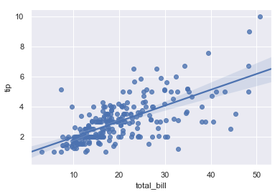
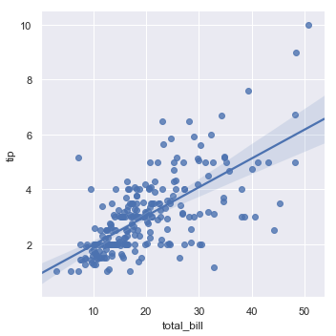
Linear Plots
Linear Plots are used to explore linear relationship between two numerical variables. Linear relationship may be positive correlated or negative correlated.
1. Regression Plot 2. Linear Model Plot
The Software Services

Slide 11
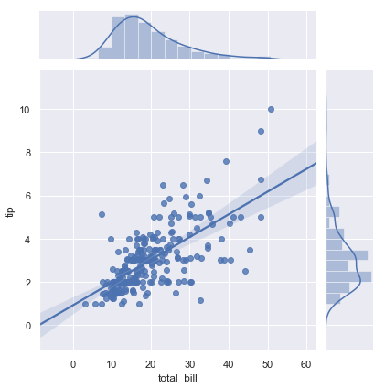
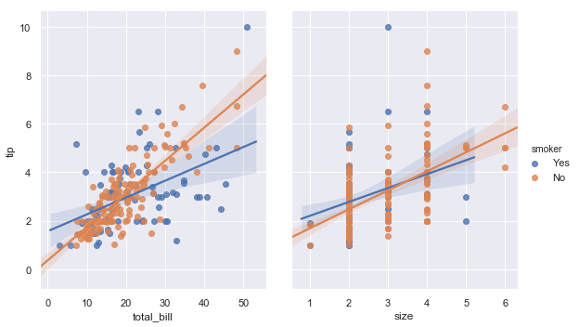
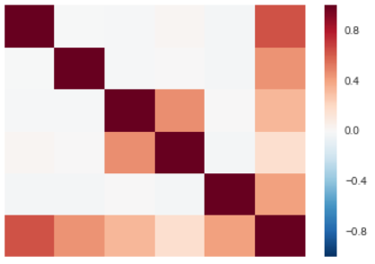
Linear Plots
3. Joint Plot
4. Pair Plot
5. Heat Map
The Software Services

Slide 12
Regression Plot
Ex :- Regression Plot
df = sns.load_dataset('tips') # loads dataset
sns.set(style = 'whitegrid') # set plot background grid style
plt.figure(figsize=(10, 8)) # set plot size ( width and height of plot )
plt.title(‘Regression Plot') # set plot title
# plotting regression plot b/w x-variable vs y-variable (both are numerical variables)
sns.regplot(x= 'total_bill' , y= 'tip' , data = df )
The Software Services

Slide 13
Linear Model Plot
Ex :- Linear Model Plot
df = sns.load_dataset('tips') # loads dataset
sns.set(style = 'whitegrid') # set plot background grid style
plt.figure(figsize=(10, 8)) # set plot size ( width and height of plot )
plt.title(‘Linear Model Plot') # set plot title
# plotting lm plot b/w x-variable vs y-variable ( both are numerical variables )
sns.lmplot(x= 'total_bill' , y= 'tip' , data = df , hue = ‘smoker’ )
The Software Services

Slide 14
Joint Plot
Ex :- Joint Plot
df = sns.load_dataset('tips') # loads dataset
sns.set(style = 'whitegrid') # set plot background grid style
plt.figure(figsize=(10, 8)) # set plot size ( width and height of plot )
plt.title(‘Joint Plot') # set plot title
# plotting joint plot b/w x-variable vs y-variable (both are numerical variables)
sns.jointplot(x= 'total_bill' , y= 'tip' , data = df , kind = 'reg' )
The Software Services

Slide 15
Pair Plot
Ex :- Pair Plot
df = sns.load_dataset('tips') # loads dataset
sns.set(style = 'whitegrid') # set plot background grid style
plt.figure(figsize=(10, 8)) # set plot size ( width and height of plot )
plt.title(‘Pair Plot') # set plot title
# plotting pair plot b/w x-variable vs y-variable (both are numerical variables)
sns.pairplot(data = df )
The Software Services

Slide 16
Heat Map Plot
Ex :- Heat Map Plot
df = sns.load_dataset('tips') # loads dataset
sns.set(style = 'whitegrid') # set plot background grid style
plt.figure(figsize=(10, 8)) # set plot size ( width and height of plot )
plt.title(‘Heat Map Plot') # set plot title
# plotting heat map plot b/w x-variable vs y-variable (both are numerical variables )
sns.heatmap(df.corr())
The Software Services

Slide 17
Categorical Plots
Categorical Plots are used to explore relationship between a categorical variable and a numerical variable.
Catergorical plots are subdivided into 3 types :
1. Categorical Scatter Plots
1. Strip Plot
2. Swarm Plot
2. Categorical Distribution Plots
1. Box Plot
2. Violin Plot
3. Categorical Estimate Plots
1. Point Plot
2. Bar Plot
3. Count Plot
The Software Services

Slide 18
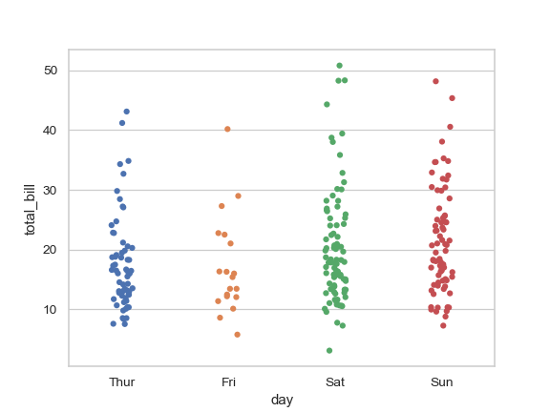
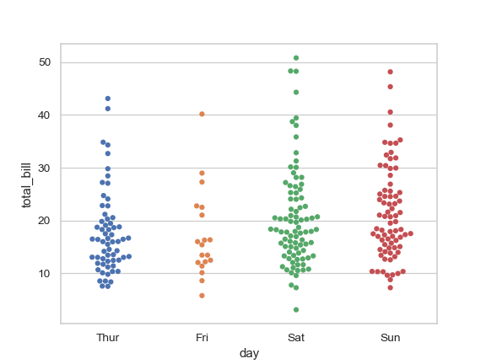
Categorical Scatter Plots
1. Strip Plot
2. Swarm Plot
The Software Services

Slide 19
Strip Plot
Ex :- Strip Plot
df = sns.load_dataset('tips') # loads dataset
sns.set(style = 'whitegrid') # set plot background grid style
plt.figure(figsize=(10, 8)) # set plot size ( width and height of plot )
plt.title(‘Strip Plot') # set plot title
# plotting strip plot b/w x-variable vs y-variable
(x is categorical variable and y is numerical variable )
sns.stripplot(x="day", y="total_bill", data=df)
The Software Services

Slide 20
Swarm Plot
Ex :- Swarm Plot
df = sns.load_dataset('tips') # loads dataset
sns.set(style = 'whitegrid') # set plot background grid style
plt.figure(figsize=(10, 8)) # set plot size ( width and height of plot )
plt.title(‘Swarm Plot') # set plot title
# plotting swarm plot b/w x-variable vs y-variable
(x is categorical variable and y is numerical variable )
sns.swarmplot(x="day", y="total_bill", data=df)
The Software Services

Slide 21
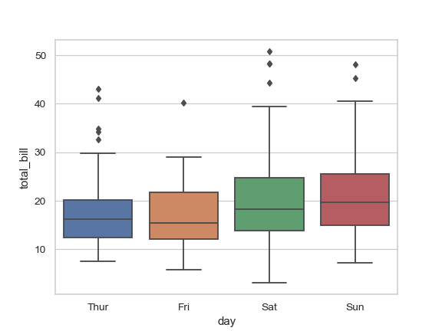
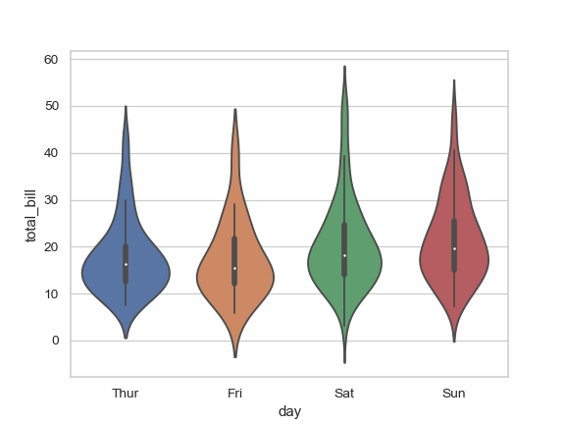
Categorical Distribution Plots
1. Box Plot
2. Violin Plot
The Software Services

Slide 22
Box Plot
Ex :- Box Plot
df = sns.load_dataset('tips') # loads dataset
sns.set(style = 'whitegrid') # set plot background grid style
plt.figure(figsize=(10, 8)) # set plot size ( width and height of plot )
plt.title(‘Box Plot') # set plot title
# plotting Box plot b/w x-variable vs y-variable
(x is categorical variable and y is numerical variable )
sns.boxplot(x="day", y="total_bill", data=df)
The Software Services

Slide 23
Violin Plot
Ex :- Violin Plot
df = sns.load_dataset('tips') # loads dataset
sns.set(style = 'whitegrid') # set plot background grid style
plt.figure(figsize=(10, 8)) # set plot size ( width and height of plot )
plt.title(‘Violin Plot') # set plot title
# plotting violin plot b/w x-variable vs y-variable
(x is categorical variable and y is numerical variable )
sns.violinplot(x="day", y="total_bill", data=df)
The Software Services

Slide 24
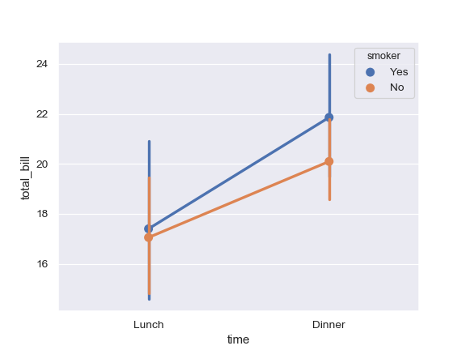
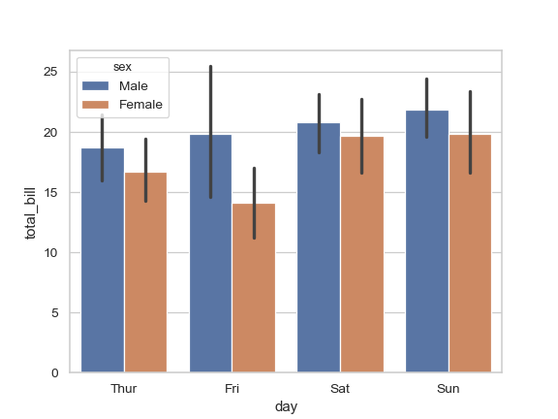
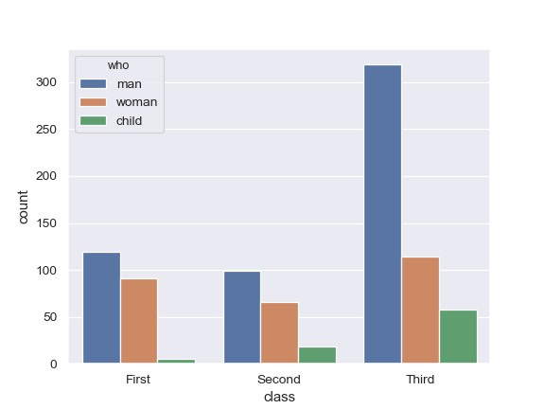
Categorical Estimate Plots
1. Point Plot
2. Bar Plot
3. Count Plot
The Software Services

Slide 25
Point Plot
Ex :- Point Plot
df = sns.load_dataset('tips') # loads dataset
sns.set(style = 'whitegrid') # set plot background grid style
plt.figure(figsize=(10, 8)) # set plot size ( width and height of plot )
plt.title(‘Point Plot') # set plot title
# plotting point plot b/w x-variable vs y-variable
(x is categorical variable and y is numerical variable )
sns.pointplot(x=“day", y="total_bill", data=df)
The Software Services

Slide 26
Bar Plot
Ex :- Bar Plot
df = sns.load_dataset('tips') # loads dataset
sns.set(style = 'whitegrid') # set plot background grid style
plt.figure(figsize=(10, 8)) # set plot size ( width and height of plot )
plt.title(‘Bar Plot') # set plot title
# plotting Bar plot b/w x-variable vs y-variable
(x is categorical variable and y is numerical variable )
sns.barplot(x=“day", y="total_bill", data=df)
The Software Services

Slide 27
Count Plot
Ex :- Count Plot
df = sns.load_dataset('tips') # loads dataset
sns.set(style = 'whitegrid') # set plot background grid style
plt.figure(figsize=(10, 8)) # set plot size ( width and height of plot )
plt.title(‘Count Plot') # set plot title
# plotting count plot x-variable or y-variable
(categorical variable)
sns.countplot(x=“day", data=df)
The Software Services

Slide 28
Distribution Plots
Distribution Plots are used to explore how a variable is distributed.
Distribution Plots are sub divided into 2 types :
Univariate Distribution Plots ( one numerical variable plot )
Dist Plot
Histogram
Bivariate Distribution Plots ( two numerical variables plot )
Joint Plot
Pair Plot
The Software Services

Slide 29
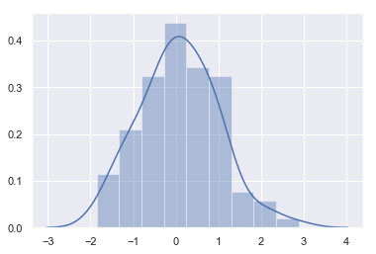
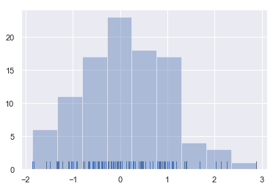
Univariate Distribution Plots
1. Dist Plot
2. Histogram Plot
The Software Services

Slide 30
Dist Plot
Ex :- Dist Plot
df = sns.load_dataset('tips') # loads dataset
sns.set(style = 'whitegrid') # set plot background grid style
plt.figure(figsize=(10, 8)) # set plot size ( width and height of plot )
plt.title(‘Dist Plot') # set plot title
# plotting dist plot b/w x-variable(class interval) vs y-variable(frequency)
(x is numerical class interval and y is frequency )
sns.distplot(a = df['tip'])
The Software Services

Slide 31
Histogram Plot
Ex :- Histogram Plot
df = sns.load_dataset('tips') # loads dataset
sns.set(style = 'whitegrid') # set plot background grid style
plt.figure(figsize=(10, 8)) # set plot size ( width and height of plot )
plt.title(‘Histogram Plot') # set plot title
# plotting histogram plot b/w x-variable(class interval) vs y-variable(frequency)
(x is numerical class interval and y is frequency )
sns.distplot(a = df['tip'] , kde = Flase , bins = 5)
The Software Services

Slide 32
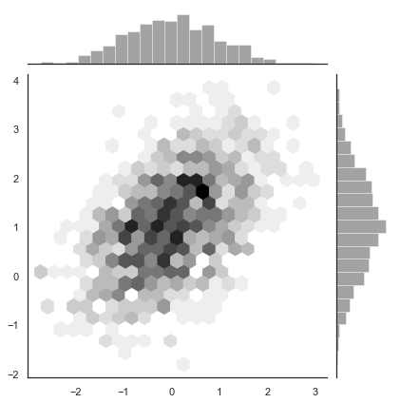
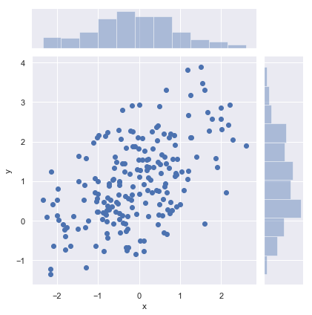
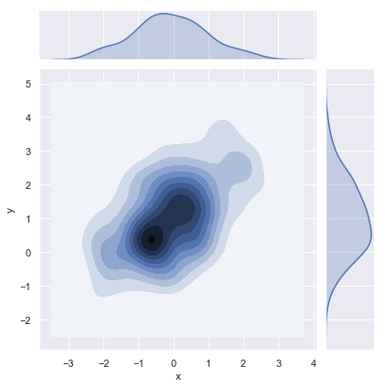
Bivariate Distribution Plots
1. Joint Plot
1. Joint Plot with HEX
1. Joint Plot with KDE
2. Pair Plot
The Software Services

Slide 33
Joint Plot
Ex :- Joint Plot
df = sns.load_dataset('tips') # loads dataset
sns.set(style = 'whitegrid') # set plot background grid style
plt.figure(figsize=(10, 8)) # set plot size ( width and height of plot )
plt.title(‘Joint Plot') # set plot title
# plotting joint plot b/w x-variable vs y-variable (both are numerical variables)
sns.jointplot(x= 'total_bill' , y= 'tip' , data = df , kind = ‘hex‘ or ‘kde’ )
The Software Services

Slide 34
Pair Plot
Ex :- Pair Plot
df = sns.load_dataset('tips') # loads dataset
sns.set(style = 'whitegrid') # set plot background grid style
plt.figure(figsize=(10, 8)) # set plot size ( width and height of plot )
plt.title(‘Pair Plot') # set plot title
# plotting joint plot b/w x-variable vs y-variable (both are numerical variables)
sns.pairplot(data = df )
The Software Services

Slide 35
The Software Services

Slide 36
The Software Services

Slide 37
The Software Services

Slide 38
The Software Services

Slide 39
The Software Services

Slide 40
The Software Services

Slide 41
The Software Services

