Slide 1
Mitahara - Nutrition for healthy body and mind
VASHISHT HACKATHON-VH236

Slide 2
Team Members:
S. No | Name of the Student | Register Number | Year / Department
1 | VEERADHARSAN R | 9921003006 | 3rd year/ CIVIL
2 | MANIBHARATHI M | 9921003003 | 3rd year/ CIVIL
3 | HARIBHARATH S | 9822003005 | 3rd year/ CIVIL
4 | SANTHOSHKUMAR S | 9921003004 | 3rd year/ CIVIL
TEAM LEADER : VEERADHARSAN R
TEAM NAME : CIVIL SPARKZ
TEAM NO. : VH236

Slide 3
Introduction
Our app offers personalized advice for diet and lifestyle changes to promote food security and improve heart health. With individualized diet plans and exercise schedules, users gain control over their cardiovascular well-being. Backed by nutritional expertise and scientific research, the app guides users toward heart-healthy meal choices while considering their ethnic preferences and dietary limitations. Our mission is to foster a healthier and more equitable society by merging the principles of food security and cardiovascular health, ensuring everyone can access the resources for a resilient heart.

Slide 4
Problem Statement and its evolution
Lack of personalized advice and limited access to heart-healthy foods impact current heart health.
Existing treatments often overlook the significance of food security for cardiovascular well-being.
The app was developed to bridge the gap between the ideal and current state of heart health.
Aims to empower users to make informed food and lifestyle choices for improved heart health.
Focuses on inclusivity, catering to all socioeconomic backgrounds and dietary preferences.
Integrates scientific research, food security principles, and personal health profiles.
Aims to create a more open and healthy society through advancing heart health management.
.

Slide 5
Survey on existing products
The goal of this survey is to investigate five products that already exist and offer users meal suggestions and heart health tracking. To assist people improve their cardiovascular health, these products offer a variety of features like customized diet planning, workout schedules, and health monitoring. In order to help with the development of the app, the survey will emphasize the advantages and disadvantages of each product.
Product A: HeartHealth+:
Features: HeartHealth+ provides individualized diet programs, workout schedules, and health monitoring via wearable technology.
Strengths: Access to a wide variety of heart-healthy recipes, thorough tracking of crucial health data, and integration with fitness wearables.
Weaknesses: There is insufficient regard for cultural food choices and a weak network of support within the community.

Slide 6
Survey on existing products
Product B: Heartwise
Features: Heartwise provides individualized meal programs, exercise monitoring, and virtual nutrition advice.
Strengths: professional advice, an easy-to-use interface, and regular progress reviews.
Weaknesses: Higher membership fees, fewer workout options, and doesn't address issues with food security
Product C: HealthyHeart
Features: Meal suggestions, heart health tracking, and social engagement tools are all offered by HealthyHeart.
Strengths: Supportive neighborhood involvement, inspiring challenges, and adaptable meal preferences.
Weaknesses: Exercise programs are monotonous, and tracking metrics' accuracy can vary.

Slide 7
Existing Methodology - Merits and Demerits
Apps tracking heart health and offering meal recommendations present valuable capabilities for improving cardiovascular health, providing access to health information, personalized nutrition programs, and exercise tracking. Users can monitor their health indicators, receive tailored nutritional advice, and gain awareness about heart health. However, limitations like reliance on self-reported data, insufficient consideration of cultural dietary choices and food security, and incomplete workout plans hinder their inclusiveness and effectiveness. An alternative solution, like the proposed Heart Health app, should address these shortcomings to offer a more practical and inclusive approach.

Slide 8
Existing Methodology - Merits and Demerits
Advantages:
Access to health information and personalized nutrition programs.
Ability to track health indicators and receive tailored nutritional recommendations.
Raises awareness and promotes cardiovascular health.
Some apps offer social interaction and community support for motivation.
Disadvantages:
Reliance on self-reported information may lead to inaccurate health tracking.
Inadequate consideration of cultural dietary choices and food security.
Lack of comprehensive workout plans may hinder promoting an active lifestyle.
Existing apps may not address all user needs and preferences effectively.

Slide 9
Proposed Methodology
The app's inclusive approach improves heart health tracking and meal recommendations
through tailored assistance, cultural sensitivity, and community support. It fuses personalized
health profiles, heart-healthy meal plans, fitness tracking, and education, aiming to transform
heart health management for better overall well-being.

Slide 10
Tools used:
Android studio
Java
Xml
Version Control
User Interface (UI) Design Tools

Slide 11
Idea Matrix- identify, organize, and develop
The Mitahara Heart Health app's idea matrix aids in identifying, organizing, and developing important features and factors for its effective implementation.
Identify:
Heart-Healthy Exercise Routines: Create exercise programs that are customized for each person's needs and fitness level to promote a more active lifestyle.
Food Security Integration: Ensure inexpensive and accessible meal options without sacrificing nutritional value, addressing concerns about food insecurity.
Health Monitoring: To successfully assess progress, including the tracking of important health metrics like blood pressure, cholesterol levels, and heart rate.
Community Support: Create a welcoming user base to encourage participation, experience sharing, and motivation.
Organize:
User Profile Setup: During the account creation process, gather important health information, dietary preferences, and exercise routines.

Slide 12
Idea Matrix- identify, organize, and develop
Meal and Recipe Database: Create a thorough database of heart-healthy recipes that takes into account different cuisines from different cultures.
Exercise Library: Create a wide range of exercises with variable durations and intensities to accommodate different user needs.
Nutritional Guidance: To provide accurate and current recommendations for heart health, work with dietitians and other professionals.
Progress Tracking: Implement tools to track improvements in users' health metrics over time.
Develop:
User Interface: Create an interface that is simple to use and allows for easy interaction with the app's capabilities.
Algorithm Development: Develop algorithms that assess user data and produce individualized meal plans and workout schedules.
Data Security: To protect the personal and health-related information of users, use strong data security measures.
Gamification and Challenges: Motivate people and improve adherence to heart-healthy practices by introducing gamification elements and challenges.

Slide 13
Outcome/Deliverables
Targeted workout programs for increased cardiovascular fitness.
Improved heart health through data-driven insights and progress tracking.
Integration of food security, advising nutrient-rich meals for all socioeconomic backgrounds.
Access to research-backed health education for informed decisions.
Aims to contribute to a healthier society with lower cardiovascular risks and improved well-being.
Comprehensive solution for heart health, combining personalized suggestions, inclusive food options, community support, and data-driven insights.
Pride Mobility Go Chair

Slide 14
Sustainability: How does your proposed solution contributes to the positive impact on the society?
By providing people with tailored heart health suggestions, inclusive eating options, and social support, the proposed Mitahara Heart Health app fosters beneficial societal effect. It helps create a healthier society by addressing issues with food security and encouraging long-lasting heart-healthy behaviors, which lowers the burden of cardiovascular diseases and enhances general wellbeing.
Innovation: How does your plan contrast with and develop at present accessible answers for your objective end client?
By providing individualized heart health recommendations with cultural sensitivity, food security integration, and a supportive community, the Mitahara Heart Health app stands apart from competing products. By utilizing data-driven insights and professional advice to establish enduring heart-healthy habits for a more inclusive and productive user experience, it exceeds one-size-fits-all approaches.

Slide 15
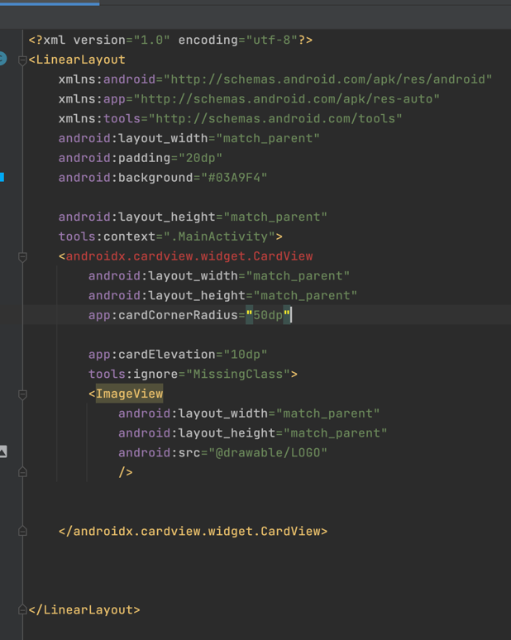
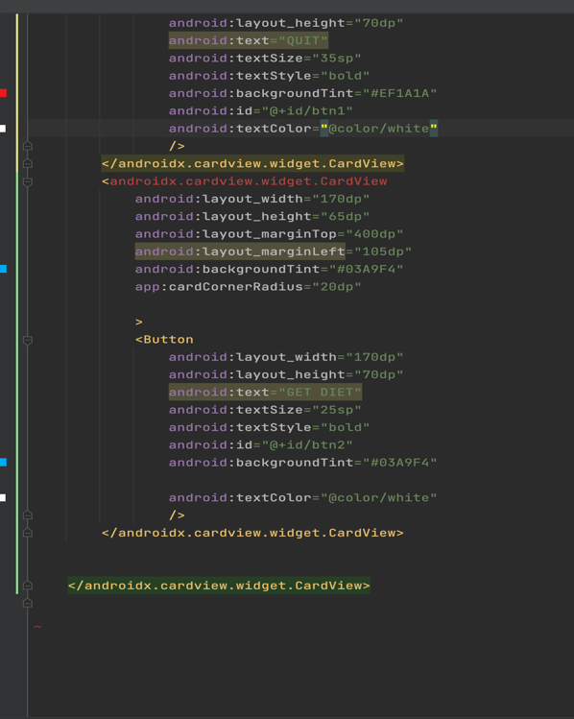
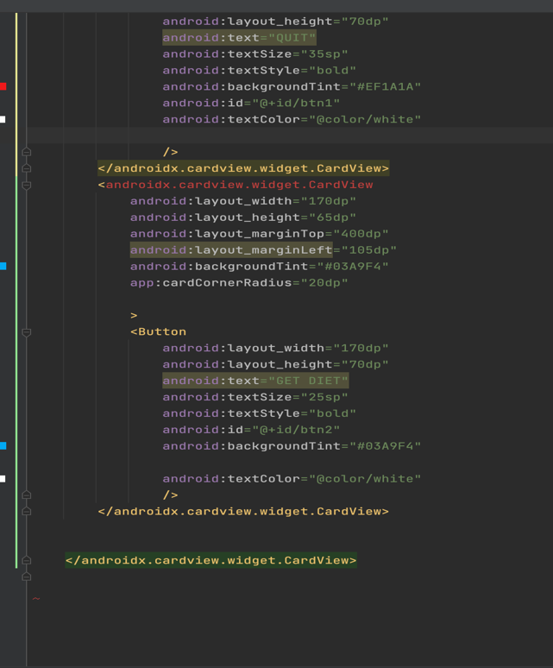
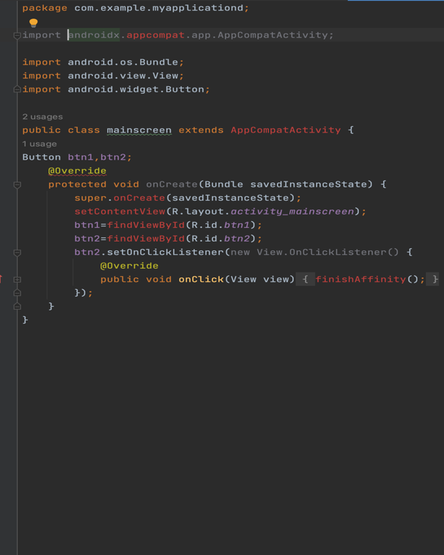
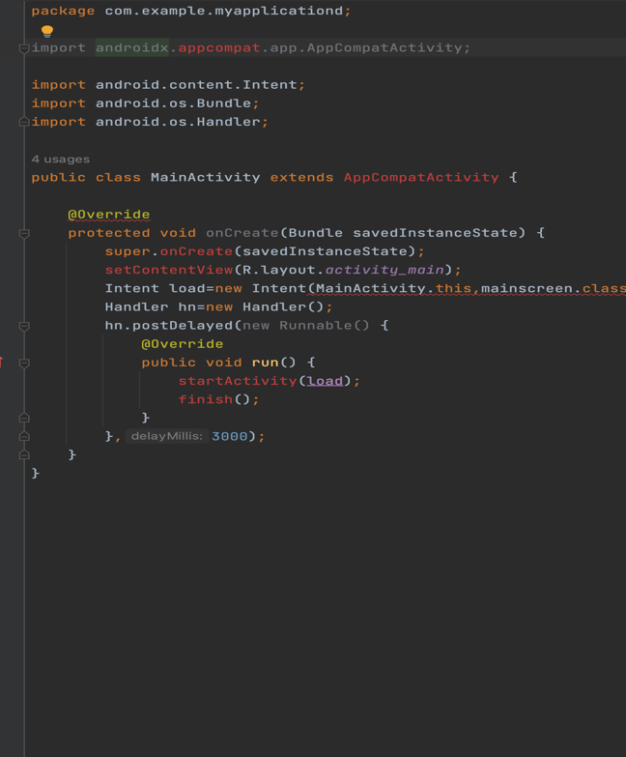
Results (Design/ prototype / simulation / drawings / photos)
Some code is done. The remaining code is delayed due to issues with dependency downloading.

Slide 16
In conclusion, the app offers a comprehensive and creative solution, addressing the limitations of other heart health tracking apps. It empowers users with personalized, culturally sensitive, and community-supported heart-healthy choices. With data-driven insights, wearable integration, and professional advice, it aims to improve cardiovascular well-being and create a positive social impact. Positioned for transforming heart health management, the app fosters an inclusive, educated, and engaged society.
Conclusion:
Pride Mobility Go Chair

Slide 17
Future Work: Long-Term Health Monitoring: Add sophisticated tools like sleep tracking and continuous glucose monitoring for a holistic view of overall health. Collaborations and Research: Conduct studies with research institutes and health groups, continuously enhancing app features based on findings. Gamification: Introduce interactive features, challenges, and rewards to motivate users for heart-healthy activities. Community Engagement: Foster a supportive user community with information exchange and peer assistance. Continuous Research: Stay updated with the latest scientific studies on diet and heart health to provide evidence-based advice.
Pride Mobility Go Chair

Slide 18
THANK YOU

