Slide 1

SMART INDIA HACKATHON 2026
Problem Statement ID – SIH26123
Problem Statement Title- Edge-AI Based Distributed Fleet Coordination for Autonomous Mobile Robots (AMRs) in Smart Warehouses
Theme- Smart Automation
PS Category- Software
Team ID- 147189
Team Name- CLUSTER HEAD

Slide 2

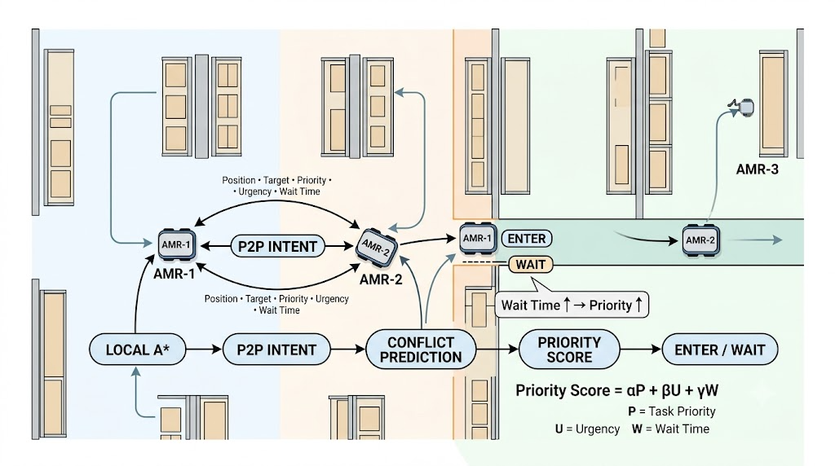




CLUSTER HEAD
Our Solution
Problem at Hand
Why We Stand Out
Centralized Dependency: Movement coordination can depend on a central controller and communication path.
Distributed Decisions: Each AMR performs its own path planning and conflict decisions. The dashboard only monitors; it does not control robot movement.
Traffic Conflicts: Multiple AMRs competing for narrow aisles and junctions can cause blocking and collisions.
Pre-emptive Coordination: Robots negotiate before entering a contested narrow lane, instead of reacting after a conflict occurs .
Deadlock & Starvation: Fixed-priority rules can repeatedly make the same robot yield, causing prolonged waiting and unfair access to shared lanes.
Fairness-Aware Priority: Waiting time increases a robot's priority, reducing repeated starvation during recurring conflicts.
Dynamic Warehouse: Blocked aisles or changing routes require robots to adapt their paths instead of following a fixed route.
Dynamic Re-planning: When an aisle or grid cell becomes blocked, the affected robot can re-run A* and find an alternative route.
Design Philosophy
Scalability Challenge: As the number of AMRs increases, coordinating every movement through one controller can increase the coordination burden and communication dependency.
Local First — Each AMR owns its movement decision.
Predict Before Conflict — Negotiate before entering shared space.
Fairness by Waiting — Waiting increases future priority.
Deterministic Decisions — Priority score + robot-ID tie-breaker.
Monitor, Don't Control — Dashboard observes; robots decide.
Cell-Level Deadlock Resolution: If a physical block persists, the lower-priority robot moves to an available backup cell and replans.

Slide 3
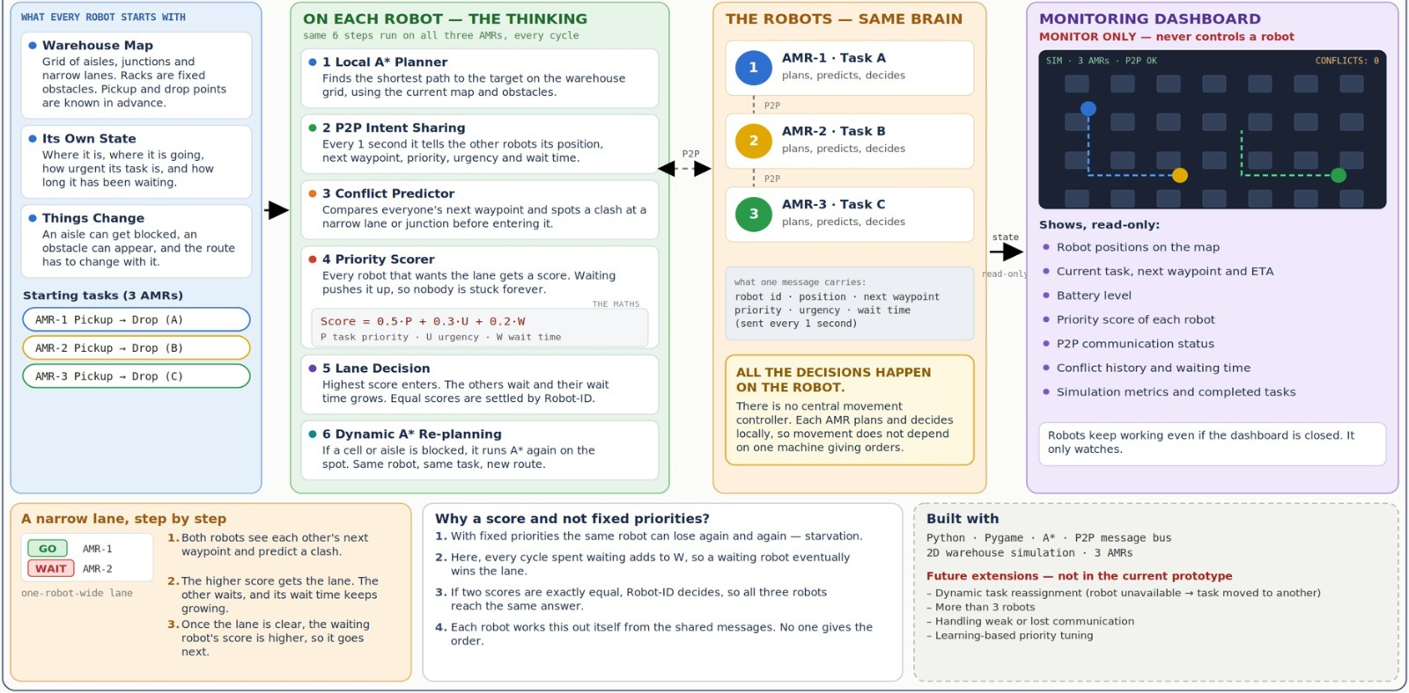
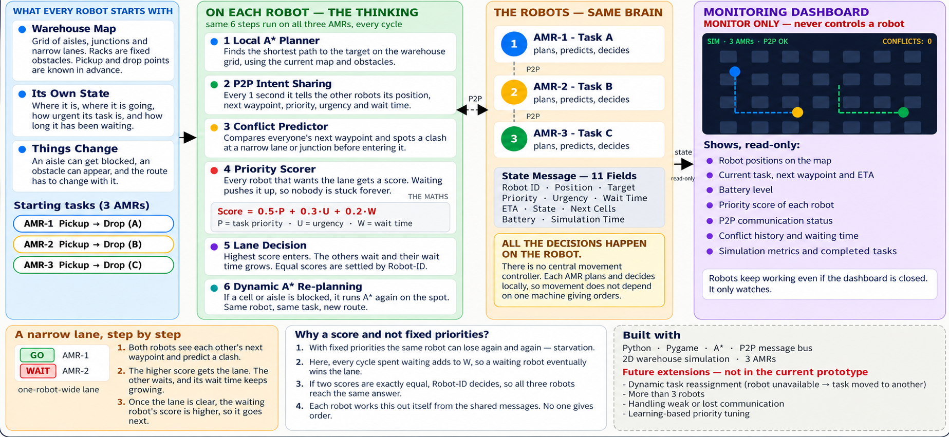
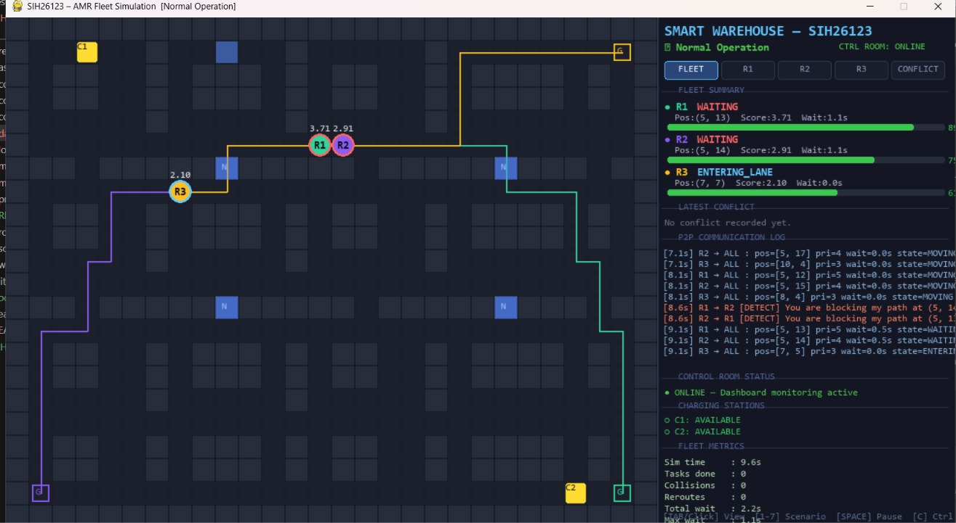

TECHNICAL APPROACH
CLUSTER HEAD

Slide 4
FEASIBILITY AND VIABILITY
CLUSTER HEAD
ANALYSIS OF THE FEASIBILITY
POTENTIAL CHALLENGES AND WAYS TO OVERCOME THEM
Dimension | Assessment
Technical | Proven methods: A* path planning + rule-based scoring No model training or specialised hardware required
Proof of concept | Working 3-robot prototype in Python + Pygame
Operational | Decentralised: each robot makes its own decisions Dashboard is monitor-only; it never controls robots
Safety and reliability | Robots negotiate right-of-way before a narrow lane Score = 0.5(priority) + 0.3(urgency) + 0.2(wait factor); Ties – Lower Robot ID
Scalability | Identical logic per robot; fleet size can be extended Path: Simulation -- Edge hardware (Pi / Jetson)
Cost and resources | Open-source stack; No cloud or license costs Runs on a standard laptop
Measurability | Logs collisions, waiting time, messages, completion time Target: ≥20% reduction in total task completion time vs stop-and-wait baseline
Challenges / Risks | Mitigation
Unfair priority decisions | Adjust priority settings Test across settings; Every run should be logged Priority based on Urgency+Waiting time
Stale or lost messages | Timestamped messages published every 1 s Robots use the latest valid peer state before entering a contested lane
Inconsistent robot decisions | Identical scoring formula and message format Deterministic tie-break using robot ID
Starvation and deadlock | Waiting time increases Priority score, helping reduce starvation Deterministic tie-breaking provides predictable conflict resolution.
Limited local view | Robots broadcast Position,Target,Priority,Urgency,Wait time and ETA every 1s
Scaling beyond 3 robots | Compact, fixed-size messages Test 4–5 robots once the core is stable
Simulation-to-real gap | Agent code is independent of hardware Pi / Jetson trial planned for next phase
Scope: 3 AMRs with decentralized coordination, A* planning, Conflict resolution, Dynamic rerouting and Task reassignment is proposed as an extension
Future: Edge deployment, Real-world validation and larger fleets.

Slide 5

CLUSTER HEAD
IMPACT AND BENEFITS
0
Target ≥ 20%
1 s
Local
collisions observed in tested simulation runs
Reduction in Task Completion Time (vs. Stop-and-Wait)
P2P State & Intent Broadcast Frequency
Decision Making
(No Central Movement Controller)
IMPACTS (Who It Helps)
Maximized Productivity
Reduced Single Point of Failure
Pre-Emptive Conflict Resolution
Warehouse Operators & Fleet Managers
Warehouse Floor & Safety Supervisors
Targets ≥20% faster task completion compared to traditional stop-and-wait approaches.
Removes central server dependency by embedding local pathfinding (A^*) and priority logic directly onto each robot.
AMRs negotiate narrow-lane access prior to entry rather than reacting after proximity warnings.
•
Reduced Central Dependency: robots can continue local coordination when the control-room connection is unavailable.
•
Pre-emptive Conflict Resolution: robots negotiate right-of-way before entering contested narrow aisles, reducing collision risk.
•
Real-Time Fleet Oversight : Read-only visual dashboard provides complete live status, battery levels, and telemetry without controlling or delaying robot paths.
•
Deadlock/Starvation Handling: wait-time escalation and deterministic tie-breaking help robots progress through repeated bottleneck conflicts.
Anti-Starvation Fairness
Deterministic Tie-Breaking
Simulated & Tested
Priority Score (α·P + β·U +
γ·W) automatically escalates
for waiting robots,helping reso
lve repeated bottleneck conflicts.
Resolves equal priority scores predictably using unique Robot IDs to ensure reproducible fleet execution.
Multi-agent 2D Python/Pygame testbed with 3 AMRs; 0 collisions observed across tested scenarios.
Logistics & Supply Chain Operations
IT & Edge Deployment Engineers
•
Adaptive Obstacle Detours : Robots locally recalculate alternative routes around blocked aisles using A*, minimizing delivery downtime.
•
Lightweight Hardware Footprint : Designed for lightweight edge deployment (e.g., Raspberry Pi / Jetson) without requiring complex middleware.
Full Telemetry Transparency
Autonomous Battery Management
Lightweight P2P Communication
•
•
Dedicated Pygame dashboard logs positions, status, battery, and P2P chatter for complete auditability.
Robots monitor battery level, route to charging stations when critically low, charge, and resume their saved task.
Robots exchange compact
state messages every 1 sec
, reducing dependence on continuous centralized communication.
Fair Resource Sharing : Dynamic wait-time priority scaling helps reduce repeated blocking and starvation.
Low Network Strain : Replaces continuous heavy cloud streaming with lightweight, periodic peer-to-peer JSON messages.
5

Slide 6
RESEARCH AND REFERENCES
CLUSTER HEAD
What research establishes: Key findings from literature
Local A* Pathfinding: A*: Established grid-based path-planning algorithm suitable for local route calculation.
Peer-to-Peer Communication Protocols: Established mechanism for direct inter-agent state and intent exchange without central brokers.
Lifelong MAPF Foundations: Establishes theoretical multi-agent pathfinding and spatial access reservation in shared warehouse environments.
Standardized Fleet Interfaces (VDA 5050 / Open-RMF): Demonstrates standardized data structures for mobile robot coordination and traffic management.
What existing systems do: Evidence from current solution
Centralized Fleet Controllers: Provide global fleet tracking but create single points of failure and high network latency.
VDA 5050 Standard Interface: Standardizes central control-to-AGV communication, but does not offer direct robot-to-robot P2P negotiation.
Open-RMF Traffic Negotiation:. Provides multi-robot traffic scheduling and negotiation; our prototype focuses on lightweight local decision-making.
Fixed-Priority Decentralized P2P: Uses local P2P with static rules (e.g., fixed Robot ID), Static priority rules can repeatedly favor the same robot, increasing starvation risk.
RESEARCH GAP : What is still missing
Over-reliance on Central Control: Centralized architectures depend on network connectivity and fleet-control availability.
Absence of Anti-Starvation Priority: Static scoring frameworks lack dynamic wait-time escalation, causing corridor deadlocks.
Reactive vs. Pre-emptive Avoidance: Systems rely on reactive stop-and-wait sensors rather than pre-entry narrow-lane negotiation.
Heavy Compute Burden: More advanced MAPF approaches can introduce additional computational and coordination complexity; our prototype focuses on lightweight local planning.
REFERENCES
Problem Statement: SIH26123, "Edge-AI Based Distributed Fleet Coordination for Autonomous Mobile Robots (AMRs) in Smart Warehouses," Bharat Electronics Limited (BEL), Smart India Hackathon 2026.
VDA 5050 Standard: VDA 5050 v3.0.0, "VDA Specification for AGV Communication Interface," Verband der Automobilindustrie (VDA), 2023.
Open-RMF Traffic Negotiation: Open Robotics, "Open-RMF Traffic Management and Negotiation Library (rmf_traffic)," Open Source Robotics Foundation, 2023.
Lifelong MAPF Research: J. Li et al., "Lifelong Multi-Agent Path Finding in Large-Scale Warehouses," Proceedings of the AAAI Conference on Artificial Intelligence, Vol. 35, No. 13, pp. 11272–11281, 2021.
A Pathfinding Basis: P. E. Hart, N. J. Nilsson, and B. Raphael, "A Formal Basis for the Heuristic Determination of Minimum Cost Paths," IEEE Transactions on Systems Science and Cybernetics, Vol. 4, No. 2, pp. 100–107, 1968.

