Slide 1
Dynamic Building Energy Flexibility Engine
  Bridging the gap between static building automation and real-time smart grid demand-response requirements through adaptive software.
Key Agenda Topics:
  The Real-Time Building Energy Blind Spot
  Real-World College & Office Scenarios
  The End-to-End 8-Stage System Architecture
  Transparent Physics & Thermodynamic Modeling
  Live Streamlit Simulation & Dashboard Demonstration
  Multi-Stakeholder Impact & Scalable Retrofit Roadmap

Slide 2
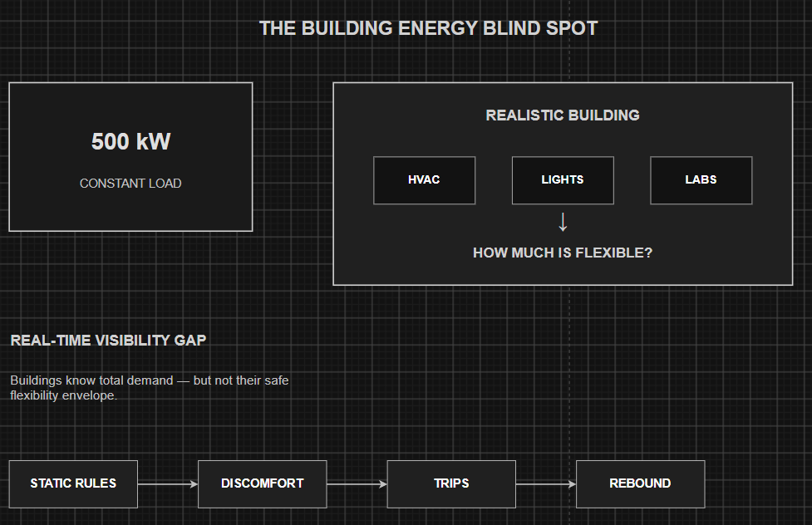
The Building Energy Blind Spot
  The Real-Time Visibility Gap: Buildings can measure total electricity use at any second, but often lack a lightweight, adaptive way to estimate how much load can be safely reduced, for how long, and with what comfort and rebound impact.
  The Fallacy of Static Rules: Current utility demand-response frameworks rely on rigid, brute-force measures, such as mandatory blind percentage reductions across entire facilities.
  Severe Operational Consequences: Static reduction rules routinely trigger tenant discomfort complaints, unexpected equipment tripping, and severe secondary power surges (rebound spikes) during recovery.
  The Technical Imperative: There is an urgent need for an adaptive software architecture that calculates actionable, real-time flexibility envelopes under continuous environmental and operational constraints.

Slide 3
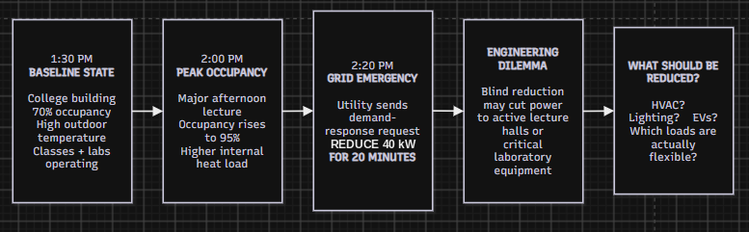
Real-World Scenario — The College Building Demand Event
  1:30 PM — Baseline State: A multi-story college building operates at 70% occupancy with high outdoor ambient temperatures; standard classes and active laboratory operations are underway.
  2:00 PM — Peak Occupancy Shift: A major afternoon lecture begins, pushing building occupancy up to 95% and significantly driving up internal thermal heat loads.
  2:20 PM — The Grid Emergency Signal: The utility grid operator issues an urgent demand-response command: "Reduce 40 kW for the next 20 minutes."
  The Core Engineering Dilemma: A blind 10% reduction cuts power haphazardly across active lecture halls or critical research infrastructure, causing immediate administrative complaints or equipment shutdowns.

Slide 4
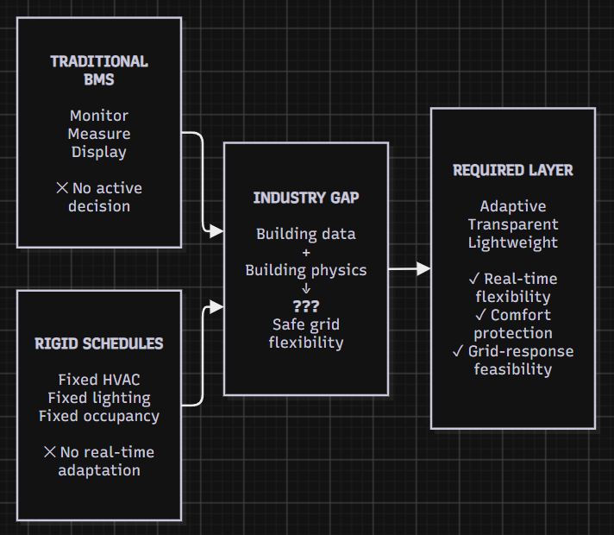
The Industry Gap
  Traditional BMS Dashboards:
  What they do: Monitor mechanical equipment states, historical energy consumption trends, and environmental sensor metrics.
  Gap: They monitor equipment and support rule-based control, but are not designed to estimate request-specific flexibility from live building state.
  Rigid Occupancy Schedules:
  What they do: Pre-program lighting and HVAC timers based on expected calendar hours and standard working days.
  Why they fail: They are entirely blind to sudden weather spikes, unpredictable occupancy changes (such as unexpected events or empty rooms), or real-time grid emergency requests.
  The Practical Research & Engineering Gap:
  The key gap is request-specific flexibility estimation: a lightweight, low-sensing layer that maps live building thermodynamics to a feasible reduction, safe duration, and comfort/rebound risk for a given DR request.
  Many alternatives require costly hardware upgrades or rely on opaque ML models that are hard to validate against comfort constraints.

Slide 5
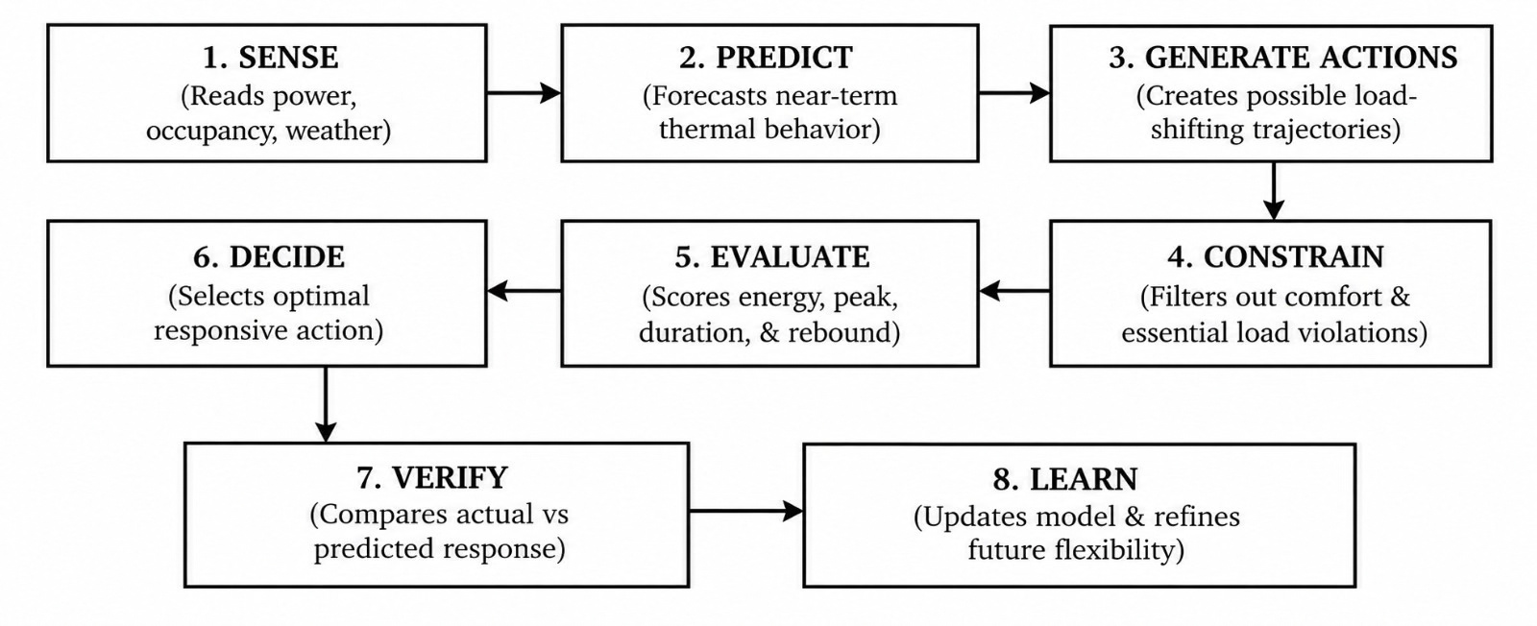
Solution — The End-to-End Engine Architecture
  The Software Layer: Sits above existing infrastructure to compute flexibility envelopes.
  Prototype Focus: HVAC/thermal flexibility; lighting, EV and other loads are future extensions.
  Core Pipeline Description: The engine continuously senses environmental parameters, predicts thermodynamic changes, runs candidate control actions through strict safety filters, outputs an optimized plan, and learns from actual responses.

Slide 6
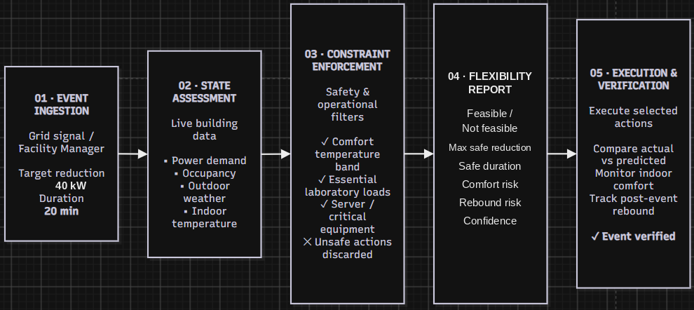
Step-by-Step User Journey
  Step 1 — Event Ingestion: The facility manager or an automated grid signal inputs a target kW reduction and duration requirement.
  Step 2 — State Assessment: The engine queries live sensor feeds, current outdoor weather profiles, and building occupancy numbers.
  Step 3 — Constraint Enforcement: Safety filters lock in strict indoor temperature comfort bands and protect essential laboratory or server loads.
  Step 4 — Optimized Recommendation: Target: 40 kW for 20 min → Feasible / Not Feasible → Maximum Safe Reduction → Safe Duration → Comfort Risk → Rebound Risk → Confidence.
  Step 5 — Execution & Verification: The command is executed, performance is verified against predictions, and post-event power rebound is tracked.

Slide 7
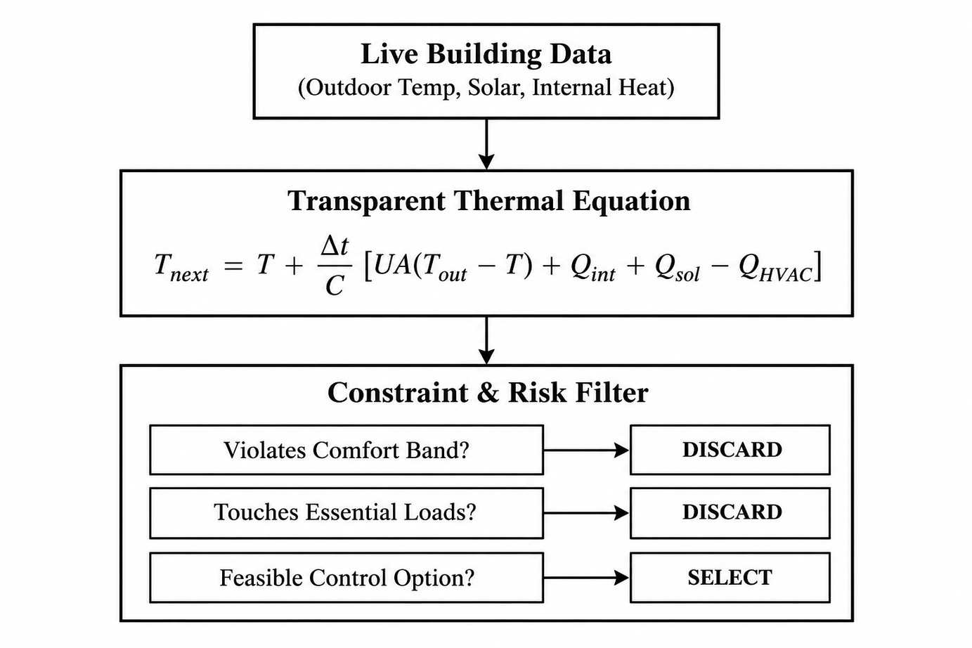
Technical Approach
  Avoiding Opaque AI: An interpretable thermal model (not a black box) predicts indoor temperature and energy response under different HVAC actions, with no long training history.
  Thermodynamic Rigor: The model tracks heat transfer coefficients, thermal mass, internal gains, and HVAC cooling output, and checks each action against comfort limits before recommending it.

Slide 8
Live Software Simulation & Dashboard Design

Slide 9
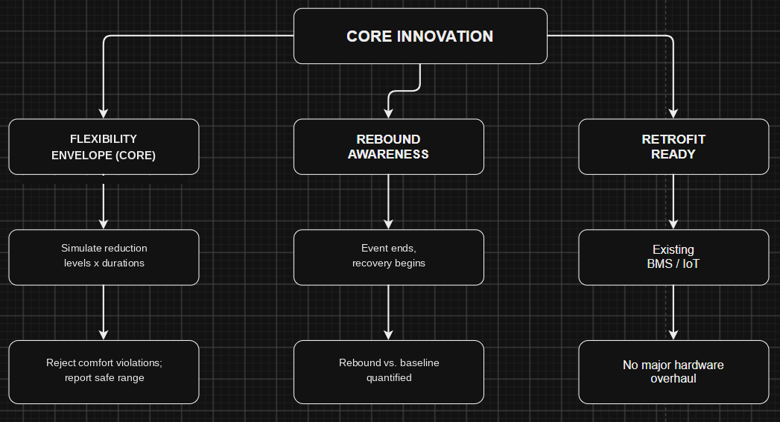
Core Innovation & Key Differentiators
1. Flexibility Envelope (Core): The engine simulates different reduction levels and durations under live weather and occupancy, rejects comfort-violating actions, and reports the safe flexibility range.
2. Explicit Rebound Awareness: Rebound is quantified as post-event recovery demand relative to the normal baseline (P_recovery − P_baseline), limiting secondary peaks.
3. Retrofit-Oriented Architecture: Designed from the ground up to integrate cleanly with existing smart meters, IoT gateways, and building management systems without requiring costly hardware overhauls.
  Localized Edge Privacy & Security: Processes sensitive occupancy and sensor telemetry locally on lightweight edge nodes, ensuring tenant privacy and eliminating vulnerabilities associated with cloud-only data centralization.

Slide 10
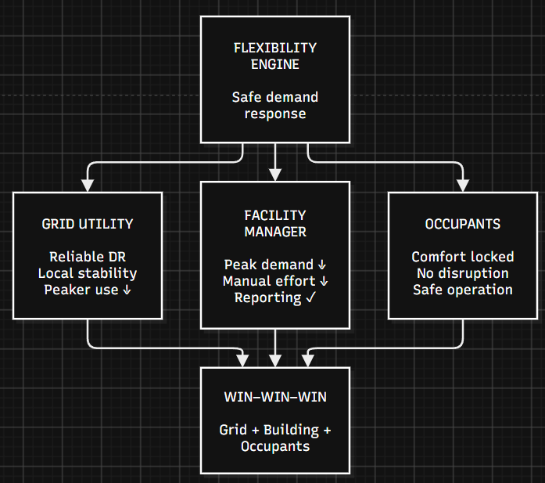
Quantified Impact
1. For Grid Utilities & Operators:
  Provides predictable, localized, and dispatchable demand-response capacity on demand.
  Effectively prevents localized brownouts, voltage sags, and catastrophic blackouts during extreme grid stress and peak summer/winter load hours.
  Lowers the economic necessity for utilities to spin up expensive, carbon-heavy peaker power plants.
2. For Facility & Campus Managers:
  Evaluation metrics: peak reduction, comfort violations, rebound, and prediction error.
  Eliminates the operational guesswork and anxiety of manual, emergency energy shedding.
  Provides automated compliance reporting for green building and corporate sustainability mandates.
3. For Building Occupants & Students:
  Maintains operation within the defined comfort band through continuous constraint monitoring.
  Prevents sudden, jarring office climate shifts or lab disruptions during peak curtailment events.

Slide 11
Deployment & Scalability Roadmap

Slide 12
Prototype Execution, Team Ownership & Conclusion

