Slide 1
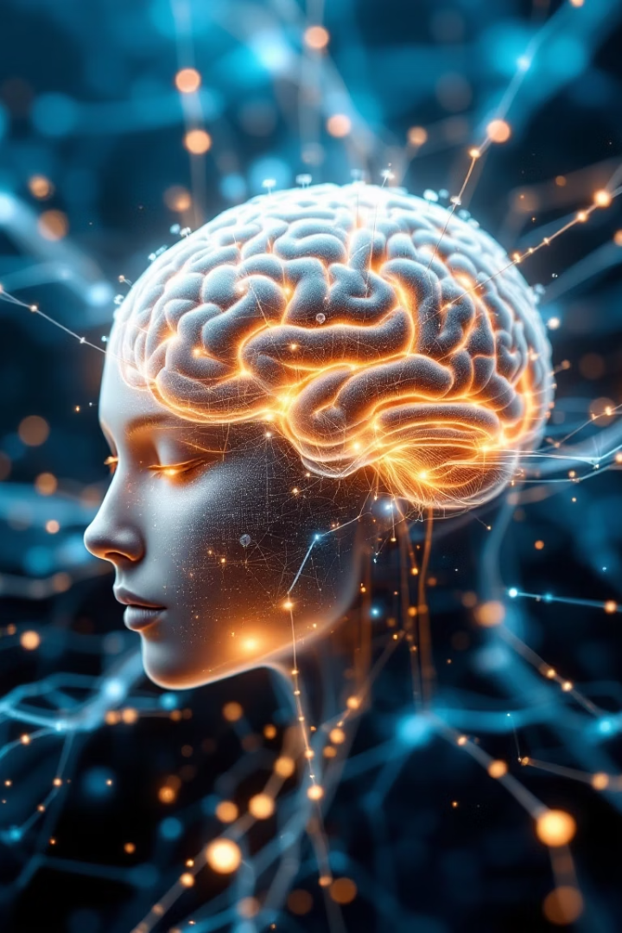
Hackathon Demo: GenAI-Powered Learning Assistant
Our Personal Assistant leverages Generative AI to boost your productivity. It's built using MCP protocol with LangGraph orchestration.
The system features three specialized agents working together: Workday, Skill, and Pathway agents.

Slide 2
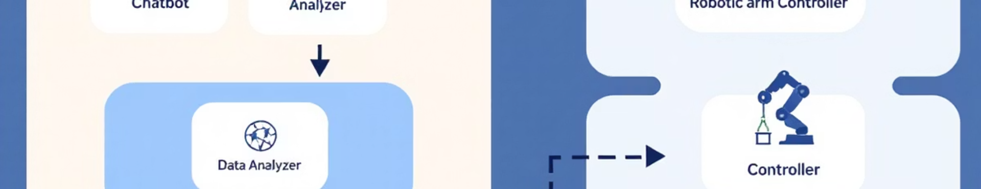
Project Overview
Learning Pathway Generation
Modular Architecture
LLM Integration
Agent-based design allows for easy scaling. New capabilities can be added without rebuilding the system.
Seamless connection with internal language models powers all assistant functions.
Our assistant automates learning pathways using GenAI. It analyzes user needs and creates personalized development paths.

Slide 3

Powered by Generative AI
Context-Aware Execution
GenAI analyzes user history, preferences, and current situation. Tasks executed with full context awareness.
The system maintains conversation memory across multiple interactions.
Our assistant adapts to your preferences over time. It learns from interactions and improves its suggestions.

Slide 4
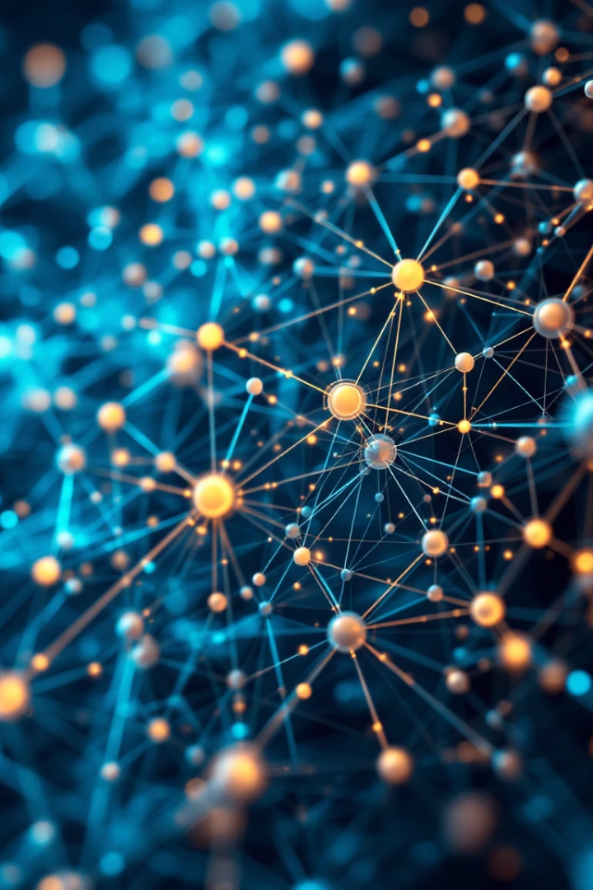
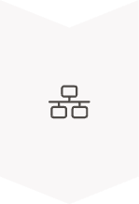


MCP Protocol & LangGraph
MCP Protocol
Ensures robust agent coordination through standardized communication patterns
LangGraph Orchestration
Enables dynamic sequencing of agent activities based on task requirements
Workflow Management
Supports flexible workflows with built-in error handling and recovery

Slide 5






Architecture: The Three Agents
Skill Agent
Performs job-specific tasks and workflows
Analyzes documents
Workday Agent
Summarizes data
Manages user information on goals, leaves, and paystubs
Generates content
User information on goals
Pathway Agent
Handles leave management
Develops personalized learning and development plans
Processes paystub details
Tracks goals
Recommends resources
Monitors progress

Slide 6








Agent Interaction Flow
User Request
LLM Processing
System receives and analyzes user input
Internal LLM determines required agent actions
Agent Activation
Response Delivery
Relevant agents are triggered following MCP guidelines
Coordinated results presented to user

Slide 7



Demo: Example User Journey
User Request
"Create my weekly summary and schedule"
Agent Processing
Three agents collaborate on different aspects
Final Output
Complete action plan with scheduling and suggestions

Slide 8






Impact and Next Steps
Future Vision
Continuous learning updates and external API integration
Expected Benefits
Increased productivity and personalized assistance
Call for Collaboration
We welcome feedback

Slide 9










Workflow: User to Agents
The assistant workflow connects users with specialized agents through an intelligent coordination protocol.
MCP Protocol
Coordinates communication between LLMs and specialized agents through standardized patterns.
Chat Interface
Users interact through a conversational UI that captures requests and context.
Workday Agent
Processes HR information and manages professional development goals.
Pathway Agent
Skills Agent
Creates learning plans and tracks progress toward professional goals.
Executes functional tasks through document analysis and content generation.

