Slide 1

ADVECTION DIFFUSION PROBLEM
BY,
M. ROWAN (22ME01040)
P. SRAVAN SRI SAI (22ME01033)
V. VARSHITHA PREETHAM (22ME01028)

Slide 2
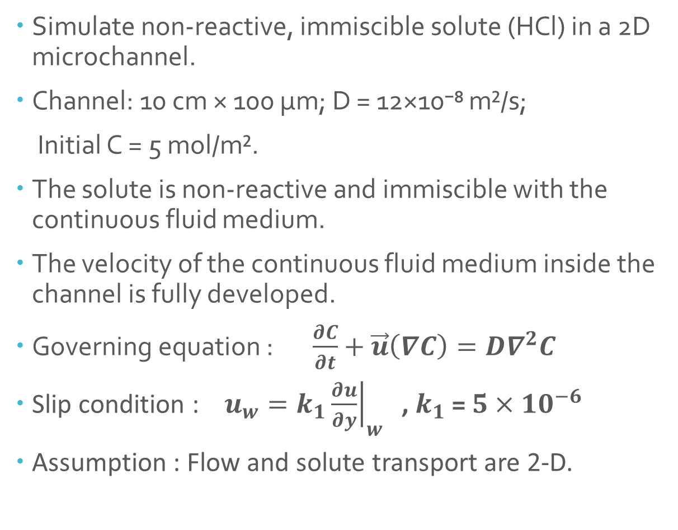
GIVEN INFORMATION
Simulate non-reactive, immiscible solute (HCl) in a 2D microchannel.
Channel: 10 cm × 100 µm; D = 12×10⁻⁸ m²/s;
Initial C = 5 mol/m².
The solute is non-reactive and immiscible with the continuous fluid medium.
The velocity of the continuous fluid medium inside the channel is fully developed.
Governing equation : $\frac{∂C}{∂t}+\vec{u}\left(∇C\right)=D∇^{2}C$
Slip condition : $u_{w}=k_{1}{\left.\frac{∂u}{∂y}\right|}_{w}$ , $k_{1}$ = $5×{10}^{−6}$
Assumption : Flow and solute transport are 2-D.

Slide 3
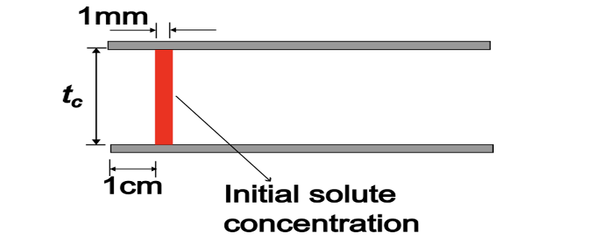
OBJECTIVE
Perform numerical simulations of the solutes in the channel for the centerline velocities of the fluid ranging from 0.1 mm/s to 8 cm/s.
Determine the location and shape of each solute after 1 sec.

Slide 4
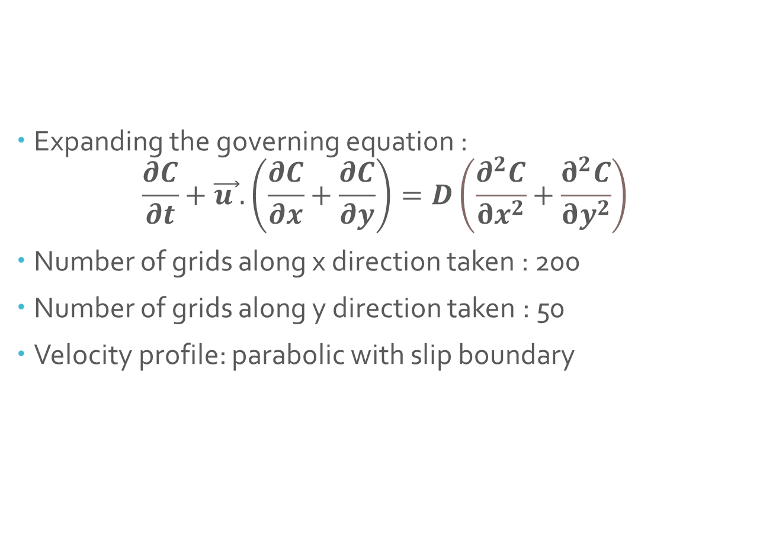
APPROACH
Expanding the governing equation :
$$\frac{∂C}{∂t}+\vec{u }.\left(\frac{∂C}{∂x}+\frac{∂C}{∂y}\right)=D\left(\frac{∂^{2}C}{∂x^{2}}+\frac{∂^{2}C}{∂y^{2}}\right)$$
Number of grids along x direction taken : 200
Number of grids along y direction taken : 50
Velocity profile: parabolic with slip boundary

Slide 5

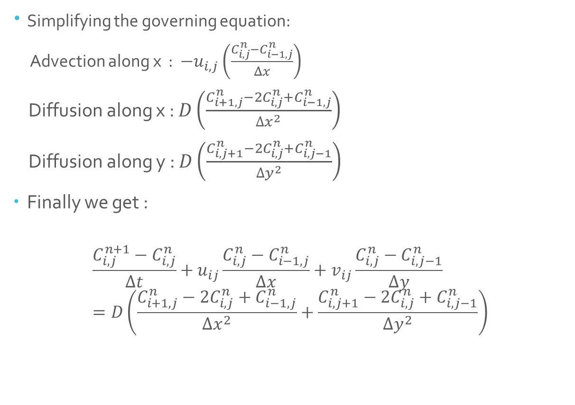
SIMPLIFICATION
Simplifying the governing equation:
Advection along x : ${−u}_{i,j}\left(\frac{C_{i,j}^{n}−C_{i−1,j}^{n}}{Δx}\right)$
Diffusion along x : $D\left(\frac{C_{i+1,j}^{n}−2C_{i,j}^{n}+C_{i−1,j}^{n}}{{∆x}^{2}}\right)$
Diffusion along y : $D\left(\frac{C_{i,j+1}^{n}−2C_{i,j}^{n}+C_{i,j−1}^{n}}{{∆y}^{2}}\right)$
Finally we get :
$$\frac{C_{i,j}^{n+1}−C_{i,j}^{n}}{∆t}+u_{ij}\frac{C_{i,j}^{n}−C_{i−1,j}^{n}}{∆x}+v_{ij}\frac{C_{i,j}^{n}−C_{i,j−1}^{n}}{∆y}=D\left(\frac{C_{i+1,j}^{n}−2C_{i,j}^{n}+C_{i−1,j}^{n}}{∆x^{2}}+\frac{C_{i,j+1}^{n}−2C_{i,j}^{n}+C_{i,j−1}^{n}}{∆y^{2}}\right)$$

Slide 6
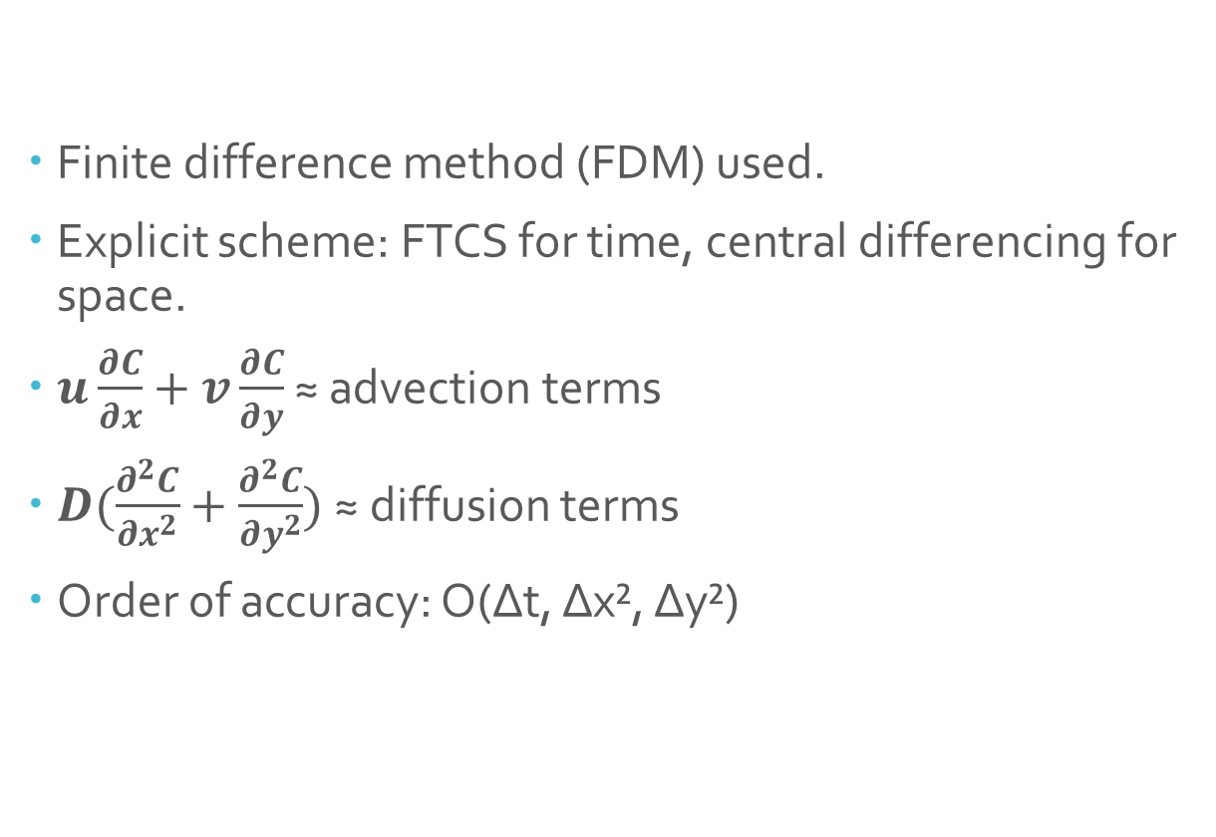
NUMERICAL SCHEME
Finite difference method (FDM) used.
Explicit scheme: FTCS for time, central differencing for space.
$u\frac{∂C}{∂x}+v\frac{∂C}{∂y}$ ≈ advection terms
$D(\frac{∂^{2}C}{∂x^{2}}+\frac{∂^{2}C}{∂y^{2}})$ ≈ diffusion terms
Order of accuracy: O(Δt, Δx², Δy²)

Slide 7
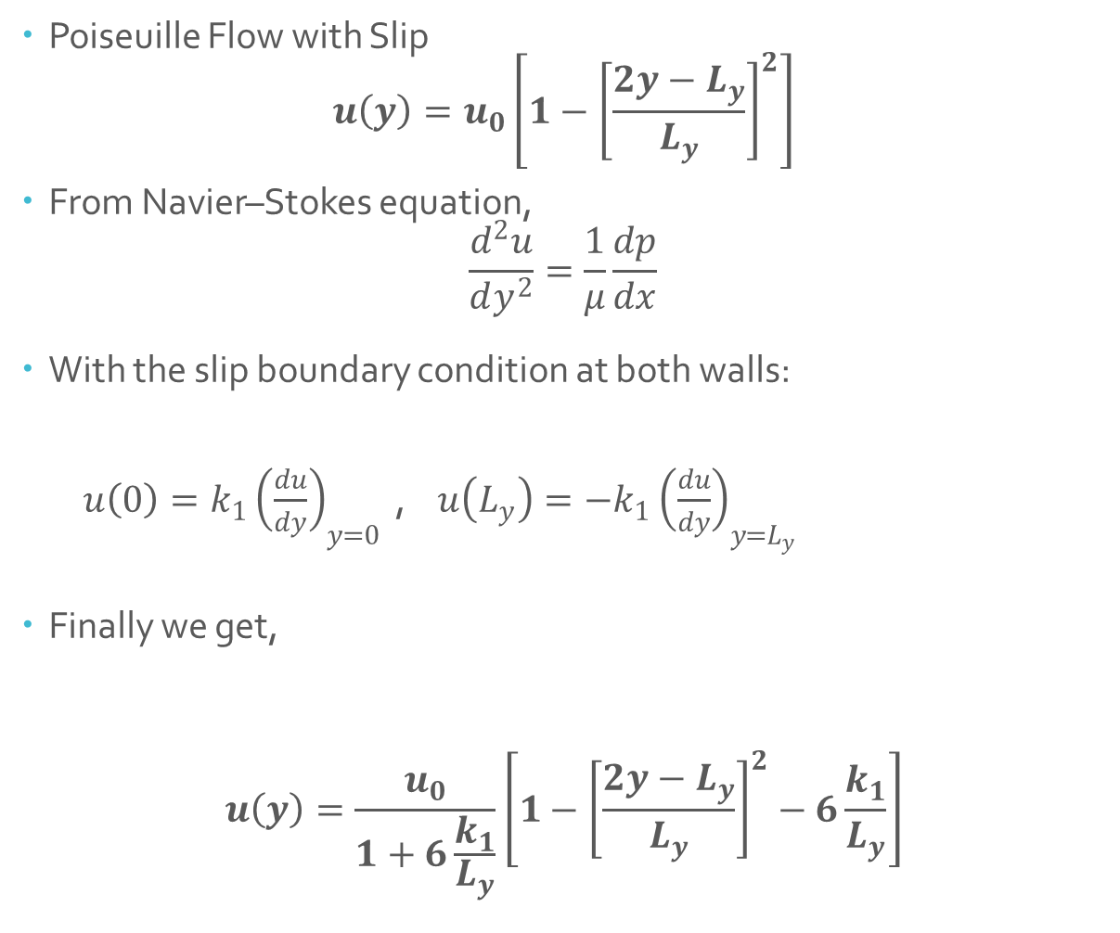
SLIP CONDITION
Poiseuille Flow with Slip
$$u\left(y\right)=u_{0}\left[1−{\left[\frac{2y−L_{y}}{L_{y}}\right]}^{2}\right]$$
From Navier–Stokes equation,
$$\frac{d^{2}u}{dy^{2}}=\frac{1}{μ}\frac{dp}{dx}$$
With the slip boundary condition at both walls:
$u\left(0\right)=k_{1}{\left(\frac{du}{dy}\right)}_{y=0}$ , $u\left(L_{y}\right)=−k_{1}{\left(\frac{du}{dy}\right)}_{y=L_{y}}$
Finally we get,
$$u\left(y\right)=\frac{u_{0}}{1+6\frac{k_{1}}{L_{y}}}\left[1−{\left[\frac{2y−L_{y}}{L_{y}}\right]}^{2}−6\frac{k_{1}}{L_{y}}\right]$$

Slide 8
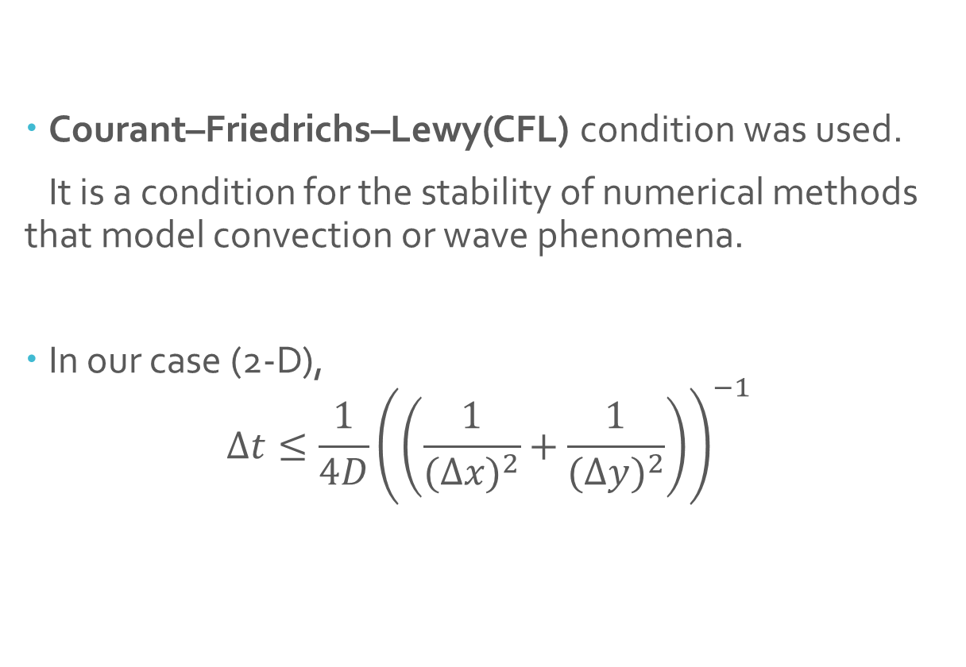
STABILITY
Courant–Friedrichs–Lewy(CFL) condition was used.
It is a condition for the stability of numerical methods that model convection or wave phenomena.
In our case (2-D),
$$Δt≤\frac{1}{4D}{\left(\left(\frac{1}{(Δ{x)}^{2}}+\frac{1}{(Δ{y)}^{2}}\right)\right)}^{−1}$$

Slide 9
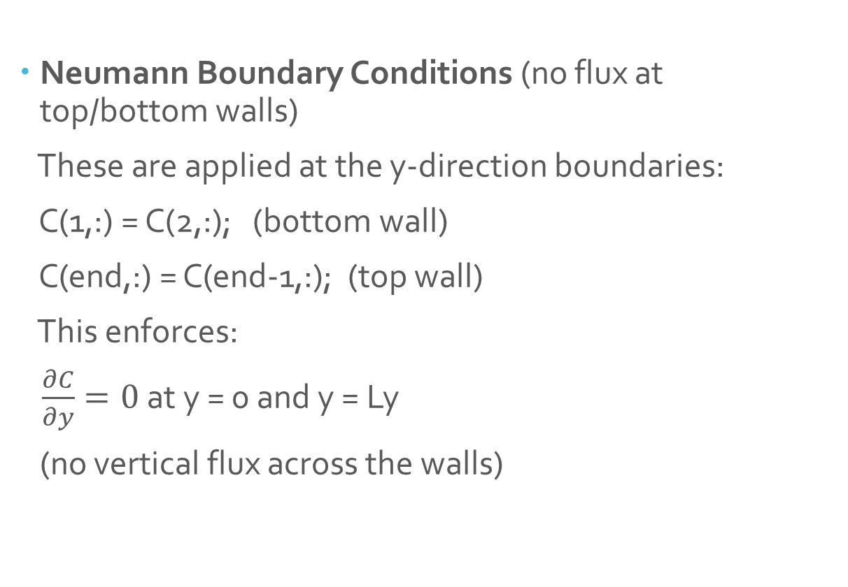
BOUNDARY CONDITIONS
Neumann Boundary Conditions (no flux at top/bottom walls)
These are applied at the y-direction boundaries:
C(1,:) = C(2,:); (b0ttom wall)
C(end,:) = C(end-1,:); (top wall)
This enforces:
$\frac{∂C}{∂y}=0$at y = 0 and y = Ly
(no vertical flux across the walls)

Slide 10
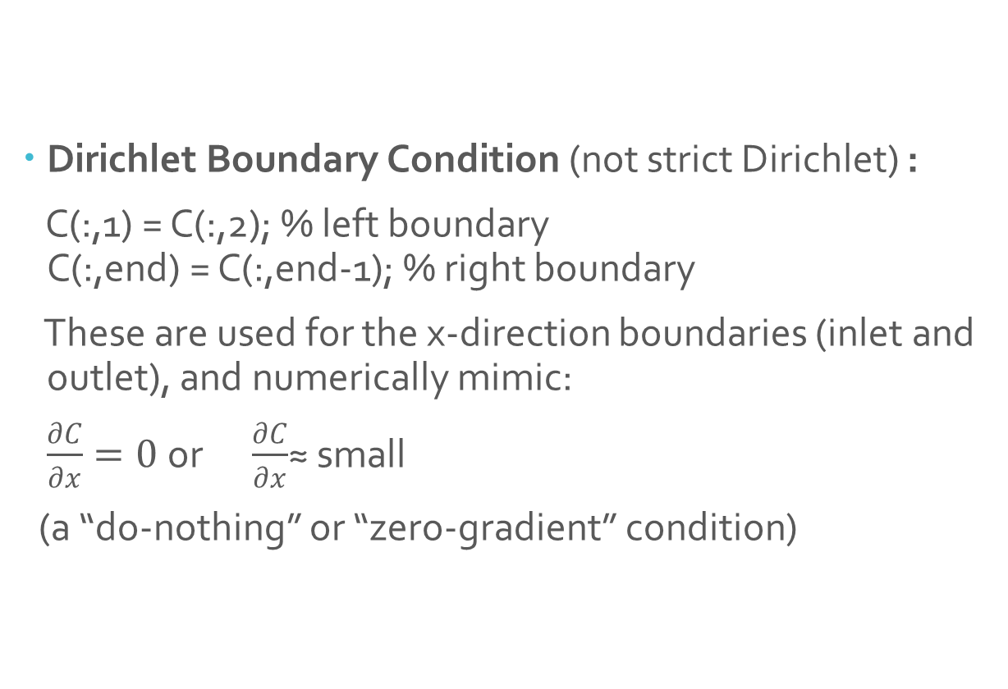
BOUNDARY CONDITIONS
Dirichlet Boundary Condition (not strict Dirichlet) :
C(:,1) = C(:,2); % left boundary C(:,end) = C(:,end-1); % right boundary
These are used for the x-direction boundaries (inlet and outlet), and numerically mimic:
$\frac{∂C}{∂x}=0$or $\frac{∂C}{∂x}$≈ small
(a “do-nothing” or “zero-gradient” condition)

Slide 11

RESULTS

Slide 12
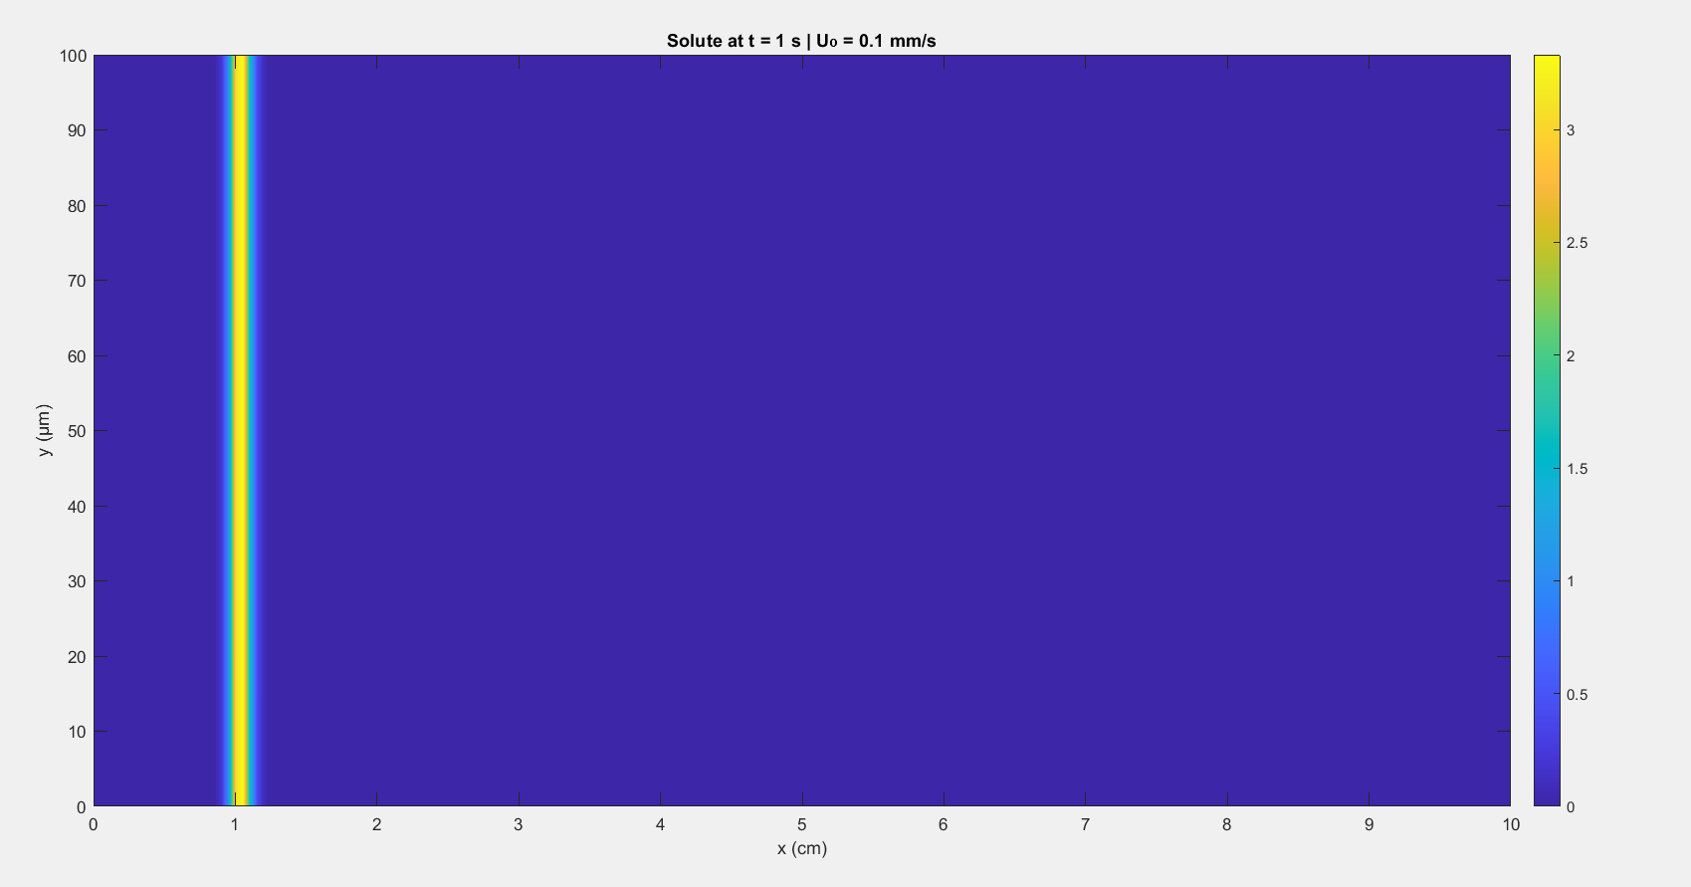
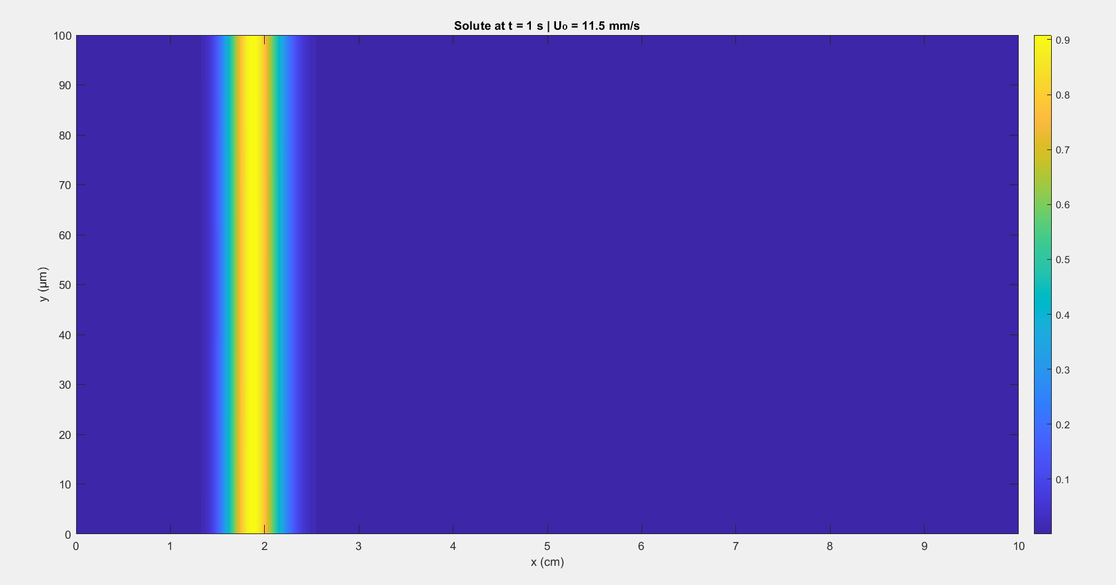
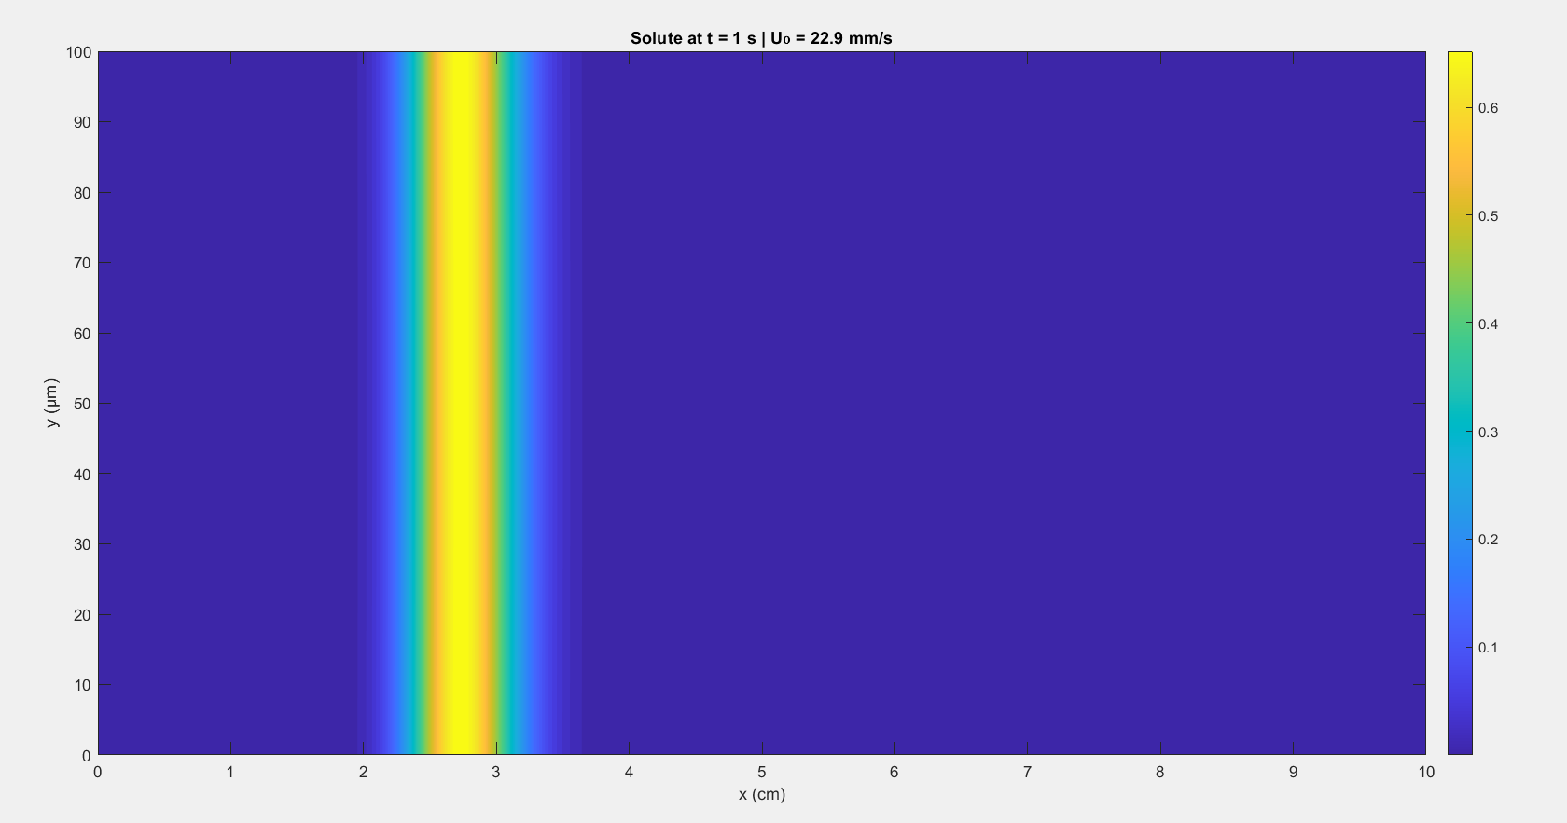
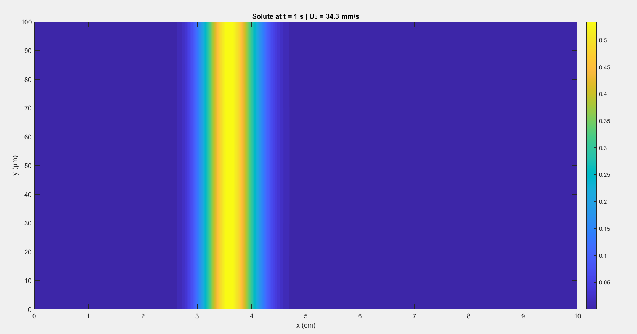

Slide 13
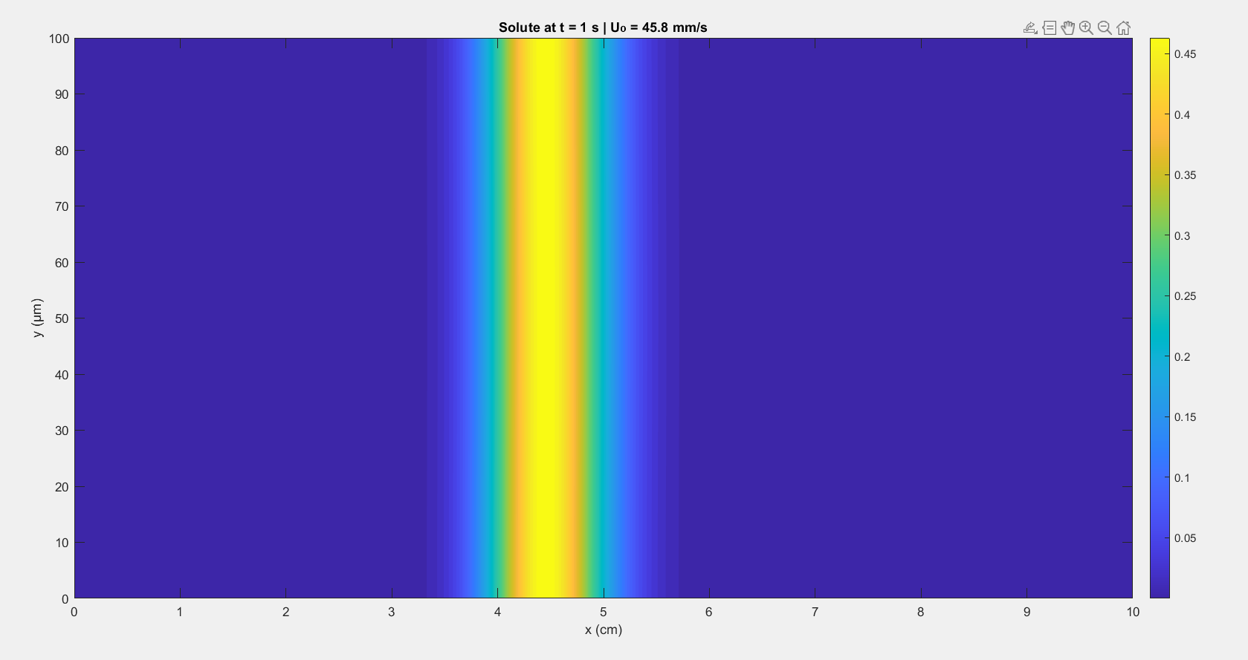
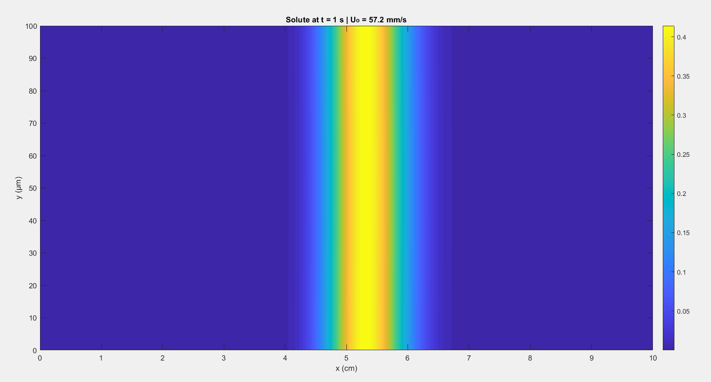
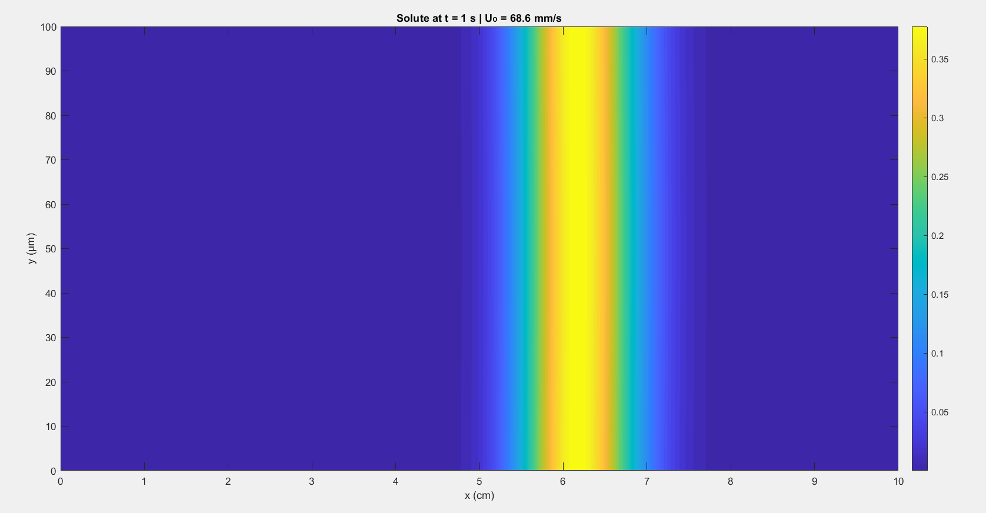
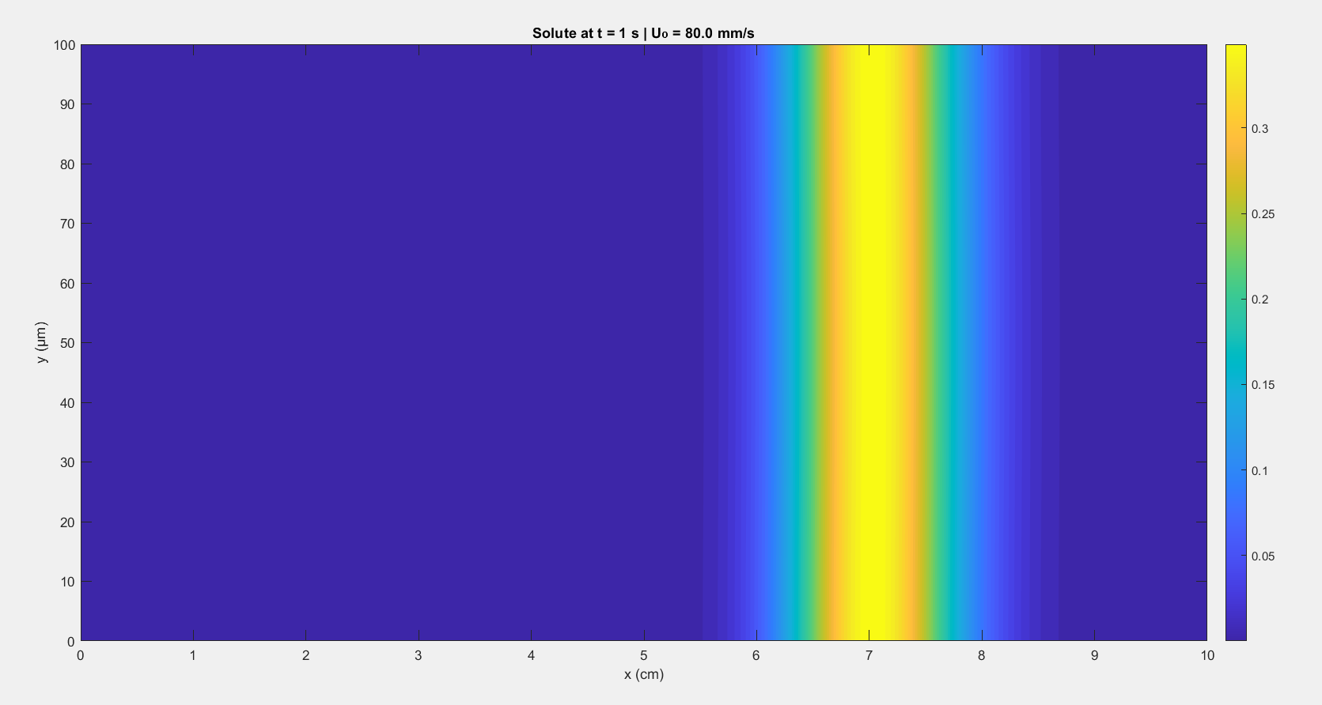

Slide 14
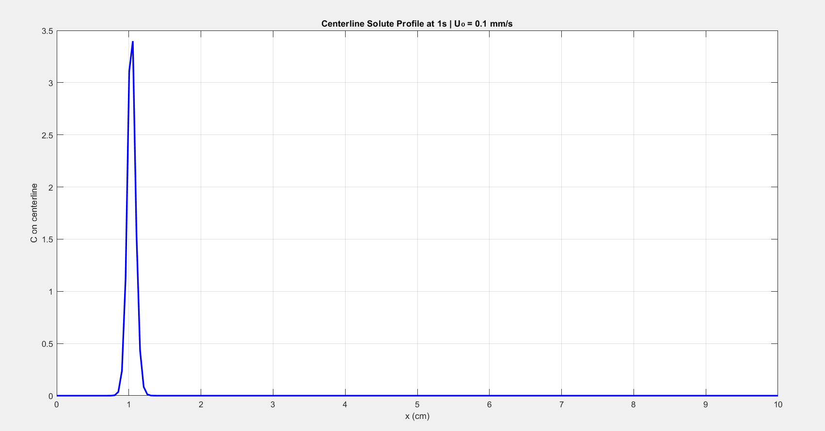
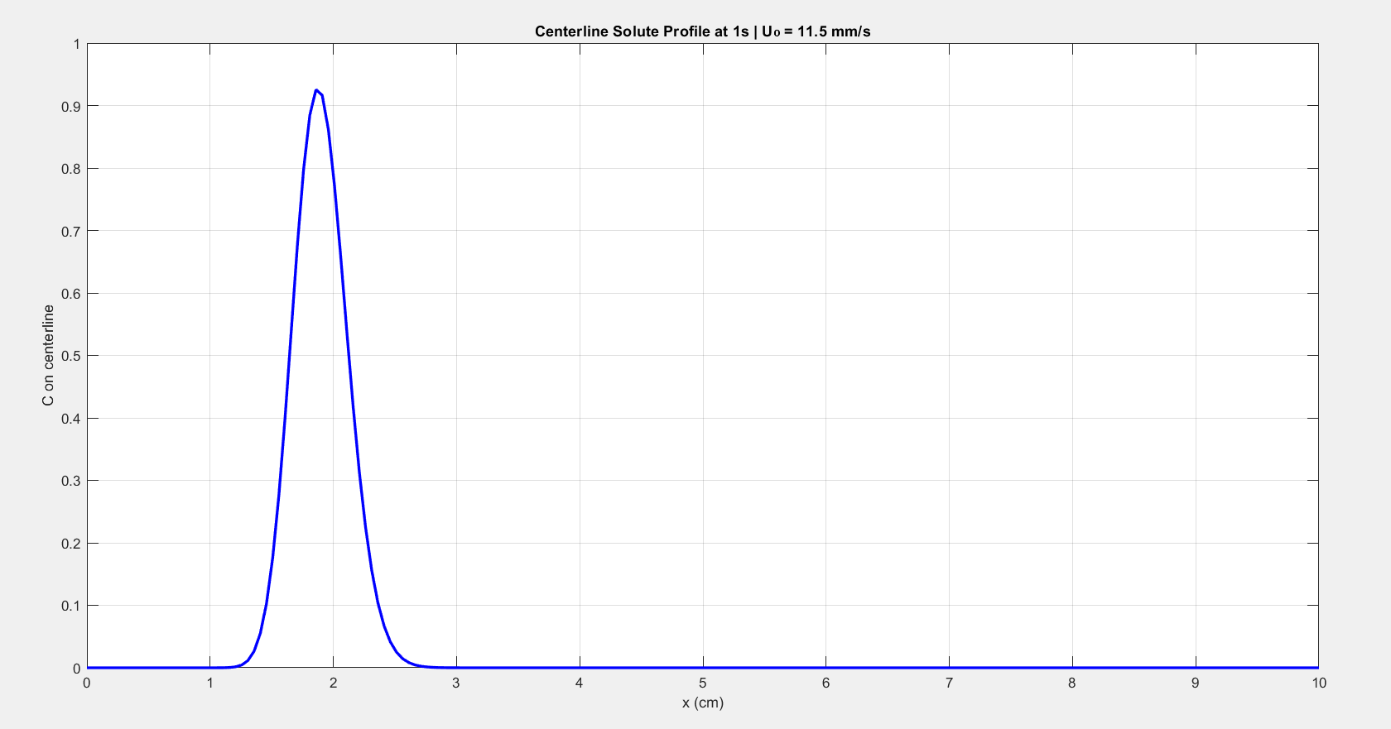
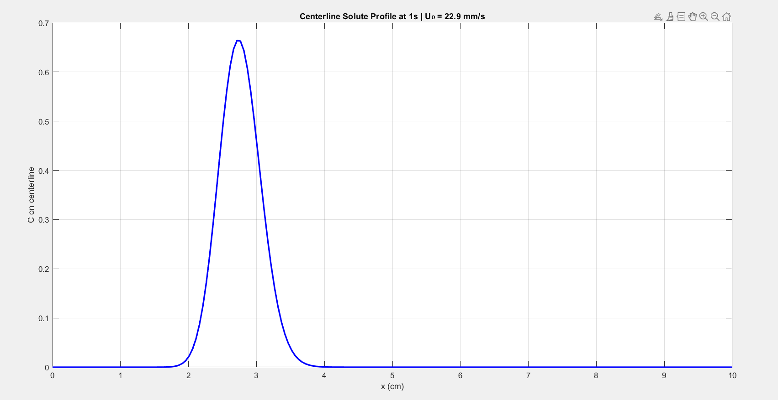
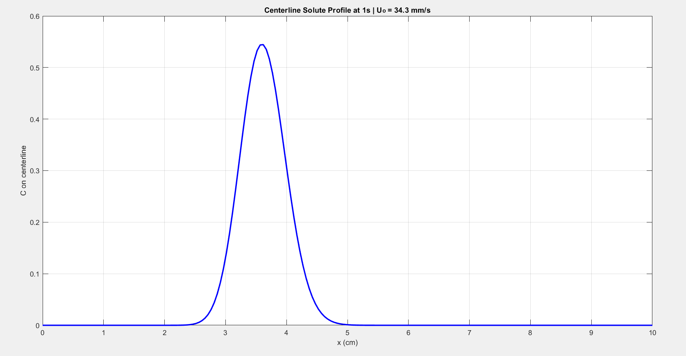

Slide 15
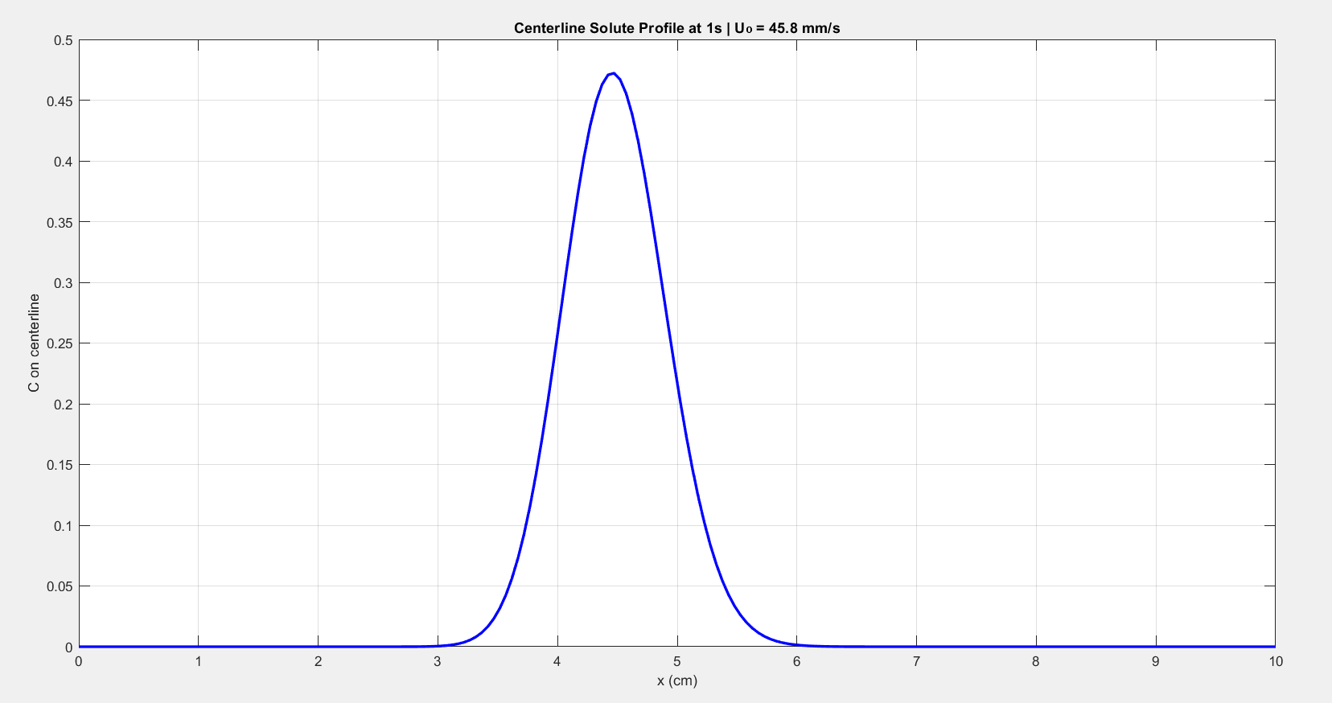
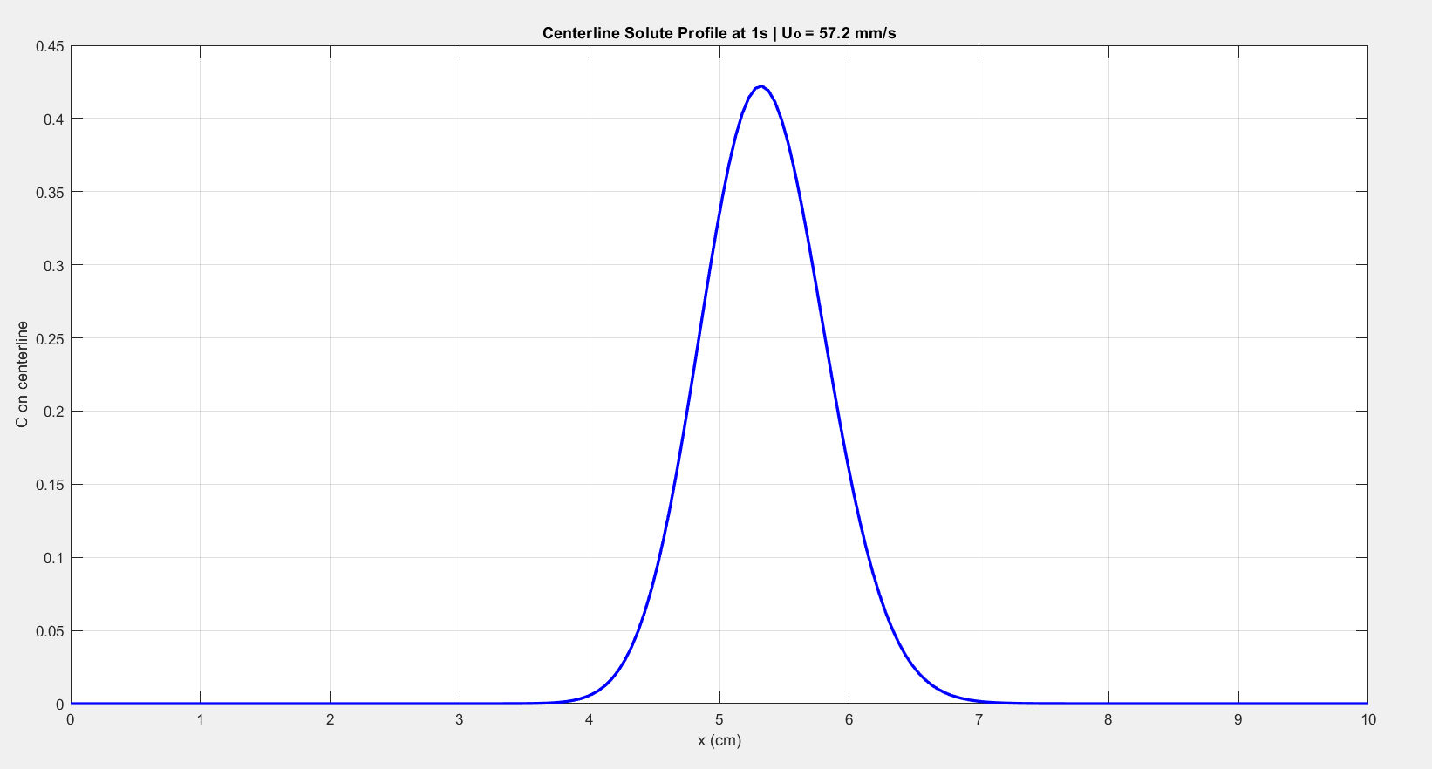
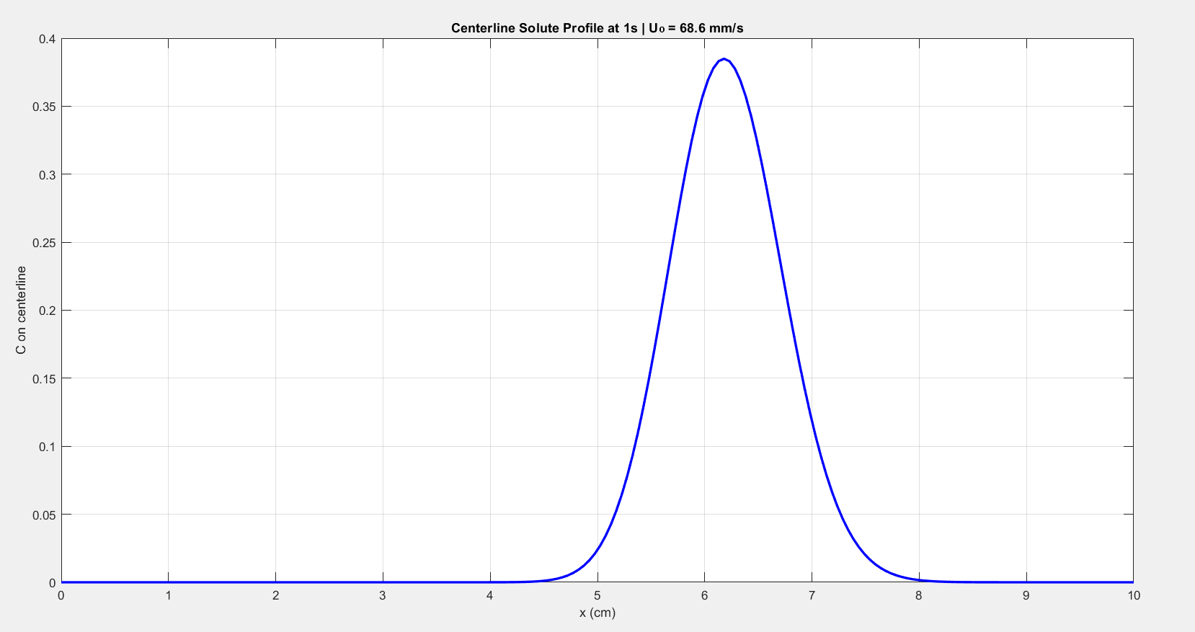
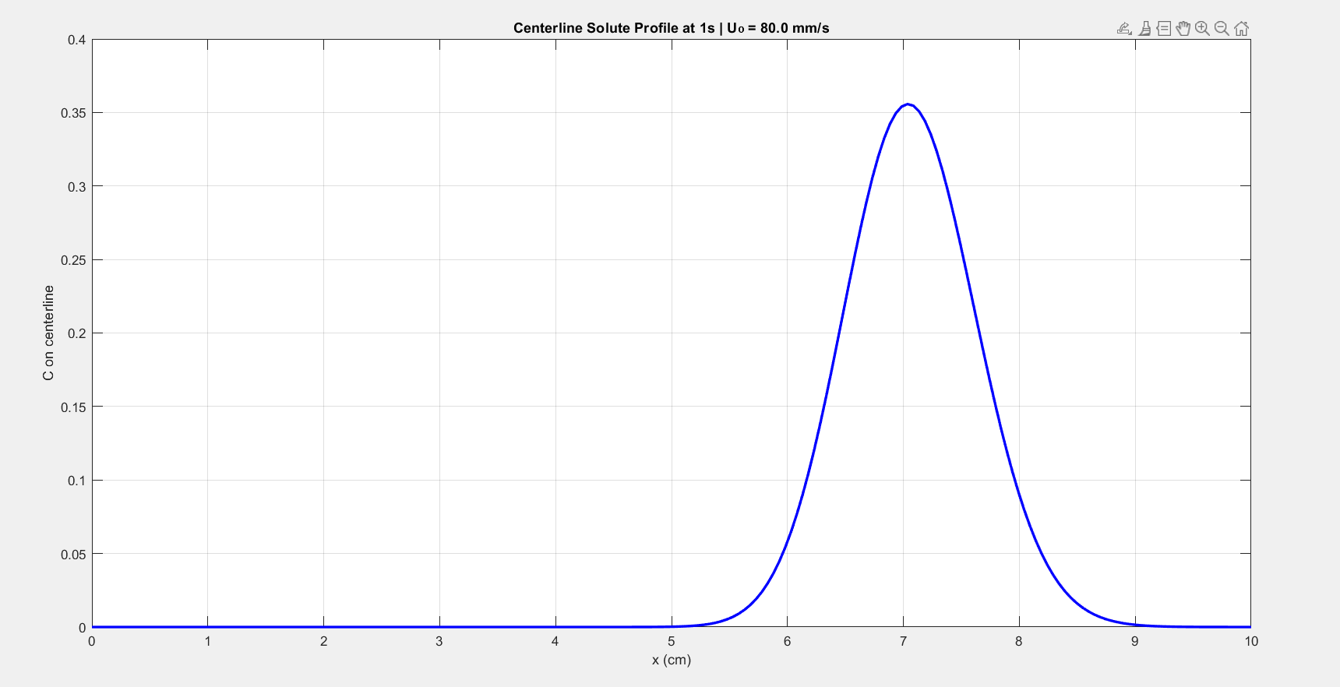

Slide 16
CONCLUSION
At low velocities, diffusion dominates, resulting in symmetric, broad solute dispersion. At higher velocities, advection dominates, producing elongated solute profiles along the direction of flow
The FTCS scheme with central differencing was found to be stable and consistent, satisfying CFL and diffusion stability conditions. The method achieved first-order accuracy in time and second-order in space.

Slide 17
THANK YOU

