Slide 1





Introduction to Robotic Process Automation
Title of the Project
Your Register No: 220701313
Name: Veeraragahavan M
Guide Name:
Designation and Department: IRPA / Computer Science and Engineering

Slide 2
Abstract
The goal of this project is to create an UiPath automation workflow for comparing weather data from several sources, such as Weather.com, AccuWeather, and OpenWeatherMap. To collect important meteorological data from these platforms, including temperature, humidity, wind speed, and forecasts, the process will make use of UiPath's web scraping and API features.
The automation will save the data in variables for comparison when it has been extracted. In order to assist users in determining the dependability of various weather platforms, the process will employ conditional logic to compare and contrast the weather data from each source. Key meteorological metrics and a synopsis of the platform comparisons will be included in the comparison findings, which will be saved in an easy-to-read format, like an Excel report.
Error handling procedures will be included to handle problems like API outages or modifications to webpage architecture in order to guarantee robustness. To further clarify the comparison, the procedure might also use visualizations like line graphs or bar charts. By automating the process of comparing weather data, this project hopes to empower people to base their judgments on compiled meteorological data from dependable sources.

Slide 3
Need for the Proposed System
1. Time Efficiency: Manual weather data recording takes a lot of time and is prone to human mistake. Accurate and timely data gathering is guaranteed via automation. 2. Accuracy and Consistency: By reducing human error, automated systems offer consistently accurate meteorological data for analysis and decision-making. 3. Real-Time Updates: The suggested system makes it possible to capture data and generate alerts in real-time, guaranteeing prompt access to vital meteorological data. 4. Improved Decision-Making: Organizations, farms, and people may better prepare and mitigate risks with the use of accurate and current weather information. 5. Cost-Effectiveness: Over time, automation saves resources and operating expenses by reducing reliance on manual labor. 6. Adaptability: The system may be modified or scaled to meet a variety of needs, such monitoring particular meteorological conditions. 7. Environmental Insights: Tracking climate changes is made easier with accurate meteorological data.

Slide 4
Advantages of the Proposed System
1. Accuracy and Reliability: By eliminating the possibility of human mistake, automated procedures guarantee accurate and consistent meteorological data collecting. 2. Real-Time Monitoring: By providing current weather data, the system facilitates prompt notifications and well-informed decision-making. 3. Enhanced Efficiency: When compared to manual techniques, automation expedites the data recording process, saving time and effort. 4. Cost-Effectiveness: Lowers operating expenses through resource optimization and manpower need minimization. 5. Scalability: The system is easily scalable to cover a wider geographic region or record more meteorological information. 6. Customizable Alerts: Users can get notifications that are relevant to their needs or weather preferences.
7. Data Integration: Provides improved analysis and reporting by seamlessly integrating with other platforms or systems.
8. Sustainability: Supports environmental research and initiatives to mitigate climate change by enabling long-term weather pattern monitoring.
9. User-Friendly: Made to be accessible and intuitive, this feature guarantees that both technical and non-technical people may utilize it with ease.

Slide 5
Main Objective
The suggested system's major goal is to automate weather data collection, recording, and reporting in order to:
1. Ensure Accuracy: Reduce human mistake and preserve accurate weather data for analysis. 2. Increase Efficiency: To save time and money, simplify the weather monitoring procedure. 3. Enable Real-Time Access: To aid in decision-making, provide current weather data and timely alerts. 4. Encourage Scalability: Create a system that can be modified to meet changing requirements, taking into account various characteristics and geographical areas. 5. Support Risk Management: By providing accurate and useful insights, help with catastrophe preparedness and mitigation. By providing a dependable tool for weather monitoring and well-informed planning, this system seeks to empower people and organizations.

Slide 6
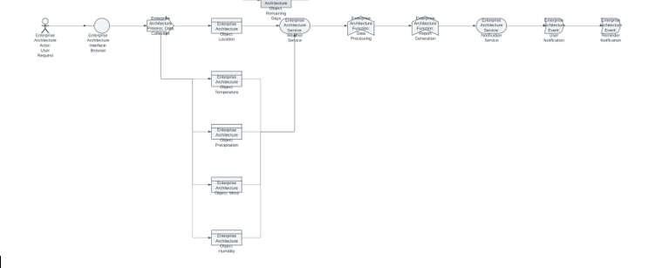
Architecture

Slide 7
System Requirements
Hardware specifications: 1. Processor: Intel Core i3 or higher is the minimum; Intel Core i5/i7 or higher is advised. 2. RAM: 4 GB is the minimum; 8 GB or more is advised for better performance. 3. Storage: An SSD is advised for quicker read/write operations; a minimum of 10 GB of free disk space is required. 4. Display: Full HD (1920 x 1080) is advised; minimum screen resolution is 1280 x 768. 5.Network: A dependable internet connection for UiPath Orchestrator integration (if applicable) and real-time data retrieval.
Software specifications:
1. Operating System: 64-bit Windows 10 or later
2.UiPath Studio Version: Community or Enterprise Edition, the most recent stable version of UiPath Studio
3. Plugins and Dependencies:
For API integrations (such as weather APIs), use the UiPath.WebAPI.Activities module.
Excel and UiPath.Data modification and storage activities.
UiPath.Mail.Email notification activities (if alerts are included).
4. Browser: Microsoft Edge, Mozilla Firefox, or Google Chrome (for weather data scraping or web-based automation).
5. Database (Optional): Any database that can store historical weather data, such as Microsoft SQL Server or SQLite.
6.Other Tools: Real-time data retrieval using weather APIs (like the OpenWeatherMap API).
4.6.1 or later for the.NET Framework.

Slide 8
Functional Description
Module 1: Tracking Weather for Recording
Short Description:
The process of tracking weather data from Google or comparable platforms, collecting information, and storing it for analysis or reporting is automated by the system. It automates workflows by integrating with UiPath Studio.
DFD / Activity Diagram
DFD:
Level 0:
Entities:
User: Provides input for weather tracking preferences.
Weather Source (Google): Supplies weather data.
System: Automates data retrieval, processing, and storage.
Level 1:
Processes:
1.Input user preferences (e.g., location, time interval).
2.Retrieve weather information from Google.
3.Process and structure data.
4.Store data in a database or file.
5.Generate alerts or reports (optional).

Slide 9
Functional Description
Activity Diagram:
1. The user specifies their choices for weather tracking (frequency, location).
2. The system starts UiPath Studio's automation.
3. The following is what the UiPath bot does:
opens Google.
looks up weather information according to user selections.
retrieves meteorological data.
4. The data is formatted and processed by the system.
5. The system saves the data in a database or Excel sheet.
6. (Optional) If the weather meets alert conditions, the system sends out notifications.

Slide 10
Functional Description
Module 1: Notifying Tracked Weather to Users
Short Description:
The technology uses collected weather data to automatically deliver customers weather updates and notifications. Email, SMS, and other forms of communication can be used to send notifications, guaranteeing that consumers receive pertinent and timely information.
DFD / Activity Diagram
DFD:
Level 0:
Entities:
User: Receives notifications..
System: Automates the process of data analysis and alerting.
Level 1:
Processes:
1. Retrieve weather data.
2. Analyze weather conditions.
3. Generate notifications
4. Send notifications to users.

Slide 11
Functional Description
Activity Diagram:
. 1. Start
System retrieves weather data from the database or API.
2.Evaluate Conditions:
Check if conditions meet notification criteria.
3.Generate Notifications:
Format alerts based on conditions and user preferences.
4.Send Notifications:
Deliver notifications to users.

Slide 12
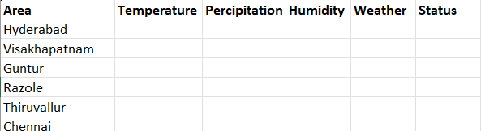
Table Design

Slide 13
Process Design
Main Process Design
Step-1: Read State Names from Excel Sheet
Input:
To begin, read the state names from an Excel document that will hold weather information. The names of the states will be listed in a column on the sheet.
Actions:
To extract the list of states from the Excel sheet, use the Read Range exercise.
For later processing, save the state names in a DataTable variable.
Step-2: Automated Search of State Names on Google
Input:
The state names will be input into the Google search bar automatically to retrieve weather information.
Actions:
Use UiPath's Open Browser activity to open the browser and navigate to Google (https://www.google.com).
Use the Type Into activity to enter each state name in the Google search bar.
Use the Send Hotkey activity to trigger the search action (usually Enter)

Slide 14
Process Design
Step-3: Scrape Weather Data (Temperature, Precipitation, Humidity, Wind)
Input:
Scrape the necessary weather information from the search result page after conducting a state weather search.
Actions:
Utilize the Get Text activity or UiPath's Data Scraping wizard to extract weather information like:
The temperature
Precipitation
The level of humidity
Wind speed
Put these specifics in each state's variables.
Step-4: Store Weather Data in Excel
Output:
The Excel file must have the temperature, precipitation, humidity, and wind statistics for every state.

Slide 15
Process Design
Actions:
Update the Excel sheet with the weather information using the Write Cell or Write Range operation. Each state's matching row should contain the data.
Make sure the appropriate columns contain the data for each state, such as Column B for temperature and Column C for precipitation.
Step-5: Send Weather Notification to Users (Message Box)
Output:
Once the data for each state is collected, send the weather details to the user via a Message Box notification.
Actions:
Use the Message Box activity to display the weather data in a formatted message (e.g., "Weather Update for [State]: Temperature: 30°C, Humidity: 80%").
You can also use Send SMTP Mail Message if you wish to send email notifications instead of a message box.
Step-6: Repeat the Process for All States
Automation Loop:
Loop through the list of state names and repeat the above steps for each state.
Actions:
Use a For Each Row activity to iterate over the DataTable containing the state names.
Within the loop, call the above steps for each state.

Slide 16
Process Design
Step-7: End Process
End:
After all states have been processed, the workflow ends.
Actions:
Optionally, you can save the Excel file with updated weather data if it's not saved during the loop.
Close the browser and any other resources used in the process.

Slide 17
Detailed Process Flow:
1.Start the Workflow
2.Read State Names from Excel
Use Read Range activity to load state names into a DataTable.
3.Open Browser & Search on Google
Use Open Browser → Type Into (state name) → Send Hotkey (Enter).
4.Scrape Weather Data
Use Data Scraping or Get Text activities to extract temperature, precipitation, humidity, and wind data.
5.Update Weather Data in Excel
Use Write Cell to update weather details in the correct row/column for each state.
6.Send Weather Notification to User
Use Message Box to show weather information.
7.Repeat the Process for Next State
Use For Each Row to iterate over the DataTable of states.
8.End Process
Close Excel and browser, and save the data if needed.

Slide 18
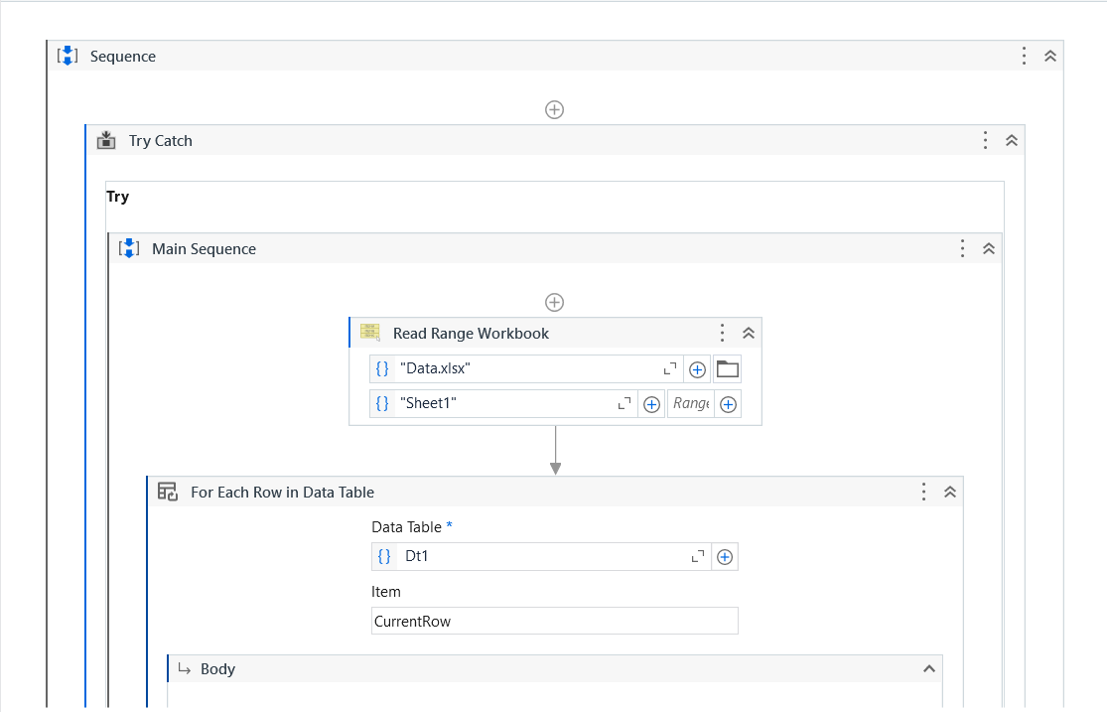
Implementation
Implementation of Module 1:

Slide 19
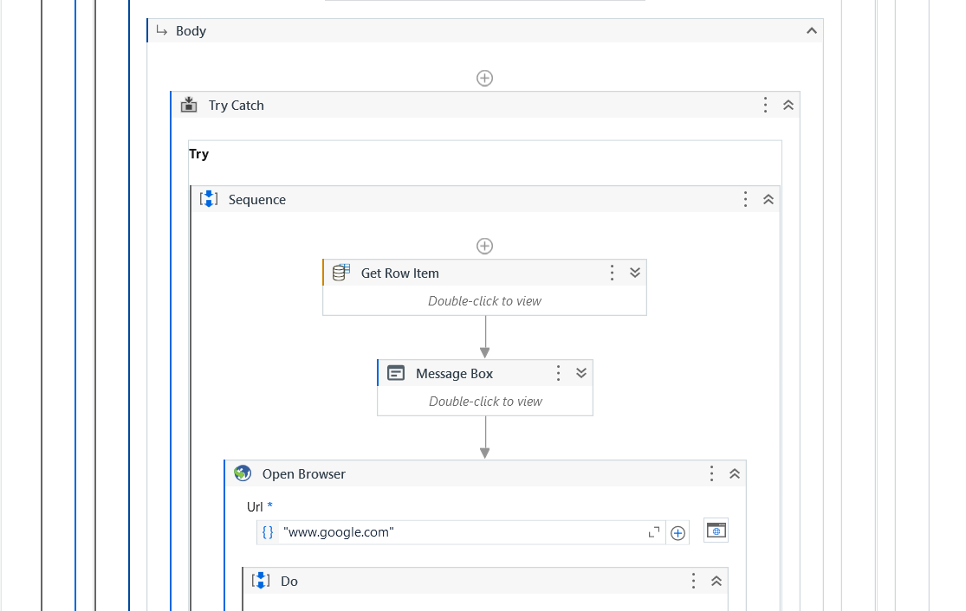
Implementation

Slide 20
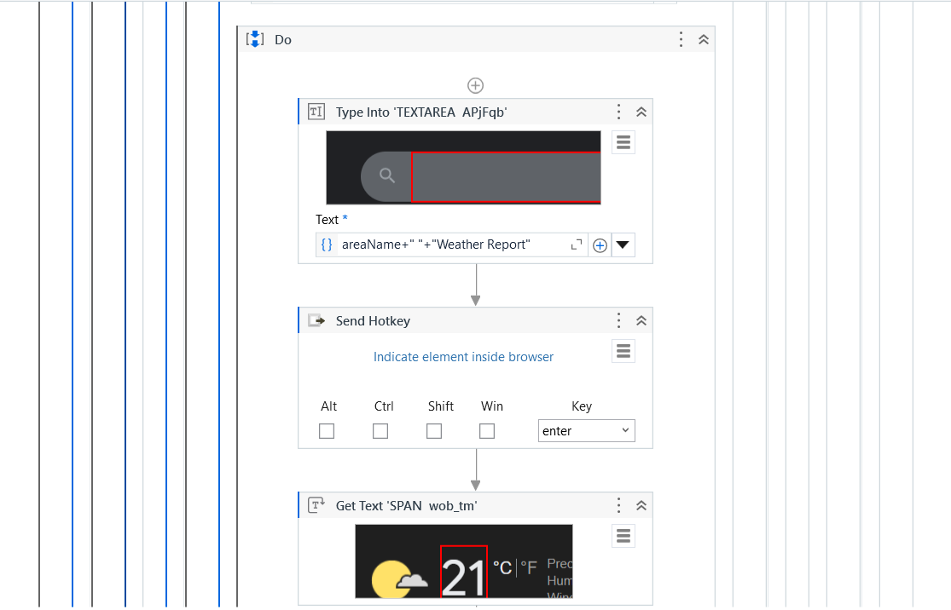
Implementation

Slide 21
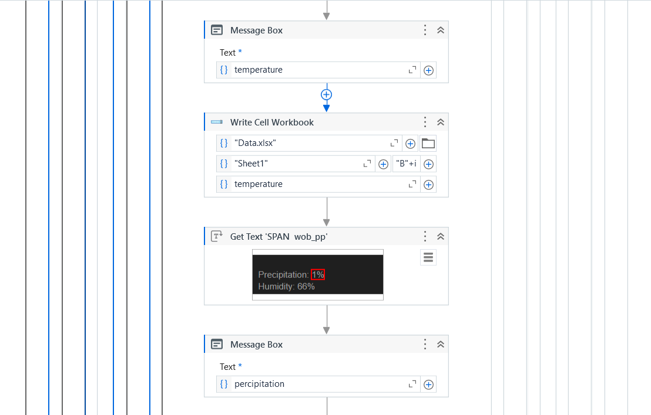
Implementation

Slide 22
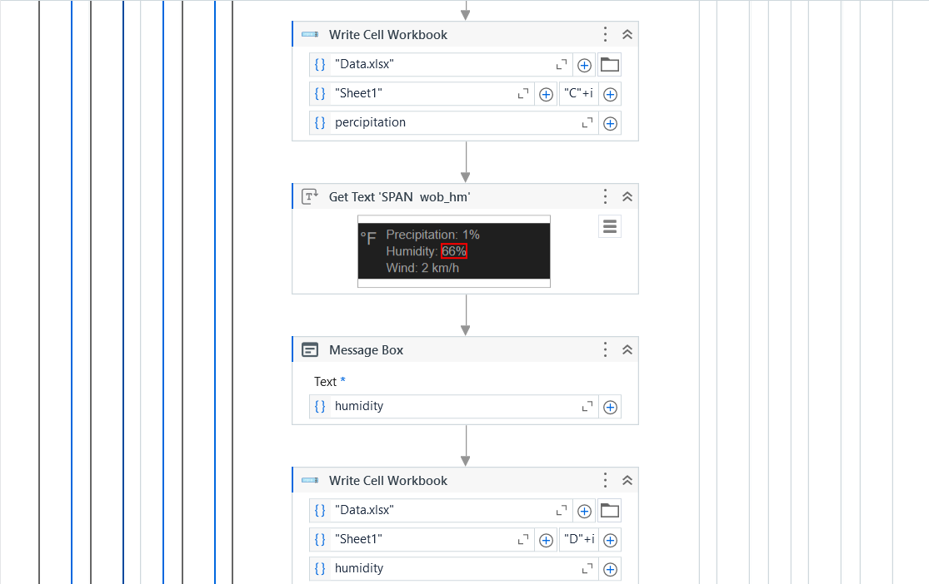
Implementation

Slide 23
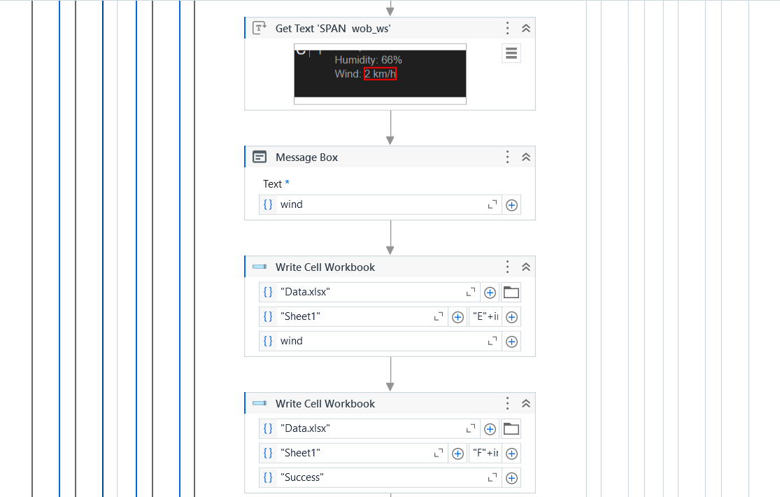
Implementation

Slide 24
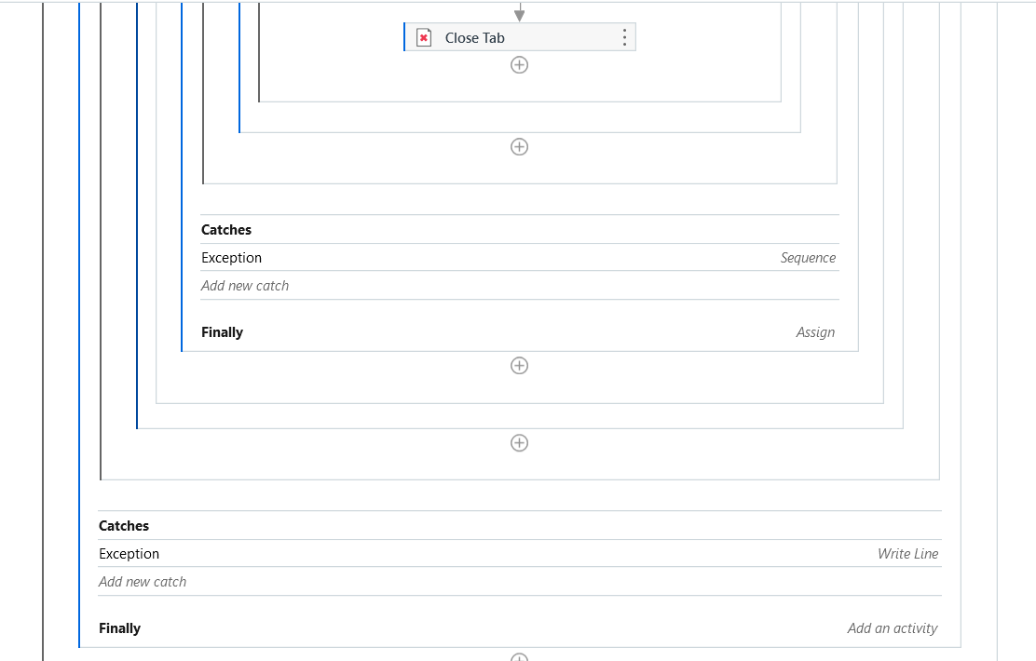
Implementation

Slide 25
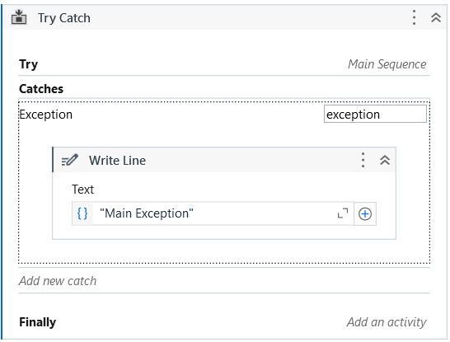
Implementation
Implementation of Module 2:
Error Handling:

Slide 26
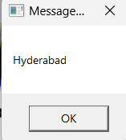
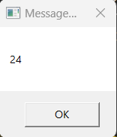
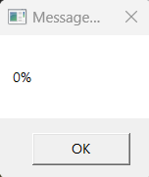
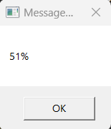
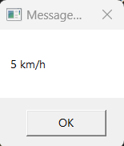
Testing
Screen shots:
Inputs are taken from excel sheet and are automated to track the weather details
For Example: The location Hyderabad is read from the excel sheet and the weather details for the locations are scrapped and send as a notification to the user.
Locations
Temperature
Percipitation
Humidity
Wind

Slide 27
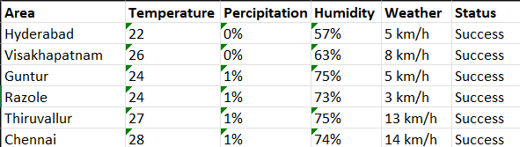
Output
Recorded Data are updated parallelly to the Excel Sheet.

Slide 28
Conclusions
In conclusion, UiPath's comparative study of weather data from websites such as Weather.com, AccuWeather, and OpenWeather provides important information on the precision and reliability of weather forecasts from various sources. The investigation emphasized the significance of taking into account numerous weather platforms to achieve a more accurate and dependable forecast by highlighting disparities in weather predictions, especially in areas like temperature, precipitation, and wind speed. A thorough picture of weather conditions from many sources was made possible by the smooth extraction and comparison of weather data made possible by UiPath automation.Additionally, analyzing these systems' forecasts and real-time weather circumstances revealed the different strengths of each in predicting particular weather aspects. AccuWeather provides comprehensive severe weather warnings, OpenWeather delivers worldwide coverage with customisable data, and Weather.com is excellent at delivering precise neighborhood forecasts. With the help of UiPath automation, this multidimensional approach enables users to base their judgments on the most pertinent and accurate meteorological data.In the end, the UiPath automation process not only made it easier to compare meteorological data from different platforms, but it also highlighted the necessity of a thorough strategy that takes into account the advantages of different sources. Weather forecasts are more reliable due to UiPath's efficiency and accuracy in data extraction and processing, which provides a more nuanced picture of weather conditions across many geographies.

Slide 29
Future Enhancement
1. Integration with Advanced Weather APIs
- Incorporate real-time weather data from multiple APIs like OpenWeatherMap, AccuWeather, or WeatherStack for more accurate and localized forecasts.
- Provide users with features like hourly forecasts, air quality index (AQI), or pollen count.
2. Mobile App Integration
- Develop a mobile application that syncs with the automation system to provide on-the-go weather updates and alerts.
3. Voice Assistant Compatibility
- Enable voice command features by integrating with AI assistants like Google Assistant, Amazon Alexa, or Siri for hands-free weather inquiries.
4. Machine Learning for Trend Analysis
- Implement predictive analytics to provide weather trends, seasonal forecasts, or anomaly detection.
- Use historical data to predict severe weather patterns and send proactive alerts.
5. Multi-Channel Notification System
- Expand notification options to include push notifications, WhatsApp alerts, or automated phone calls for urgent updates.
- Allow users to choose their preferred communication channel.
6. Automated Disaster Management Alerts
- Integrate with governmental disaster warning systems to issue alerts for events like hurricanes, floods, or wildfires.
- Include evacuation recommendations and safe route mapping.

Slide 30
Future Enhancement
6. Automated Disaster Management Alerts
- Integrate with governmental disaster warning systems to issue alerts for events like hurricanes, floods, or wildfires.
- Include evacuation recommendations and safe route mapping.
7. User-Specific Recommendations
- Personalize notifications based on user activities, such as outdoor event planning or agricultural needs.
- Add recommendations like “Carry an umbrella” or “Delay travel due to fog.”
8. Real-Time Data Visualization
- Include dashboards with graphs, heatmaps, and charts to visualize weather data trends for better user comprehension.
- Implement geographical mapping to display regional weather updates.
9. Global Coverage Expansion
- Enhance the system to track weather for global locations, supporting international users and travelers.
- Include features like time zone-specific updates.
10. Energy Efficiency Monitoring
- Provide insights on how weather conditions affect energy consumption, such as heating or cooling requirements.
- Recommend energy-saving tips based on local forecasts.
11. Integration with IoT Devices
- Connect the automation system with IoT devices like smart thermostats, sprinklers, or wearable tech to adjust settings automatically based on weather.
- For example, turn off sprinklers if rain is forecasted.
12. Emergency Services Integration
- Collaborate with emergency services to relay critical weather warnings and help coordinate relief operations in real-time.
13. Offline Mode with Cached Data
- Allow users to access recently fetched weather data even without an internet connection.
- Automatically update the data once connectivity is restored.

Slide 31
Future Enhancement
14. Weather-Driven Automation for Businesses
- Tailor features for industries like agriculture, aviation, logistics, and tourism.
Provide agricultural advisories, flight disruption alerts, or traffic predictions based on weather
15. Enhanced Security Features
- Implement user authentication and encrypted communication to ensure secure data handling, especially for notifications.
These enhancements not only increase the functionality of the system but also improve user satisfaction and engagement. Let me know if you'd like to expand on any of these points!

Slide 32
References
Automated weather details:
{ https://medium.com/@priyaskulkarni99/automating-weather-data-collection-with-bash-a-practical-guide-8739dad1efcb}
Youtube references { https://youtu.be/kpnXIWh2T58?si=3E8lkEO4aWI7qPMT}
Research on Weather details:
{ https://www.visualcrossing.com/weather-api}

Slide 33
Thank You

