Slide 1
VEERASHELUCK VP
Final Project
3/21/2024 Annual Review

Slide 2
PROJECT TITLE
Fake News Detection using Naive Bayes Classifier with TF-IDF Vectorization
3/21/2024 Annual Review

Slide 3


AGENDA
Problem Statement
Project Overview
Who are the end users?
Solutions and value of propositions
WOW factor in the solution
Modelling
Results
3/21/2024 Annual Review

Slide 4

PROBLEM STATEMENT
Developing a machine learning-based solution to automatically detect fake news articles, utilizing techniques such as natural language processing and classification algorithms to distinguish between genuine and misleading information in textual content.
3/21/2024 Annual Review

Slide 5

PROJECT OVERVIEW
Implementing a machine learning model to detect fake news, utilizing techniques such as TF-IDF vectorization and Multinomial Naive Bayes classification. The project aims to contribute to the fight against misinformation by automatically identifying and flagging potentially deceptive news articles.
3/21/2024 Annual Review

Slide 6

WHO ARE THE END USERS?
General Public: Ordinary citizens who consume news articles online are end users of the fake news detection system.
Social Media Platforms: Social media platforms like Facebook, Twitter, and Reddit are end users of fake news detection systems. They can integrate these systems into their platforms to automatically flag or label potentially fake news articles shared by users.
News Publishers and Journalists: News publishers and journalists can use fake news detection systems to ensure the accuracy and credibility of their content before publishing or sharing it with the public.
Educational Institutions: Educational institutions, such as schools and universities, can leverage fake news detection systems as educational tools to teach students about media literacy and critical thinking skills.
Government Agencies and Regulatory Bodies: Government agencies and regulatory bodies responsible for overseeing media and information dissemination may use fake news detection systems to monitor and address the spread of misinformation, particularly during sensitive events such as elections or public health crises.
3/21/2024 Annual Review

Slide 7

YOUR SOLUTION AND ITS VALUE PROPOSITION
Our solution involves developing a machine learning model for fake news detection using natural language processing (NLP) techniques and classification algorithms. Specifically, we utilize TF-IDF vectorization to represent text data and a Multinomial Naive Bayes classifier for classification.
Accuracy: Our solution accurately detects fake news using advanced machine learning techniques, ensuring users receive reliable information.
Efficiency: With automated detection, users save time and effort, quickly identifying deceptive news articles.
Scalability: Our model efficiently processes large volumes of articles, suitable for platforms and organizations combating misinformation.
Transparency: We offer clear insight into the detection process, fostering trust and confidence in the authenticity of news content.
3/21/2024 Annual Review

Slide 8

THE WOW IN YOUR SOLUTION
The "wow" factor in our solution lies in its ability to harness the power of machine learning and natural language processing to combat the pervasive issue of fake news. By seamlessly integrating advanced algorithms, our solution provides:
Accurate Detection: Our model goes beyond simple keyword matching, leveraging sophisticated techniques to analyze linguistic patterns and features, resulting in highly accurate identification of fake news articles.
Real-time Analysis: With its efficient processing capabilities, our solution can analyze news articles in real-time, enabling timely detection and mitigation of misinformation as it spreads across digital platforms.
Adaptability: Our solution is adaptable to evolving trends and tactics used by purveyors of fake news, continuously improving its detection capabilities through ongoing training and refinement.
User Empowerment: By providing users with the tools to verify the credibility of news content, our solution empowers individuals to navigate the digital landscape with confidence and critical discernment.
3/21/2024 Annual Review
8

Slide 9
MODELLING
Teams cam add wireframes
Data Preparation: Clean and split the dataset into features and labels.
Feature Extraction: Use TF-IDF vectorization to convert text data into numerical features.
Model Selection: Choose a suitable algorithm like Naive Bayes or Logistic Regression for classification.
Model Training: Train the model using the training dataset to learn patterns in the text data.
Model Evaluation: Assess the model's performance using metrics like accuracy and F1-score on a separate testing dataset.
Hyperparameter Tuning: Optimize the model's parameters to improve its performance.
Model Deployment: Integrate the trained model into a production environment for real-time classification.
3/21/2024 Annual Review
9

Slide 10
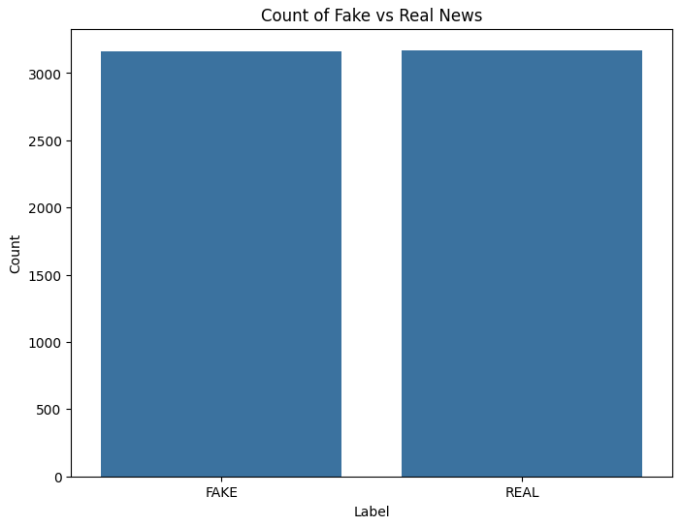
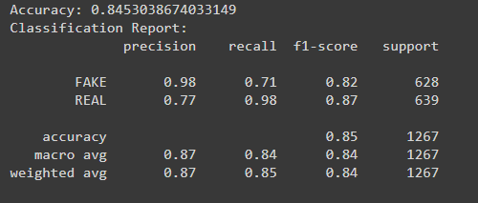
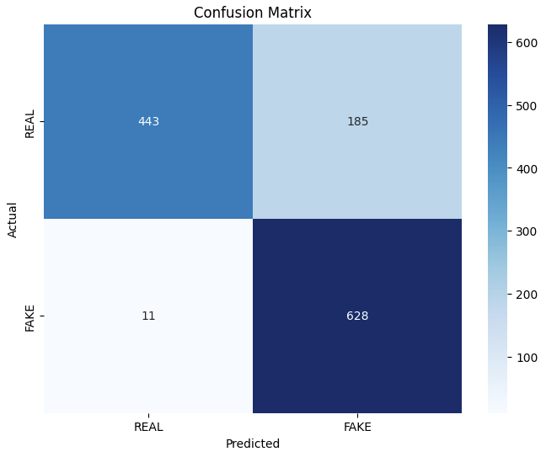
RESULTS
https://colab.research.google.com/drive/1Go7RZ_0jOB3lEn8Ioh4WO697fnjg2mfp#scrollTo=TLhpca7w2Lx4
3/21/2024 Annual Review
10

