Slide 1
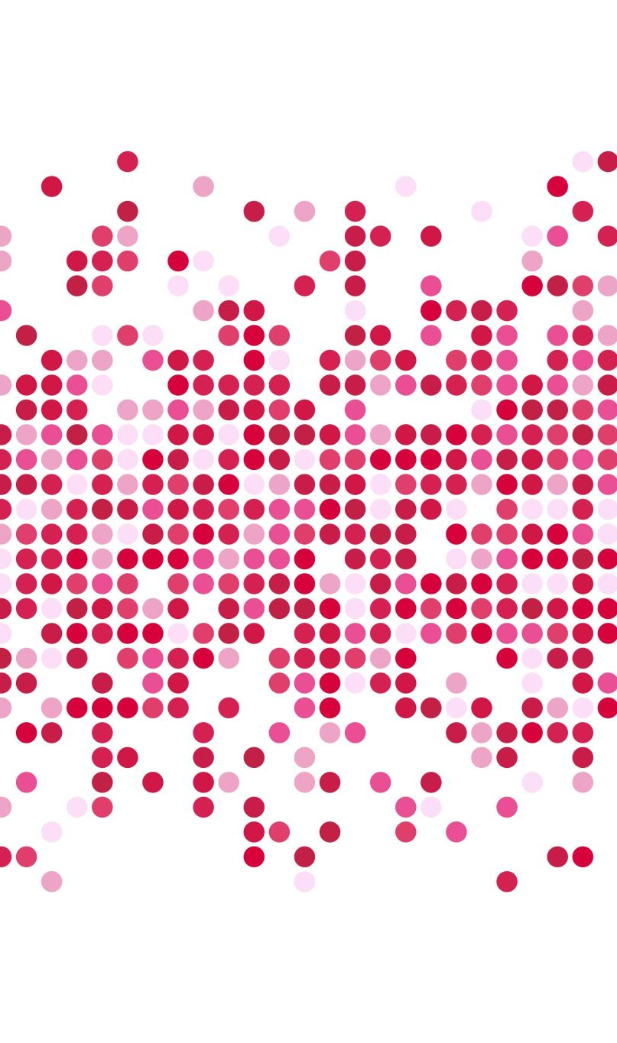
Amazon Product Review Analysis
By:
Veera Venkata Ramakrishna

Slide 2
Introduction
When a customer decides to buy a product online, he/she will lookup at the reviews which were provided by those customers who have already purchased that product. So, customers need to rely largely on product reviews to make up their minds for better decision making on purchase.
As a result, analysing past data on product reviews is very vital for any organization to improve on their existing product and forecast bettersales in the near future.
Therefore, models able to predict the user rating from the text review are critically important. Getting an overall sense of a textual review could in turn improve consumer experience

Slide 3

Goal
The goal of this project is to develop an automated system to analyse and monitor an enormous number of Amazon product reviews. By monitoring the entire review history of products, we wish to analyse tone, language, keywords, and trends over time to provide valuable insights that increases the success rate of existing and new products and marketing campaigns.
Tasks Performed:
Data Preparation
Sentiment Analysis
Recommender System
Sentiment Time Series Forecasting

Slide 4

Data Source
The Amazon Product Review dataset was considered for our analysis. This dataset contains product reviews and ratings from Amazon, including 142.8 million reviews spanning May 1996 - July 2014.
I have opted to work with Digital music and Music Instruments categories of datasets
I are hereby attaching the source link to the dataset we have used below:
Data Source Link: Link

Slide 5
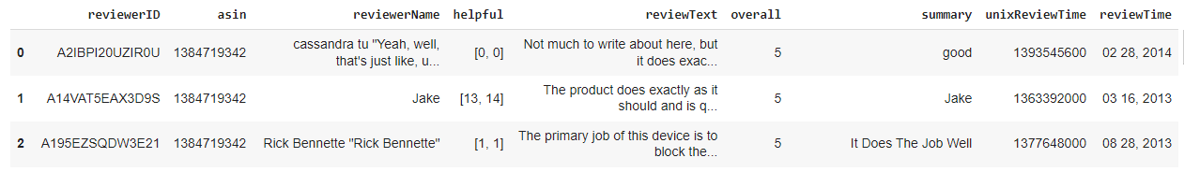
Description of the dataset
Data Dictionary:
reviewerID – ID of the reviewer
asin – ID of the product
reviewerName – Name of the reviewer
helpful – Helpfulness of the review
reviewText – Text of the review
overall - Rating
summary – Summary of the review
reviewTime – Time of the review

Slide 6

Data Preparation
Data Preparation involves Data Pre-processing and Text Pre-processing.
In the Data Pre-processing stage, we work primarily with data cleaning and data preparation.
In the Text Pre-processing stage, we work primarily with the text data which is present in the dataset. This stage can be considered as the initial stage of NLP Pipeline.

Slide 7
Data Pre-processing
The required datasets have been imported and converted into data frames for further analysis.
Columns were renamed for clarity purpose.
Dropped missing values from the data frame.
The ‘Review_Time’ feature has been converted into an appropriate date format.
‘Helpful’ feature was split into two separate features: ‘Review_Likes’ and ‘Review_Dislikes’.
Ratings greater than 3 was classified as “good”, less than 3 was classified as “bad” and equal to 3 was classified as “neutral”.
Concatenated ‘summary’ and ‘Review_Text’ features into one single feature and subsequently dropped the previous two columns.

Slide 8
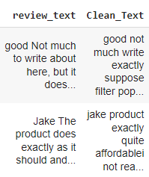
Text Pre-processing
Since, text is the most unstructured form of all the available data, various types of noise are present in it and the data is not readily analysable without any pre-processing. The entire process of cleaning and standardization of text, making it noise-free and ready for analysis is known as text pre-processing.
The following pre-processing techniques were applied:
Removing Special Characters
Removing Stopwords
Lemmatizaion
Consolidated Output of the above-mentioned functions:

Slide 9
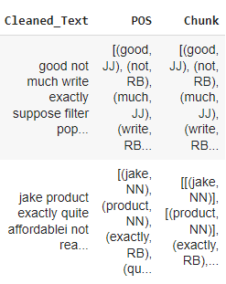
Text Pre-processing
Further techniques were applied to perform the following tasks:
Expanding Contractions
POS Tagging
Chunking
Named Entity Recognition
Consolidated Output of the above-mentioned functions:

Slide 10
Exploratory Data Analysis:
Exploratory Data Analysis (EDA) is an approach to analyze the data using visual techniques. It is used to discover trends, patterns, or to check assumptions with the help of statistical summary and graphical representations.
For the purpose of EDA, we have made use of Tableau. Each analysis has been plotted and consolidated in the form of a dashboard.
We are hereby attaching the dashboard link below for reference:
Link To Dashboard

Slide 11
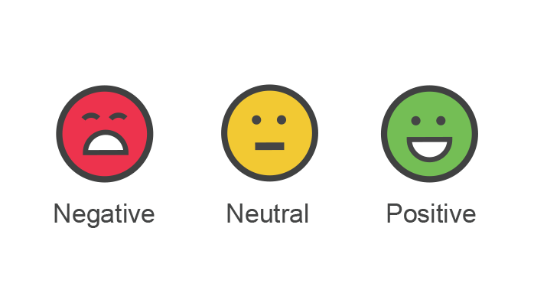
Sentiment Analysis
Sentiment analysis is used to determine whether a given text contains negative, positive, or neutral emotions. It’s a form of text analytics that uses natural language processing (NLP) and machine learning.
Machine Learning models take numerical values as input. The product reviews are textual data. So in order to extract patterns from the data, we need to find a way to represent it in a way that machine learning algorithm can understand. And for this purpose, we can vectorize the textual data using TF-IDF vectorizer.

Slide 12

Sentiment Analysis
Tasks Performed:
Separating Response Variable and Features
Splitting Dataset into Train and Test Sets
TF-IDF Vectorization
Model Building
Classification Report
Confusion Matrix
Comparison of Models with TF-IDF Vectorizer
f1-Score Plot

Slide 13
Model Building
We built two classification models for Sentiment Analysis namely:
Logistic Regression
Random Forest Classifier
Since Logistic Regression is a probability based classifier, we wanted to use another algorithm which gives a probabilistic result as well. As a result, we have decided to use Random Forest Classifier.

Slide 14
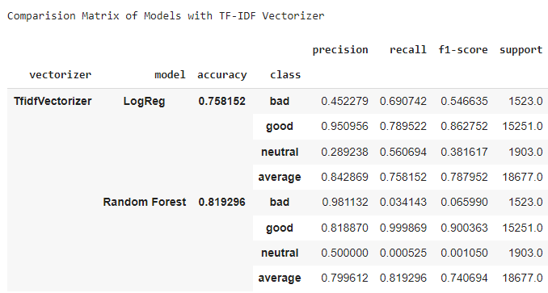


Sentiment Analysis-Comparison of Models
Interpretation:
The accuracy of Random Forest is greater than that of Logistic Regression.
But since the data is highly imbalanced, accuracy is not advisable to compare.
As a result, comparing these models on the basis of f1-score is more meaningful and logical.
Logistic Regression has a better average f1-score than when compared to Random Forest.
Hence, Logistic Regression is the better model for Sentiment Analysis.

Slide 15
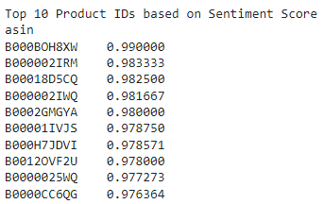
Sentiment Analysis
Based on the Review Text of each product, Sentiment Score has been calculated.
And the Top 10 products on the basis of mean value of Sentiment Score are shown:

Slide 16
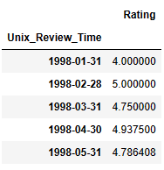
Sentiment Time Series Forecasting
Tasks Performed:
Import the data
Set “Unix_Review_Time” as index
Dropped “Reviewer_ID” and “asin”
Sample Data:
Plot the Time Series Components
Check for Data Stationarity
Plot ACF and PACF
Split the data into train and test
Model Building : ARMA and SARIMA

Slide 17
Model Building
Tasks Performed:
Determine ‘p’ and ‘q’ values. 'd’ value assigned to zero because the data is stationary.
Build the Model
Print Model summary
Predictions have been made
Error values have been calculated for every actual and predicted value
Plot the error values
Perform LJung-Box test
Calculate RMSE and MSE values
Plot actual and predicted values

Slide 18
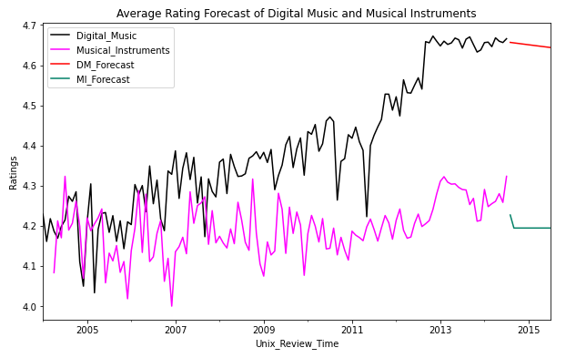
Sentiment Time Series Forecasting
Forecasting the Ratings for next 12 months using ARMA Model:

Slide 19
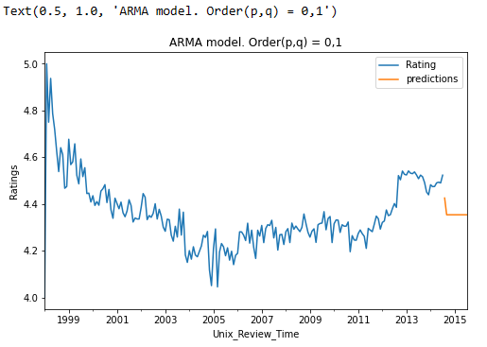
Sentiment Time Series Forecasting
Forecasting the Ratings for next 12 months using ARMA Model of both the categories combined ( Digital Music and Musical Instruments ):

Slide 20
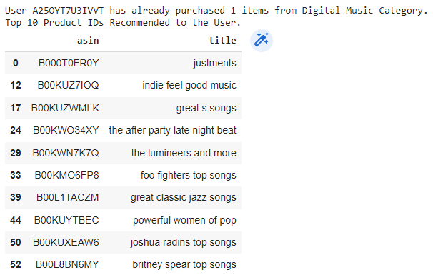


Recommender System (Digital Music)
We have implemented a Collaborative filtering based Recommender System where product IDs will be recommended to the User based on his/her past behavior.
The similarity between each item pair was computed and based on that, similar items were recommended which are liked by the users in the past.

Slide 21
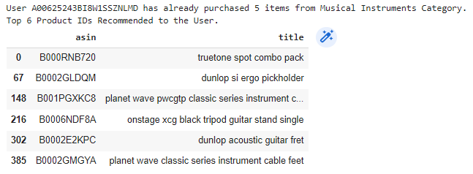


Recommender System (Musical Instruments)

Slide 22


