Slide 1
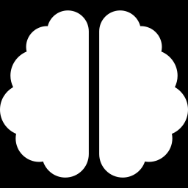
AI / ML TRAINING · DAY 7 · PHASE D — MODELLING
Supervised Learning Foundations
Learning a mapping from labelled examples — the heart of applied ML
Classification vs regression · how models learn · the model zoo · evaluation
Unit U14 · Phase D · 22 slides

Slide 2
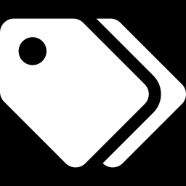
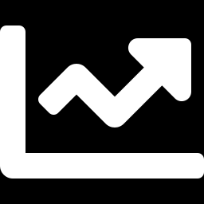
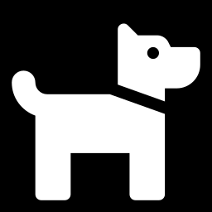
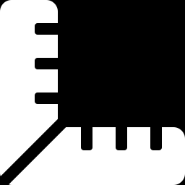
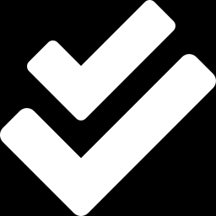
ORIENTATION
Teaching a model from examples
The core idea: show the model many examples of inputs paired with the right answers, and it learns the mapping — then predicts the answer for new, unseen inputs.
1
2
3
4
5
The setup
Two tasks
The model zoo
Evaluate
Generalise
X → y from labels
classify or predict a number
the main algorithm families
metrics that fit the task
perform on new data
Everything you built in Phase C — the clean, model-ready dataset — feeds straight into this.
U14 · Supervised Learning Foundations
2

Slide 3
1
THE SETUP
What is supervised learning?
Inputs with known answers — the model learns to reproduce, then predict them.
Supervised Learning Foundations · Phase D · 01 / 22

Slide 4
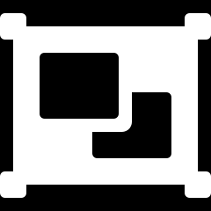
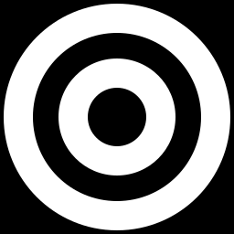
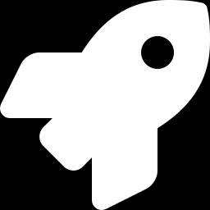
LEARN FROM LABELLED DATA
What is supervised learning?
Definition: learning a function that maps inputs X to a known output y, using examples where the correct y is given (the labels).
Features (X)
Label (y)
Model
Predict
the inputs describing each example
the known correct answer
learns the X → y relationship
estimate y for new inputs
'Supervised' because the labels supervise learning — like an answer key during practice.
U14 · Supervised Learning Foundations
4

Slide 5
TWO KINDS OF TARGET
Classification vs regression
CLASSIFICATION
REGRESSION
Predict a category / class.
Predict a continuous number.
spam vs not spam
will churn: yes / no
digit 0–9
output: a label
house price
tomorrow's temperature
energy usage
output: a quantity
U14 · Supervised Learning Foundations
5

Slide 6
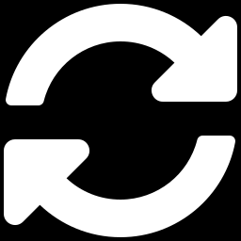
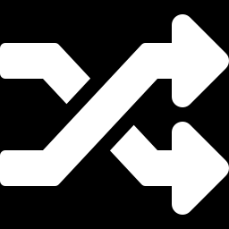


THE SUPERVISED WORKFLOW
From data to predictions
1
2
3
4
5
DATA
SPLIT
TRAIN
EVALUATE
PREDICT
model-ready X, y
train / test
model.fit(X, y)
score on test
on new data
The discipline: the model only ever sees training data while learning. The test set is the unseen exam that estimates real-world performance.
U14 · Supervised Learning Foundations
6

Slide 7
HOW A MODEL LEARNS
Fit, then predict
fit(X, y) — learns parameters from training data
supervised.py
from sklearn.linear_model import LogisticRegression
model = LogisticRegression()
model.fit(X_train, y_train) # learn
preds = model.predict(X_test) # apply
acc = model.score(X_test, y_test)
print(acc)
predict(X) — applies them to produce ŷ
score(X, y) — measures how good predictions are
Same API — for almost every model in scikit-learn
The model is just a set of learned numbers (parameters) plus a rule for turning X into ŷ.
U14 · Supervised Learning Foundations
7

Slide 8
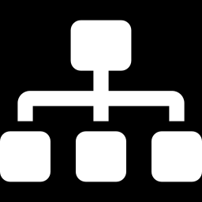
HOW MODELS REPRESENT KNOWLEDGE
Parametric vs non-parametric
PARAMETRIC
NON-PARAMETRIC
Fixed number of parameters, set during training.
Flexibility grows with the data.
Linear / logistic regression
Fast, compact, interpretable
Strong assumptions about shape
k-NN, decision trees
Few assumptions, very flexible
Need more data; can overfit
U14 · Supervised Learning Foundations
8

Slide 9
2
THE TOOLKIT
The model landscape
A tour of the main algorithm families and how they differ.
Supervised Learning Foundations · Phase D · 02 / 22

Slide 10
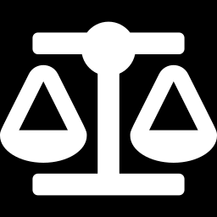
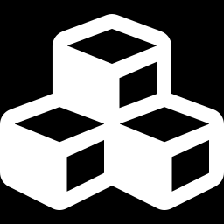
THE MODEL ZOO
Families you'll meet
Linear models
Decision trees
k-NN
regression & logistic — simple, fast
if-then splits; very interpretable
predict from nearest neighbours
SVM
Ensembles
Neural nets
maximum-margin boundaries
random forests, gradient boosting
deep, flexible, data-hungry
Most start simple (linear / trees) for a baseline, then move to ensembles or nets if needed.
U14 · Supervised Learning Foundations
10

Slide 11
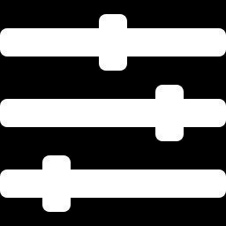
TWO KINDS OF KNOBS
Parameters vs hyperparameters
PARAMETERS
HYPERPARAMETERS
Learned from data during fit().
Set by you before training.
e.g. regression weights w, b
set automatically by training
you don't choose them
e.g. learning rate, tree depth, k
control how the model learns
tuned via cross-validation
Training finds the parameters; you (or a search) find the hyperparameters that make training work best.
U14 · Supervised Learning Foundations
11

Slide 12
3
DOING IT WELL
Training & evaluating
How to judge a model honestly and pick the right yardstick.
Supervised Learning Foundations · Phase D · 03 / 22

Slide 13
THE REAL GOAL
Generalisation: train vs test
Train score — how well it fits seen data
Train looks great; test is what counts
Test score — how well it does on unseen data
What matters — the test score — real-world proxy
Big gap — overfitting (memorised the train set)
the 'complex' model overfits: high train, low test
U14 · Supervised Learning Foundations
13

Slide 14
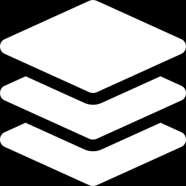
A STABLER ESTIMATE
Cross-validation
One split is noisy — the score depends on which rows landed in test
5-fold cross-validation
k-fold — rotate the validation fold k times
Average — report mean ± spread across folds
Use it — to compare models & tune hyperparameters
gold = validation fold (rotates)
U14 · Supervised Learning Foundations
14

Slide 15
JUDGING A CLASSIFIER
Classification metrics
Accuracy
% correct overall
watch: misleading on imbalanced data
Precision
of predicted positives, how many right
watch: cost of false positives
Recall
of actual positives, how many caught
watch: cost of false negatives
F1 score
harmonic mean of precision & recall
watch: balanced single number
ROC-AUC
ranking quality across thresholds
watch: threshold-independent
On imbalanced data, accuracy lies — lead with precision, recall, F1 or ROC-AUC.
U14 · Supervised Learning Foundations
15

Slide 16
JUDGING A REGRESSOR
Regression metrics
MAE
MSE
RMSE
R²
mean absolute error
mean squared error
root mean squared error
coefficient of determination
average miss, in original units; robust
penalises big errors heavily
like MSE but back in real units
share of variance explained (0–1)
Quick guide: report RMSE for an error in real units and R² for 'how much better than the mean'. Use MAE when outliers shouldn't dominate.
U14 · Supervised Learning Foundations
16

Slide 17
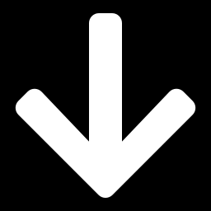
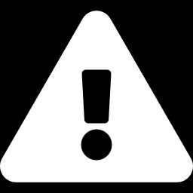
THE BALANCE TO STRIKE
Underfitting & overfitting
Underfit
Good fit
Overfit
Bias–variance
too simple — high train & test error
captures signal, ignores noise
memorises noise — big train-test gap
the trade-off behind it (U13)
Aim: the model complexity where test error is lowest — fitting the pattern without chasing the noise.
U14 · Supervised Learning Foundations
17

Slide 18
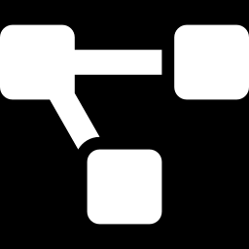

ONE PATTERN, EVERY MODEL
The scikit-learn workflow
Consistent API — fit / predict / score on every estimator
workflow.py
from sklearn.pipeline import make_pipeline
from sklearn.preprocessing import StandardScaler
from sklearn.ensemble import RandomForestClassifier
from sklearn.model_selection import cross_val_score
pipe = make_pipeline(StandardScaler(),
RandomForestClassifier())
cross_val_score(pipe, X, y, cv=5).mean()
Swap models freely — change one line to try another
Pipelines — bundle preprocessing + model, leak-free
cross_val_score — evaluate robustly in one call
IN-CLASS LAB Train two different classifiers on the same data with one line changed; compare CV scores.
U14 · Supervised Learning Foundations
18

Slide 19
CHOOSING A MODEL
No free lunch — start simple
Need a quick, interpretable baseline
Linear / logistic regression
Tabular data, mixed feature types
Tree ensembles (random forest, XGBoost)
Few features, smooth boundary
SVM or k-NN
Images, text, audio, huge data
Neural networks
Always
Start simple; add complexity only if it helps
No single model wins everywhere — the 'best' one depends on your data and goal.
U14 · Supervised Learning Foundations
19

Slide 20
THE SUPERVISED RECIPE
Putting it all together
Frame
Baseline
Evaluate
Improve
Ship
classification or regression?
a simple model first
the right metric, via CV
tune, add complexity if it helps
score on the held-out test set
Remember: a simple model you understand and evaluate honestly beats a complex one you can't trust. The next units fill in each algorithm.
U14 · Supervised Learning Foundations
20

Slide 21
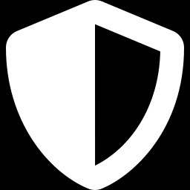
DO IT RIGHT
Pitfalls & best practices
Never test on train
Match metric to task
Baseline first
Cross-validate
always evaluate on unseen data
accuracy ≠ the goal on imbalanced data
beat a simple model before going complex
one split can mislead you
The classic trap: celebrating a high training score. Only the held-out test score tells you how the model will really perform.
U14 · Supervised Learning Foundations
21

Slide 22
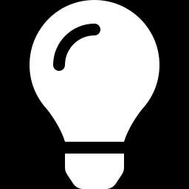
WRAP-UP
Recap, homework & what comes next
KEY TAKEAWAYS
HOMEWORK / SELF-PACED
UP NEXT
Supervised = learn X → y from labels
Classification vs regression
Same API: fit / predict / score
Match the metric to the task
Judge on unseen data; cross-validate
Train a classifier with fit/predict/score
Compute accuracy, precision, recall, F1
Train a regressor; report RMSE & R²
Swap in a second model; compare via CV
Check the train vs test gap
U15
Regression (Part 1) — your first model in depth
→
linear regression, fit, evaluate, interpret
Bottom line: supervised learning is a disciplined loop — frame the task, fit a model, evaluate it honestly on unseen data, and improve.
U14 · Supervised Learning Foundations
22

