Slide 1

TEAM: LAST MINUTE SOLVERS
Faiz Hashim
210050050
Pratham Garg
210050123
Veeresh B Patil
210050163

Slide 2


Memory/Cache hierarchy optimizations for Graph Analytics

Slide 3
What is Cache ?
“Cache” is hardware that is used to store something, usually data, temporarily in a computing environment.
It is a small amount of faster, more expensive memory used to improve the performance of recently or frequently accessed data.
Keep frequently accessed data in cache to save time.
Only access RAM(which is very slow) if cache doesn’t have what you want

Slide 4
Caching in Graphing Algorithms
IPC in graphing algorithms like PageRank, Breadth First Search, Single Source Shortest Path etc prove to be very low compared to other programs.
WHY?
Graphs have a very random memory access order. Addresses have low temporal density hence caching is not very effective. Owing to the small size of caches till the time the program requests a previously accesses memory it is already evicted most of the time. Hence we need to access to RAM frequently which is costly.

Slide 5
How to improve ?
There are several parameters of cache which, and related policies that, one can explore to improvise and maximize the performance of cache like:
Cache Hierarchy variation
Cache Size variation
Replacement policy variation
Cache Associativity variation

Slide 6
Cache Hierarchy
Cache hierarchy is broadly of 3 types –
Inclusive – Every address present in any higher level cache is also present in lower level cache
Exclusive – All caches have different addresses and no 2 caches have a similar entry
NINE – Neither Inclusive Nor Exclusive, basically any cache can have any address
**We have implemented all three. Implementation details are in README of github repo

Slide 7
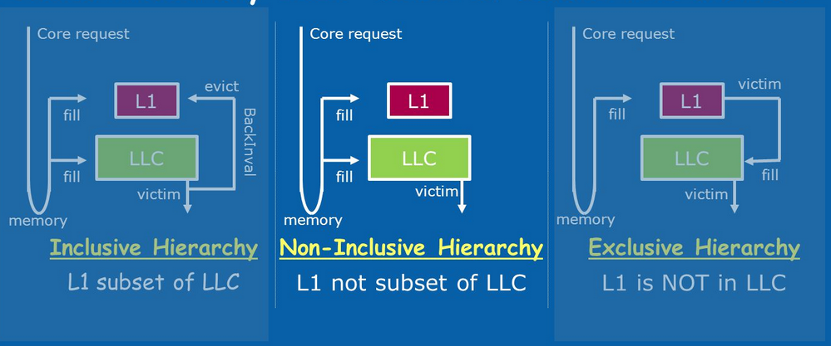

Slide 8
Which hierarchy is best?
From the empirical results, no clear winner could be decided and it varied with different replacement policies. For instance, in case of LRU, the exclusive hierarchy performed better than others by a percentage points.
The possible reason for this could be the fact that exclusive hierarchy allows maximum number of distinct addresses to be present in all three caches at a time and hence a handful of addresses which were fetched long ago are retained in exclusive but not in inclusive and hence their fetching from the cache instead of the RAM improves the exclusive.
**Different trends were observed for other replacement policies as depicted in the following plots

Slide 9
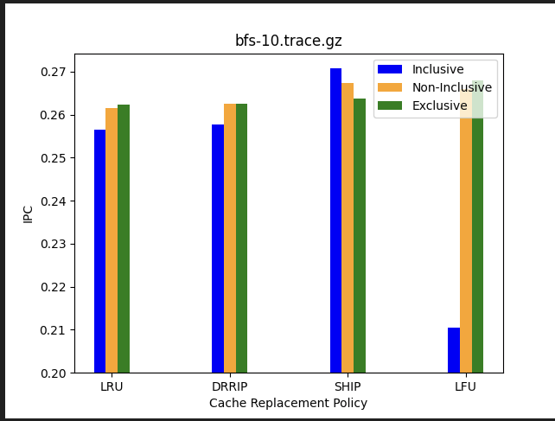

Slide 10
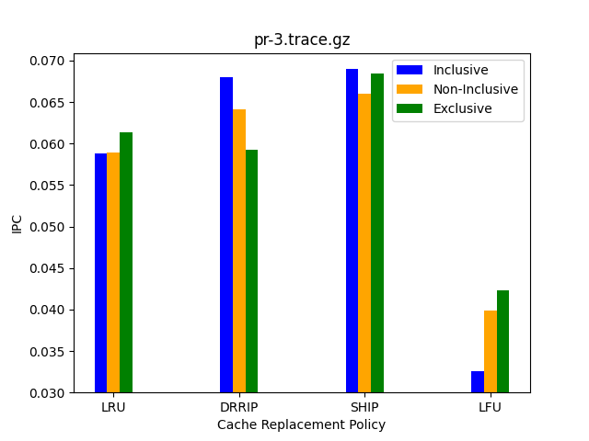

Slide 11
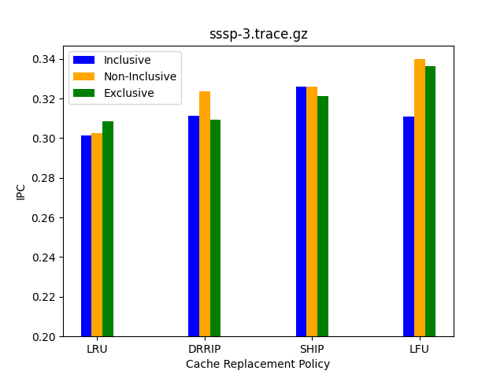

Slide 12
Cache Size
Cache size is a major factor in deciding the performance of the processor. More cache size allows more space for memory which can be accessed faster.
Then why not make cache as big as RAM?
Caches while being faster, are also expensive since they are specialized hardware and hence cannot be used in bulk
Another reason is that on increasing the size, the memory access time of the cache (latency) increases and hence it gets the process gets slower. So there is a trade-off between the size and latency of the cache we need to determine empirically what is best.
** The following graph was used as reference for hardcoding latency in champsim

Slide 13
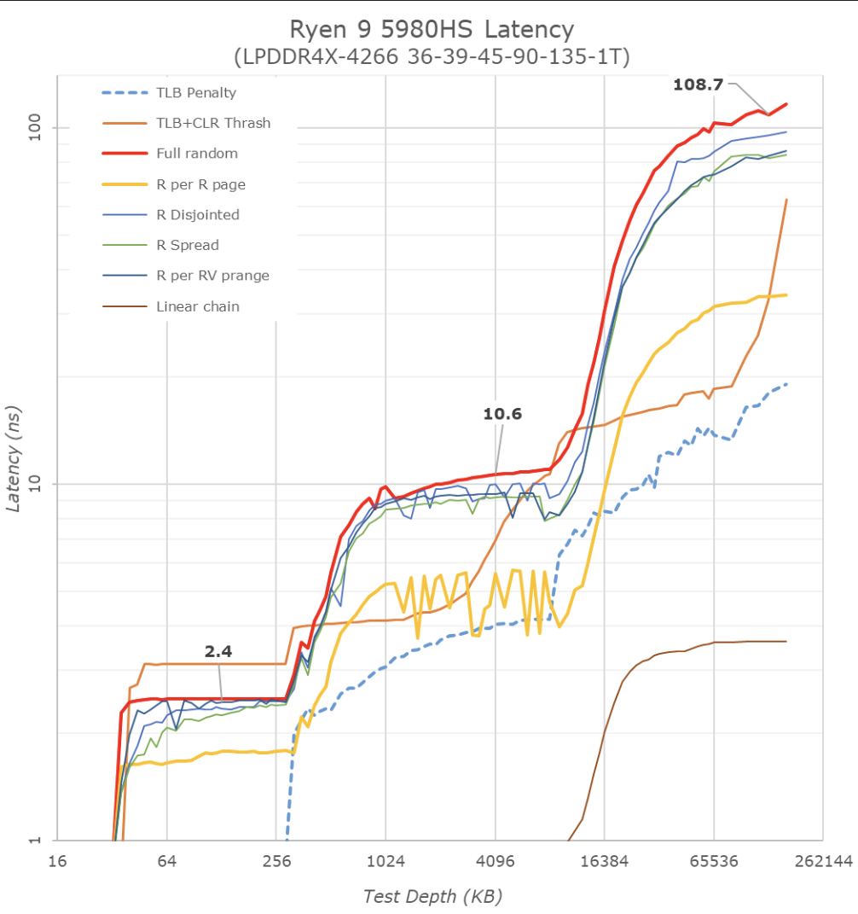

Slide 14
Cache Size Effect
bfs-10.trace.gz
A consequence of the fact that graphing algorithms access memory vary randomly and hence the distance between temporally near memory addresses is very high which these caches are unable to accommodate and hence the miss ratio is very high for both L2C and LLC. Hence decreasing the size of either of these caches improves the IPC since that decreases the latency too. Here, latency comes out as a dominating factor. Changing the L1 size is not viable since increasing the L1 size introduces a jump in latency while decreasing the size would decrease the L1 hits which are abundant originally.

Slide 15
L2C Cache Size | IPC
256KB | 0.278
512KB | 0.267
LLC Cache Size | IPC
1MB | 0.270
2MB | 0.267
4MB | 0.258
8MB | 0.230
L1D Cache Size | IPC
48KB | 0.267
96KB | 0.265

Slide 16
pr-3.trace.gz
A different trend was observed for this trace file, where L1 and L2 had huge miss ratio while LLC had a considerable percentage of hits. Consequently, here increasing the size of LLC proved to be effective since it allowed temporally farther addresses to be present in the cache thus increasing the proportion of hits, which more than compensated for the increase in latency as well.
This may arise from the fact that address requests are a lot more spread out and less frequently accessed, as also observed from the fact that LFU performance has a drastic drop in the analysis.

Slide 17
L2C Cache Size | IPC
256KB | 0.060
512KB | 0.058
LLC Cache Size | IPC
1MB | 0.047
2MB | 0.058
8MB | 0.104
L1D Cache Size | IPC
48KB | 0.058
96KB | 0.057

Slide 18
Cache Replacement Policy
One method to improve cache performances is to choose better cache replacement policies.
“When a new line is to be inserted into the cache, which line should be evicted to make space for the new line?“ This is what these policies deal with, and play a very important role in determining the efficiency of the caches used.
Let’s go through some basic replacement policies that we have used in our experimental setup-

Slide 19
Least Recently Used (LRU)
Discards the least recently used items first. This algorithm requires keeping track of what was used when, which is expensive if one wants to make sure the algorithm always discards the least recently used item. General implementations of this technique require keeping "age bits" for cache-lines and track the "Least Recently Used" cache-line based on age-bits. In such an implementation, every time a cache-line is used, the age of all other cache-lines change.
LRU is actually a family of caching algorithms with members including 2Q by Theodore Johnson and Dennis Shasha, and LRU/K by Pat O'Neil, Betty O'Neil and Gerhard Weikum.

Slide 20
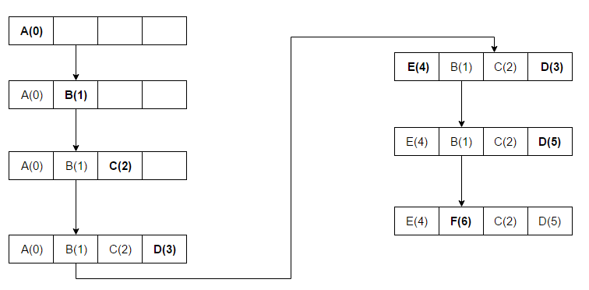

Slide 21
Least Frequently Used (LFU)
Counts how often an item is needed. Those that are used least often are discarded first. This works very similar to LRU except that instead of storing the value of how recently a block was accessed, we store the value of how many times it was accessed. So of course while running an access sequence we will replace a block which was used fewest times from our cache. E.g., if A was used (accessed) 5 times and B was used 3 times and others C and D were used 10 times each, we will replace B.

Slide 22
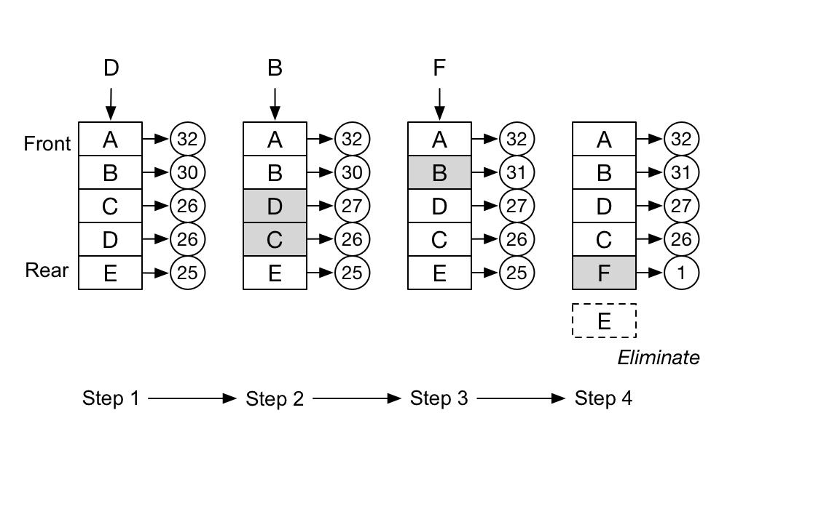

Slide 23
DRRIP Dynamic Re-Reference Interval Prediction
SRRIP inserts lines with an RRPV value of maxRRIP. This means that a line that has just been inserted will be the most likely to be evicted on a cache miss.
SRRIP performs well in the normal case, but suffers when the working set is much larger than the cache size and causes cache thrashing, this is remedied by inserting lines with an RRPV value of maxRRPV most of time, and inserting lines with an RRPV value of maxRRPV - 1 randomly with a low probability. This causes some lines "stick" in the cache and help against thrashing. However, BRRIP degrades performance on non thrashing accesses.
SRRIP performs best when the working set is smaller than the cache size, while BRRIP performs best when the working set is larger than the cache size. DRRIP aims for the best of both worlds. It uses set dueling to select whether to use SRRIP or BRRIP. It dedicates a few sets (typically 32) to only use SRRIP and another few to only use BRRIP, and it uses a policy counter that monitors which of these sets performs better to determine which policy will be used by the rest of the cache.

Slide 24
SHiP Signature-based Hit Predictor
The goal of signature-based cache replacement is to predict whether the insertions by a given signature will receive future cache hits. The intuition is that if cache insertions by a given signature are re-referenced, then future cache insertions by the same signature will again be re-referenced. Conversely, if cache insertions by a given signature do not receive subsequent hits, then future insertions by the same signature will again not receive any subsequent hits.

Slide 25
The Better Replacement Policy ?
We have used the aforementioned 4 replacement policies – LFU, LRU, DRRIP, SHiP – in our analysis setup.
Reading the result of the simulations indicates some shocking results. We are unable to decide a clear winner for this award of best replacement policy. Different policies result relatively better in certain traces, while some policies have comparable results itself.
However, it can still be observed that LFU fails miserably when working on the PageRank trace.
The primary reason for both these observations could lie in the fact that address accesses are relatively random for graph workloads.

Slide 26
Cache Associativity
In fully associative cache: we have M cells, each capable of holding a cache line corresponding to any of the N total memory locations, and in case of contention, the one not accessed the longest gets kicked out and replaced with the new one.
The problem with fully associative cache is that implementing the “find the oldest cache line among millions” operation is pretty hard to do in software and just unfeasible in hardware. You can make a fully associative cache that has 16 entries or so, but managing hundreds of cache lines already becomes either prohibitively expensive or so slow that it’s not worth it.

Slide 27
We can resort to another, much simpler approach: just map each block of 64 bytes in RAM to a single cache line which it can occupy. Say, if we have 4096 blocks in memory and 64 cache lines for them, then each cache line at any time stores the contents of one of 4096/64 = 64 different blocks.
A direct-mapped cache is easy to implement doesn’t require storing any additional meta-information associated with a cache line except its tag (the actual memory location of a cached block). The disadvantage is that the entries can be kicked out too quickly — for example, when bouncing between two addresses that map to the same cache line — leading to lower overall cache utilization.

Slide 28
For that reason, we settle for something in-between direct-mapped and fully associative caches: the set-associative cache. It splits the address space into equal groups, which separately act as small fully-associative caches.
Associativity is the size of the cache sets, or, in other words, how many different cache lines each data block can be mapped to. Higher associativity allows for more efficient utilization of cache but also increases the cost.

Slide 29
Changing Associativity !!
In our analysis experiment, we also changed the associativity of a few caches and analyzed the effect on the performances.
Based on the results obtained, we can conclude that for our traces, there was negligible effect on performance with change in associativity.

Slide 30
Way-associativity | IPC
6 | 0.267804
12 | 0.2670
24 | 0.267851
bfs-10.trace.gz
In the execution of the BFS trace, L1D cache faced the maximum hit rate, and thus the analysis was performed on the way-associativity of this cache, in hope for significant results.

Slide 31
Way-associativity | IPC
8 | 0.0582745
16 | 0.0586558
32 | 0.0589155
pr-3.trace.gz
In the execution of the PageRank trace, LLC cache faced the maximum hit rate, and thus the analysis was performed on the way-associativity of this cache, in hope for significant results.

Slide 32
CONCLUSION
Wrapping it up, Graph Workload Algorithms perform in a way that access memory quite randomly and non-temporally located.
This nearly randomized behavior does not conclude to a satisfying result that can be unified for all the available traces.
Better results can be obtained with the use of customized processors, fin-tuned to serve a particular graph algorithm, rather than the bunch as a whole.

Slide 33
THANK YOU

