Slide 1
Issue Tracking System Using Spring Boot, Microservices, and MySQL Version Dated: 05.2026

Slide 2
Table of Contents
Problem Statement 3
Project Overview 3
Objective 3
Tools and Technologies 3
Architecture 3
Functional Requirements 4
User Management 4
Sign Up 4
Login 4
Dashboard 4
Project Owner Module 4
Assignee Module 4
Create Project (Project Owner View) 4
Retrieve Projects (Project Owner View) 5
Create Issue (Project Owner View) 5
Issue Detail (Project Owner View/ Assignee View) 5
Retrieve Issues (Project Owner View) 5
Update Issue (Project Owner View) 5
Microservices Breakdown 5
API Specification 6
User Service Endpoints 6
Project Service Endpoints 6
Issue Service Endpoints 7
Database Structure 7
Implementation Strategy 7
Non-Functional Requirements 8
Guidelines 8
Best Practices 8
Milestones and Evaluation Criteria

Slide 3
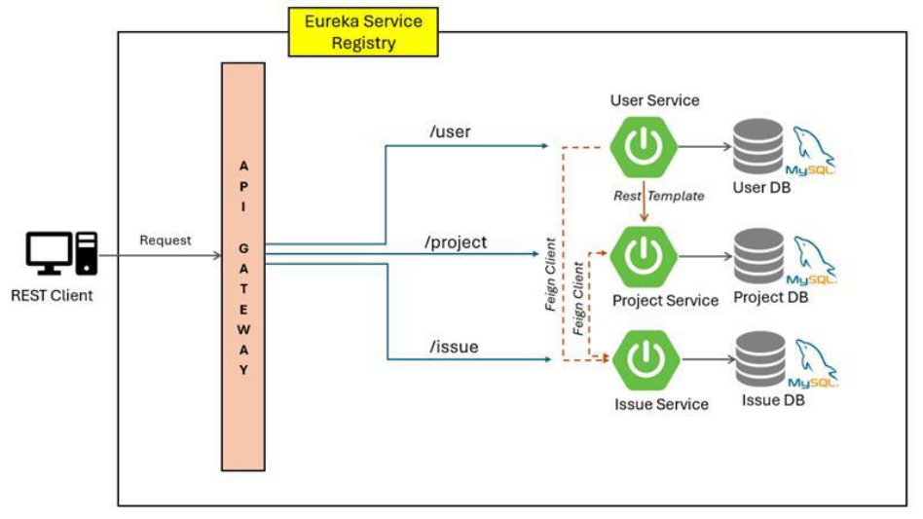
Problem Statement
Project Overview
This case study describes the development of an Issue Tracking System (ITS) based on a microservices architecture. The system will handle project details, issues related to these projects, and user assignments. The system will allow users to create, update, and manage issues with various statuses, priorities, and assignments associated with those projects, and assignees (users) who interact with the application. It will be developed using Spring Boot for creating microservices and MySQL for database management. The system will provide RESTful services using Spring Boot and store data in a MySQL database.
Objective
Develop a RESTful service using Spring Boot, which will interact with a MySQL database to manage issues effectively. The system should provide endpoints for adding, retrieving, updating, and deleting issue records.
Tools and Technologies
Spring Boot Framework for building microservices
Spring Cloud For microservices patterns like configuration management, service discovery
Spring Cloud Gateway For API gateway service
MySQL Database for storing data of different services
Eureka Server For service discovery
Architecture

Slide 4
Functional Requirements
The system will be divided into several microservices, each handling a specific domain of the application.
Link to all Sample End Points:
References- Endpoints and DB.xlsx
User Management
Sign Up
Description: Allows creation of a new user with details including name, email, password, profile image, and role.
Inputs: Name, email, password, profile Image, and role.
Outputs: Confirmation of user creation with message “Your account is created successfully” with hyper link to login.
Process: Validates input and adds a new user to the database.
Login
The login screen is a common entry point for both Project Owners and Assignees. It includes the following fields:
• Name
• Email
• Password
• Profile Image (optional)
• Role (Project Owner or Assignee)
Upon successful login, users are redirected to their respective dashboards based on their role.
Dashboard
The dashboard provides a summary of the relevant information for each user role:
Project Owner Module
The Project Owner module includes functionalities for project and issue management: dashboard overview, project creation, management, issue creation, management, and assignment.
Assignee Module
The Assignee module includes functionalities for issue management: dashboard overview, viewing assigned issues and updating issue status.
Create Project (Project Owner View)
Description: Allows creation of a new project with details such as project name, product owner, start date, and end date
Inputs: Project name, product owner ID, start date, and end date
Outputs: Confirmation of project creation, project ID
Process: Validates input and adds a new project to the database

Slide 5
Retrieve Projects (Project Owner View)
Description: Allows retrieval of all projects or a single project by ID
Inputs: Project ID
Outputs: List of projects or single project details
Process: Fetches project details from the database
Create Issue (Project Owner View)
Description: Allows creation of a new issue related to a project
Inputs: Summary, project ID, description, priority, assignee ID, status, created date, last updated date, and comments
Outputs: Confirmation of issue creation, issue ID
Process: Validates input and adds a new issue to the database
Issue Detail (Project Owner View/ Assignee View)
Description: Allows retrieval of all issues, a single issue by ID, issues by project, or issues by user (assignee)
Inputs: Issue ID or project ID or user ID
Outputs: List of issues or single-issue details
Process: Fetches issue details from the database based on the provided criteria
Retrieve Issues (Project Owner View)
Description: Allows retrieval of all issues, a single issue by ID, issues by project, or issues by user (assignee)
Inputs: Issue ID or project ID or user ID
Outputs: List of issues or single-issue details
Process: Fetches issue details from the database based on the provided criteria
Update Issue (Project Owner View)
Description: Allows updating existing issue details
Inputs: Issue ID, fields to update such as status, assignee
Outputs: Updated issue details
Process: Validates changes and updates the issue details in the database
Microservices Breakdown
Project Service: Manages all project-related operations
Issue Service: Handles issues within projects
User Service: Manages user information and roles
Comment Service: Manages comments related to an issue

Slide 6
API Specification
(Link is also shared above with sample data in table format and sample endpoint outcomes)
User Service Endpoints
HTTP Method Endpoint Description
GET /api/users Retrieve a list of all users.
POST /api/users Create a new user.
POST /api/users/login Authenticate a user and log them in.
GET /api/users/{userId} Retrieve details of a specific user by user ID.
GET /api/users/{userId}/issues Retrieve issues assigned to a specific user by user ID. – Inter service communication
GET /api/users/username/{username}/issues Retrieve issues assigned to a specific user by username. – Inter service communication
Project Service Endpoints HTTP Method Endpoint Description
GET /api/projects/{projectId} Retrieve details of a specific project by project ID.
PUT /api/projects/{projectId} Update details of a specific project by project ID.
DELETE /api/projects/{projectId} Delete a specific project by project ID.
GET /api/projects Retrieve a list of all projects.
POST /api/projects Create a new project.
GET /api/projects/{projectId}/issues Retrieve issues within a specific project by project ID. – Inter service communication
GET /api/projects/projectName/{projectName}/ issues Retrieve issues within a specific project by project name. – Inter service communication
GET /api/projects/owner/{ownerId} Retrieve projects owned by a specific user by owner ID.

Slide 7
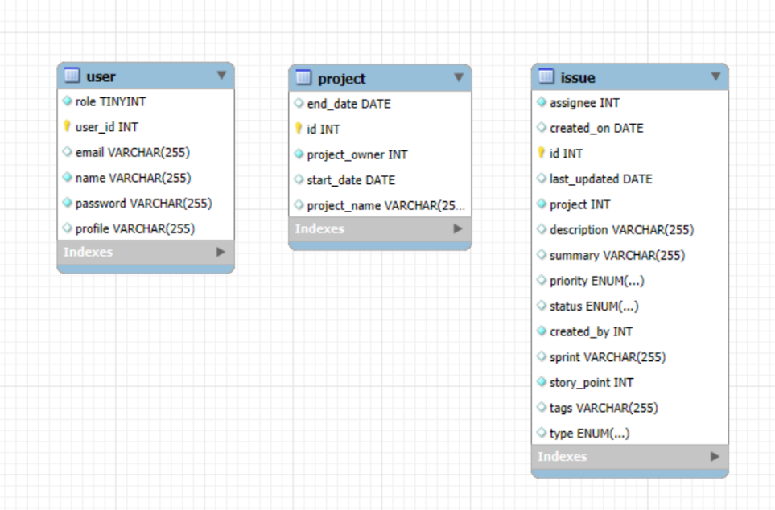
Issue Service Endpoints HTTP Method Endpoint Description
GET /api/issues/{id} Retrieve details of a specific issue by issue ID.
PUT /api/issues/{id} Update details of a specific issue by issue ID.
GET /api/issues Retrieve a list of all issues.
POST /api/issues Create a new issue.
GET /api/issues/project/{projectId} Retrieve issues within a specific project by project – Inter service communication ID.
GET /api/issues/owner/{ownerId} Retrieve issues owned by a specific user by owner – Inter service communication ID.
GET /api/issues/assignee/{assigneeId} Retrieve issues assigned to a specific user by – Inter service communication assignee ID.
Database Structure
Each service will manage its own database schema, reflecting the principles of microservices architecture to ensure loose coupling and high cohesion.

Slide 8
Implementation Strategy
Microservices Setup: Each microservice is set up as a separate Spring Boot application
Service Discovery: Implement Eureka Server for dynamic service discovery
API Gateway: A single-entry point for all clients. Routes requests appropriate microservices, handles failures, and provides some API aggregation
Inter-service Communication: Services communicate using RestTemplate or Feign Client
Database Configuration: Each service interacts with its own MySQL database instance
Testing and Deployment: Each microservice is developed, tested, and deployed independently
Swagger: Each of the above services should have swagger documentation of all APIs
Non-Functional Requirements
The application should have low latency and high throughput.
The application and data should be secured by Authentication.
System should be scalable and maintainable.
Guidelines
Make use of best coding practices.
Develop the application in such a way that it facilitates easy plugging of other related modules/functionalities like getting real-time updates and targeted notifications in case of status changes, in-issue commenting, etc. while scaling the application at a later point in time.
You can make assumptions and incorporate additional features or functionalities.
A simple but working prototype is preferred over a non-working but good-looking application.
The screenshots provided in this document are intended to help you understand and can be used as a reference to build the application.
Add relevant comments for proper documentation.
There would be a heavy focus on code quality and robustness of code in general.
Use Git to maintain the project repository, manage pull requests, and resolve conflicts.
Best Practices Clear and Consistent Resource Naming Use nouns that accurately reflect the resources your API manages (e.g., /products, /users)
Follow RESTful Principles Design APIs around resources, using HTTP methods explicitly (GET for fetching, POST for creating, PUT/PATCH for updating, DELETE for removing)
HTTP Status Code Use appropriate status codes to indicate API responses clearly
Embrace Dependency Injection (DI) Use @Autowired to inject dependencies (services, repositories) into controllers. Promote loose coupling and testability
Exception Handling Use @ControllerAdvice or @RestControllerAdvice to handle exceptions globally. Provide meaningful error responses that include status codes, error messages, and, if necessary, additional details

Slide 9
Milestones and Evaluation Criteria S. No. Details
Milestone 1 User Microservice: Create User Microservice along with Service specific endpoints, as in section 7.1, and test using postman
Milestone 2 Project Microservice: Create Project Microservice along with Service specific endpoints, as in section 7.2, and test using postman
Milestone 3 Issue Microservice: Create Issue Microservice along with Service specific endpoints, as in section 7.3, and test using postman
Milestone 4 Microservices Configuration:
Implement Eureka Server for dynamic service discovery
Register all microservices on Eureka Service dashboard
Milestone 5 Implement all Interservice Communication endpoints
Note: Refer section 7.1 to 7.4 (specified as Inter service Communication)
Milestone 6 Make use of ResponseEntity in all above microservices to effectively manage HTTP status codes and provide descriptive status messages. Must implement Swagger to enable API documentation and visualization
Milestone 7 Implement API gateway to enable client-side load-balancing & accessing all Microservice endpoints through the API Gateway
Milestone 8 Push the build to your Github repository
Technical Interview Discussion of Assumptions, Functionalities, and Validations

