Slide 1


Exploratory Data Analysis Course Project
Team – 12
Semester | Section – 4|D
Topic: Real World Vehicular Emission
01
02
03
04
01FE22BCS296
01FE22BCS279
01FE22BCS286
01FE22BCS327
440
437
438
446
VEERESH HIREMATH
MANOJ
RAHUL
MOHAMMED
REHAN HAVALDAR
Course Guide: Dr. Sujata C

Slide 2

PREFACE:
Serial Number | Contents
1 | Problem Statement
2 | Domain Understanding
3 | SDG3
4 | Data set description
5 | Preprocessing Techniques
6 | Data visualisations
7 | Model building
8 | Testing the Model
9 | Conclusion

Slide 3
Problem Statement
Uncover the primary contributors to vehicular emissions
Understanding Vehicular Emission Pattern: Identifying High-Impact Vehicles and Sustainable Fuel Types.
Identify sustainable and clean fuel types
Understand the relationship between Fuel Consumption and CO2 emission

Slide 4
DOMAIN UNDERSTANDING
According to The International Energy Agency (IEA), transportation accounts for approximately 48% of global CO2 emissions from fuel combustion.
Most vehicles still rely on fossil fuels such as gasoline and diesel, which emit large quantities of CO2, Nox, and other pollutants.
The International Council on Clean Transportation (ICCT) reported that in 2021, passenger vehicles were responsible for 58% of global CO2 emissions from road transport.
The global vehicle fleet has grown significantly, with the International Organization of Motor Vehicle Manufacturers (OICA) reporting over 1.6 billion vehicles on the roads as of 2021.

Slide 5




Sustainable Development Goals
Associated SDG 3.13
SDG 3.11
Climate Action
Transportation is a major source of greenhouse gas emissions contributing to global warming.
Sustainable Production and Consumption
Associated SDG 3.12
Promoting sustainable production and consumption of fuels in the automotive industry and encouraging the manufacture of low-emission vehicles.
Affordable and Clean Energy
Increasing the adoption of electric vehicles and other alternative fuel vehicles can significantly reduce vehicular emissions.

Slide 6
Raw Data set: Description
The provided file contains data related to individual passenger vehicle fuel consumption and usage regardless of the make or type of the vehicles.
Dataset Shape: (928573, 14)
Driver-selectable charge increasing operation:
Refers to the value recorded while the driver has chosen to increase the charge of the vehicle’s battery. This typically indicates the value recorded while actively engaging in charging operations that are manually selected by the driver, such as using regenerative braking, plugging into a charging station, or any other method available to increase the battery charge level. This metric helps to gauge the usage of electric or hybrid vehicles in terms of actively replenishing their energy sources over the vehicle's lifetime.
In charge depleting operation:
This suggests that the vehicle is operating in a mode where it's primarily using the energy stored in its battery (i.e., in electric mode) rather than relying on the internal combustion engine.
Total grid energy into the battery (lifetime) (kWh):
The total grid energy transferred into the vehicle's battery over its lifetime, measured in kilowatt-hours.

Slide 7
Aggregated Data set: Description
The provided file contains aggregated data about passenger vehicles of different fuel types and manufacturers.
Dataset Shape: (134,20)
OBFC Monitor:
It stands for "On-Board Fuel Consumption Monitor.” This would refer to a system or device installed in vehicles to monitor and display real-time resource consumption/emission rates, typically measured in litres per 100 kilometres (l/100 km).
WLTP Measure:
It refers to the resource consumption/emission of a vehicle measured using the Worldwide Harmonized Light Vehicles Test Procedure (WLTP). WLTP is a globally harmonized test cycle for measuring vehicle emissions and fuel consumption, designed to provide more accurate and realistic data compared to previous testing procedures.
Absolute gap consumption:
likely refers to a parameter or measurement related to the difference between the actual fuel consumption of a vehicle and a benchmark or target fuel consumption rate.
OBFCM Fuel consumption weighted:
likely refers to a weighted average of fuel consumption for a group of vehicles or a specific vehicle model.

Slide 8
Preprocessing Techniques Adopted
Feature engineering
Data integration
Data Cleaning
Adding an extra column to distinguish between cars and vans, price each vehicle, and dropping irrelevant attributes like registration year for improved and efficient analysis of passenger vehicular emissions.
Check for duplicates, null values, and the percentage of noisy data in each column, then drop the necessary tuples and attributes. Transform the data by replacing outliers with the mean value to ensure consistency.
Integrating raw data for cars and vans as well as aggregated data for cars and vans separately, to ensure comprehensive analysis.

Slide 9
Questions to explore hidden patterns
Understanding the relationship between Fuel Consumption and CO2 Emission Rates.
Does the price of Vehicles depend on the Fuel type they Operate on?
Understand the Fuel efficiency of different Fuels.
01
02
03
04
05
Identify which Fuel types are most sustainable and environmentally friendly?
Identifying which companies manufacture fuel efficient vehicles.

Slide 10
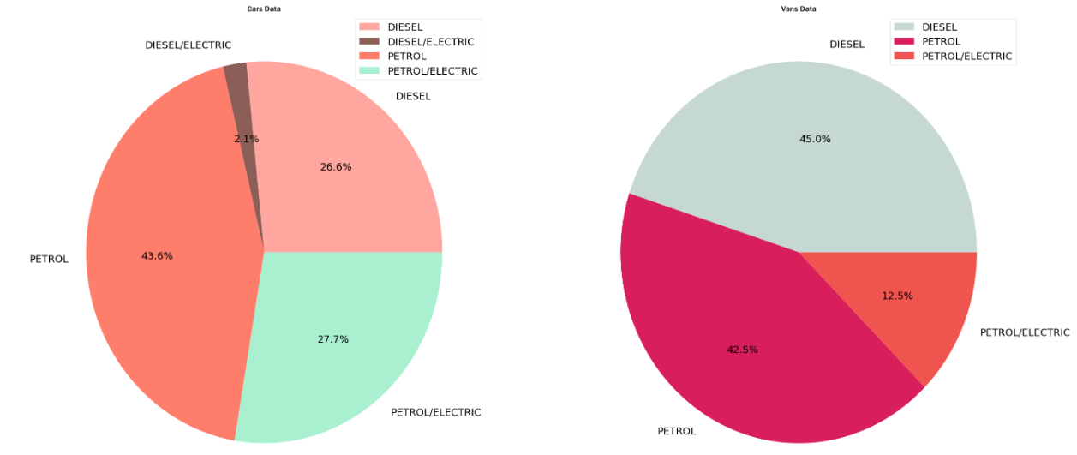
Inference 1:
Distribution of cars and vans categorized by their fuel types.
Most cars use environmentally harmful fossil fuels such as petrol and diesel, while only a mere 12% of cars are hybrids, which are much more environmentally friendly and also help save finite fossil fuels
In contrast, vans have a higher proportion of hybrid vehicles, with up to 30%. While this is an improvement, it is still insufficient to effectively regulate carbon emissions.

Slide 11
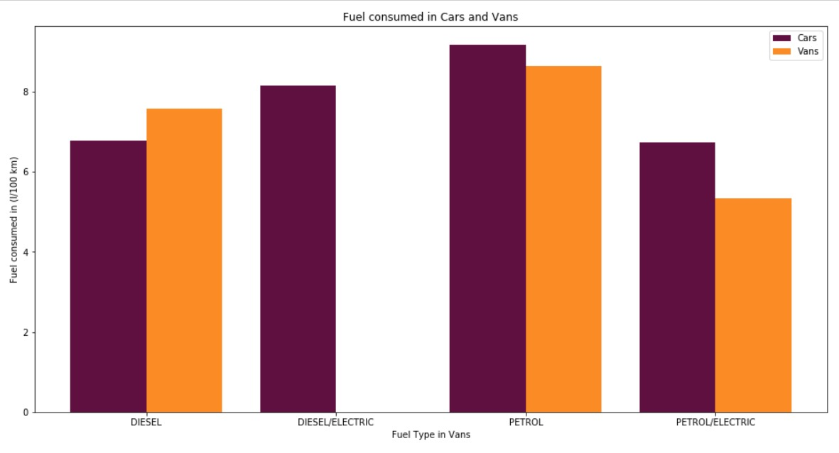
Inference 2:
Fuel consumed by different types of vehicles to travel 100km distance.
Understand the Fuel efficiency of different Fuels.
Cars fueled by fossil fuels, Both petrol and diesel consume comparatively larger amounts of fuel whereas hybrid cars exhibit minimal fuel consumption to travel the equal distance.

Slide 12
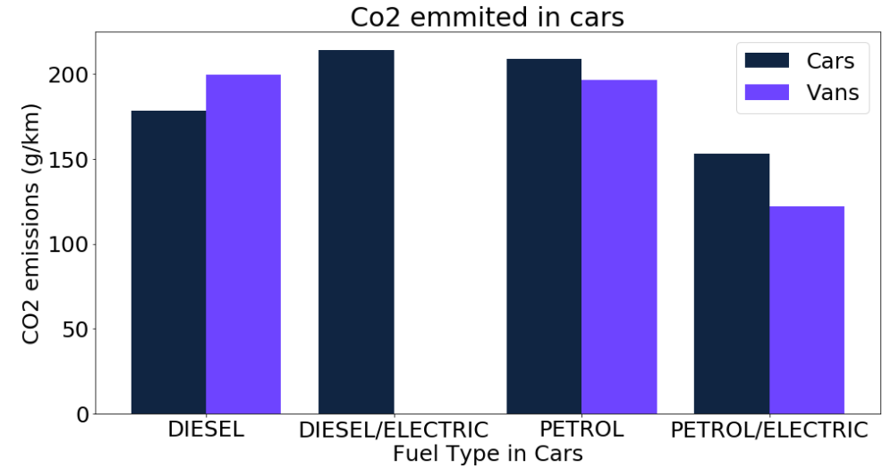
Inference 3:
Fuel Type Vs CO2 emitted by different vehicles per 100 km.
Identify which Fuel types are most sustainable and environmentally friendly?
Cars fueled by fossil fuels, Both petrol and diesel emit comparatively larger amounts of CO2 whereas petrol/electric hybrid cars exhibit minimal CO2 emission to travel the equal distance.

Slide 13
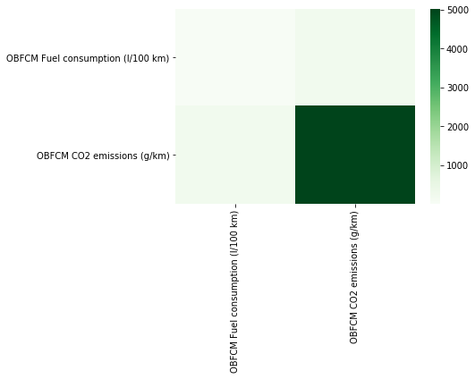
Inference 4:
Understanding the nature of relationship between Fuel Consumption and CO2 Emission
Is there any corelation between Fuel Consumed and CO2 Emitted?
It can be observed that both these quantities are positively corelated, that is, as fuel consumption increases, so does the level of CO2 emitted.

Slide 14
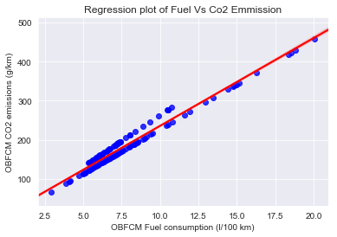
Inference 5:
Type of positive relationship between Fuel Consumption and CO2 Emissions.
Understanding the nature of the positive correlation between the two attributes.
Based on the analysis of the scatter plot provided, there appears to be a clear indication that the relationship between Fuel consumption and CO2 follows a linear trend.

Slide 15
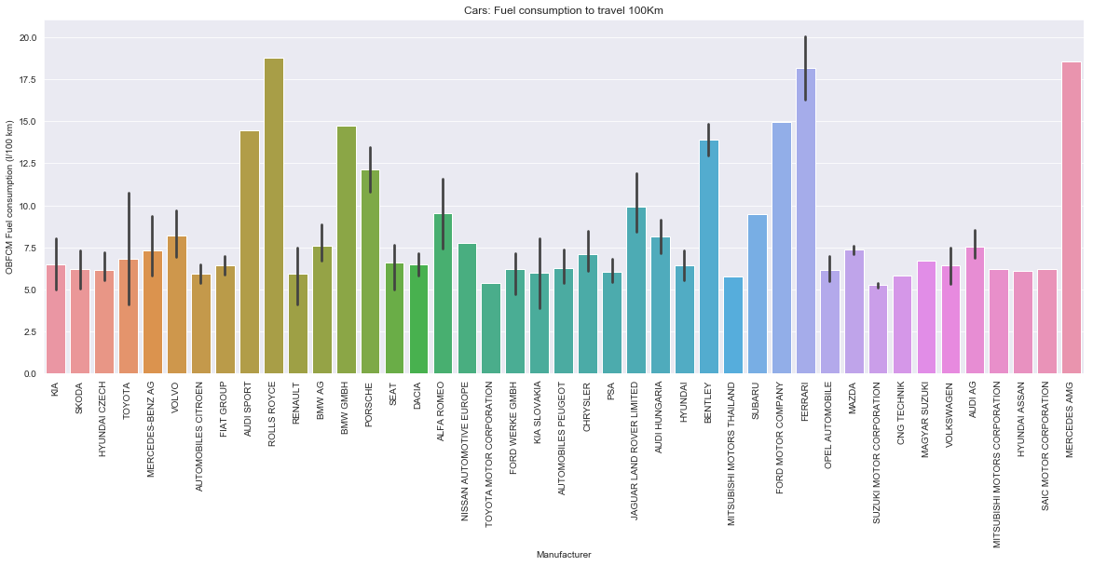
Inference 6:
Fuel efficiency of cars categorized by manufacturer and make.
Does fuel consumption vary from manufacturer to manufacturer?
Manufacturers like Rolls-Royce, Bentley, Ferrari, and Mercedes AMG have the least fuel-efficient cars because they specialize in producing high-end luxury executive cars that prioritize luxurious features over fuel efficiency. In contrast, manufacturers like CNG Technik, Suzuki, and Toyota prioritize fuel efficiency in their vans.

Slide 16
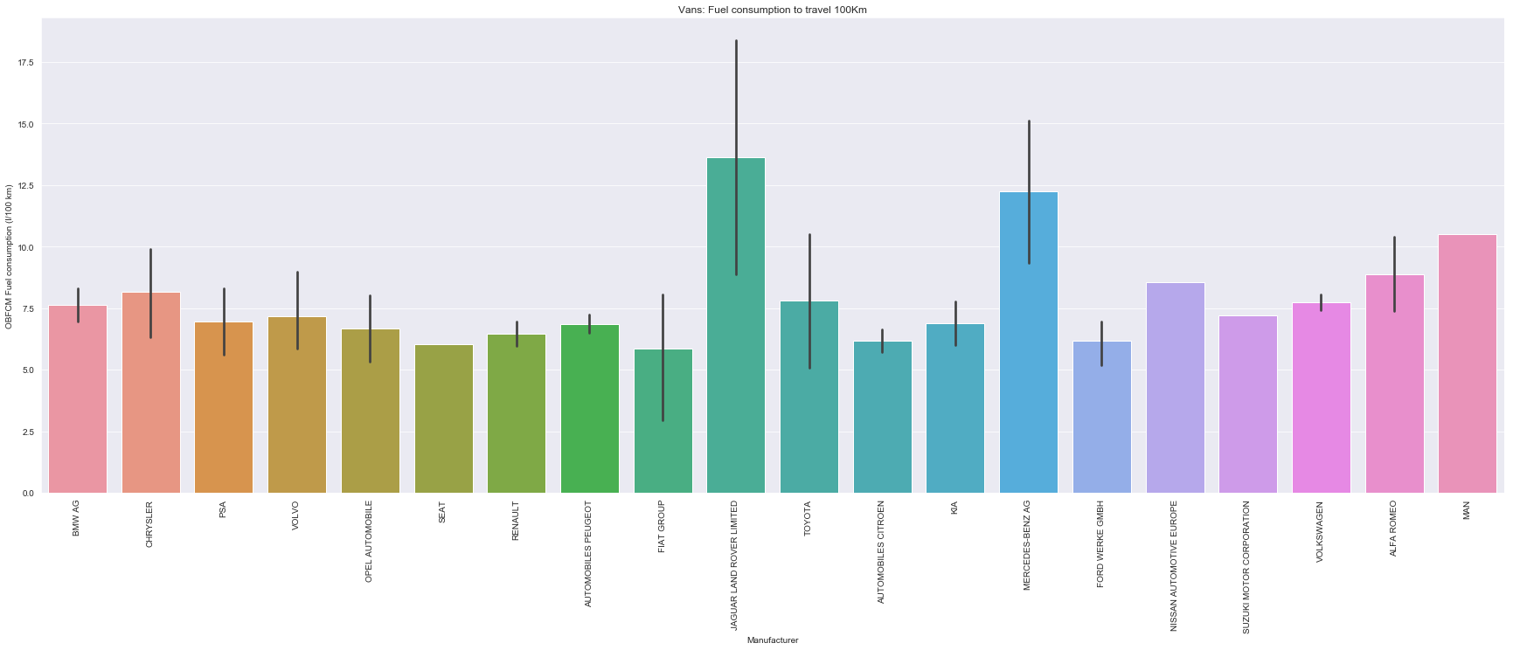
Inference 7:
Fuel efficiency of vans categorized by manufacturer and make.
Identifying which companies manufacture fuel efficient vehicles.
Manufacturers like Land Rover and Mercedes Benz have the least fuel efficient vans since they produce all terrain vans which have powerful engines prioritizing performance whereas, FIAT Group, KIA and FORD have the most fuel efficient cars.

Slide 17
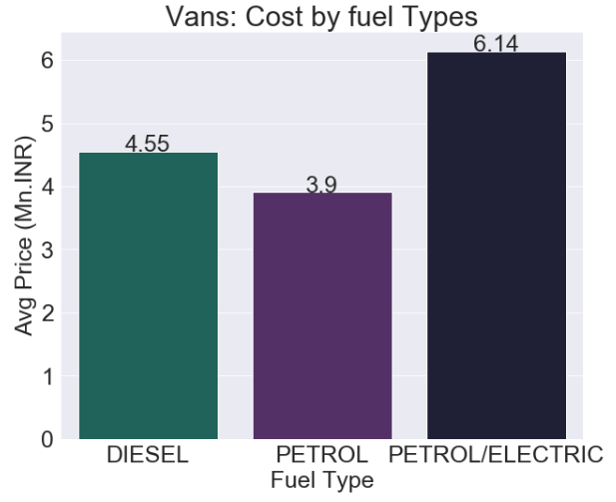
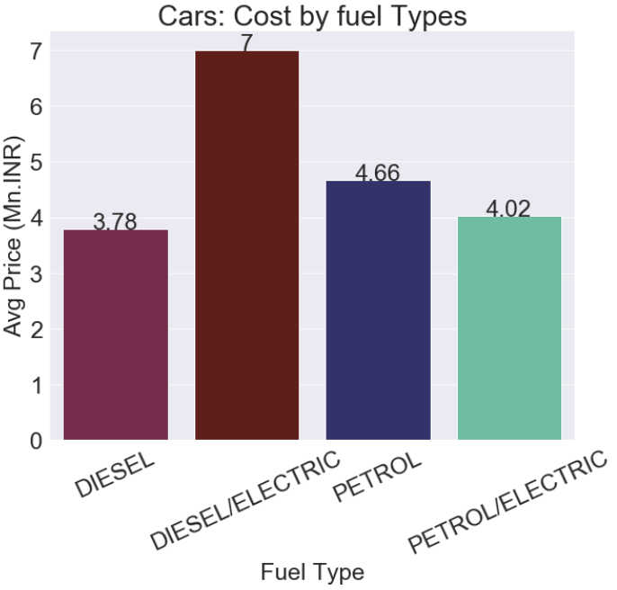
Inference 8:
Average cost of vehicles categorized by fuel type
Does the Price of vehicles depend on the Fuel Type they operate on?
As it can be observed the vehicles that operate on traditional fossil fuels are comparatively cheaper compared to the Hybrid Electrical vehicles due to their complex engine design to incorporate different fuel energies.

Slide 18
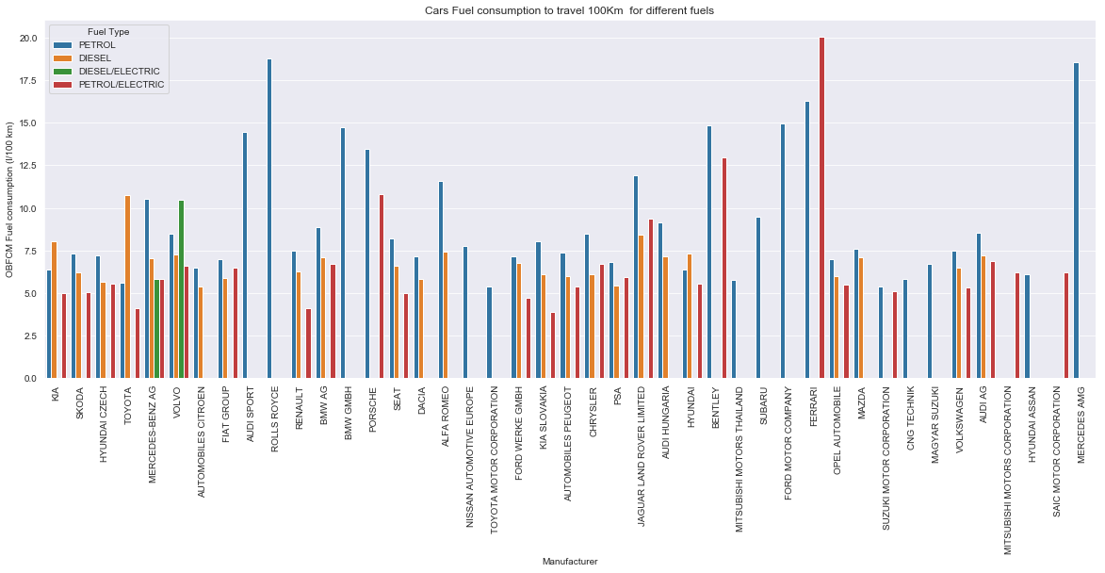
Inference 9:
Fuel efficiency of cars categorized by fuel type and manufacturer.
Which Fuel Type is More Efficient and Popular Among Industry Manufacturers?
From our analysis, it is evident that petrol and diesel remain the most commonly used fuel types among industry manufacturers. Petrol-electric hybrids also enjoy significant popularity. However, diesel-electric cars are relatively rare, with only a few manufacturers like Mercedes and Volvo producing them. Graphical data clearly shows that diesel and petrol-electric cars lead in fuel efficiency. This highlights a trend towards the adoption of hybrid technologies, which combine the convenience of petrol with the efficiency benefits of electric propulsion.

Slide 19
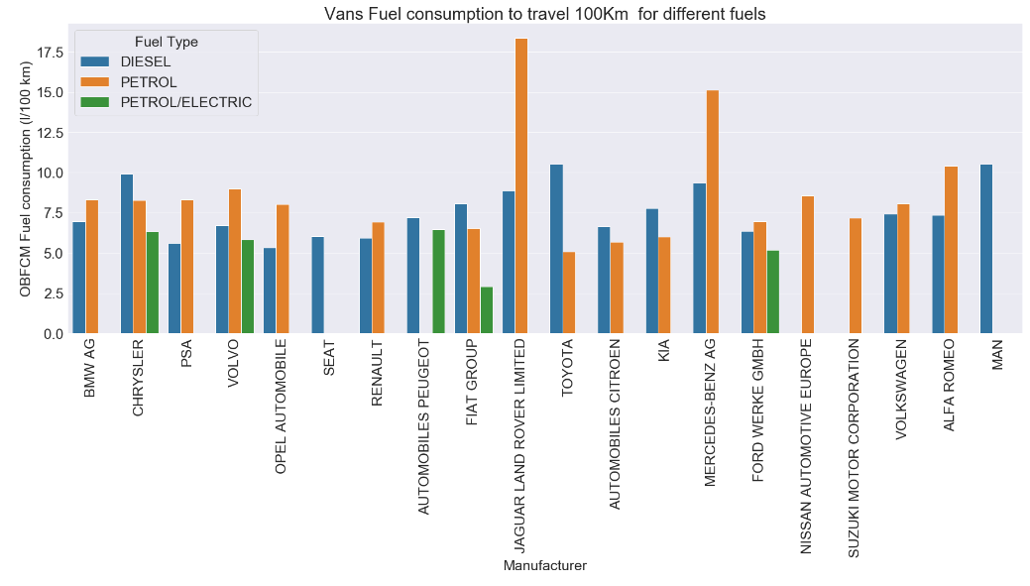
Inference 10:
Fuel efficiency of vans categorized by fuel type and manufacturer.
Which Fuel Type is More Efficient and Popular Among Industry Manufacturers?
From our analysis, it is evident that petrol and diesel remain the most commonly used fuel types among industry manufacturers. Petrol-electric hybrids also enjoy significant popularity. However, diesel-electric vans are completely ignored. Graphical data clearly shows that diesel and petrol-electric vans lead in fuel efficiency. This highlights a trend towards the adoption of hybrid technologies, which combine the convenience of petrol with the efficiency benefits of electric propulsion.

Slide 20
Developing a Linear Model to test the Fuel Consumption and CO2 emission:
Linear Model for Cars :
Y = a0 + (a1*x) + e
C02_Emmited = 13.89 + (22.05 * Fuel_Consumed)
Linear Model for Vans :
Y = a0 + (a1*x) + e
C02_Emmited = 19.07 + (22.95 * Fuel_Consumed)
Model Training Technique:
To train our linear regression model, we utilized 80% of the tuples from the raw dataset, which includes data on fuel consumption and CO2 emissions. The remaining 20% of the data was reserved for testing the model.
This approach ensures that the model is trained on a substantial portion of the data while still allowing for an independent assessment of its predictive accuracy. The model is designed to calculate fuel consumption and CO2 emissions, enabling us to evaluate its performance and reliability effectively.

Slide 21
Results of Testing:
Vehicle Type | Measured value of fuel consumed (L/100 Km) | Calculated value using model for fuel consumed (L/100 Km) | Accuracy (%) | Error (%)
Car | 6.51 | 6.23 | 92.03 | 7.97
Van | 7.095 | 6.20 | 86.68 | 13.12
Vehicle Type | Measured value of CO2 emitted (g/Km) | Calculated value using model for fuel consumed (g/Km) | Accuracy (%) | Error (%)
Car | 151.36 | 157.62 | 92.44 | 7.54
Van | 161.62 | 181.93 | 86.68 | 13.12

Slide 22
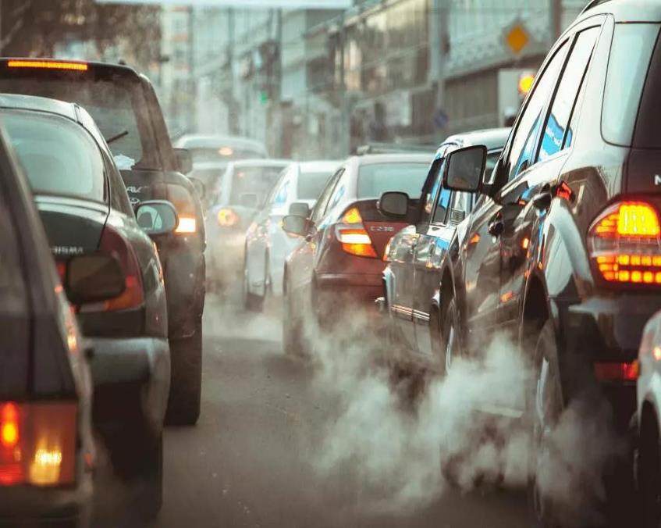
Conclusion
In our detailed analysis of the vehicular emissions of passenger vehicles, it is evident that:
Vehicle Emission effects are very serious on environment and public health.
while hybrid vehicles are significantly more environmentally friendly, they are not as popular as traditional vehicles running on finite fossil fuels. This discrepancy can be attributed to several key factors such as Lack of infrastructure, limited range, low advancement in technology, etc.
There is a positive correlation observed in fuel consumption and CO2 emissions.
This relationship was validated using a Linear Regression Model, confirming that as fuel consumption increases, CO2 emissions rise correspondingly.
Hybrid vehicles are also expensive when compared to Traditional vehicles.
There are not many players in hybrid vehicle productions

Slide 23
Suggestion
To address these challenges and promote the adoption of environmentally friendly vehicles, several key actions are necessary,
First, implementing stringent government policies on emission regulations and fuel efficiency standards, such as the BS6 norms, is crucial.
These regulations will ensure that vehicles adhere to lower emission thresholds, significantly reducing their environmental impact.
Second, encouraging manufacturers to innovate and produce more eco-friendly vehicles is essential.
By setting ambitious targets for reducing vehicular emissions, we can accelerate the transition towards hybrid and electric vehicles.
This transition not only supports cleaner transportation but also aligns with India's initiative to achieve net carbon zero status by 2070. These measures collectively pave the way for a sustainable automotive future.

Slide 24
References:
“Vehicular Emission Datasets” Real-world vehicle emissions (kaggle.com)
“Data Analytics Techniques for Environmental Pollution Analysis.” Available: www.example.com/data-analytics-environment
“Predictive Modeling for Air Quality Forecasting.” Available: www.example.com/air-quality-forecasting
“Advances in Sensor Technology for Real-Time Emissions Monitoring.” Available: www.example.com/sensor-technology-emissions-monitoring
“Impact of Vehicle Emissions on Urban Air Quality: A Review.” Available: www.example.com/vehicle-emissions-urban-air-quality
“Machine Learning Approaches for Predictive Modeling of Air Pollution.” Available: www.example.com/machine-learning-air-pollution
“The rise of real drive emission to mitigate difference of lab tests and on-road emission” Available: (PDF) The rise of real drive emission to mitigate difference of lab tests and on-road emission (researchgate.net)

