Slide 1


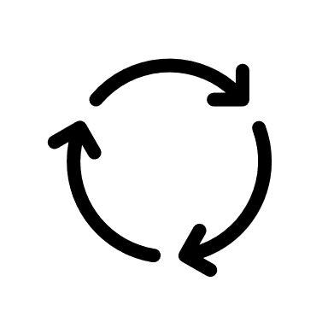



Step-1
Step-2
Step-3
Result !
➡️
Choose the Disease to get Help about
Upload Your Health Details (Questionaries or Image Uploading)
Our Model is Working for your Disease Prediction
Get Predictions on Your Health

