Slide 1
Team HackingParadox
Bring your presentation to the next level

Slide 2
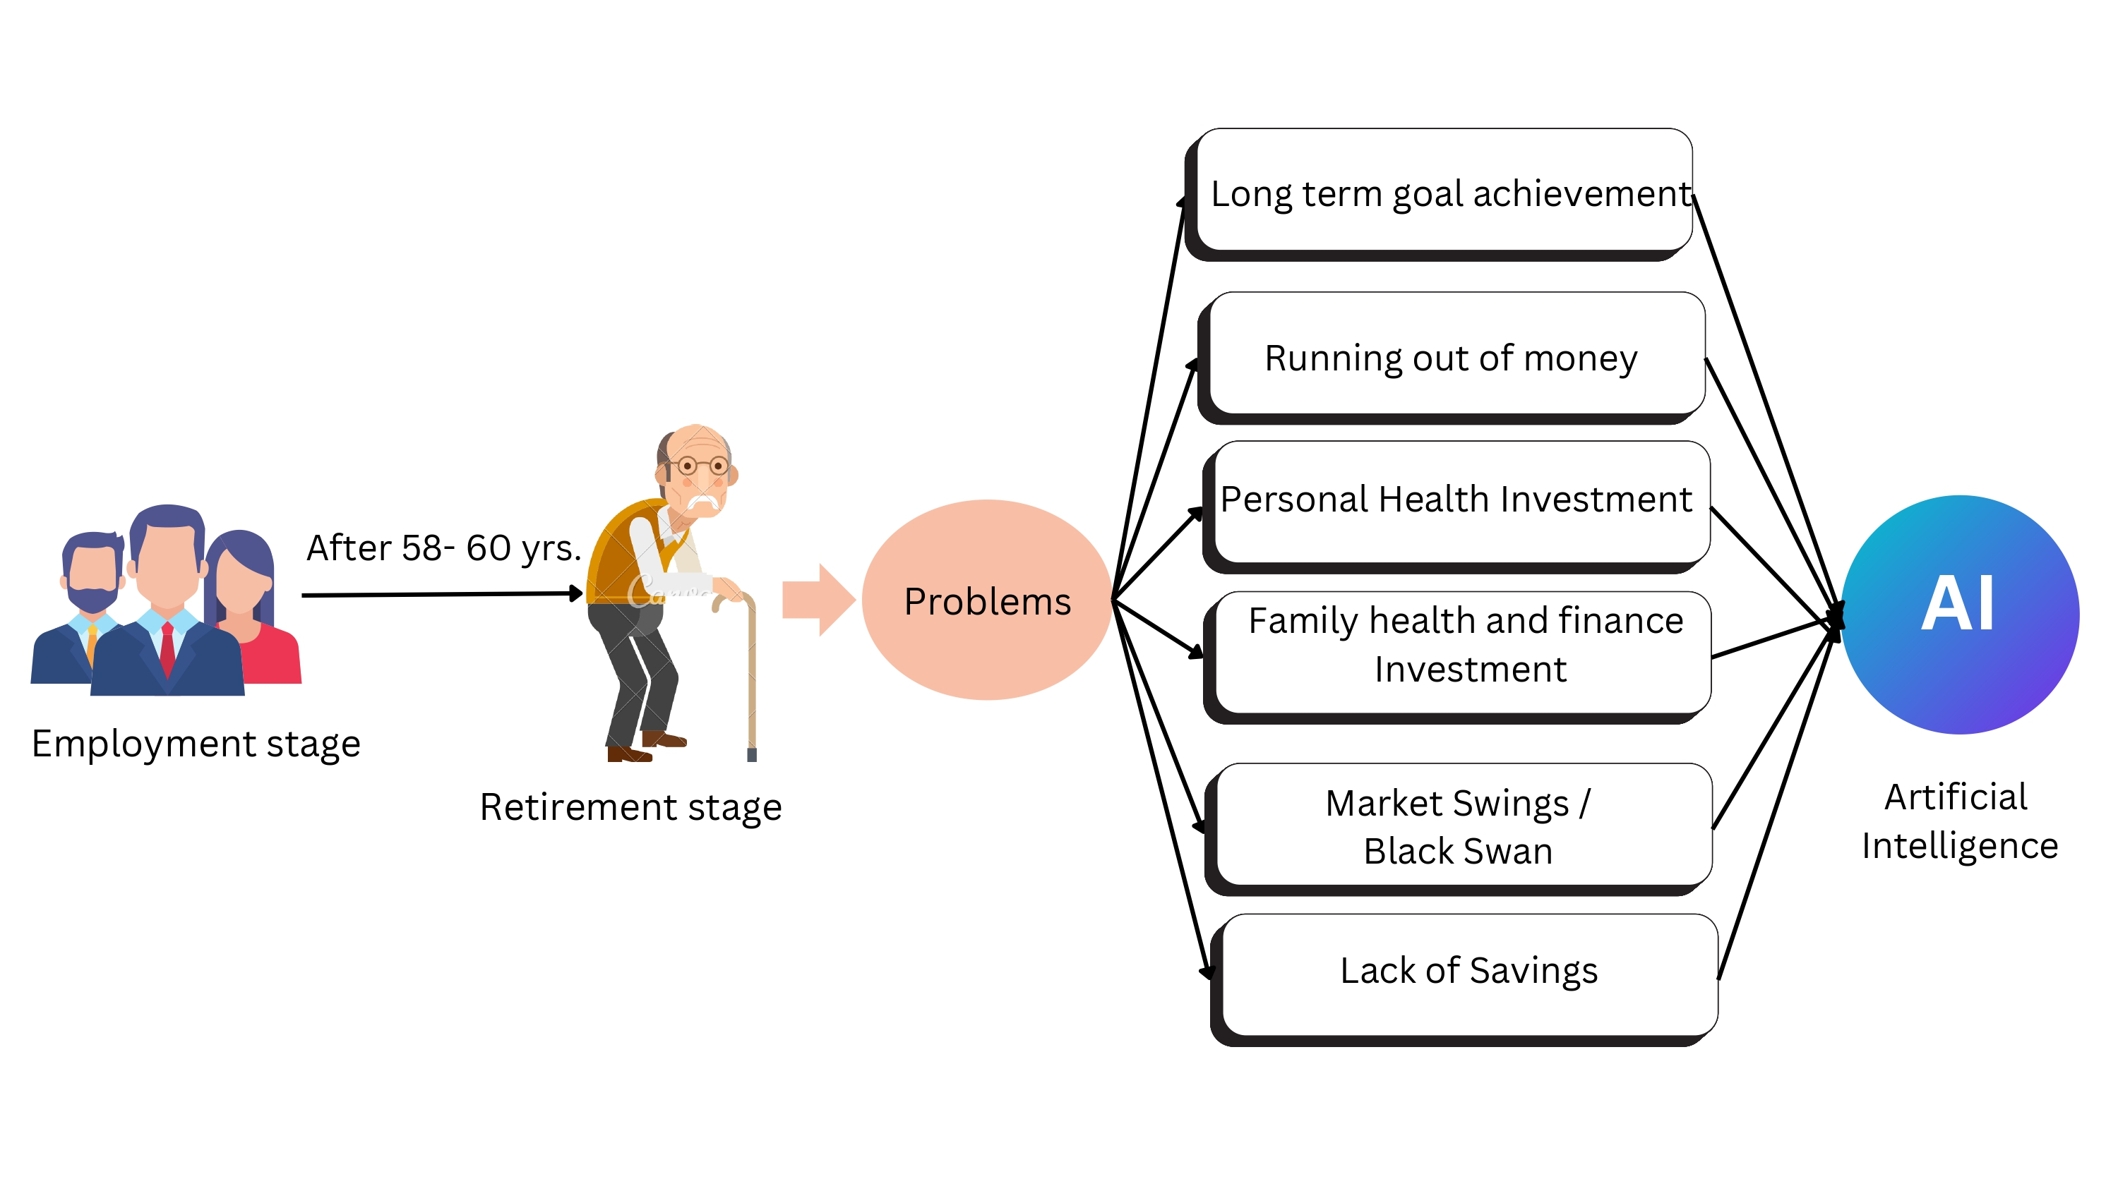
AI in Business Challenges in Retirement Industry
Insights on the challenges:
Health Issues
Age group of 55-60 is the commonly found age group of retiree and also the likely age of getting affected with various Health Problems
Inadequate Risk Management
Retirees face significant risks such as market fluctuation and inflation, which traditional approaches fail to address efficiently.
Regulations
Complex regulations impede the use of modern technologies, adversely affecting the retirement industry's transformation.
Retirement Income Management:
Managing retirement income sources and withdrawals can be complex.
Estate Planning and Legal Guidance:
Estate planning and legal matters can be complex for retirees.
Problems faced by Retiree :
Personal Health Issues
Lack of Savings
Dynamic Financial Landscape
Legacy planning
Discrepancy of Robust Investment Strategies

Slide 3
Contribution of AI to the Solution
AI Chatbots: This helps the model to be up to date. Helps Solving queries and improves personalization of the chatbot
AI chatbots can integrate with existing retirement systems, simplify the retirement journey and provide personalized support 24/7.
AI Finance Models can use user’s transactional history for analysis. This allows us to provide an insight into the expenses. The model can suggest more better ways to save money and grow. Also various other assistance in fields like Health Care and Robust Investment Strategies. AI-driven financial platforms can optimize retirement income strategies, ensuring retirees make informed decisions to maximize their income throughout retirement.
AI Finance Assistance:
It uses the transactional data of the user to assist and guide the user for his/her financial well-being future.

Slide 4
AI in Business Challenges in Retirement Industry
Transaction and past work history Analysis:
What we have? How do we do it?
Insights of analysis:
Transaction statements processed and analysed, and insights of transactions manifested with help visual tools
What AI thinks on your analysis
Context created by using analysis provided to Generative AI for better recommendations and consultancy and let AI assist you to optimize your future transactions.
What next?
Robust strategies and plannings in-order to grow money via AI powered solution.
Personalized Real Time Market Analysis according to portfolio
AI-Powered Financial Forecasting.
Family Financial Planning
Risk Assessment and Mitigation
Health Monitoring and Incentivization
(LLM API + analysed data context + transactional data)
How System Works(Flow chart {Diagrammatical})
+
Technology Stack

Slide 5
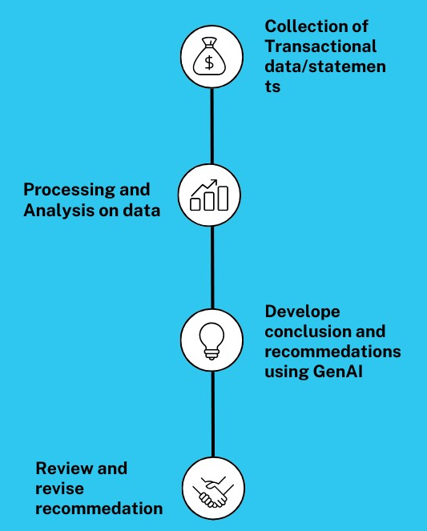
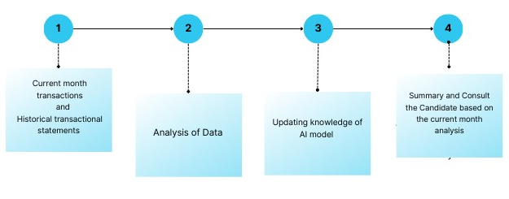
Requirement Gathering and Process:
Collection of transactional history and current month transactional dataset of the candidate for analysis Process.
The model uses transactional data analysis to create investment strategies tailored to retirees' specific financial needs. Identify common spending patterns among retirees.
Understand how spending varies across different categories such as housing, healthcare, leisure, etc.
System Working

Slide 6
AI in Business Challenges in Retirement Industry

Slide 7
AI in Business Challenges in Retirement Industry
Post Analysis
Post analysis the identified parameters serve as the foundation for creating a personalized and precise context for generating a summary. Each parameter represents a key surface of your financial landscape
With the baked prompt in hand, we seamlessly integrate it with the LLM REST API. This makes sure our prompt serves the best for the generation of a personalized and insightful summary encapsulating the details captured from your transactional data.
The resultant content is designed with utmost simplicity, tailored specifically for a retiree audience. This ensures that the AI-generated summary is not only accurate but also easily comprehensible, fostering a seamless understanding of the financial analysis insights.
Analysis Insights
Context Generation
Large Language Model (LLM) Integration
API Interaction
Results and Implications
User Interface
Personalized Summary
Effective Dashboard representation
Feedback Loop
Impactful Insights
Enhanced Decision Making

Slide 9

AI in Business Challenges in Retirement Industry
Contribution of ChatBot is like Cheery on the Cake
Timely Alerts:
Receive personalized alerts about transactions, ensuring retirees stay informed about financial activities as well as golden opportunities.
Account Updates:
Real-time notifications about account balance changes, enabling retirees to track their financial health effortlessly.
Automated Insights:
The Chatbot provides automated insights drawn from data analysis, offering a sophisticated understanding of financial patterns.
User-Friendly Interaction:
Designed with retirees in mind, the Chatbot ensures a user-friendly and accessible interaction, simplifying complex financial information.
The deployment of a customized Chatbot, supported by robust data analysis and API functionalities, represents a noteworthy advancement in elevating financial awareness and security for retirees.

Slide 11
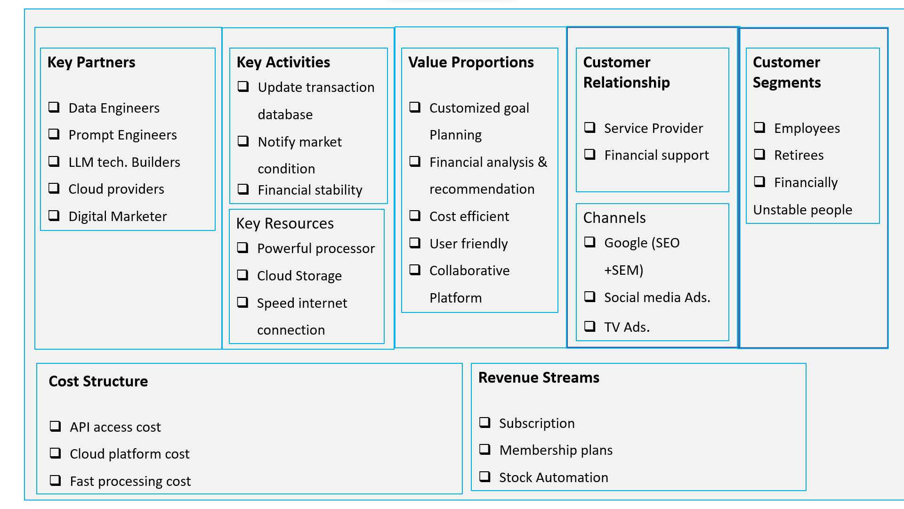
Business Model

Slide 12

Empower with visual charts
Share info that resonates
The Power of Visual Charts
Visual charts make data and numbers on presentations interesting and memorable.

