Slide 1

HR Analytics – Predict Employee Attrition
End-to-End Machine Learning Project | Using Python, Scikit-Learn, and SHAP
Presenter/Author: Veerkumar Savant

Slide 2

Project Overview
Goal
Tools Used
Predict whether an employee will stay or leave the company.
Python, Pandas, Scikit-Learn, SHAP, Matplotlib, Seaborn.
Key Workflow Steps:
Data Cleaning & EDA
Data Preprocessing (Scaling, Encoding)
Model Training (Logistic Regression & Decision Tree)
Model Evaluation (Reports, Metrics)
Explainability (SHAP Analysis)
Results Export

Slide 3


Dataset Summary & EDA Insights
Dataset Summary:
EDA Insights:
Includes employee details like Department, Salary, Age, Monthly Income, Job Satisfaction, and the Attrition status (Target Variable: Yes/No, transformed to 1/0).
Revealed that departments with higher workload and low-income bands have greater attrition rates.
Suggestion: Include a placeholder/note to add the Department vs Attrition and Income Band vs Attrition bar plots here.

Slide 4
Model Development & Performance
Model Development Steps
Tuning & Selection
Models Trained
Pipelines used with StandardScaler for numerical data and OneHotEncoder for categorical features.
Hyperparameter tuning via GridSearchCV with 5-fold cross-validation; selection based on ROC-AUC score.
Logistic Regression and Decision Tree Classifier.
Model Performance (Test Set):
Logistic Regression:
ROC-AUC ≈0.78−0.82 (CV Mean ≈0.80)
Decision Tree:
ROC-AUC ≈0.74−0.79 (CV Mean ≈0.76)
Note: Logistic Regression performed slightly better overall.

Slide 5
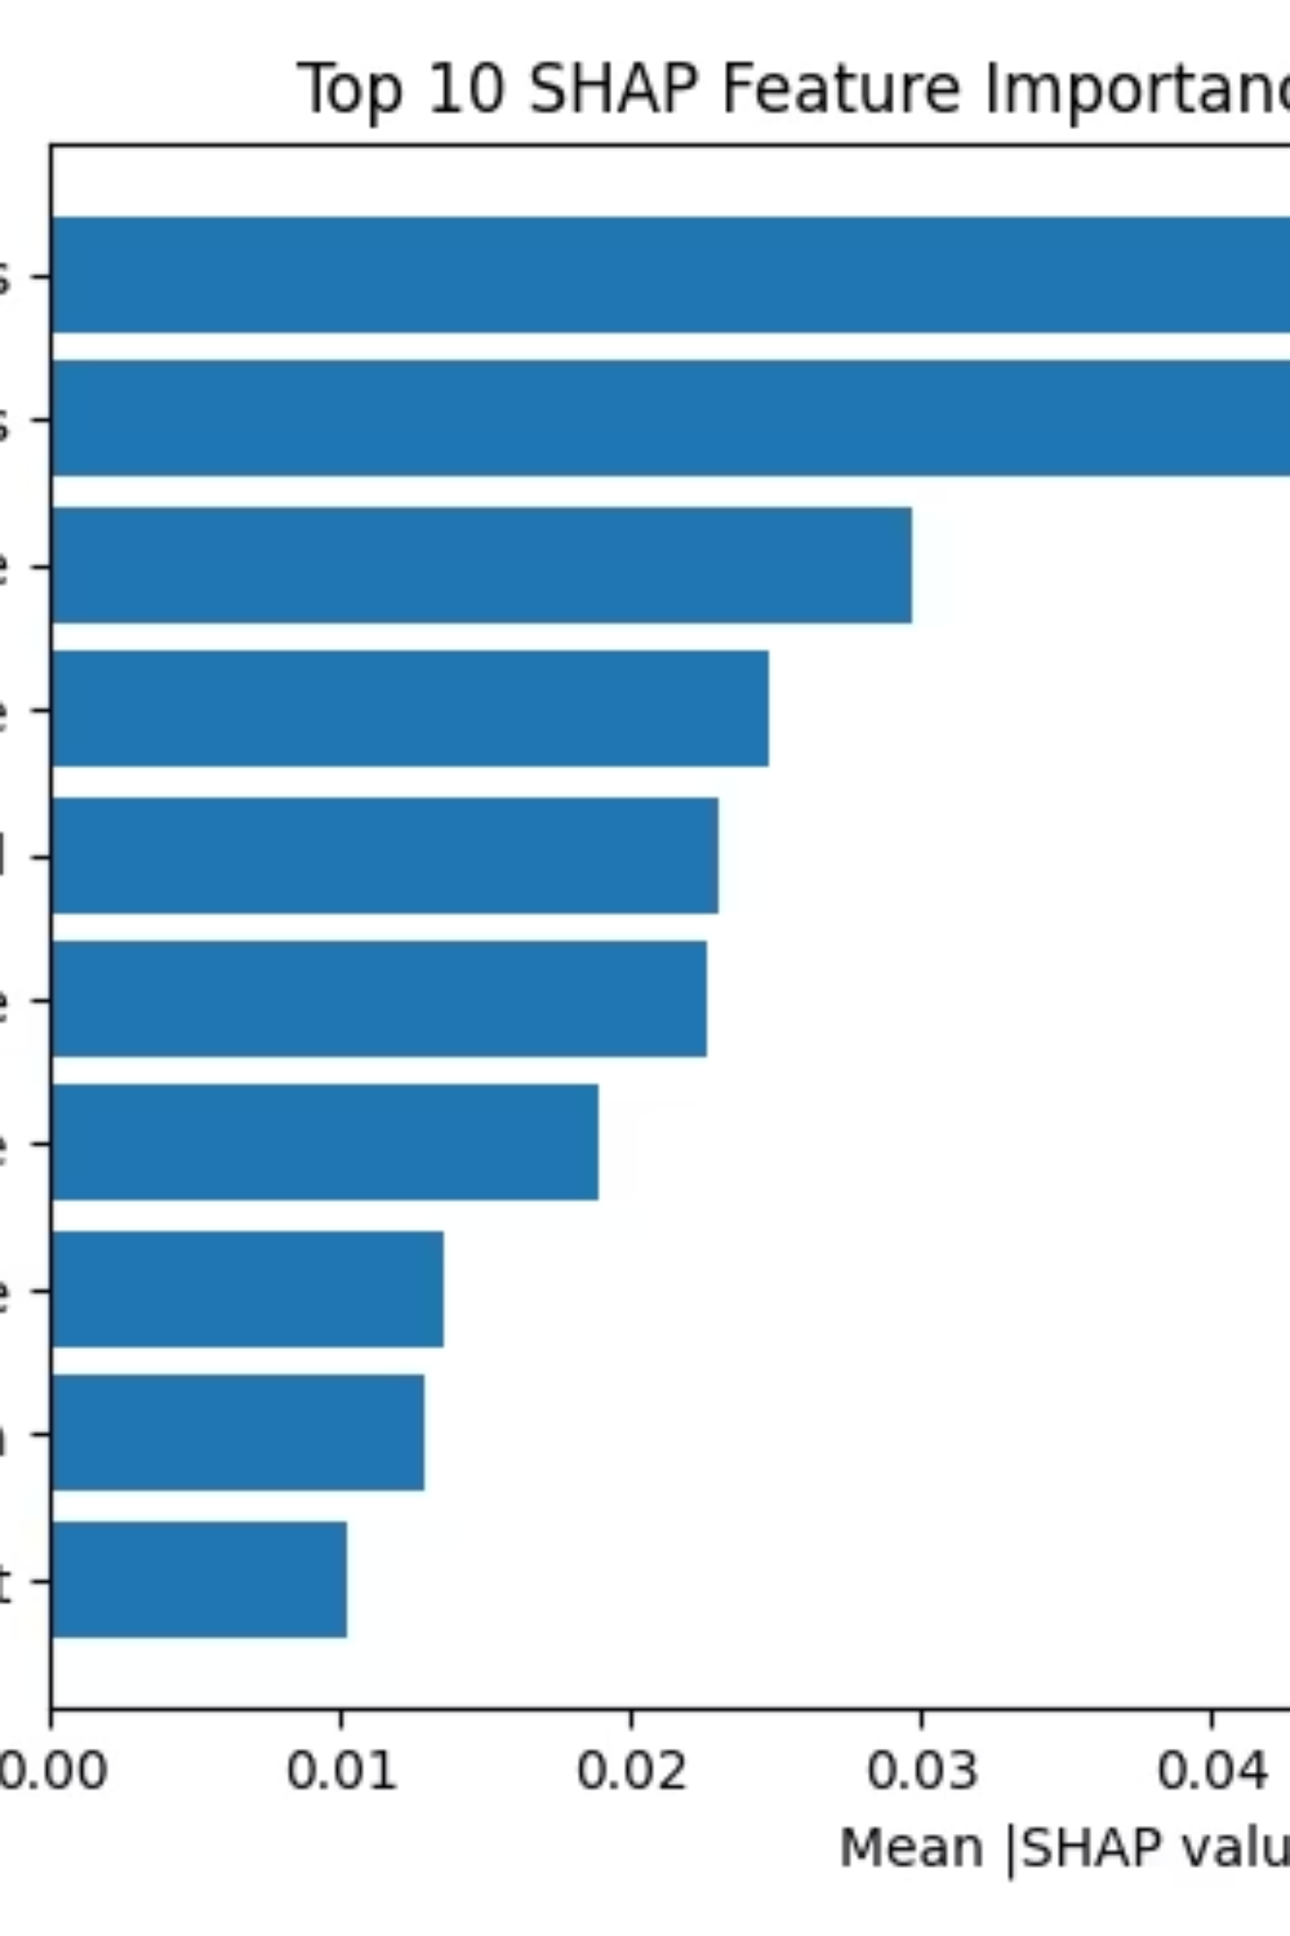
Top 10 SHAP Feature Importances (Decision Tree)
Content: Insert shap_feature_importance_tree.png.
Key Drivers (from chart): cat__OverTime_Yes is the most important feature, followed by num__TotalWorkingYears and num__Age.

Slide 6
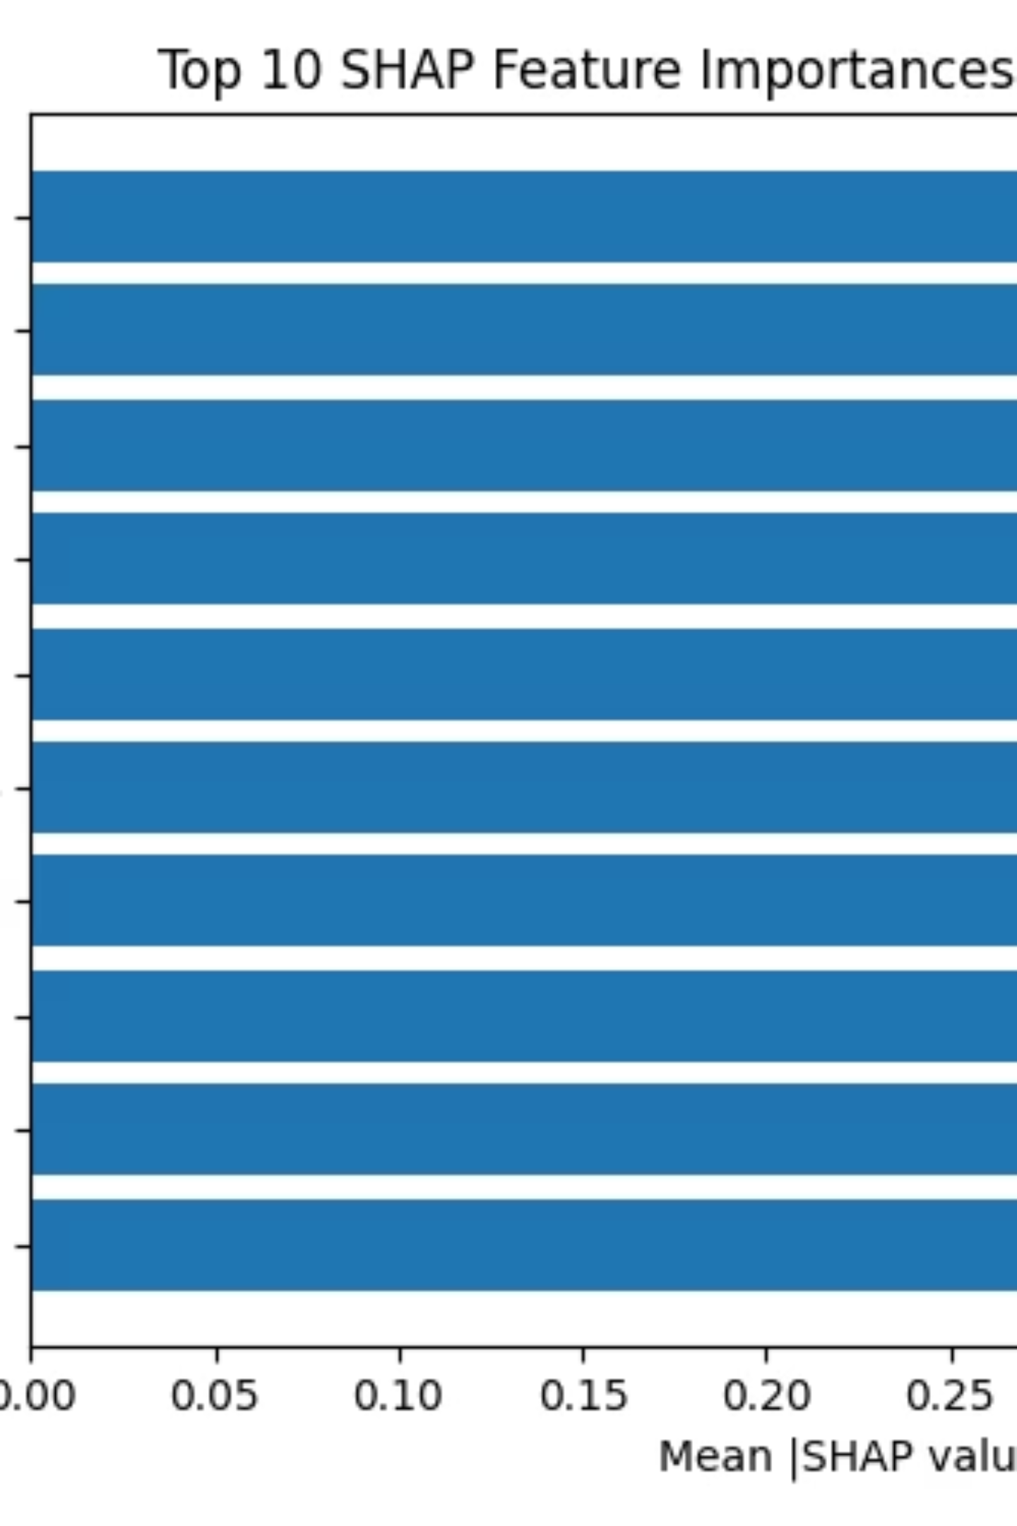
Top 10 SHAP Feature Importances (Logistic Regression)
Content: Insert shap_feature_importance_log.png.
Key Drivers (from chart): num__EnvironmentSatisfaction is the most important feature, followed closely by num__YearsSinceLastPromotion and num__TotalWorkingYears.

Slide 7
SHAP Summary Plot - Decision Tree
Content: Insert shap_summary_tree.png.
Observation: The plot shows how feature values (color) impact the model output (SHAP value). For example, high feature values (red dots) for cat__OverTime_Yes push the output higher (more positive, towards High Attrition).

Slide 8
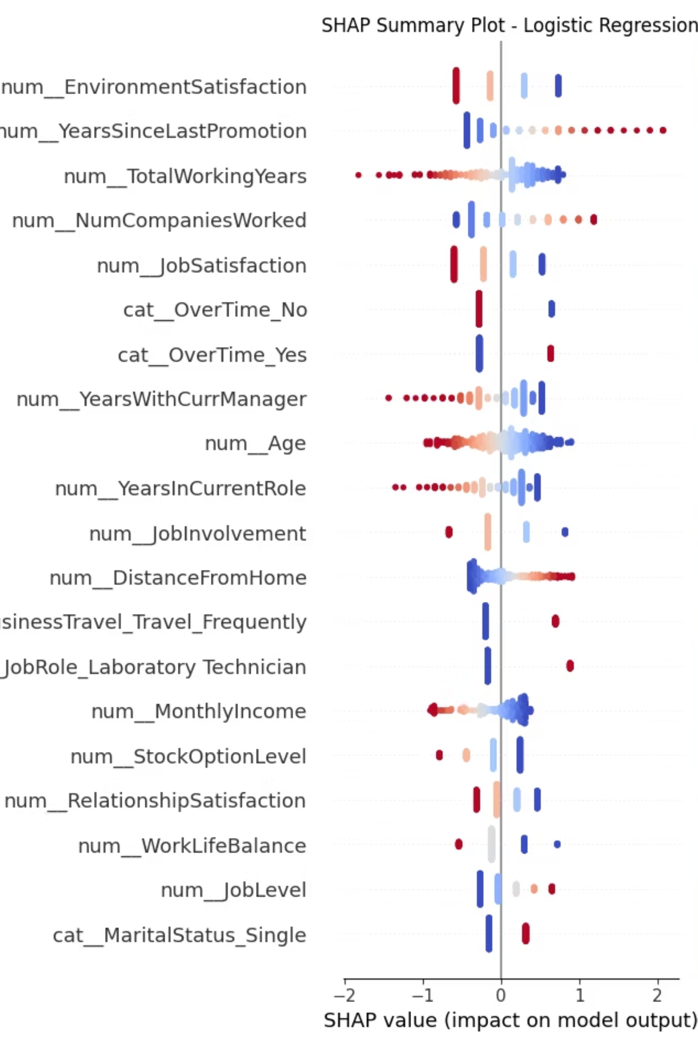
SHAP Summary Plot - Logistic Regression
Content: Insert shap_summary_log.png.
Observation: Low num__EnvironmentSatisfaction (blue dots) is associated with more positive SHAP values (higher attrition risk). High num__YearsSinceLastPromotion (red dots) also shows a strong positive impact on attrition risk.

Slide 9
Key Insights & Conclusion
Key Insights:
Low salary and low job satisfaction increase attrition likelihood.
Logistic Regression performed slightly better overall, but Decision Tree offers better interpretability.
SHAP helps HR understand model reasoning clearly.
Conclusion:
Successfully identified major drivers of employee attrition.
Combining ML models with SHAP interpretation provides actionable insights for retention strategies and workforce planning.

Slide 10

Key Outputs & Next Steps
Key Outputs:
Project Highlights:
Attrition insights by Department and Income Band.
Complete end-to-end ML pipeline automation, hyperparameter tuning, and model interpretability using SHAP.
Best performing models: Logistic Regression & Decision Tree.
SHAP summary and feature importance graphs.
Performance metrics stored in model_metrics.csv.

