Slide 1
ITI 1120 - Lab # 5
Fall 2022
lists , range function
more for loops, “pointer/reference” variables, aliasing
(This is a very important lab. Please make sure you learn and understand all of this material)

Slide 2
Lab 5 overview
Open a browser and log into Brightspace
On the left hand side under Labs tab, find lab5 material contained in lab5-students.zip
Download that file to the Desktop and open it.
Read slides one by one and follow the instructions explaining what to do. When stuck ask for help from the TA. Ideally you should try to complete some, or all of this, at home and then use the lab as a place where you can get help with things you may have had difficulties with.

Slide 3
What is in this lab?
This lab has 7 Tasks.
4 programming exercises (0 to 3, for your Lab Grades)
The slides that are included here but do not explain either Tasks or Programming exercises are there as reminder of some relevant material that is needed for this lab.

Slide 4
Do all the Tasks in your head FIRST then run the cell
Later, if you wish, you can type them into a computer

Slide 5
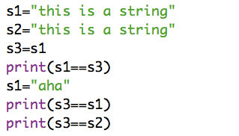
Task 0: What does this print?

Slide 6
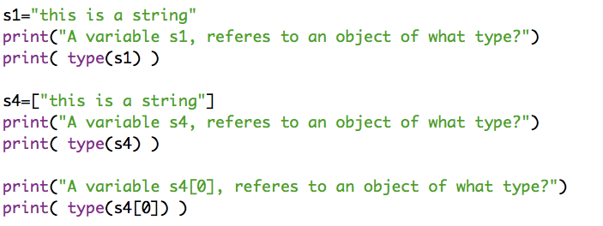
Task 1: What does this print?

Slide 7
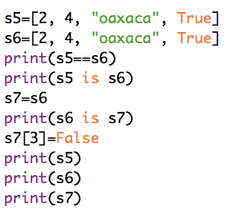
Task 2: What does this print?

Slide 8
Returns sum of all positive integers smaller than n
Study the following four fundamental algorithms:
Returns a product of all positive integers smaller than n
def summation(n):
'’'(number)->number'''
odd_sum = 0
for num in range(n):
odd_sum = odd_sum + num
return odd_sum
def product(n):
'’'(number)->number'’’
prod = 1
for num in range(n):
prod = prod * num
return prod
Sum of numbers in a given list a.
A solution with loop over elements
Sum of numbers in a given list a.
A solution with a loop over indices
def sum_list_v1(a):
''' (list)->num ''’
list_sum = 0
for item in a:
list_sum = list_sum + item
return list_sum
def sum_list_v2(a):
''' (list)->num ''’
list_sum = 0
i = 0
for i in range(len(a)):
list_sum = list_sum + a[i]
return list_sum

Slide 9
Task 3 and Programming Exercise 0
After studying the previous four fundamental functions, how would you modify them to only sum odd numbers (or odd list elements)? Try yourself and then see next step for solutions.
Run the code cells in task 3 one by one, Example 1 to 4 into Python visualizer. Run through each example and understand how the solutions work and how the variables change in the loops. As always, you can find python visualizer here (make sure you choose Python 3)
  http://www.pythontutor.com/visualize.html#mode=edit
Programming exercise: Write a function called ah(l,x,y) that given a list l, and integers x and y such that x <=y, returns two numbers. The first is the number of elements of l that are between x and y (including x and y). The second number is the minimum element of l that is between x and y (including x and y).
Recall that you can return two numbers referred by variables a and b by just returning a tuple (a,b)

Slide 10

Task 4
  How many stars does the following program print?
a) 0 b) 15 c) 45 d) 48 e) 68

Slide 11
Intermission: print function revisited
  Built-in function print, when its completes printing, enters a new line.
  For example:
  print("This is")
  print("Lab 5”)
  Prints:
  This is
  Lab 5
  As mentioned in the last lab, this default behavior of the print function can be changed by specifying what we want print function to end with. For example:
  print("This is", end='***')
  print("Lab 5.")
  print("This is", end='')
  print("Lab 6", end='\n')
  print("This is", end=' ')
  print("Lab 7")
Would
Print
=>
This is***Lab 5
This isLab 6
This is Lab 7
In other words, unless specified otherwise, the default end for the print function is end='\n'

Slide 12
More examples of use of print function
Function print prints, by default,
a newline character after printing its arguments
>>> pets = ['boa', 'cat', 'dog']
>>> for pet in pets:
print(pet)
boa
cat
dog
>>>
>>> pets = ['boa', 'cat', 'dog']
>>> for pet in pets:
print(pet)
boa\n
cat\n
dog\n
>>>
>>> pets = ['boa', 'cat', 'dog']
>>> for pet in pets:
print(pet)
boa
cat
dog
>>> for pet in pets:
print(pet, end=', ')
boa, cat, dog,
>>>
>>> pets = ['boa', 'cat', 'dog']
>>> for pet in pets:
print(pet)
boa
cat
dog
>>> for pet in pets:
print(pet, end=', ')
boa, cat, dog,
>>> for pet in pets:
print(pet, end='!!! ')
boa!!! cat!!! dog!!!
>>>
The end argument allows for customized end characters

Slide 13
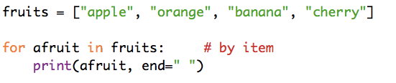
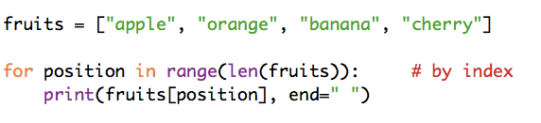

Task 5
1. What does this print?
2. What does this print?
3. What does this print?

Slide 14
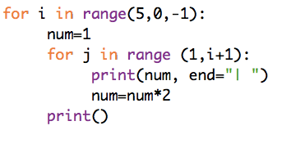
Task 6
  What does the following program print?

Slide 15
Programming Exercise 1:
Experiment with Perfect Numbers
A positive integer is called a perfect number if it is equal to the sum of all of its positive divisors, excluding itself. For example, 6 is perfect number since 6=1+2+3. The next is 28=1+2+4+7+12. There are four perfect numbers less than 10,000. Write a program that prints all these four numbers.
Your program should have a function called is_perfect that takes as input a positive integers and returns True if it is perfect and False otherwise. Modify the divisors(n) function you implemented from the pervious lab. So, it returns a list of divisors of number n. Use this function to do the rest.

Slide 16
Programming Exercise 1:
Experiment with Perfect Numbers
Once you are done. Modify your program so that it looks for all perfect numbers smaller than 35 million. What do you notice? Assuming that you computer can do a billion instructions in a sec, can you figure out how long, roughly, will it take your computer to find 5th perfect number (it is 33,550,336). Is the answer roughly: couple of minutes, couple of hours, couple of days, … weeks, months, years ?
What if you wanted to wait until it prints 6th perfect number, which is 8,589,869,056?

Slide 17
Programming Exercise 2:
Arithmetic progression
Recall that a sequence of numbers forms an arithmetic progression if the difference between every pair of consecutive numbers is the same. For example, [-5, -1, 3, 7, 11] forms an arithmetic progression since the difference between every neighbor is 4.
On the contrary, [5, 10, 15, 24, 29] is not an arithmetic progression since the difference between some consecutive pairs is 5 or 4.
A sequence that has exactly one number is considered arithmetic, too.
Write a function called arithmetic that takes as input a list of numbers and returns True if the numbers of the list form arithmetic progression. And False otherwise
Testing:
>>> arithmetic( [-5, -1, 3, 7, 11] )
True
>>> arithmetic([0, -1, 3, 7, 11])
False
>>> a = [5, 10, 15, 24, 29]
>>> arithmetic(a)
False
>>> arithmetic(a[:3])
True

Slide 18
Programming Exercise 3:
and now … is it sorted?
Now modify your method arithmetic slightly so that instead it tests if the numbers in the give lists are ordered for smallest to largest. Call the new function is_sorted

Slide 19
How to submit lab5:
  You do not have to submit the tasks, only the exercises notebook. Although the tasks are required material.
  You need to submit your notebook (ipynb file) .
  You can download your ipynb file using in colab from the file menu.
  Also, please do not compress your files ( no zip or rar).

